Slide 1
Monitoring
How will I know if I am getting anywhere?
Notes:
Healthy Country Planning is an adaptive management approach
Making the plan is an important part of that
But we can only adapt to what we learn if we monitor
We need to decide what the most important things to monitor are and what we will do with the information
If we have done the rest of the process well then this step should be reasonably simple (or simpler than we might think)

Slide 2
Deciding what the plan is about
Goals
Strategies
Road Maps
Measures
Telling ourselves and others
Making the plan
Getting data
Looking at results
Adapting the plan
Work Plan & Timeline
Budget
Implement
Deciding if the plan is working
Doing and monitoring the work
Notes:
This steps connects to a number of others:
The monitoring activities will go in the workplan
We will use the work we do here to guide our reviews

Slide 3
Making the Plan
Monitoring
Overview presentation
Why we do monitoring
The three main layers of monitoring
Making a monitoring plan
Tips for a monitoring plan

Slide 4
Making the Plan
Monitoring
Knowing if our plan is working
Monitoring help us to know:
Are our actions working?
Is our work being effective & efficient?
Are our targets or the threats getting better or worse?
Can we correct course if we need to?
Is it all worthwhile?
Donors, partners and managers are demanding greater transparency and accountability
Notes:
Monitoring will tell us many things
It will also help us to work with the different groups that support us

Slide 5
Making the Plan
Monitoring
Knowing if our plan is working
Monitoring seen as last step - often neglected
Many examples of ineffective monitoring failing to inform ineffective management
Notes:
Our interest in developing improved measures of success comes runs counter to a common approach where measures of success is often the neglected last step.
There are many examples of ineffective monitoring that has not provided the information needed to improve management decisions.
This has given monitoring a bad name among some managers and some funding agencies will refuse to fund monitoring projects – they want to see all of their money put into action.

Slide 6
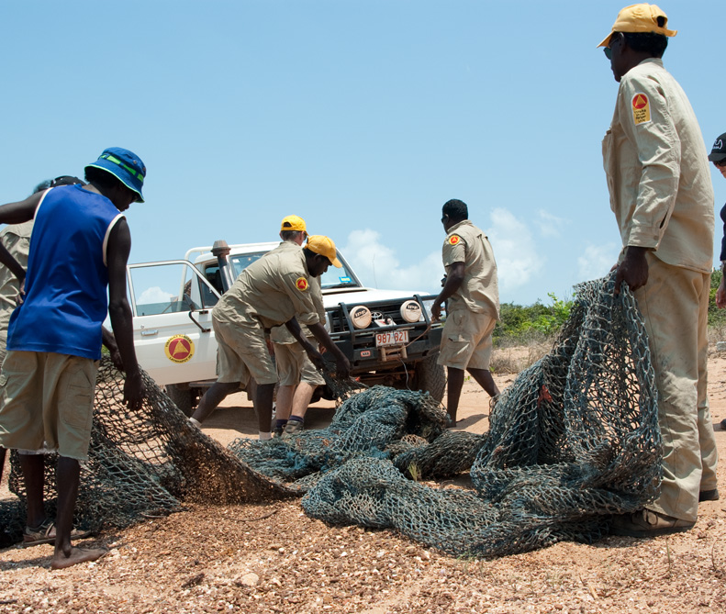
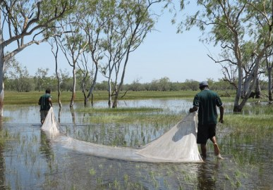
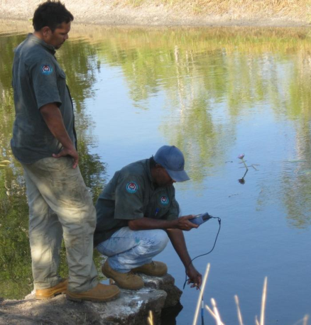
Making the Plan
Monitoring
Knowing if our plan is working
Monitoring is a key part of knowing the impact of our work
We need to monitor the things that will improve management
And actually use that monitoring to improve management
Notes:
If we do not monitor we will not know if the plan is working
But sometimes it can take a while to see results
So we will do the monitoring in a few stages over time to learn as much as we can as soon as we can

Slide 7
Making the Plan
Monitoring
Overview presentation
Why we do monitoring
The three main layers of monitoring
Making a monitoring plan
Tips for a monitoring plan

Slide 8
Making the Plan
Monitoring
Three ‘layers’ of monitoring
Inputs / Outputs (Strategies / Actions)
Are we using the plans we have made?
Outcomes (Threats)
Are our actions having their intended outcomes?
Impact (Targets)
How is the country we care about doing?
How are threats to country changing?
Is the capacity to improve country changing?
Notes:
We think about monitoring in HCP at three levels:
first, the simplest and quickest monitoring just looks at the strategies and actions – what we do and if we are doing it
Second, we see if we are making progress along the roadmap as we expected – these are outcomes and include changes in the threat
Finally, we hope to be able to see changes in the target – our impact.

Slide 9
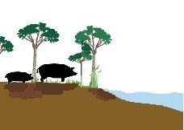
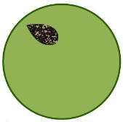
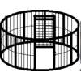
Making the Plan
Monitoring
Three ‘layers’ of monitoring
Healthy Wetlands
Wetlands healthier
Target
Goals
Impact
(5-10 years)
By 2020 pigs have less impact on country
Less country is impacted by pigs
Threat Goals
Outcomes
(1-3 years)
Implement feral animal control
Feral control being done
Strategies
Outputs
(every year)
Pig control in wetlands
Record pig management efforts
Actions
Notes:
This diagram shows the relationship between those layers of monitoring and the planning work we have done previously using an example of feral pig management
The Planning starts at the ‘top’ (targets) and works down to actions, monitoring works back in the other direction

Slide 10
Making the Plan
Monitoring
Three ‘layers’ of monitoring
Motivate farmers to change to low-water crops
Agricultural practices change
Surface water diversion reduced
River flow regime restored
Salmon
6
5
4
3
2
1
1. IMPACT: Numbers of adults returning to spawn
2. OUTCOMES: Water flow measurements
3. OUTCOMES : Volume of water withdrawn for agricultural purposes
4. OUTCOMES : Hectares of farm land converted from water-intensive crops to low-water need crops
5. OUTPUTS: Strategic Actions and Action Steps implemented
6. OUTPUTS: Resources Spent (Staff & $$$)
Notes:
This example shows the three layers of monitoring and indicators in a result chain

Slide 11
Making the Plan
Monitoring
Overview presentation
Why we do monitoring
The three main layers of monitoring
Making a monitoring plan
Tips for a monitoring plan

Slide 12
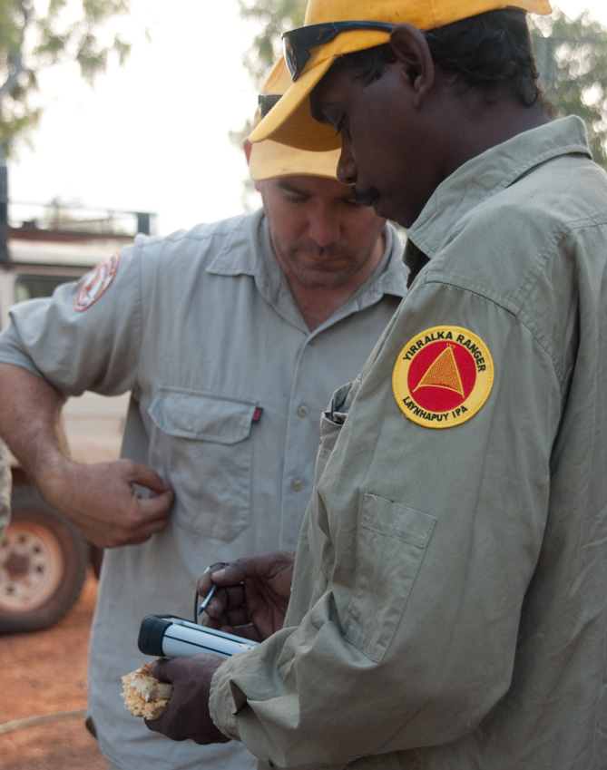
Making the Plan
Monitoring
How we do this step
Figure out who you need to report to (define audience and interest)
Select which indicators you will use (what)
Work out how to collect information on your indicators
Schedule who needs to do what and when (when, where, and who)
Target = Healthy Wetlands
Threats = Pigs
Record data
# of pigs shot
Pig damage ↓
Notes:
To really bring our monitoring plan together we need to think about these things
It is important to think about who you want to report to (even if it is only yourself) at the start
This will guide what you need to know in order to tell the people you need to report to what they need to know

Slide 13
Making the Plan
Monitoring
Who needs to know?
Who will see and review the information and data you collect
Helps you consider the monitoring design and methods
Audiences are: Project team (rangers / managers); funders; Executive / Board; Partners
Notes:
First step – who do you need to tell and what do you need to tell them
You can use the stakeholder analysis from earlier steps to guide you here

Slide 14
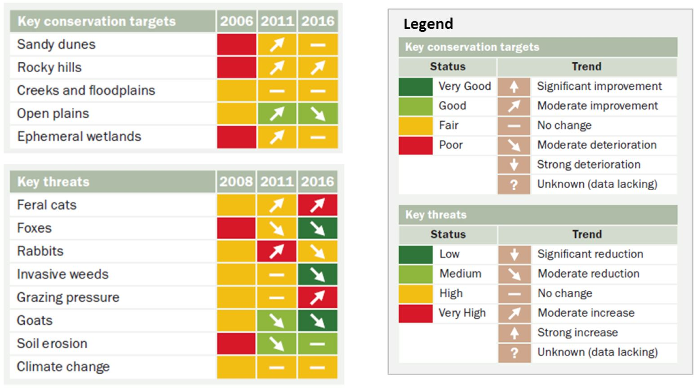
Making the Plan
Monitoring
Example for Board / funders
Notes:
This is an example of the wort of information that is often needed at a senior level – not too much detail, just knowing how the most important things (targets) are going.

Slide 15
Making the Plan
Monitoring
Selecting your indicators
What are you actually going to measure?
Use the minimum resources to provide you with the minimum information needed to best adapt
Reduce, reuse, recycle – ‘mine’ the road map
Indicators from the work you’ve already done
Look to your Targets, Threats and Goals
Good (SMART) Goals and Strategies will lead to good indicators
Notes:
Once you know who you need to tell you can then think about what you want to tell them
And so then you will start thinking about indicators
We think about an idea called ‘optimal ignorance’ we want to know the least amount of information we can to make the decisions we need to make
This is different form the way many people think about this which is more of a ‘maximize information’ approach.

Slide 16
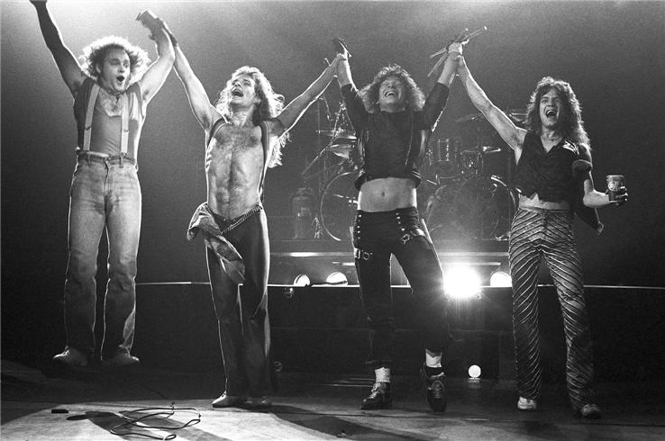
Making the Plan
Monitoring
Picking indicators
Notes:
A simple example is the use of M&Ms by Van Halen to ‘indicate’ whether their stage instructions had been followed
A simple indicator telling them to act, not trying to tell them any more than they needed to know.

Slide 17
Making the Plan
Monitoring
Using the road map
Focus monitoring efforts on the core assumptions you have made in your project – represented by the result chain
Regional pig trapping program
More traps set up
Increased numbers of pigs caught in traps
Reduced numbers of pigs
Healthy wetlands
Ranger time on pig traps
# traps purchased
$ on program
# traps deployed
Area traps deployed
# pigs caught
# trap set
Reduction in pig damage
Increase in vegetation cover and fish caught

Slide 18
Making the Plan
Monitoring
Lessons from the School of Hard Knocks!
The Health table is a good place to find ideas for indicators but you won’t need to monitor everything there.
Beware a monitoring plan you will never do. Or worse, one you will do for a year or two and then stop.
Never monitor something you can’t or won’t do anything about.
Notes:
There are some things to be aware of that are important
You have already thought about indicators, so make sure you look back on your earlier work – you should not really be thinking about new things now but using earlier work
- Make sure you only create as many indicators as you are actually going to use
Don’t monitor things you wont change

Slide 19
Making the Plan
Monitoring
A good indicator
A good indicator should meet the following criteria:
Measurable: you can record something and analyzed it.
Precise: Defined the same way by all people.
Consistent: Consistent over time so that it always provides comparable measurements.
Sensitive: Changes in response to actual changes in what you are measuring.
Sustainable: able to be used with the resources you have
Notes:
These are very ‘scientific’ criteria – but they are helpful when thinking about what will be a useful indicator to answer you questions and what will not

Slide 20
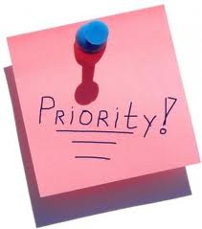
Making the Plan
Monitoring
Prioritize your monitoring budget
Keep it as simple as possible - focus on essential monitoring
Where possible prioritise measures that address a few items (goals, threats etc) or activities with co-benefits
Consider available resources
Where possible, incorporate monitoring into existing work or research
Consider availability of base-line data
Invite someone with experience to peer review monitoring plan
Notes:
Monitoring is expensive and will add up as a big cost over time’
Try to minimize the cost in as many ways as you can
Here are some ideas to do that

Slide 21
Making the Plan
Monitoring
A good method
Accurate: minimal error
Reliable: consistently repeatable
Cost-effective
Feasible: people, material and financial resources
Appropriate: environmental, cultural, and political context
Notes:
The way you monitor indicators is the method
Like indicators, there are some scientific criteria for good methods – ones that will give you information you can actually use to make decisions
Use these as a guide

Slide 22
Making the Plan
Monitoring
Examples of Monitoring Methods
Quantitative data
Tracking project records
Formal survey
Cyber-tracker
Qualitative data:
Key informant interview
Focus group discussion
Direct observation
Social (participatory) mapping

Slide 23
Making the Plan
Activity
Creating a Monitoring Plan
Strategy | Regional trapping program
Indicator | Method | Frequency | Location | Who | Cost / year | Source
Ranger time on pig traps | Ranger time sheets | Annual | On-site | Head ranger | $500 | Internal
# traps set up | GPS sites | Annual | Trap sites | Ranger | $500 | Internal
Pig damage | Damage density data | Bi-Annual | Trap locations & control | Ecologist + rangers | $5,000 | TBD
Target = Healthy Wetlands
# pigs trapped
Pig damage ↓
Notes:
Take the information you have created and put it into a simple table which can then go into the work plan.
You might need to make a table for each of the three layers, as they will require different people and resources

Slide 24
Making the Plan
Monitoring
Overview presentation
Why we do monitoring
The three main layers of monitoring
Making a monitoring plan
Tips for a monitoring plan

Slide 25
Making the Plan
Monitoring
Tips to reduce monitoring costs
Consider low-cost, qualitative options rather than no monitoring
Consider less frequent monitoring visits rather than no monitoring
Use partner data whenever possible
Engage local people & volunteers in monitoring efforts
Notes:
Monitoring is expensive and will add up as a big cost over time’
Try to minimize the cost in as many ways as you can
Here are some ideas to do that

Slide 26
Making the Plan
Monitoring
Remember…
Monitoring requires time and money and needs to be in your work plans & budgets but …
it doesn’t always need to be complicated or costly
Monitoring data must be analyzed and results used to inform our next decisions

Slide 27
Making the Plan
Monitoring
Hints
This step is probably best completed with a small group
Use external expertise to help – there are likely to be things that will need specialist advice
Look for measures and techniques that are linked to day to day / community activities – they are more likely to continue
Don’t discount community / traditional indicators
Some data and results are better than no data at all – you can refine your work as you go

Slide 28
Doing and Monitoring the Work
Monitoring
Additional Resources

Slide 29
Making the Plan
Monitoring
Exercise
Look across your Road Map and identify the points where an indicator would be most critical to demonstrate the causal links in the chain - focusing on those ‘if-then’ steps with greatest uncertainty
Further prioritize your indicators based on your monitoring budget
For priority indicators, select your monitoring methods and how you will collect the information
Decide who will collect the data and when
What changes could result from the information
Draw up a table to record your decisions

