Slide 1
Telling the story
Notes:
Telling the Story constitutes the last phase of HCP cycle. This presentation is about communicating the plan, the aspirations and goals of a project. Communication occurs throughout the life-span of a HCP project at different times. The example focusses on the development of the Plan of Management, but we communicate as well after the plan is developed: to share findings – or to report back.
*Note: This presentation can be shortened to focus on the following pages: 4,5,7,8,9.

Slide 2
Telling ourselves and others
Communication
Overview
Record what we learn
Share what we learn
Help others to share what they learn
Deciding what the plan is about
Telling ourselves and others
Making the plan
Deciding if the plan is working
Doing and monitoring the work
Notes:
The last step of the HCP process focusses on how we best communicate what and to whom.

Slide 3
Telling ourselves and others
Communication
Overview Presentation
Why do we do this step?
Products and Audiences
Example Plans

Slide 4
Telling the story
Communication
Why we do this step?
  To think in creative and expansive ways about how to present your work using stories that highlight the most critical and empowering messages
  To decide who we need to tell, and how we will tell them
Notes:
Communicating (e.g. design and printing) and collating the stories (monitoring) are often expensive exercises; some critical thought on who the audience is, what critical messages are and how we reach the audience will help in the development of communication materials.
The printed plan of management is solely a communication tool – the real plan of management is a living document that sits in the background and will be updated in the intervals determined in the monitoring plans of a project.

Slide 5
Telling the story
Communication
Living documents
What most people think of as a Management Plan is really a communication document
Management Plans are ‘living’, changing constantly
The communication document tells different audiences about our plan at a particular time
We need to think about
  who we need to tell
  what we tell them
  how we tell them
Notes:
What most people think of as a Management Plan is really a communication document
Management Plans are ‘living’, changing constantly – sitting either in Miradi or your CAP Excel Workbook. Ideally the plan is continuously updated as teams collect monitoring information.

Slide 6
Telling ourselves and others
Communication
Overview Presentation
Why do we do this step?
Products and Audiences
Example Plans

Slide 7
Telling the story
Communication
Audience
Who do you need to engage and why?
Which audiences do you want to target? - your target audiences might also be plan drivers.
What are the barriers and limitations for audiences accessing the plan and its information?
Notes:
Sometimes project has the ability to use certain communication products for certain audiences
More than often due to a lack of resources the same product often needs to address more than one audience.
The accessibility to the document and the information in the document becomes critical so that all audiences can equally extract the relevant information for them.

Slide 8
Telling the story
Communication
Create compelling messages
  What information about the problem or solution will change my audience’s perceptions?
  What information do people need about how to implement the solution?
  What information about the consequences of the desired action is not well understood?
  What do people care about? What do they want to change?
Notes:
A Plan of Management often holds key messages for key audiences to fulfil its purpose:
It may a tool to unify within a communicate; Or a tool to attract interest (e.g. in the form of partnerships) from the outside.

Slide 9
Telling the story
Communication
More than one communications tool
A main short plan that is strategic and adaptive with a small number of achievable strategies related to dream, targets and threats.
May have 3-5 year work / action plans which describe detailed actions and the resources needed to achieve the Plan.
Most detailed information in separate resource and supporting documents
Plain English, storybook or poster versions of the Plan as a way of engaging the whole community.
Regular updates and reports

Slide 10
Telling the story
Communication
Main short plan – typical contents
Typical contents
Vision/ dream
Maps (scope)
Targets & health
Threats
Goals
Strategies
Monitoring
Typically NOT
Situation diagram
Road Maps
Work plans
Budgets
Notes:
Situation Diagram, Road Maps, Work Plans and Budgets would normally be collated in an operational work plan for e.g. one or multi-year and only desktop printed.

Slide 11
Telling ourselves and others
Communication
Overview Presentation
Why do we do this step?
Products and Audiences
Example Plans

Slide 12
Telling the story
Communication
Creating the Management Plan
Helps with examples of things that should go in a plan.
Says the same things as Healthy Country Planning.
Other examples also around eg Country-based planning
Notes:
The Australian Government produced in 2011 guidelines for Indigenous Protected Area Management Plans – and Healthy Country Planning / The Open Standards are a case-study in the guidelines. The document shows other approaches for planning – e.g. country based planning.

Slide 13
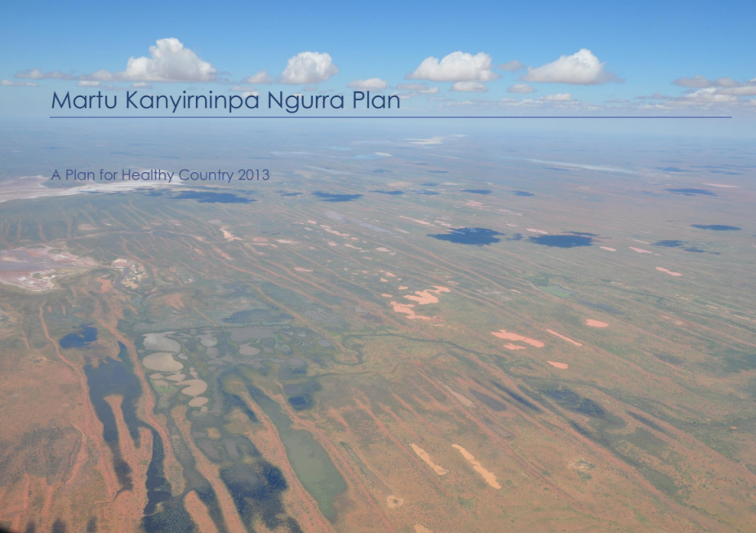



Slide 14



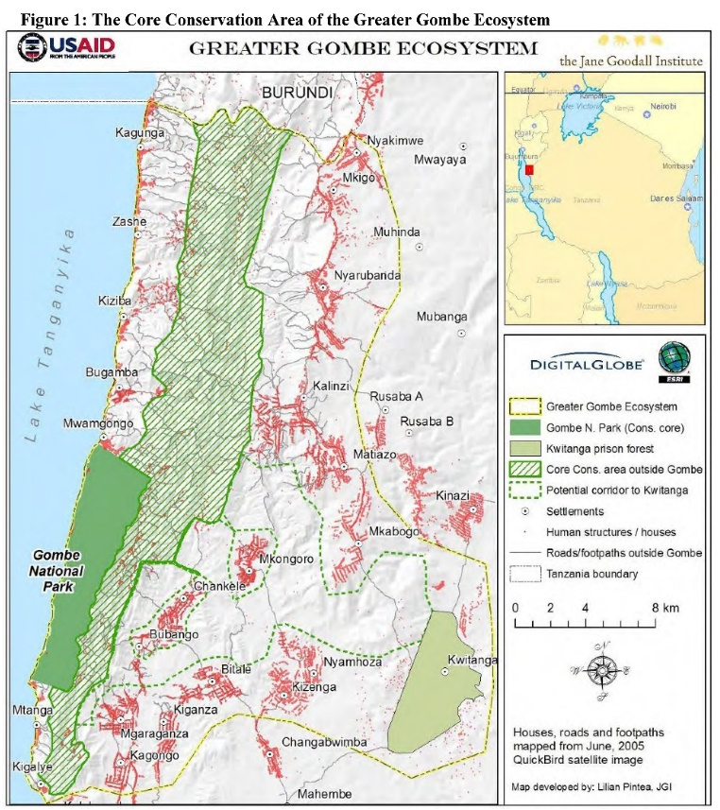

Slide 15
Telling the story
Communication
Creating the Management Plan
Notes:
A set of Healthy Country Plan documents was developed and published for the Wunambal Gaambera Healthy Country Plan. Aside from the full management plan, Uunguu created as well a 4-page short-story summary document and annual Healthy Country Action Plans which contain the operational plans and resourcing information.

Slide 16
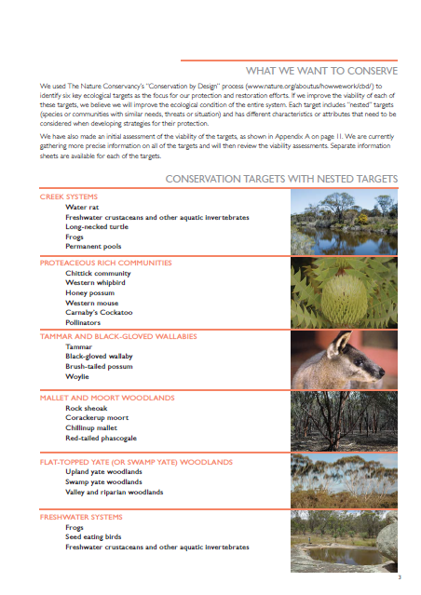
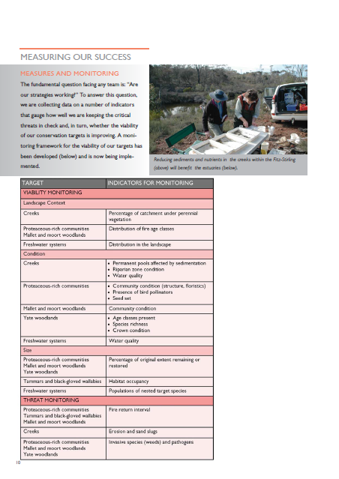
Telling the story
Communication
Summary documents

Slide 17
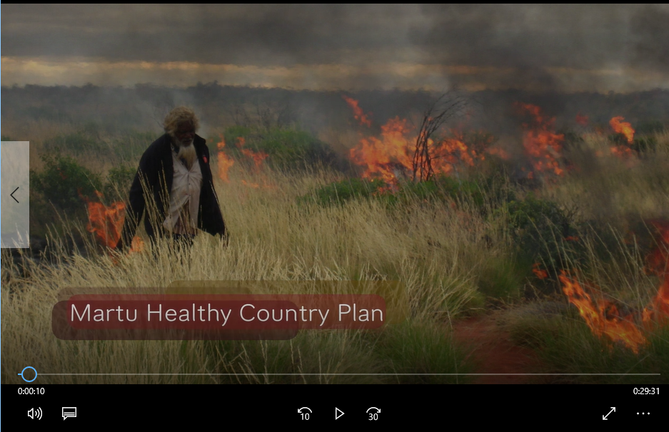
Telling the story
Communication
Video
Notes:
For some communities, written documents are not as suitable and accessible. This group in the desert of Australia created a movie as their management plan.

Slide 18
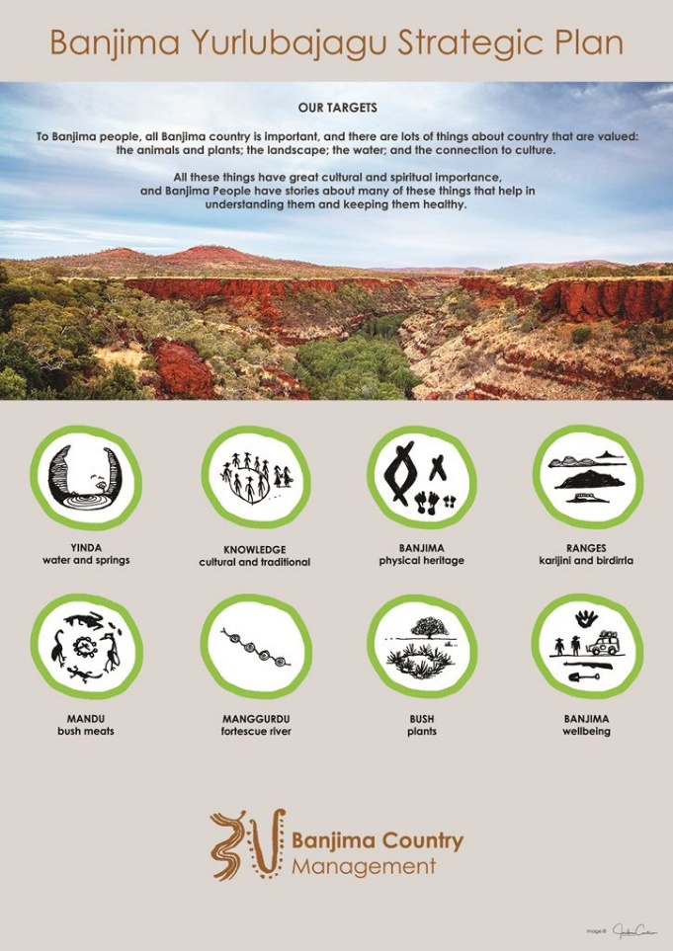
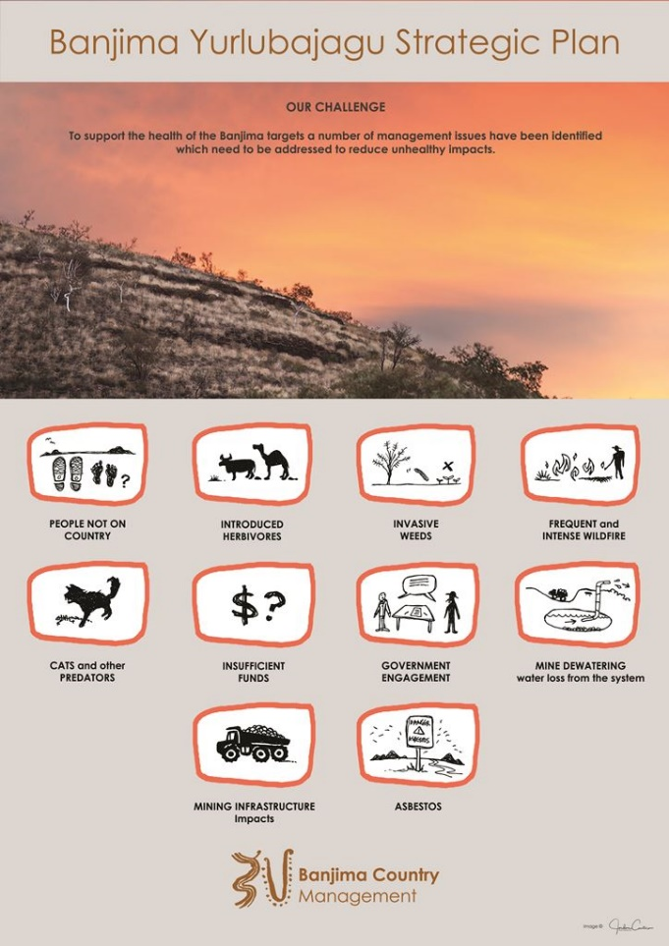
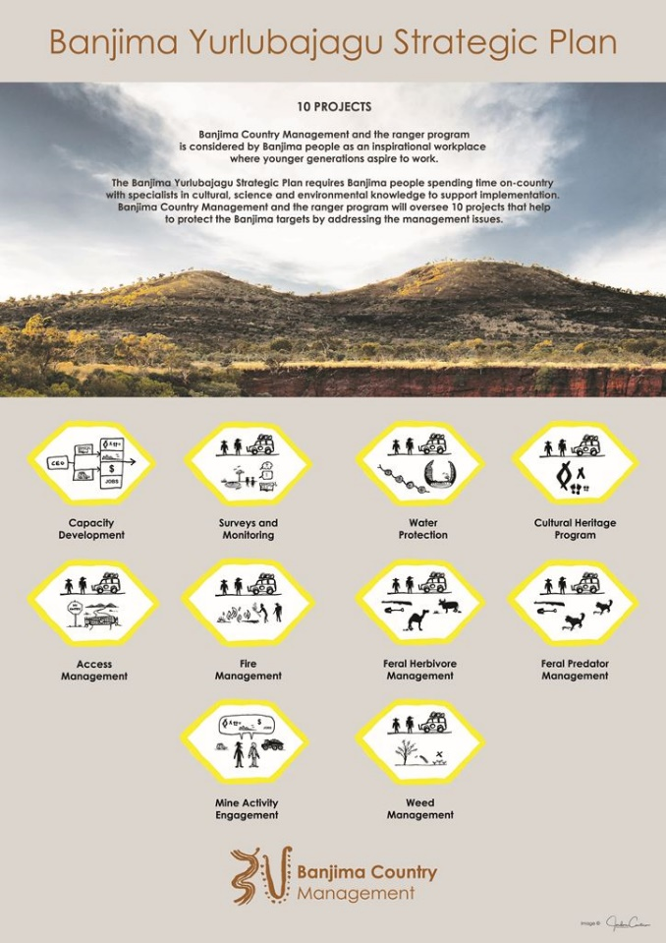
Telling the story
Communication
Posters
Notes:
The community dynamic often affects the products: when the Ranger Base or Corporation Office becomes a place with daily visitors, posters can become a strong tool to communicate back to the community.
In this case the posters use as little English language as possible and rather utilises icons to describe the information.

Slide 19
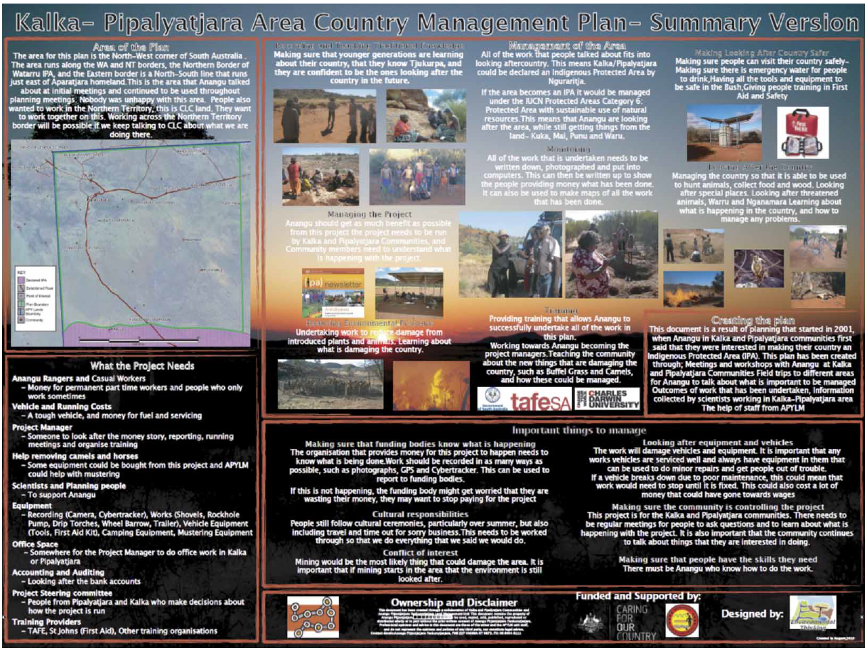
Telling the story
Communication
Posters
FROM:
Our Country Our Way: Guidelines for Australian Indigenous Protected Area Management Plans. Hill, R., Walsh F., Davies, J. and Sandford, M. 2011
Notes:
This is a plan that is best centrally placed in a community where people often visit – a poster is a good tool to remind people.

Slide 20
Telling the story
Communication
Workshop exercise
Presenting a Plan of Management
Based on the outcomes from all workshop exercise collate a “Plan”;
Use results from scope, vision, target, viability, threats, strategies and other elements as required to tell the story of your project;
Consider key audiences and appropriate formats for the Plan (Communication Plan);
Notes:
We anticipate for this exercise 60 minutes. Depending on the design of the training – this exercise may be undertaken by groups on their last evening of training to present on the final day.

