Slide 1
2A. Develop a Formal Action Plan:
Results Chains

Slide 2

Copyright and Use Terms
© Foundations of Success, 2008
FOS strongly recommends that this presentation is given by experts familiar with the adaptive management process presented by the Conservation Measures Partnership’s Open Standards for the Practice of Conservation.
This work is licensed under the Creative Commons Attribution-Noncommercial-Share Alike 3.0 License.
To view a copy of this license, visit http://creativecommons.org/licenses/by-nc-sa/3.0/ or send a letter to Creative Commons, 171 Second Street, Suite 300, San Francisco, CA 94105, USA.
Under this license, you are free to share this presentation and adapt it for your use under the following conditions:
You must attribute the work in the manner specified by the author or licensor (but not in any way that suggests that they endorse you or your use of the work).
You may not use this work for commercial purposes.
If you alter, transform, or build upon this work, you must remove the FOS logo, and you may distribute the resulting work only under the same or similar license to this one.

Slide 3
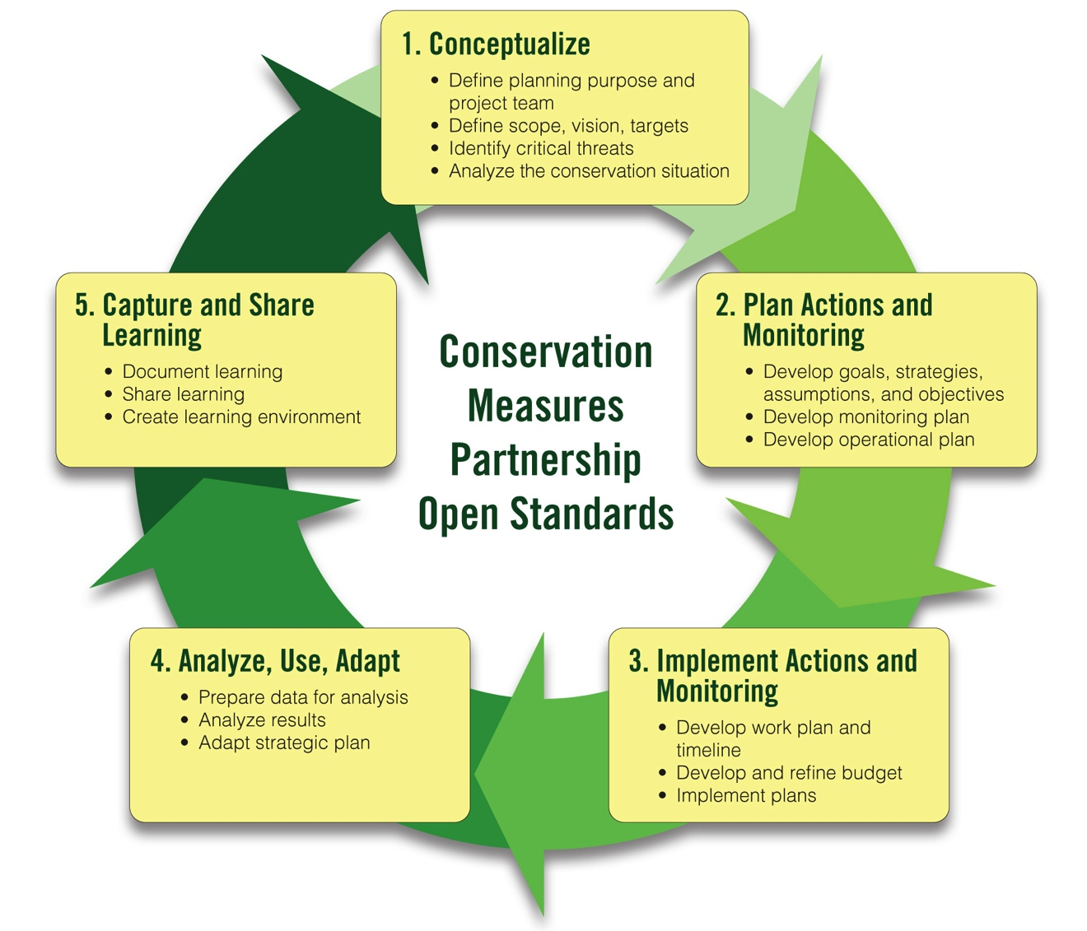
Adaptive Management Workshop Presentations
1A-1B. Team, Scope, Vision
1B. Conservation Targets
1B. Viability Assessment
2A-1. Strategy Selection
2A-2. Results Chains + Activities
2A-3. Objectives
1C. Threat Rating
1D. Conceptual Models
2B. Monitoring Plan

Slide 4
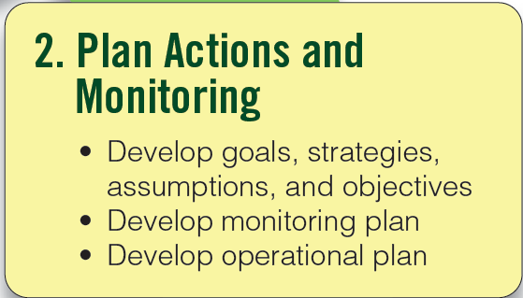
Plan Your Actions & Monitoring
Step 2
Notes:
4

Slide 5
This Presentation
What Is a Results Chain?
How to Develop Results Chains
Common Mistakes and Tips
Notes:
Gauge level of familiarity with audience

Slide 6
What is a Results Chain?
A tool that clarifies assumptions about how conservation strategies contribute to reducing threats and achieving the conservation of targets

Slide 7
What is a Results Chain?
A diagram of a series of “if…then” causal statements that:
Defines how a project team thinks a strategy will contribute to reducing a threat and conserving a target
Focuses on the achievement of results – not the execution of activities
Is composed of assumptions that can be tested

Slide 8
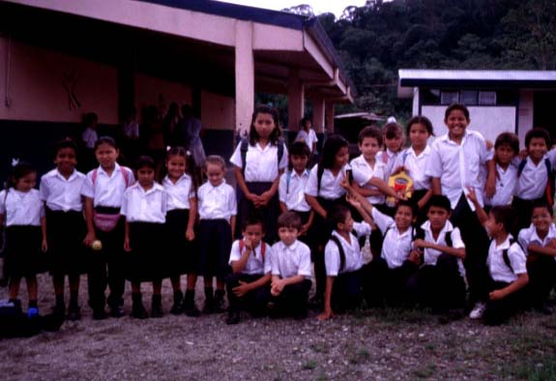
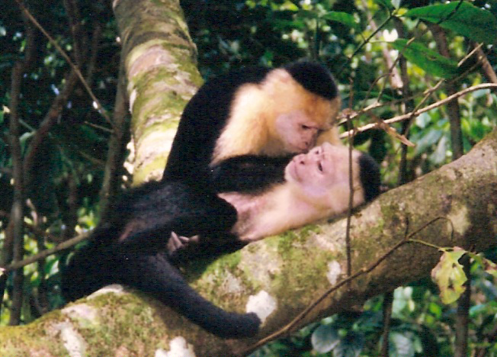
Results Chains
Implicit Assumptions:

Slide 9
What is a Results Chain?
The Basic Components of a Results Chain:

Slide 10
What is a Results Chain?
The Basic Components of a Results Chain:

Slide 11
What is a Results Chain?
The Basic Components of a Results Chain:

Slide 12
This Presentation
What Is a Results Chain?
How to Develop Results Chains
Common Mistakes and Tips

Slide 13
How to Develop a Results Chain
Construct an initial results chain
Complete the links in the results chain
Verify that your results chain meets criteria of a good results chain

Slide 14
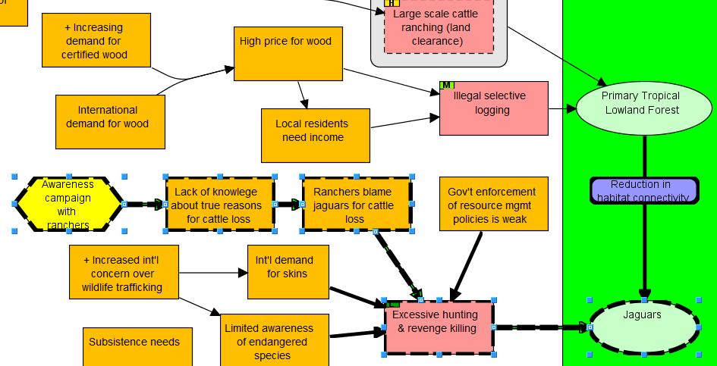
A Chain From the Model Allows You to…

Slide 15
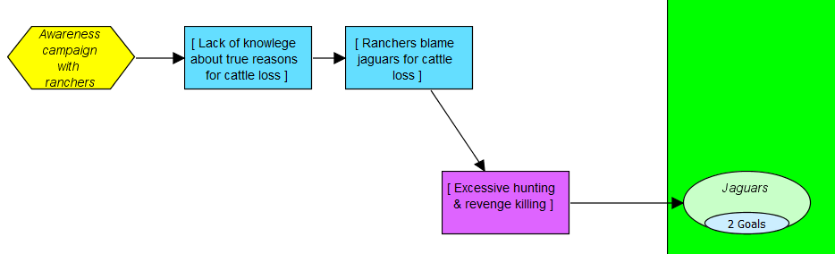
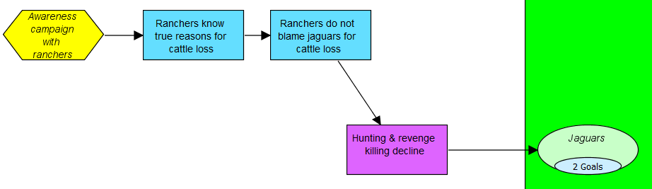
1. Construct an Initial Results Chain

Slide 16
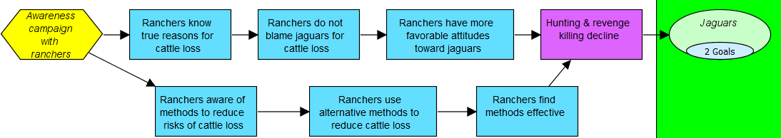
2. Complete the Links in the Results Chain

Slide 17
3. Review the Criteria for Good Results Chains
Results oriented: Boxes contain desired results (e.g., reduction of hunting), and not activities (e.g., conduct a study).
Connected in a “causal” manner: There are clear connections of “if…then” between each pair of successive boxes.
Demonstrates change: Each box describes how you hope the relevant factor will change (e.g., improve, increase, or decrease).
Notes:
Write down criteria for results chains on flip chart

Slide 18
3. Review the Criteria for Good Results Chains
Relatively complete: There are sufficient boxes to construct logical connections but not so many that the chain becomes overly complex.
Simple: There is only one result per box.
Notes:
Mention that they ideally should be stand-alone – can be understood without additional text.

Slide 19
What is a Results Chain?
A diagram of a series of “if…then” statements (“causal”) that:
Defines how a project team thinks a strategy will contribute to reducing a threat and conserving a target
Focuses on the achievement of results – not the execution of activities
Is composed of assumptions that can be tested

Slide 20
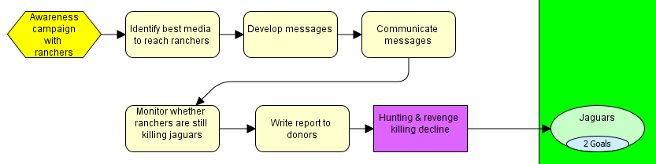
What is NOT a Results Chain?
It is not an implementation flow diagram…

Slide 21
Your Turn: Which of the Following is NOT a Results Chain?
Notes:
Now, it’s your turn to determine which of these three chains does not meet the criteria for good results chains. Please look at these chains and then select one of the following responses. Be sure to click the “submit” button to see if your response is correct. To advance to the next slide you will then need to click the “continue” button. If needed, you can go back to previous slides to review the criteria.
CORRECT ANSWER [DO NOT INCLUDE IN AUDIO]: Chain A is not a results chain. It mixes implementation steps with results. For the most part, it shows a series of activities the team will do. These activities, or implementation steps, include: identify key decision makers, educate decision makers, and research and develop regulations. The chain does include a few boxes that are more results-oriented. These include: decision makers pass laws, no wildlife trade, and jaguar populations increased.

Slide 22
This Presentation
What Is a Results Chain?
How to Develop Results Chains
Common Mistakes and Tips

Slide 23
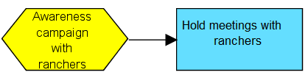
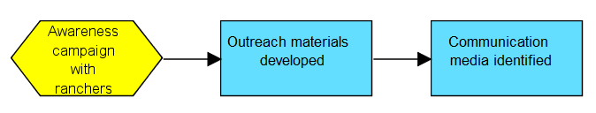
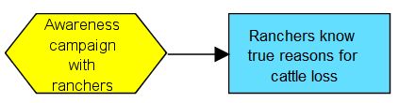

Focusing on activities and outputs instead of results
X
Activity
X
X
Outputs
Outcomes
Tip: Think about the changes in the “external”
world that you expect to see
Notes:
Some outputs are OK, but don’t want a lot and only at beginning of chain

Slide 24
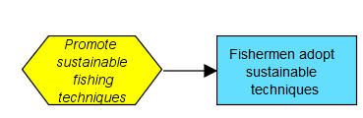
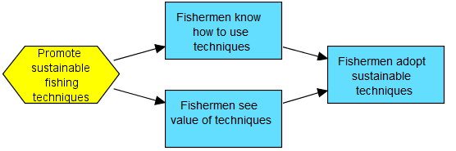


Major “Leaps of Faith”
X
Leap of Faith
Ahh…much better!
Tip: Read your results as
“if-then” statements
X
Leap of Faith
Ahh…much better!

Slide 25

Being Clear about the “Who”
X
Not clear whom you
are trying to affect
Ahh…much better!
Tip: Identify your subject

Slide 26
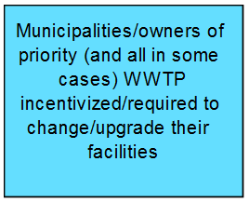
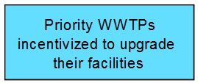
Spare Me the Details!
X
TMI!
Too much information
Ahh…much better!
Tip: Record important details outside of
your chain (e.g., in details box, if using Miradi)

Slide 27
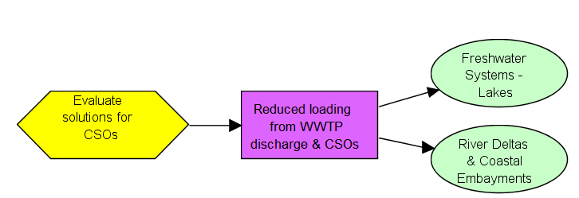
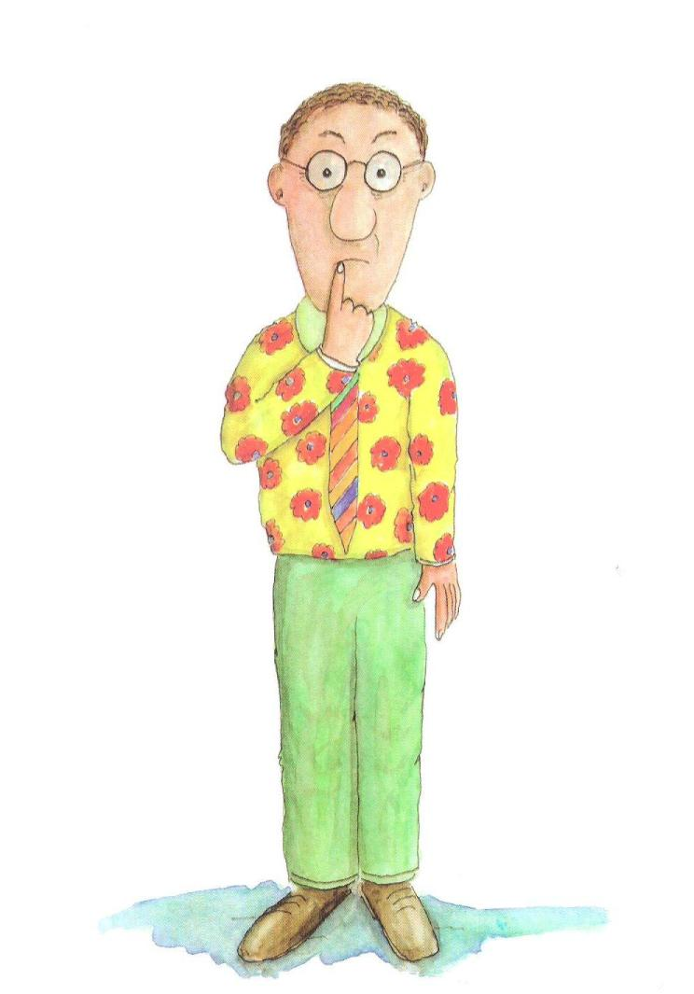
Getting the Right Balance of Detail for Your Audience
?
Tip: Final results chains should be stand-alone diagrams that anyone can understand by looking at the diagram and explanation of it
Notes:
Results chains have to be useful
Not too complex (including complex chains, writing a whole paragraph in a box, arrows - To the degree possible, clear layout – not lots of crisscrossing lines, don’t show all relationships, just the most important ones)
Not too simple
Everyone can remember later, and people not involved in the process understand it.

Slide 28
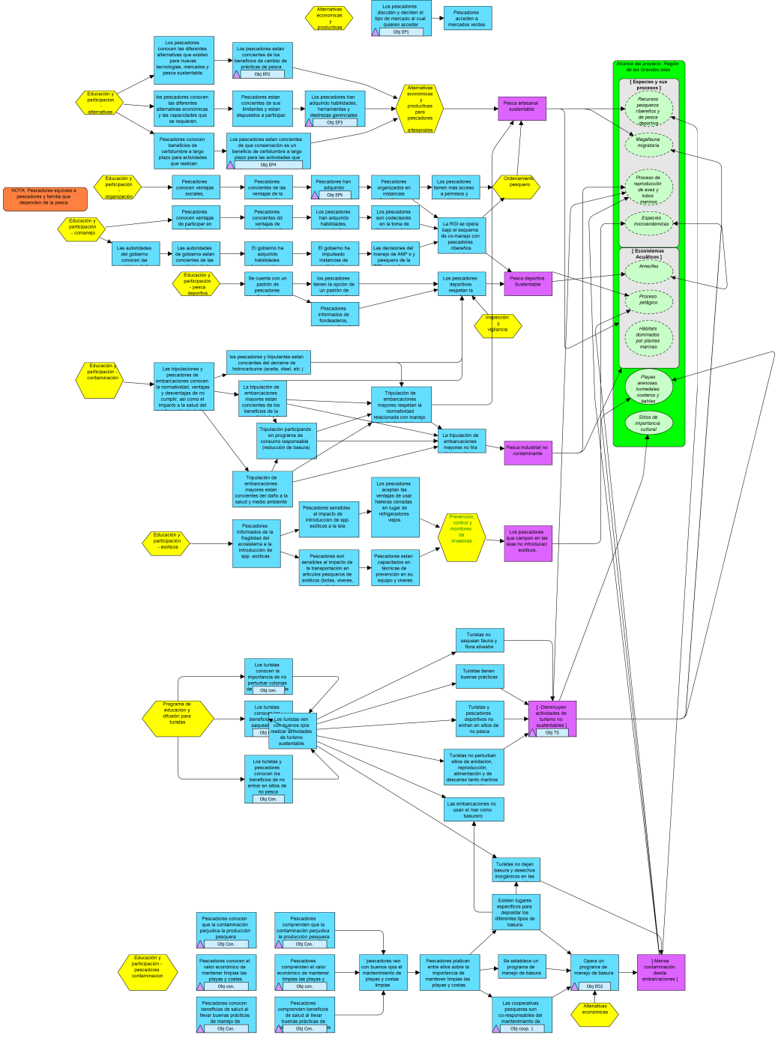
Getting the Right Balance of Detail for Your Audience
Notes:
Results chains have to be useful
Not too complex (including complex chains, writing a whole paragraph in a box, arrows - To the degree possible, clear layout – not lots of crisscrossing lines, don’t show all relationships, just the most important ones)
Not too simple

Slide 29
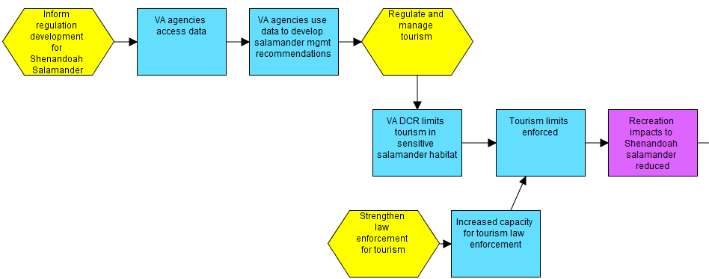
Limiting Number of Strategies on a Page
Tip: If your strategies are mutually dependent, it can be useful to put them together
Notes:
Multiple strategies in one chain – Tip: if they are mutually dependent, it’s useful to put them together. If they just complement, put them separately (but can show strategy boxes to show intersections)

Slide 30
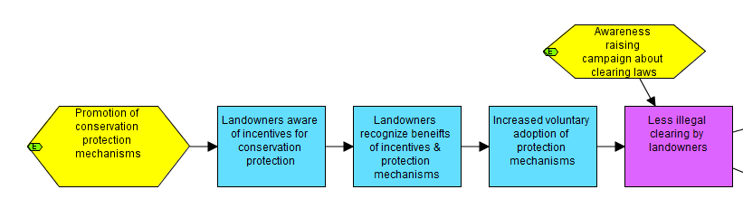
Limiting Number of Strategies on a Page
…If they just complement one another, put them on separate pages (but you can show intersections)

Slide 31
Also, Keep in Mind
It is absolutely critical to have:
  The right people with
  The right information with
  The right (skilled) facilitator

