Slide 1
2A & 2B. Objectives, Activities and
Monitoring Plans

Slide 2

Copyright and Use Terms
© Foundations of Success, 2008
FOS strongly recommends that this presentation is given by experts familiar with the adaptive management process presented by the Conservation Measures Partnership’s Open Standards for the Practice of Conservation.
This work is licensed under the Creative Commons Attribution-Noncommercial-Share Alike 3.0 License.
To view a copy of this license, visit http://creativecommons.org/licenses/by-nc-sa/3.0/ or send a letter to Creative Commons, 171 Second Street, Suite 300, San Francisco, CA 94105, USA.
Under this license, you are free to share this presentation and adapt it for your use under the following conditions:
You must attribute the work in the manner specified by the author or licensor (but not in any way that suggests that they endorse you or your use of the work).
You may not use this work for commercial purposes.
If you alter, transform, or build upon this work, you must remove the FOS logo, and you may distribute the resulting work only under the same or similar license to this one.

Slide 3
Plan Your Actions & Monitoring:
Develop Goals & Strategies
Step 2

Slide 4
Plan Your Actions & Monitoring:
Develop Goals & Strategies
Step 2

Slide 5
Plan Your Actions & Monitoring:
Construct Results Chains
Step 2

Slide 6
Plan Your Actions & Monitoring:
Develop Objectives & Activities
Step 2

Slide 7
Plan Your Actions & Monitoring:
Develop a Monitoring Plan
Step 2
I
I
I
I
I
I

Slide 8
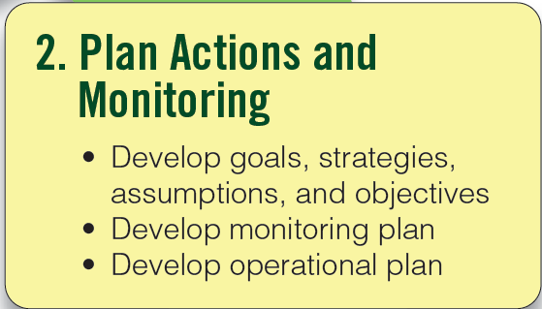
Plan Your Actions & Monitoring
Step 2
Notes:
8

Slide 9
Develop Your Objectives
Step 2A
Objective: A formal statement detailing a desired outcome of a project such as reducing a critical threat.
A good objective should meet the following criteria:
Outcome Oriented: Specifies necessary changes in critical threats and other factors that affect one or more project goals

Slide 10
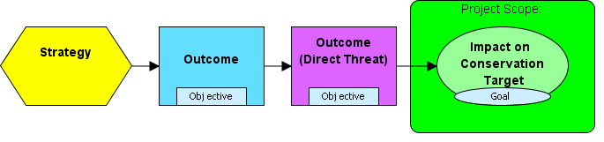
A Basic Results Chain

Slide 11
Develop Your Objectives
Step 2A
Specific: Clearly defined so that all people involved in the project have the same understanding of what the terms in the objective mean.
Measurable: Definable in relation to some standard scale (numbers, percentage, fractions, or all/nothing states).
Time Limited: Achievable within a specific period of time. (Necessarily less than the timeframe of the associated goal.)
Practical: Achievable and appropriate within the context of the project site.

Slide 12
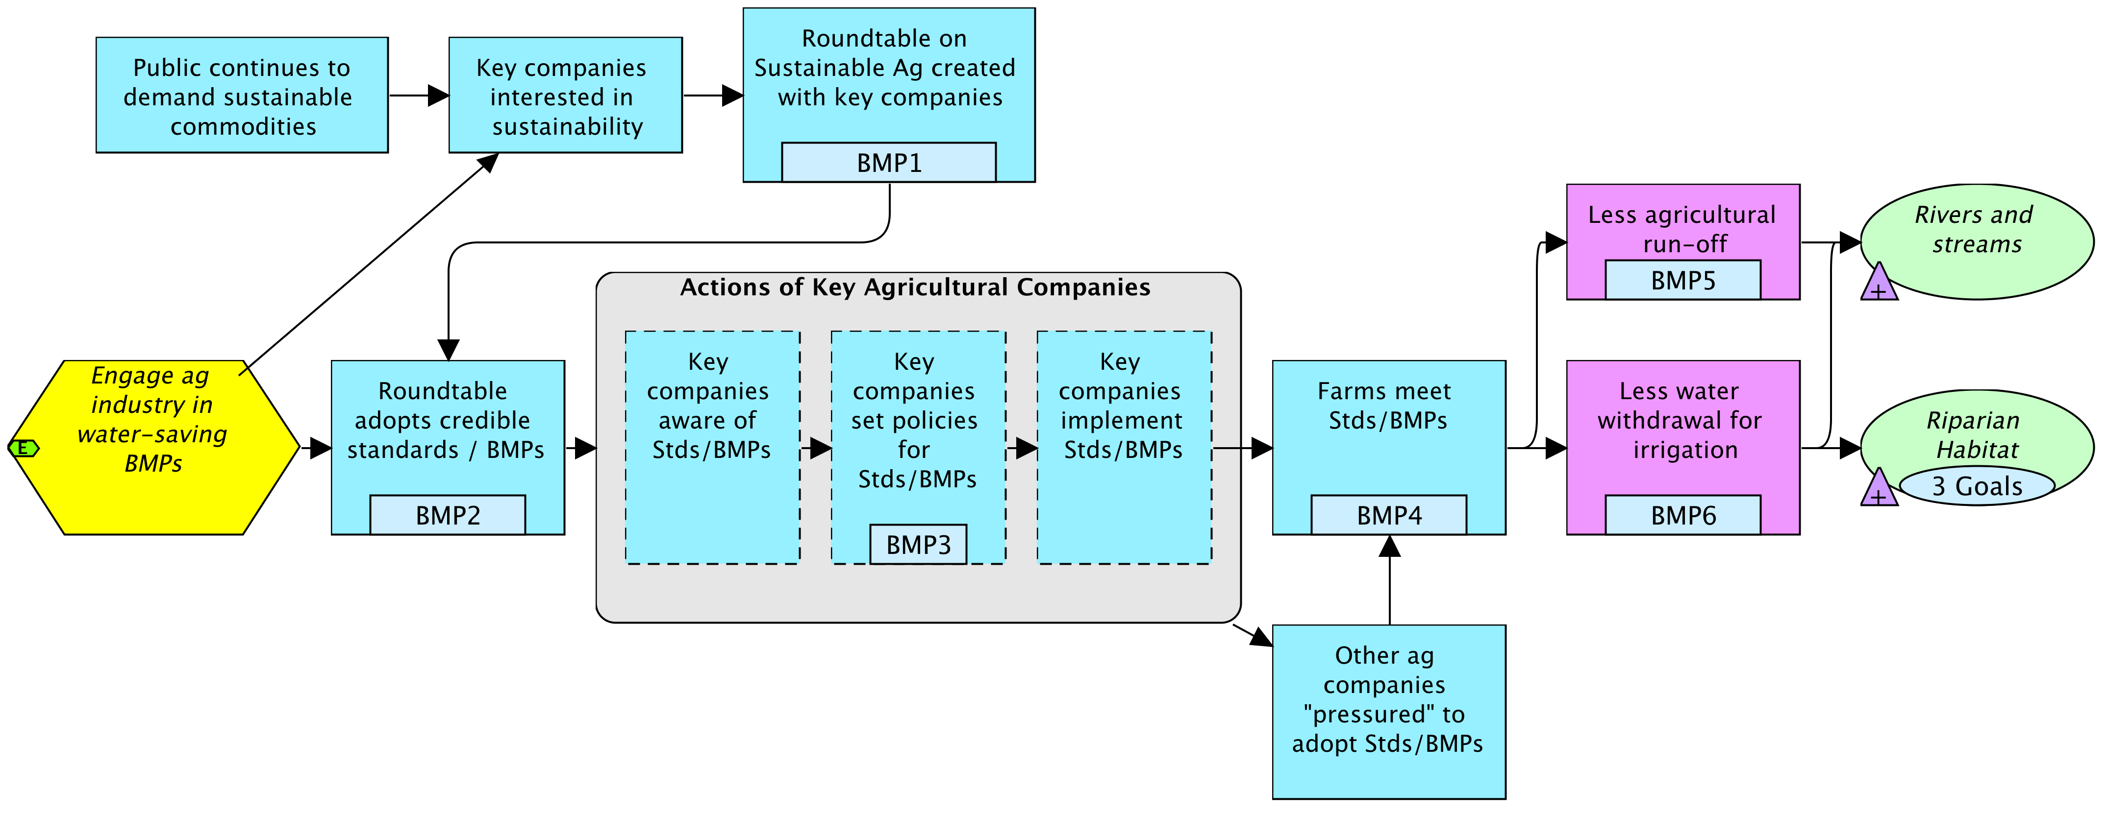
Develop Your Objectives
Step 2A
OBJ 1. By June 2015, a Sacramento Basin Roundtable on Sustainable Agriculture is created with companies representing more than 50% of the irrigated agricultural land in the basin.
OBJ. 6. By 2020, water withdrawal for irrigation has decreased by at least 20% compared to 2014 baseline levels.
OBJ. 3. By the end of end of 2017, at least 75% of the companies that are members of the Roundtable have developed internal policies adopting the Roundtable's environmental standards and BMPs.
Notes:
Points to make:
Obj A – measurable – all or nothing state
Obj C – could have 2 objectives – one related to new invasives coming in, one related to % of footprint of invasives
Team used a combination of %, all/nothing, and #s to make their objectives measureable

Slide 13
Which of the Following Comply with the Criteria for a Good Objective?
By 2010, no water concessions are granted in identified critical grasslands and associated wetlands.
Promote community wellbeing and health in the area surrounding the Indah Biosphere Reserve.
To establish a sustainable enterprise-based conservation and development project that meets the needs of local people while protecting biodiversity in the region surrounding Indah Biosphere Reserve.
By the end of the project, annual household income for all families participating in non-timber forest product harvesting enterprises has increased by at least 20%.

Slide 14
How Do You Write a Good Objective?
Key companies set policies for Stds/BMPs
Select a result in your results
chain where you want an objective
Write a draft objective for that result
Draft 1: “Majority of companies have adopted the Roundtable’s standards and BMPs”
Apply the criteria to modify and refine your draft objective
- Outcome oriented - Specific
- Measureable - Time limited
- Practical
Notes:
14

Slide 15
How Do You Write a Good Objective?
Apply the criteria to modify and refine your draft objective
Draft 2: “By the end of 2017, at least 75% of irrigation companies have adopted the Roundtable’s environmental standards and BMPs.”
Draft 3: “By the end of end of 2017, at least 75% of the companies that are members of the Roundtable have developed internal policies adopting the Roundtable's environmental standards and BMPs.”
Notes:
15

Slide 16
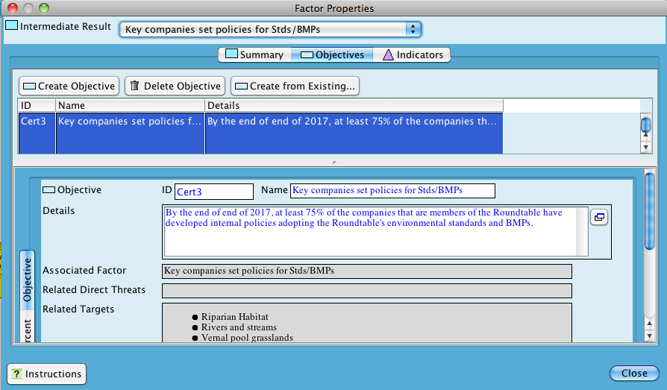
Objectives in Miradi
Notes:
Fishing objective

Slide 17
Develop Your Activities
Step 2A
Activity: A specific action or set of tasks undertaken by project staff and/or partners to reach one or more objectives.
Define activities to accomplish your strategy and add them onto the results chain

Slide 18
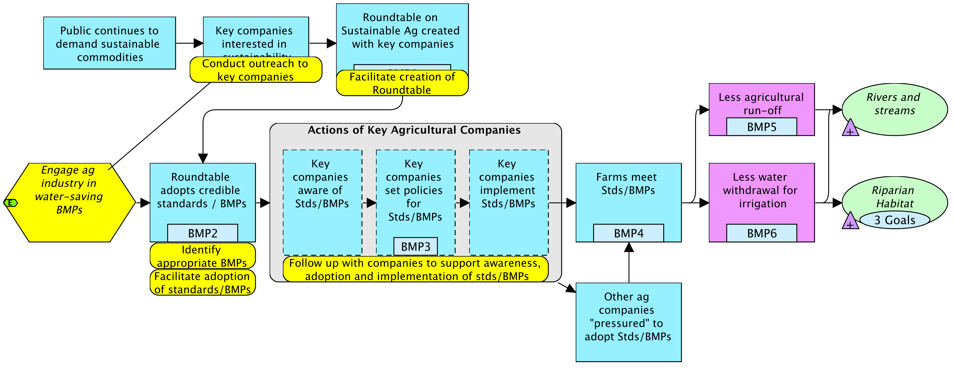
Develop Your Activities
Step 2A

Slide 19
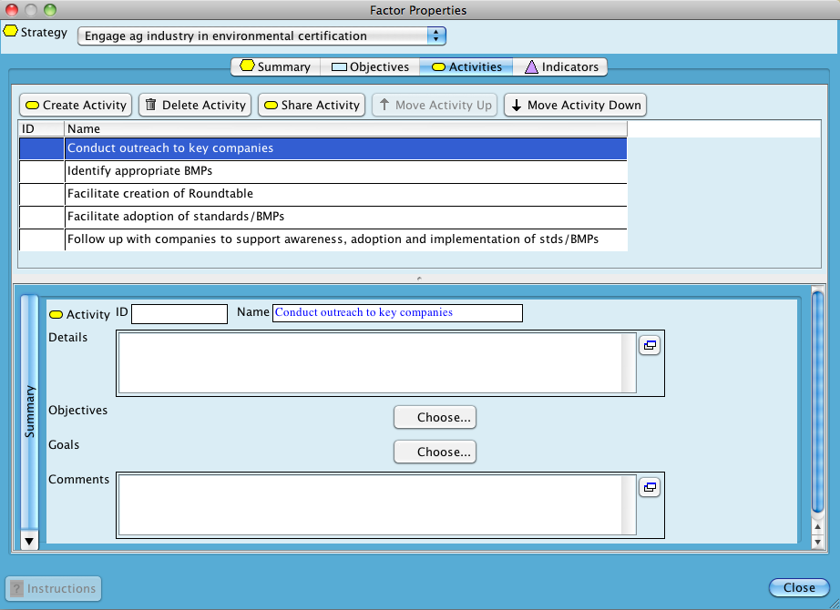
Activities in Miradi
Step 2A

Slide 20
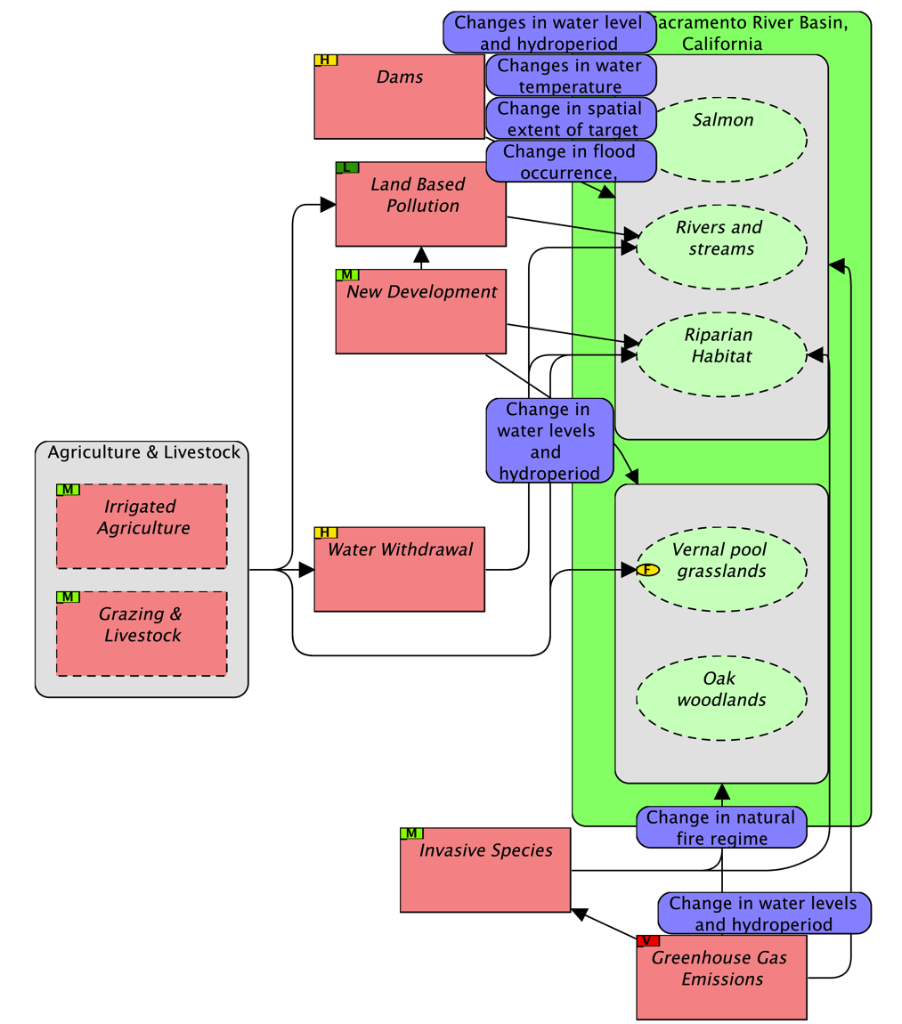
4. Show Highest Stresses on Overall Conceptual Model
Show stresses with a VH or H magnitude (scope + severity) on the model

Slide 21
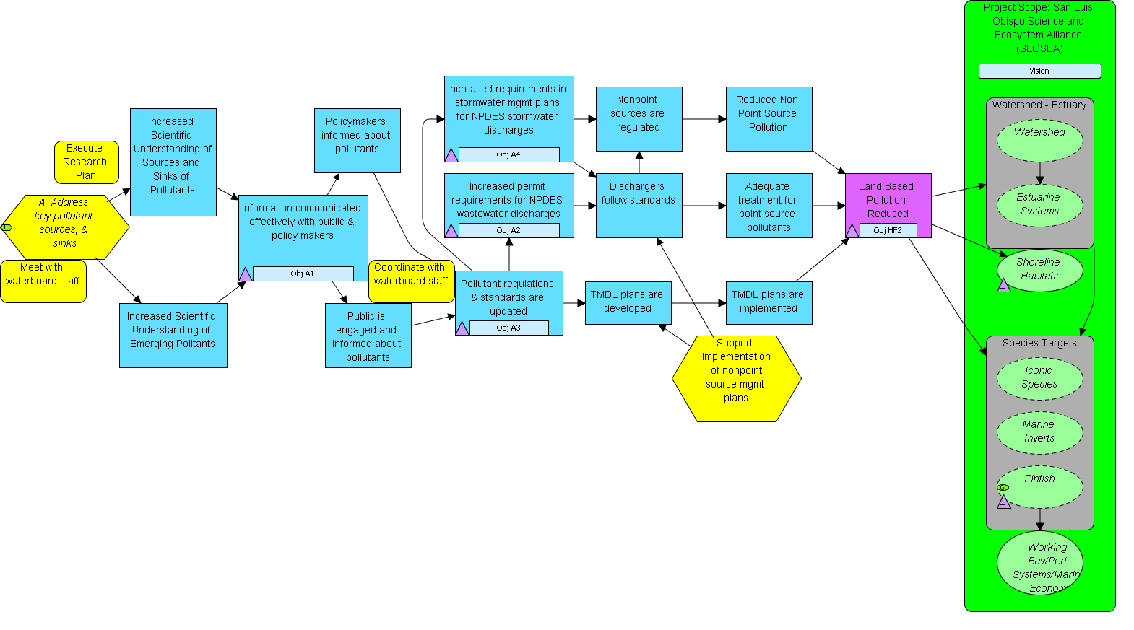
Real World Examples of Objectives & Activities
OBJ. A4: During next cycle, stormwater plans are updated to reflect findings from the pollutant monitoring strategy
OBJ. A1: At least once/year starting in 2008, SLOSEA provides a synthesis of pollutant data to public and policy makers
OBJ. A2: By 2011, permits for NPDES include limits for nonylphenol
OBJ. HF2: By 2012, at least 80% of samples over entire scope meet updated State and Federal water quality standards of nitrates, nonylphenols, and other potential pollutants
Adapted from SLOSEA 2008, Morro Bay, California
Notes:
A1 – much more output oriented

Slide 22
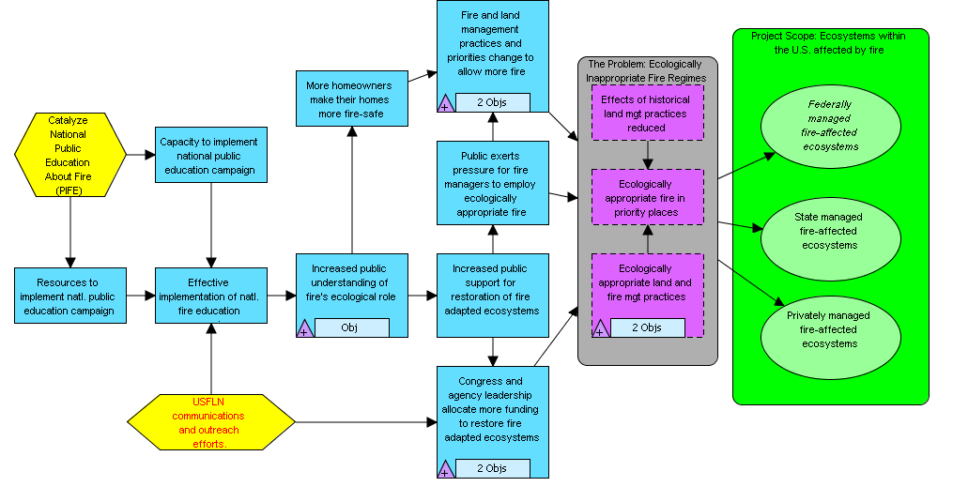
Real World Examples of Objectives & Activities
OBJ.: By 2012, 60% of American population understands the need for ecological fire management (including rxfire, thinning, letting natural fires burn)
OBJ.: By 2015 Congress and agency leadership allocate $705 million/year for restoration of fire-adapted ecosystems
OBJ.: By 2015, 2.78 million acres in WUI treated annually by federal agencies
Adapted from TNC Global Fire Initiative 2008, USA
Notes:
A1 – much more output oriented

Slide 23
Plan Your Actions & Monitoring
Step 2
Notes:
23

Slide 24
Develop Your Monitoring Plan
Step 2B
Key Steps
Identify your audiences
Identify your information needs
Develop one or more indicators for each information need
Select your monitoring approach
Select your methods and how you will collect the information
Determine when, by whom, and where data collection will happen

Slide 25
1. Identify Your Audiences:
For Whom Is the Monitoring
Internal Audiences
- Project team
- Community members
External Audiences
- Donors
- Project partners
- Ministry of Natural Resources

Slide 26
2. Identify Key Information Needs: What Is Necessary…
I
I
I
I
I
I
I
I

Slide 27
2. Identify Key Information Needs: What Is Ideal…
I
I
I
I
I
I
I
I
I
I

Slide 28
3. Develop One or More Indicators for Each Information Need
Indicator: A measurable entity related to a specific information need such as the status of a target, change in a threat, or progress toward an objective
A good indicator should meet the following criteria:
Measurable: Able to be recorded and analyzed in quantitative or qualitative terms.
Notes:
INDICATOR CRITERIA HAVE BEEN MODIFIED BY NICK AND CAROLINE – TAKING INTO ACCOUNT OLD PPT DEFINITIONS AND NEW DEFINITIONS UNDER WWF STANDARDS AND GUIDELINES

Slide 29
3. Develop One or More Indicators for Each Information Need
Precise: Defined the same way by all people.
Consistent: Not changing over time so that it always provides comparable measurements.
Sensitive: Changing proportionately in response to actual changes in the condition or item being measured.
Notes:
INDICATOR CRITERIA HAVE BEEN MODIFIED BY NICK AND CAROLINE – TAKING INTO ACCOUNT OLD PPT DEFINITIONS AND NEW DEFINITIONS UNDER WWF STANDARDS AND GUIDELINES

Slide 30
What Is Meant by “Sensitive”
Notes:
Proxy: A substitute for an indicator that cannot be directly measured or assessed

Slide 31
Examples of Indicators
Goal for Riparian Habitat: By 2020, at least 90% of the Sacramento River has a riparian buffer of at least 50 feet on each side of the river with more than 95% native species cover.
Indicator 1: % of the Sacramento River (or # of miles) that have a riparian buffer of at least 50 feet on each side of the river
Indicator 2: % of native species cover in riparian buffers

Slide 32
Examples of Indicators
OBJ 4. By June 2015, a Sacramento Basin Roundtable on Sustainable Agriculture is created with companies representing more than 50% of the irrigated agricultural land in the basin.
% of irrigated agricultural land in the basin represented by companies in the Roundtable

Slide 33
Examples of Indicators
% of farms owned by Roundtable companies that receive environmental certification
OBJ 4. By 2018, at least 80% of the farms owned by the Roundtable companies receive environmental certification.

Slide 34
Examples of Indicators
Company employees’ attitudes toward Standards and BMPs

Slide 35
Develop Your Monitoring Plan
Step 2B
Key Steps
Identify your audiences
Identify your information needs
Develop one or more indicators for each information need
Select your monitoring approach
Select your methods and how you will collect the information
Determine when, by whom, and where data collection will happen

Slide 36
Types of Monitoring Approaches
Basic Monitoring Approaches:
1. Comparison of the unit affected by the project with itself over time.
  “Pre-test / Post-test”
  “Time Series”

Slide 37
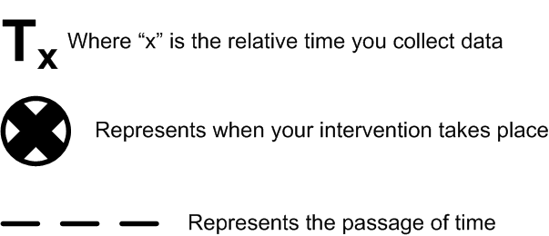

Types of Monitoring Approaches
Pre-test Post-test:

Slide 38

Types of Monitoring Approaches
Time Series:

Slide 39
Types of Monitoring Approaches
Basic Monitoring Approaches:
1. Comparison of the unit affected by the project with itself over time.
  “Pre-test / Post-test”
  “Time Series”
Comparison of the unit affected by the project with another not affected by the project
  Monitoring with “Strict Control Group” (experimental design).
  Monitoring with “Comparison Groups”

Slide 40

Types of Monitoring Approaches
Strict Control Group:
Group affected by your project
Group NOT affected by your project
Notes:
Experimental design with randomly selected sites – may not be ethical or feasible.

Slide 41
Types of Monitoring Approaches
Comparison Group:
Group affected by your project
Group NOT affected by your project
Notes:
Sites do not need to be randomly selected using comparison group approach (quasi-experimental design)

Slide 42
Types of Monitoring Approaches
Basic Monitoring Approaches:
1. Comparison of the unit affected by the project with itself over time.
  “Pre-test / Post-test”
  “Time Series”
Comparison of the unit affected by the project with another not affected by the project
  Monitoring with “Strict Control Group” (experimental design).
  Monitoring with “Comparison Groups”

Slide 43
Develop Your Monitoring Plan
Step 2B
Key Steps
Identify your audiences
Identify your information needs
Develop one or more indicators for each information need
Select your monitoring approach
Select your methods and how you will collect the information
Determine when, by whom, and where data collection will happen
Notes:
43

Slide 44
Selection of Appropriate Method
Method: A specific technique used to collect data to measure an indicator.
The selection of the most appropriate monitoring method depends on:
The information you need
The information you have
The skills of the project team
Availability of time, money and other resources

Slide 45
A Few Types of Monitoring Methods
To obtain quantitative data
  Tracking project records
  Formal survey
To obtain qualitative data:
  Key informant interview
  Focus group discussion
  Matrix ranking
  Direct observation
  Mapping

Slide 46
5. Select your methods and how you will collect the information
A good method should meet the following criteria:
Accurate: Gives minimal or no error
Reliable: Results obtained using the method are consistently repeatable
Cost-effective: Not overly expensive for the data the method yields or for the resources the project has
Feasible: Project team has people who can use the method, as well as the material and financial resources to use the method
Appropriate: Appropriate to the environmental, cultural, and political context of the project
Notes:
46
METHODS CRITERIA HAVE BEEN MODIFIED BY NICK AND CAROLINE – TAKING INTO ACCOUNT OLD PPT DEFINITIONS AND NEW DEFINITIONS UNDER WWF STANDARDS AND GUIDELINES

Slide 47
Examples of Monitoring Methods
OBJ 4. By June 2015, a Sacramento Basin Roundtable on Sustainable Agriculture is created with companies representing more than 50% of the irrigated agricultural land in the basin.
% of irrigated agricultural land in the basin represented by companies in the Roundtable
Method: GIS analysis of land ownership data
% of farms owned by Roundtable companies that receive environmental certification
OBJ 4. By 2018, at least 80% of the farms owned by the Roundtable companies receive environmental certification.
Method: Review certification organization’s records

Slide 48
Examples of Monitoring Methods
Indicator: Company employees’ attitudes toward Standards and BMPs
Method: key informant interviews

Slide 49
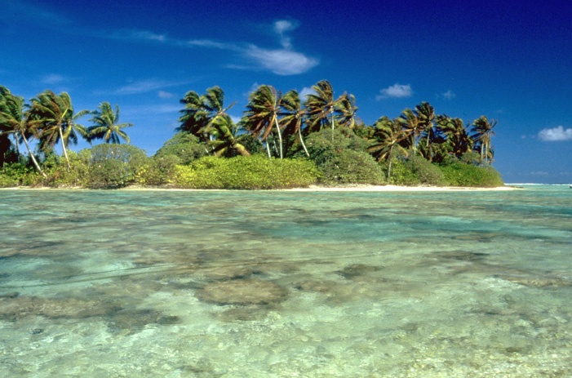
Examples of Monitoring Methods
By 2017 all 12 MPAs reach a management effectiveness minimum score of “Good” …
By 2012 all 12 Marine Protected Areas (MPAs) have at least one sustainable mechanism that is generating income, representing at least 20% of their total annual budget
I
I
I
I
% of MPA budget that comes from self generating sources of income
Management effectiveness assessment score
Method: track project records
Method: formal survey

Slide 50
Develop Your Monitoring Plan
Step 2B
Key Steps
Identify your audiences
Identify your information needs
Develop one or more indicators for each information need
Select your monitoring approach
Select your methods and how you will collect the information
Determine when, by whom, and where data collection will happen
Notes:
50

Slide 51
6. Determine When, by Whom, and Where Data Collection Will Happen

Slide 52
Example of a Monitoring Plan
What (Indicator) | How (Methods) | When | Who | Where | Comments
Goal: By 2020, at least 90% of the Sacramento River has a riparian buffer of at least 50 feet on each side of the river with more than 95% native species cover.
Monitoring Approach: time series
% of the Sacramento River (or # of miles) that have a riparian buffer of at least 50 feet on each side of the river | Remote sensing | Every 4 years in July. | UC – Davis grad students | Entire River | Develop a cooperative agreement with UC-Davis Conservation Mgmt Program
% of native species cover in riparian buffers | Vegetation surveys - plots | Every 2 years in July. | UC – Davis grad students | Selected sites

Slide 53
Example of a Monitoring Plan
What (Indicator) | How (Methods) | When | Who | Where | Comments
Objective: By 2018, at least 80% of the farms owned by the Roundtable companies receive environmental certification.
Monitoring Approach: time series
% of farms owned by Roundtable companies that receive environmental certification | Review certification organization’s records | Every 2 years, in Sept, beginning in 2016 | Matt, Sac River Conservancy | Certification organization’s office | Develop MOU with certification organization

Slide 54
To Address These Questions
Are we doing the right things?
Are we doing them well?
Are we achieving an impact?
We design strategies based on a conceptual model, prioritize threats and use result chains
We monitor objectives
We monitor goals

Slide 55
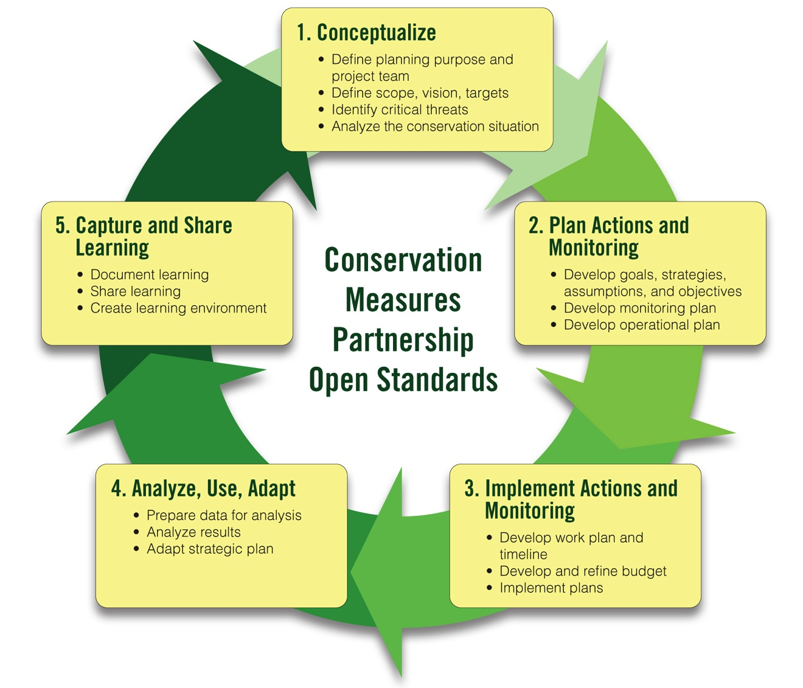
CMP Strategic Planning Process
Team, Scope, Vision
Conservation Targets
Viability Assessment
Goals
Determining Strategies
Results Chains
Objectives and Activities
Threat Rating
Conceptual Model
Monitoring Plan

Slide 56
Instructions – Objectives & Activities
Develop an objective for the direct threat in your results chain. Apply your criteria cards and revise.
Develop objectives for at least two other key results in your results chain. Apply your criteria cards and revise.
Identify at least two activities that are necessary to achieve your objectives.

Slide 57
Instructions – Indicators and Monitoring Methods
Use your results chains and your action plan:
Discuss who your primary audiences are and what information each audience might need.
Select one objective and develop one or more indicators for it. Check against criteria.
Select a monitoring strategy.
Outline the method that you will use to collect data for each indicator. Check against criteria.
Repeat Steps 1-8 for your goal and at least one other objective.

Slide 58
Questions that Coaches Should Ask:
Objectives and Activities
Does the team have a well-articulated concept of success for their project, expressed in specific, measurable, time-bound goals and threat reduction objectives?
Are the goals and TR objectives ambitious but achievable?
Do these goals and TR objectives really provide direction for the project’s actions?
Do all objectives meet the criteria?
Have the most important activities been defined?
Does the team have roughly sufficient capacity to implement the activities?

Slide 59
Questions that Coaches Should Ask:
Monitoring
Is the audience for the monitoring clearly defined?
Has the team identified performance measurement indicators for each of their goals and objectives?
Has the team identified monitoring methods that are accurate, reliable, cost-effective, feasible and appropriate?
Has the team prioritized the indicators and made the monitoring plan feasible?

Slide 60
Questions that Coaches Should Ask:
Monitoring
Do you believe that the team has struck a good balance between taking action, tracking strategy effectiveness, and tracking the status of targets or threats not currently the focus of management actions (i.e., early warning status indicators)?
For its monitoring, can the team use any information already being gathered by others?

