Slide 1
2A. Develop a Formal Action Plan: Objectives

Slide 2

Copyright and Use Terms
© Foundations of Success, 2008
FOS strongly recommends that this presentation is given by experts familiar with the adaptive management process presented by the Conservation Measures Partnership’s Open Standards for the Practice of Conservation.
This work is licensed under the Creative Commons Attribution-Noncommercial-Share Alike 3.0 License.
To view a copy of this license, visit http://creativecommons.org/licenses/by-nc-sa/3.0/ or send a letter to Creative Commons, 171 Second Street, Suite 300, San Francisco, CA 94105, USA.
Under this license, you are free to share this presentation and adapt it for your use under the following conditions:
You must attribute the work in the manner specified by the author or licensor (but not in any way that suggests that they endorse you or your use of the work).
You may not use this work for commercial purposes.
If you alter, transform, or build upon this work, you must remove the FOS logo, and you may distribute the resulting work only under the same or similar license to this one.

Slide 3
Plan Your Actions & Monitoring:
Develop Goals & Strategies
Step 2

Slide 4
Plan Your Actions & Monitoring:
Develop Goals & Strategies
Step 2

Slide 5
Plan Your Actions & Monitoring:
Construct Results Chains
Step 2

Slide 6
Plan Your Actions & Monitoring:
Develop Objectives & Activities
Step 2

Slide 7
Plan Your Actions & Monitoring:
Develop a Monitoring Plan
Step 2
I
I
I
I
I
I

Slide 8
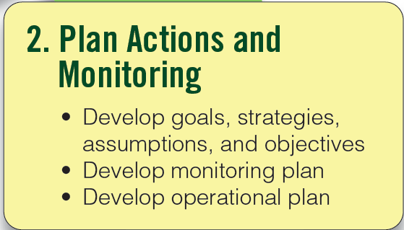
Plan Your Actions & Monitoring
Step 2
Notes:
8

Slide 9
This Presentation
What are objectives?
How to define objectives
What are indicators and methods?
How to develop a monitoring plan

Slide 10
Develop Your Objectives
Step 2A
Objective: A formal statement detailing a desired outcome of a project such as reducing a critical threat.
A good objective should meet the following criteria:
Outcome Oriented: Specifies necessary changes in critical threats and other factors that affect one or more project goals

Slide 11
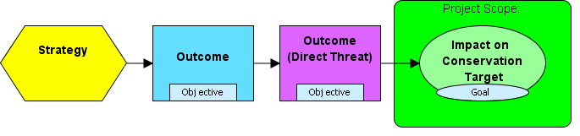
A Basic Results Chain

Slide 12
Develop Your Objectives
Step 2A
Specific: Clearly defined so that all people involved in the project have the same understanding of what the terms in the objective mean.
Measurable: Definable in relation to some standard scale (numbers, percentage, fractions, or all/nothing states).
Time Limited: Achievable within a specific period of time. (Necessarily less than the timeframe of the associated goal.)
Practical: Achievable and appropriate within the context of the project site.

Slide 13
This Presentation
What are objectives?
How to define objectives
What are indicators and methods?
How to develop a monitoring plan

Slide 14
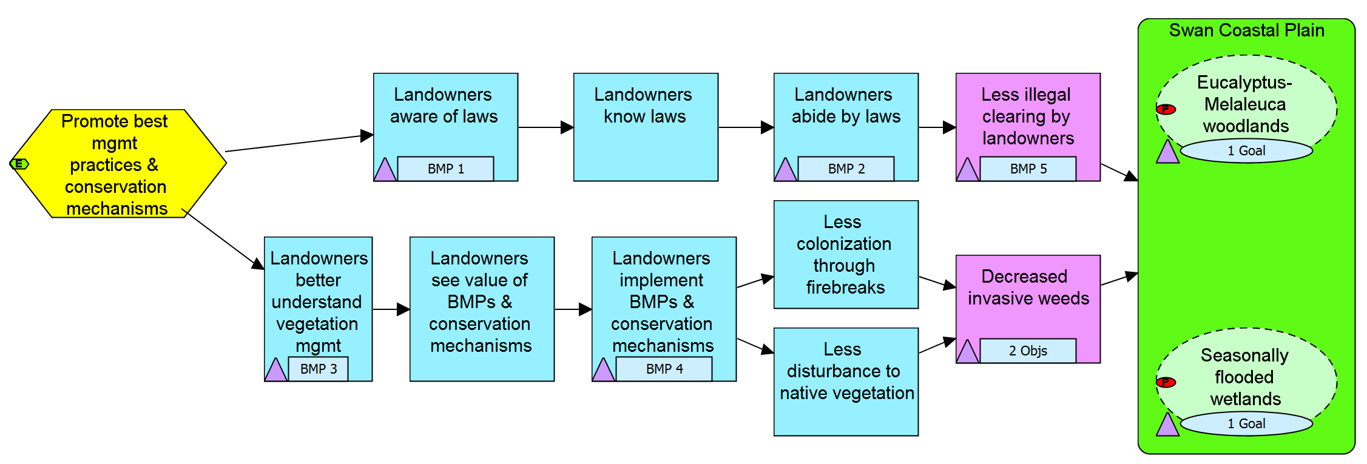
How Do You Write a Good Objective?
Landowners implement best mgmt practices
Select a result in your results
chain where you want an objective
Notes:
14

Slide 15
How Do You Write a Good Objective?
Landowners implement best mgmt practices
Select a result in your results
chain where you want an objective
Write a draft objective for that result
Draft 1: “More landowners are implementing BMPs on their properties”
Apply the criteria to modify and refine your draft objective
- Outcome oriented - Specific
- Measureable - Time limited
- Practical
Notes:
15

Slide 16
How Do You Write a Good Objective?
Apply the criteria to modify and refine your draft objective
Draft 2: “By 2012, at least 75% of landowners are implementing BMPs on their properties”
Draft 3: “By 2012, at least 75% of those landowners informed about best management practices are implementing at least two BMPs on their properties”
- Outcome oriented - Specific
- Measureable - Time limited
- Practical
Notes:
16

Slide 17
Develop Your Objectives
Step 2A
Objective BMP2. By 2014, there are no more than 10 infractions issued annually against landowners in the Swan Coastal Plain for illegal clearing of vegetation
Objective BMP6. By 2018 & thereafter, no new invasive plant species are detected in the Eucalyptus-Melaleuca woodlands & seasonally flooded wetlands
Notes:
Points to make:
Obj A – measurable – all or nothing state
Obj C – could have 2 objectives – one related to new invasives coming in, one related to % of footprint of invasives
Team used a combination of %, all/nothing, and #s to make their objectives measureable

Slide 18
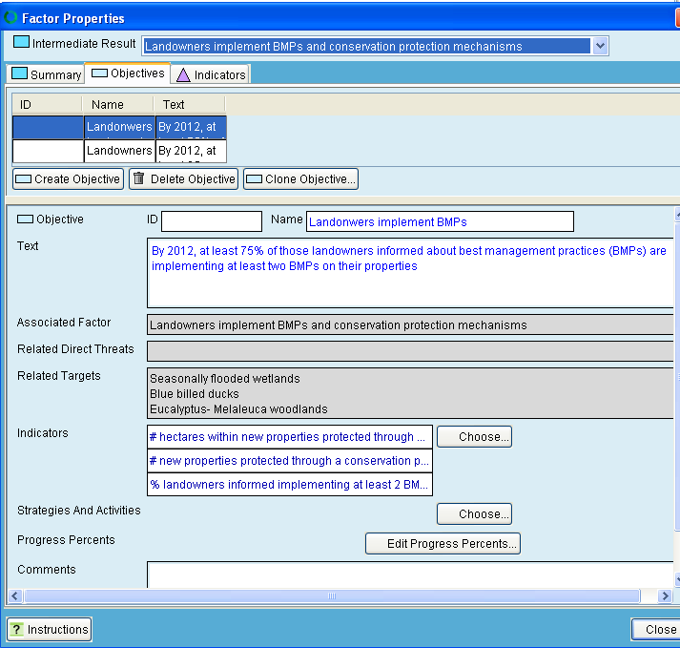
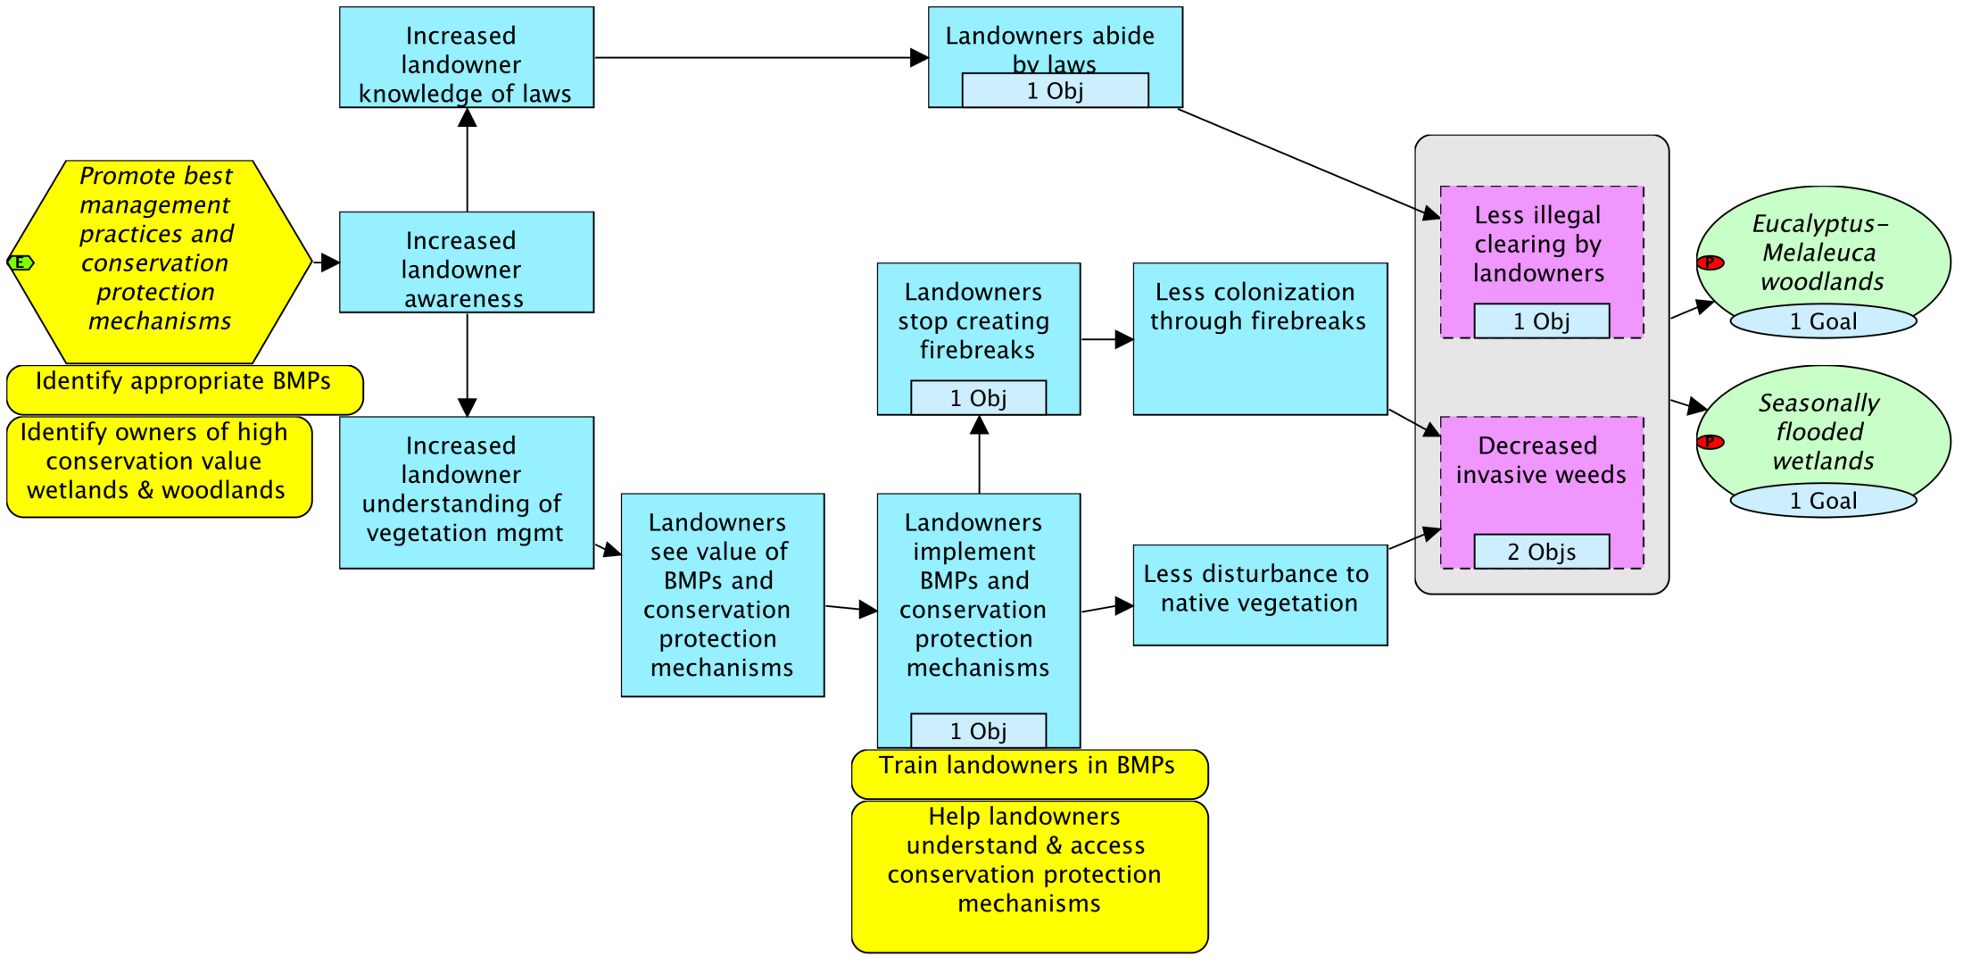
Objectives in Miradi
Notes:
Fishing objective

Slide 19
Which of the Following Comply with the Criteria for a Good Objective?
By 2010, no water concessions in identified critical grasslands and associated wetlands are granted.
Promote community wellbeing and health in the area surrounding the Indah Biosphere Reserve.
To establish a sustainable enterprise-based conservation and development project that meets the needs of local people while protecting biodiversity in the region surrounding Indah Biosphere Reserve.
By the end of the project, annual household income for all families participating in non-timber forest product harvesting enterprises has increased by at least 20%.

Slide 20
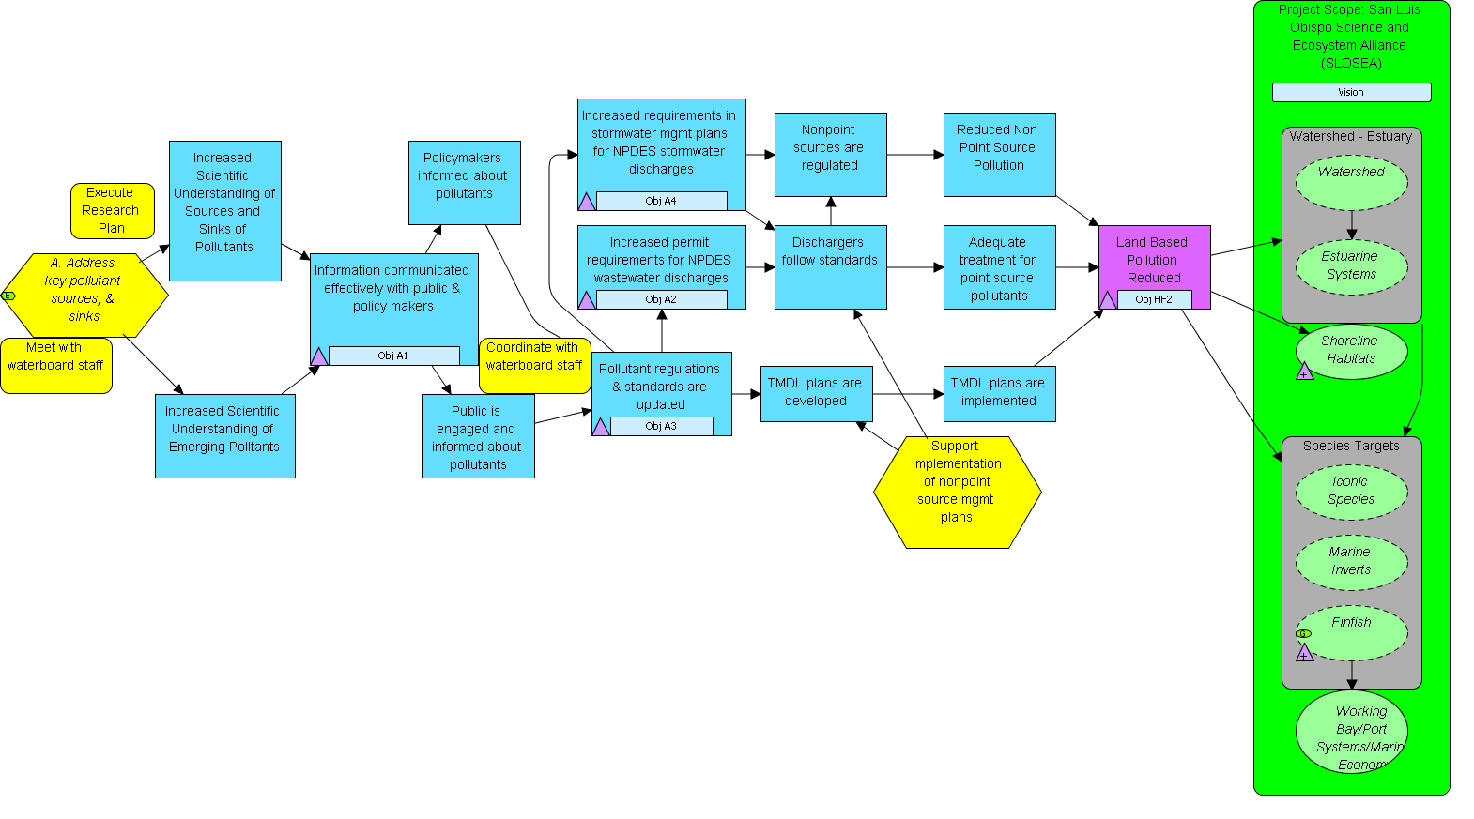
Real World Examples of Objectives & Activities
OBJ. A4: During next cycle, stormwater plans are updated to reflect findings from the pollutant monitoring strategy
OBJ. A1: At least once/year starting in 2008, SLOSEA provides a synthesis of pollutant data to public and policy makers
OBJ. A2: By 2011, permits for NPDES include limits for nonylphenol
OBJ. HF2: By 2012, at least 80% of samples over entire scope meet updated State and Federal water quality standards of nitrates, nonylphenols, and other potential pollutants
Adapted from SLOSEA 2008, Morro Bay, California
Notes:
A1 – much more output oriented

Slide 21
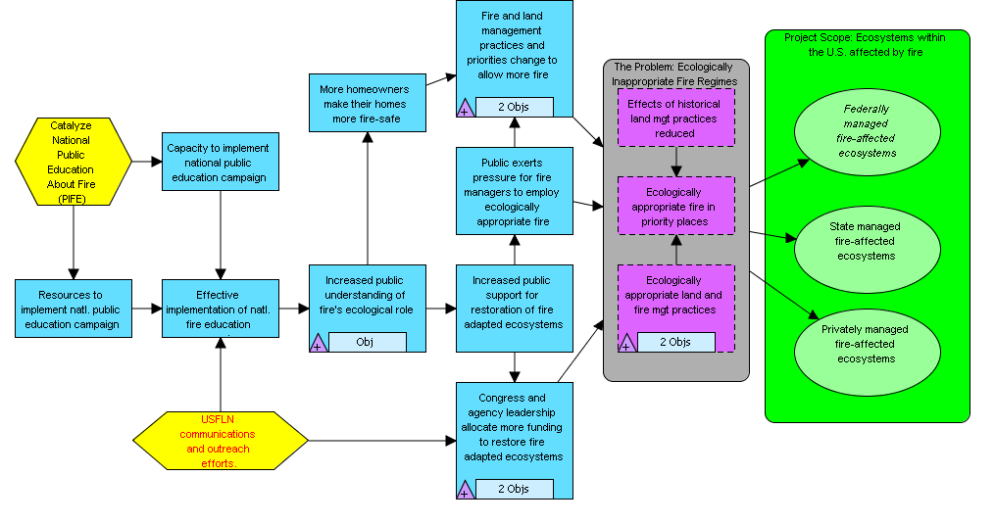
Real World Examples of Objectives & Activities
OBJ.: By 2012, 60% of American population understands the need for ecological fire management (including rxfire, thinning, letting natural fires burn)
OBJ.: By 2015 Congress and agency leadership allocate $705 million/year for restoration of fire-adapted ecosystems
OBJ.: By 2015, 2.78 million acres in WUI treated annually by federal agencies
Adapted from TNC Global Fire Initiative 2008, USA
Notes:
A1 – much more output oriented

Slide 22
This Presentation
What are objectives?
How to define objectives
What are indicators and methods?
How to develop a monitoring plan

Slide 23
This Presentation
What are objectives?
How to define objectives
How to determine if strategies (with results chains and objectives) are sufficient to achieve goals

Slide 24
Determining if Strategies are Sufficient to Achieve a Goal
Build a high-level results chain including:
  A target and its goal(s)
  All relevant threat reduction results
  Viability results (optional)
  All relevant strategies
  For each strategy, 1-2 major intermediate results
Analyze whether all strategies, with their associated major results / objectives, will be sufficient to achieve the goal

Slide 25
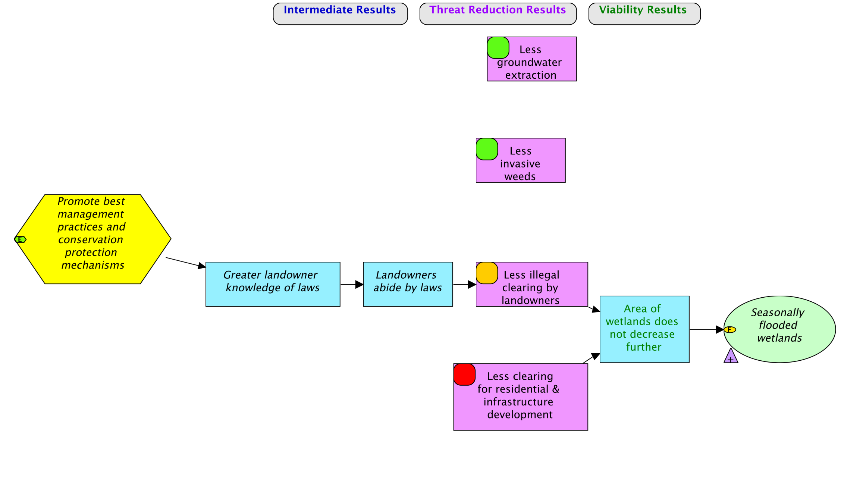
Determining if Strategies are Sufficient to Achieve a Goal
Goal: By 2025, at least 2,100 ha of high conservation value* wetlands on the Swan Coastal Plain maintain a “good” hydroperiod…
Viability results (optional) are included to clarify which strategies contribute to which aspects of viability

Slide 26
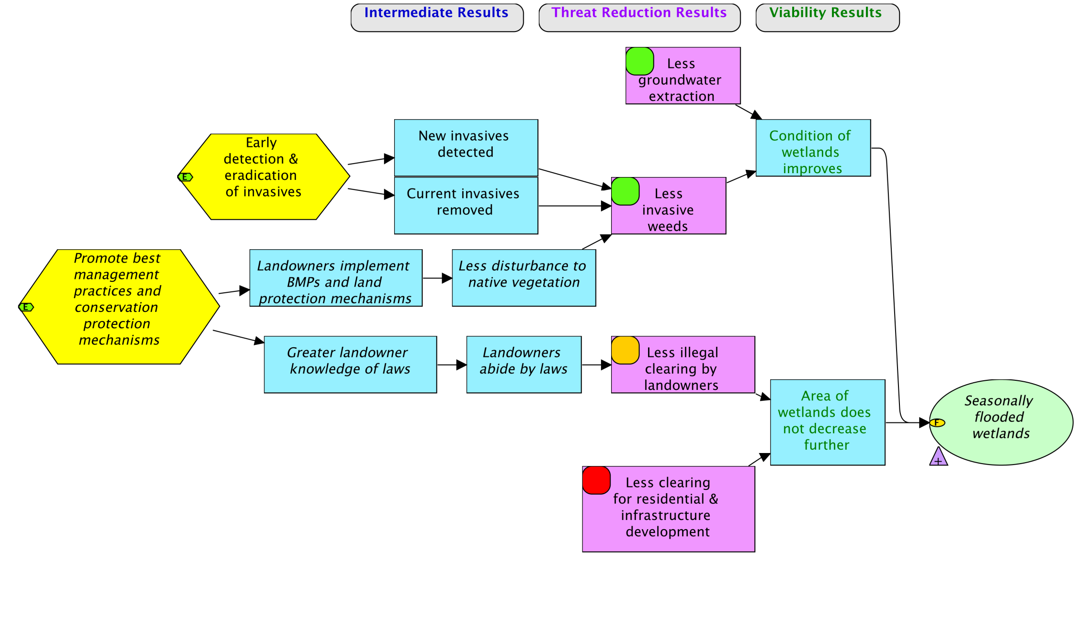
Determining if Strategies are Sufficient to Achieve a Goal

Slide 27
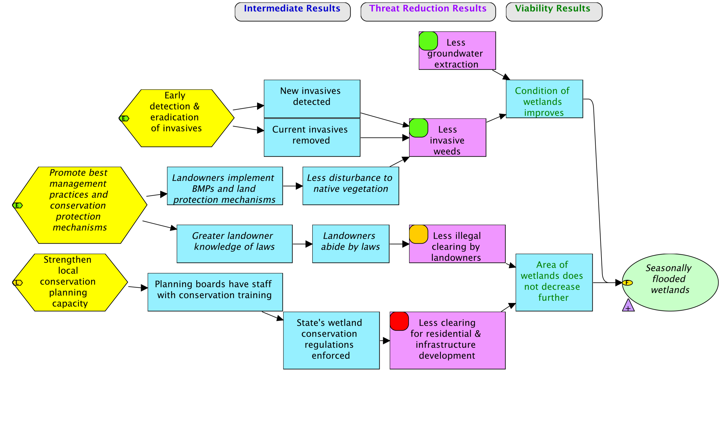
Determining if Strategies are Sufficient to Achieve a Goal

Slide 28
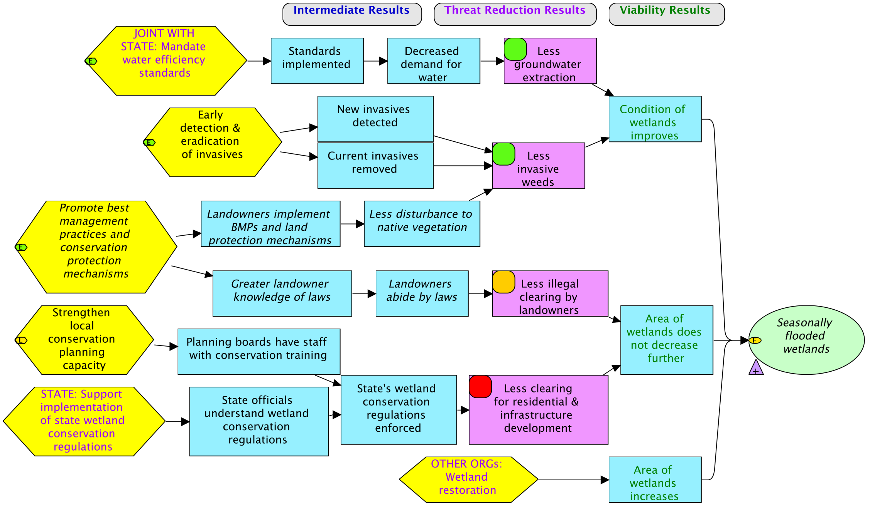
Determining if Strategies are Sufficient to Achieve a Goal
Sufficient?
Goal: By 2025, at least 2,100 ha of high conservation value* wetlands on the Swan Coastal Plain maintain a “good” hydroperiod…
Include strategies that other organizations are implementing

Slide 29
Key Points – Goals & Objectives
Conservation strategies are a group of actions designed to enhance viability of a target (GOAL) and/or abate a critical threat (OBJECTIVE).
Goals & Objectives – What you want to accomplish
Strategies – How you are going to get there
A threat reduction objective is not a goal.
Objectives should be specific, measurable, time-limited, and practical.
Be relatively sure that your strategies are really sufficient to achieve your objective/goal.

Slide 30
Develop Your Monitoring Plan
Key Steps
Identify your audiences
Develop one or more indicators for your objectives and goals; add others as needed
Select your monitoring approach
Select your methods and how you will collect the information
Determine when, by whom, and where data collection will happen

Slide 31
1. Identify Your Audiences:
For Whom Is the Monitoring
Internal Audiences
- Project team
- Community members
External Audiences
- Donors
- Project partners
- Ministry of Natural Resources

Slide 32
2. Develop Indicators
What Is Necessary…
Monitoring goals & objectives
I
I
I
I
I
I
I
I

Slide 33
2. Develop Indicators
What Is Ideal…
Monitoring key results, even if they don’t have an associated outcome
I
I
I
I
I
I
I
I
I

Slide 34
3. Develop One or More Indicators for Each Information Need
Indicator: A measurable entity related to a specific information need such as the status of a biodiversity focal interest, change in a pressure, or progress toward an outcome
A good indicator should meet the following criteria:
Measurable: Able to be recorded and analyzed in quantitative or qualitative terms.

Slide 35
3. Develop One or More Indicators for Each Information Need
Precise: Defined the same way by all people.
Consistent: Not changing over time so that it always provides comparable measurements.
Sensitive: Changing proportionately in response to actual changes in the condition or item being measured.

Slide 36
What Is Meant by “Sensitive”
Notes:
Proxy: A substitute for an indicator that cannot be directly measured or assessed

Slide 37
Develop Your Monitoring Plan: Indicators
Step 2B
Objective BMP2. By 2014, there are no more than 10 infractions issued annually against landowners in the Swan Coastal Plain for illegal clearing of vegetation
Indicator: # infractions issued annually against landowners in the Swan Coastal Plain for illegal clearing of vegetation
Objective BMP6. By 2018 & thereafter, no new invasive plant species are detected in the Eucalyptus-Melaleuca woodlands & seasonally flooded wetlands
Indicator: # of new invasive plant species recorded in the Eucalyptus-Melaleuca woodlands and seasonally flooded wetlands
Notes:
Points to make:
Obj A – measurable – all or nothing state
Obj C – could have 2 objectives – one related to new invasives coming in, one related to % of footprint of invasives
Team used a combination of %, all/nothing, and #s to make their objectives measureable

Slide 38
Develop Your Monitoring Plan: Indicators
Step 2B
% of landowners with positive attitudes toward BMPs and conservation protection mechanisms
Notes:
Points to make:
Obj A – measurable – all or nothing state
Obj C – could have 2 objectives – one related to new invasives coming in, one related to % of footprint of invasives
Team used a combination of %, all/nothing, and #s to make their objectives measureable

Slide 39
Examples of Indicators
Goal for Mangroves: By mid-2025, coverage (in hectares) of mangroves has increased by at least 15%, as compared to 2014 levels.
Indicator 1: # hectares of mangroves

Slide 40
Examples of Indicators
Goal for Blue-billed Ducks: By mid-2025, the presence (no. of locations documented) and abundance of blue-billed ducks dependent upon the Swan Coastal Plain return to at least 1995 levels.
Indicator 1: # of individual blue-billed ducks
Indicator 2: Distribution (GPS locations) of blue-billed duck occurrences

Slide 41
Example of Status Indicators
Biodiversity Focal Interest: Lakes
KA: Water quality
Goal: Beginning in 2015, water quality in the lakes remains stable or improves.
Indicators:
  Dissolved oxygen (mg/L)
  Nitrates (mg/L) and Phosphates (mg/L)
  Transparency (depth of light penetration)
Note: These are status indicators because the project team is not taking action to improve water quality. If they were, these would be effectiveness indicators.

Slide 42
Develop Your Monitoring Plan
Key Steps
Identify your audiences
Develop one or more indicators for your objectives and goals; add others as needed
Select your monitoring approach
Select your methods and how you will collect the information
Determine when, by whom, and where data collection will happen

Slide 43
Types of Monitoring Approaches
Basic Monitoring Approaches:
1. Comparison of the unit affected by the project with itself over time.
  “Pre-test / Post-test”
  “Time Series”

Slide 44
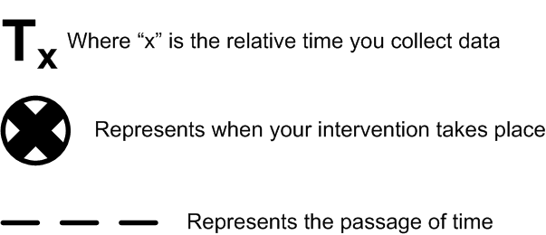

Types of Monitoring Approaches
Pre-test Post-test:

Slide 45

Types of Monitoring Approaches
Time Series:

Slide 46
Types of Monitoring Approaches
Basic Monitoring Approaches:
1. Comparison of the unit affected by the project with itself over time.
  “Pre-test / Post-test”
  “Time Series”
Comparison of the unit affected by the project with another not affected by the project
  Monitoring with “Strict Control Group” (experimental design).
  Monitoring with “Comparison Groups”
Notes:
USAID Impact Evaluations require comparison or control group in most cases.

Slide 47

Types of Monitoring Approaches
Strict Control Group:
Group affected by your project
Group NOT affected by your project
Notes:
Experimental design with randomly selected sites – may not be ethical or feasible.

Slide 48
Types of Monitoring Approaches
Comparison Group:
Group affected by your project
Group NOT affected by your project
Notes:
Sites do not need to be randomly selected using comparison group approach (quasi-experimental design)

Slide 49
Types of Monitoring Approaches
Basic Monitoring Approaches:
1. Comparison of the unit affected by the project with itself over time.
  “Pre-test / Post-test”
  “Time Series”
Comparison of the unit affected by the project with another not affected by the project
  Monitoring with “Strict Control Group” (experimental design).
  Monitoring with “Comparison Groups”

Slide 50
Develop Your Monitoring Plan
Key Steps
Identify your audiences
Develop one or more indicators for your objectives and goals; add others as needed
Select your monitoring approach
Select your methods and how you will collect the information
Determine when, by whom, and where data collection will happen
Notes:
50

Slide 51
Selection of Appropriate Method
Method: A specific technique used to collect data to measure an indicator.
The selection of the most appropriate monitoring method depends on:
The information you need
The information you have
The skills of the project team
Availability of time, money and other resources

Slide 52
Types of Monitoring Methods
To obtain quantitative data
  Tracking project records
  Formal survey
To obtain qualitative data:
  Key informant interview
  Focus group discussion
  Matrix ranking
  Direct observation
  Mapping

Slide 53
5. Select your methods and how you will collect the information
A good method should meet the following criteria:
Accurate: Gives minimal or no error
Reliable: Results obtained using the method are consistently repeatable
Cost-effective: Not overly expensive for the data the method yields or for the resources the project has
Feasible: Project team has people who can use the method, as well as the material and financial resources to use the method
Appropriate: Appropriate to the environmental, cultural, and political context of the project
Notes:
53
METHODS CRITERIA HAVE BEEN MODIFIED BY NICK AND CAROLINE – TAKING INTO ACCOUNT OLD PPT DEFINITIONS AND NEW DEFINITIONS UNDER WWF STANDARDS AND GUIDELINES

Slide 54
Examples of Monitoring Methods
Method: track law enforcement records
Indicator: # infractions issued annually against landowners in the Swan Coastal Plain for illegal clearing of vegetation
% of landowners with positive attitudes toward BMPs and conservation protection mechanisms
Method: key informant interviews or focus group
Indicator: # of new invasive plant species recorded in the Eucalyptus-Melaleuca woodlands and seasonally flooded wetlands
Method: conduct vegetation surveys

Slide 55
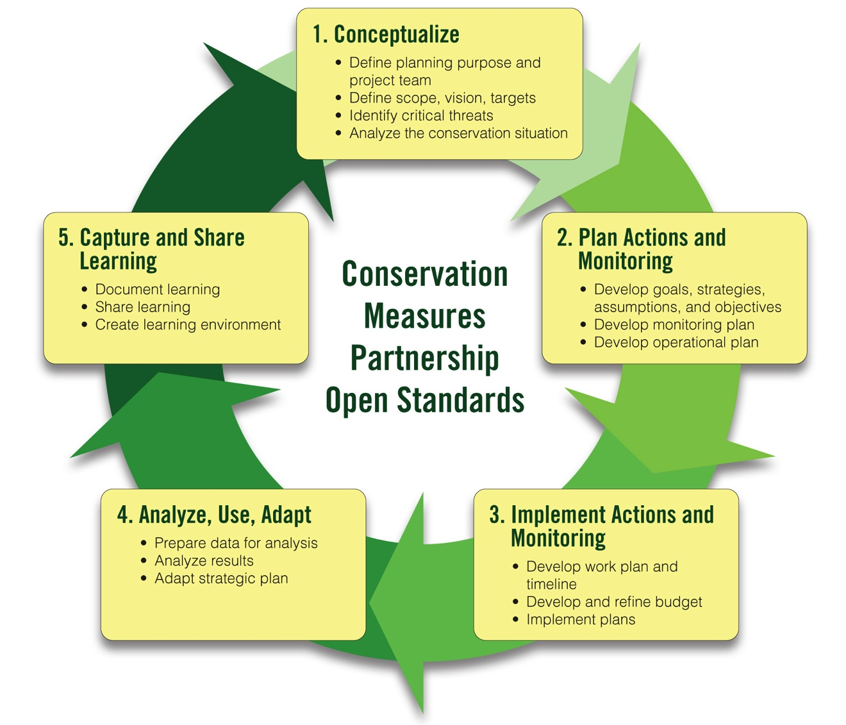
Adaptive Management Workshop Presentations
1A-1B. Team, Scope, Vision
1B. Conservation Targets
1B. Viability Assessment and Goals
1C. Threat Rating
1d. Conceptual Models
2A-1. Strategy Selection
2A-2. Results Chains
2A-3. Objectives
2B. Monitoring Plan

Slide 56
Instructions
Using your results chain, identify key results and develop at least one objective for an intermediate result (blue box) and one objective for a direct threat reduction result (purple box)
For each objective, identify one or more indicators
For each indicator, identify the relevant method
Be sure to make sure your objectives, indicators, and methods meet the relevant criteria

Slide 57
Instructions – Objectives
Develop an objective for the direct threat in your results chain. Apply your criteria cards and revise.
Develop objectives for at least two other key results in your results chain. Apply your criteria cards and revise.

