Slide 1
2A. Goals

Slide 2
Copyright and Use Terms
© Foundations of Success, 2013
FOS strongly recommends that this presentation is given by experts familiar with the adaptive management process presented by the Conservation Measures Partnership’s Open Standards for the Practice of Conservation.
This work is licensed under the Creative Commons Attribution-Noncommercial-Share Alike 3.0 License.
To view a copy of this license, visit http://creativecommons.org/licenses/by-nc-sa/3.0/ or send a letter to Creative Commons, 171 Second Street, Suite 300, San Francisco, CA 94105, USA.
Under this license, you are free to share this presentation and adapt it for your use under the following conditions:
You must attribute the work in the manner specified by the author or licensor (but not in any way that suggests that they endorse you or your use of the work).
You may not use this work for commercial purposes.
If you alter, transform, or build upon this work, you must remove the FOS logo, and you may distribute the resulting work only under the same or similar license to this one.

Slide 3
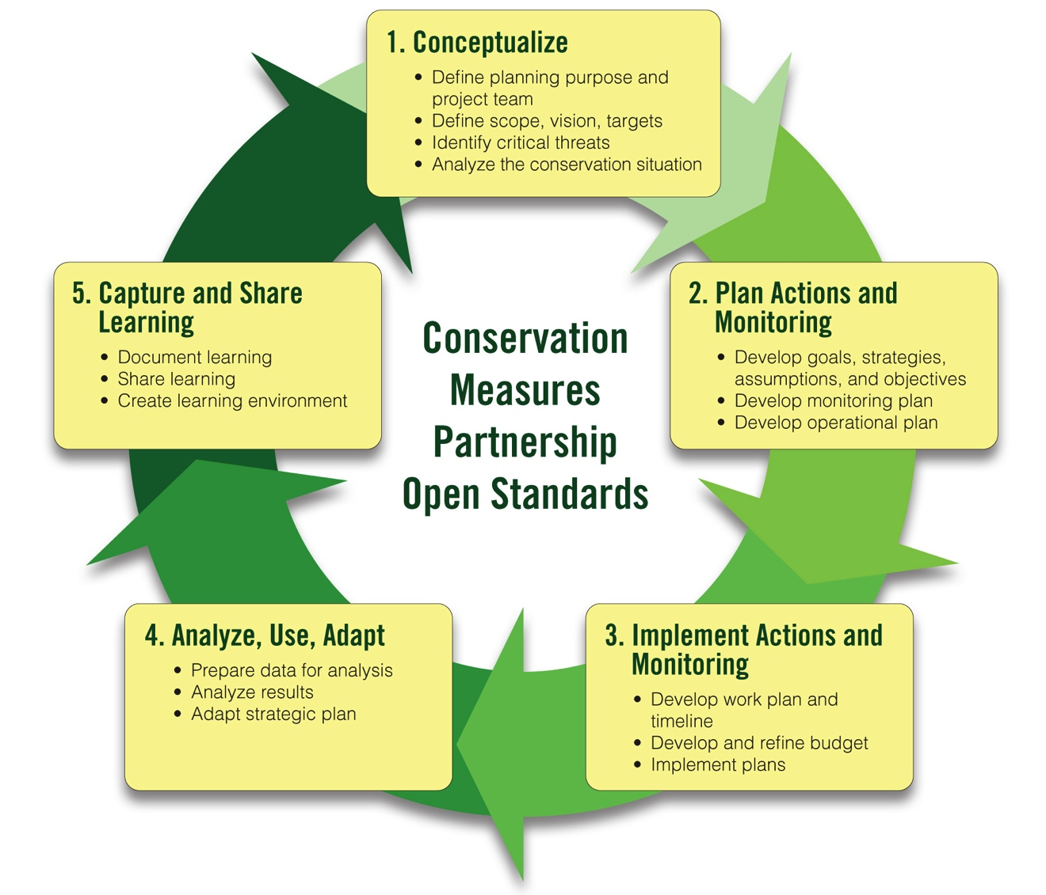
CMP Open Standards

Slide 4
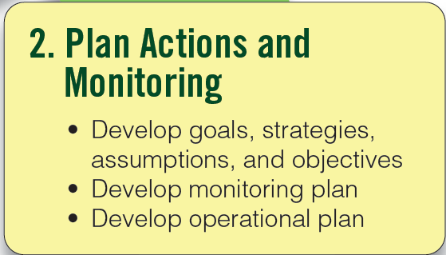
Plan Your Actions & Monitoring
Step 2
Notes:
4

Slide 5
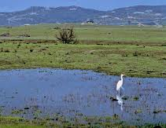
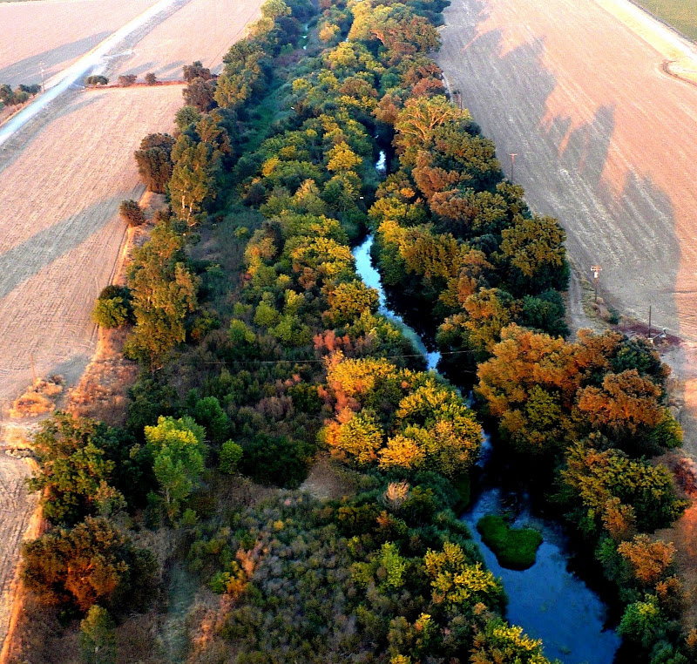
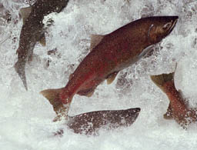
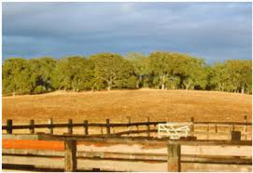
Our Example – Sacramento River Basin
Notes:
Throughout our presentations, we use example outputs from the Wetland Watch project from WWF Australia that we have modified slightly to reflect the structure and products of the CMP Open Standards. The intent is to give a real-world example of how the Standards have been applied.

Slide 6
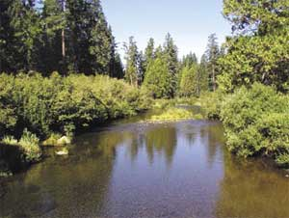
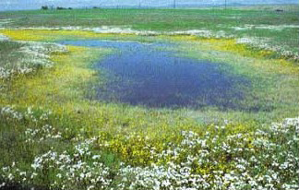
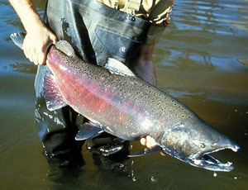
Conceptualize: Define Conservation Targets
Step 1B
Rivers and streams
Riparian habitat
Salmon
Vernal pool grasslands
Oak woodlands
Notes:
This region supports significant breeding numbers of the near threatened Blue-billed Duck.

Slide 7
Develop Your Goals
Goal: A formal statement detailing a desired impact of a project, such as the desired future status of a target.
Notes:
7

Slide 8
Develop Your Goals
A Good Goal Meets the Criteria:
Linked to targets: Directly associated with one or more of your conservation targets.
Should be phrased in terms of the Key Ecological Attribute(s) of the target that you are trying to conserve
Size – Geographic extent (ecosystem or habitat); Abundance &/or demographics of the population/community (species)
Condition – Composition, structure, & biotic interactions
Landscape Context – Landscape-scale ecological processes, adjacency and connectivity
Notes:
8

Slide 9
Develop Your Goals
Impact oriented: Represents the desired future status of the conservation target over the long-term.
A preview of Results Chains:
Notes:
9

Slide 10
Develop Your Goals
Time Limited: Achievable within a specific period of time, generally 10 or more years.
Measurable: Definable in relation to some standard scale (numbers, percentage, fractions, or all/nothing states).
Specific: Clearly defined so that all people involved in the project have the same understanding of what the terms in the goal mean.
Notes:
10

Slide 11
How to Develop a Goal
Choose a conservation target
Select key ecological attributes of the target to represent in the goal
Write a draft description of the future desired condition of the target
Apply criteria
Modify the goal as needed

Slide 12
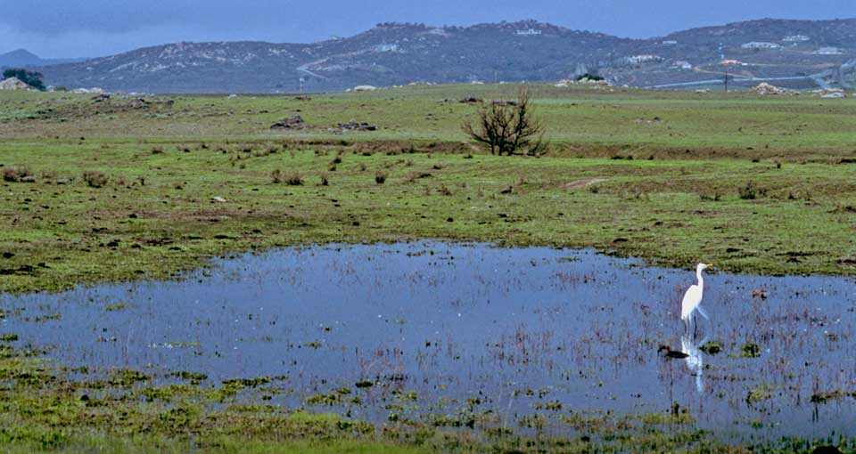
1. Choose a Conservation Target
Vernal pool grasslands
Source: www.conserveca.org
Notes:
Mention:
Opportunities
Showing uncertainty in relationships (with a ?)

Slide 13
2. Select Key Ecological Attributes of the Target to Represent in the Goal
From the Viability Assessment…
 |  |  |  | Indicator Ratings
Target | Category | KEA | Indicator | Poor | Fair | Good | Very Good
Vernal pool grasslands | Size | Size of vernal pool complex | # of acres of ecol. viable vernal pool complexes | < 10,000 | 10,000 – 19,999 | 20,000 – 30,000 | > 30,000
Current Status |  |  |  |  | 15,000
Desired Future Status |  |  |  |  |  | 25,000
Notes:
Mention:
Opportunities
Showing uncertainty in relationships (with a ?)

Slide 14
2. Select Key Ecological Attributes of the Target to Represent in the Goal
Target: Vernal pool grasslands
Key Ecological Attributes:
Size of vernal pool complexes
Connectivity of vernal pool complexes
Species composition
Notes:
Mention:
Opportunities
Showing uncertainty in relationships (with a ?)

Slide 15
3. Write a Draft Goal
Target: Vernal pool grasslands
Key Ecological Attributes:
Size of vernal pool complexes
Connectivity of vernal pool complexes
Species composition
Draft Goal: By 2025, the size, connectivity and species composition of vernal pools are restored to historic levels.
Notes:
Mention:
Opportunities
Showing uncertainty in relationships (with a ?)

Slide 16
4. Appy Criteria
Target: Vernal pool grasslands
Key Ecological Attributes:
Size
Connectivity
Species composition
Draft Goal: By 2025, the size, connectivity and species composition of vernal pools are restored to historic levels.
Criteria:
Linked to target?
Impact-oriented?
Time-bound?
Specific?
Measurable?
Modified Goal: By 2025, there will be at least 30,000 acres of ecologically viable vernal pool grasslands.
Notes:
Mention:
Opportunities
Showing uncertainty in relationships (with a ?)

Slide 17
5. Modify the Goal as Needed
Target: Vernal pool grasslands
Key Ecological Attributes:
Size
Connectivity
Species composition
Draft Goal: By 2025, there will be at least 30,000 acres of ecologically viable vernal pool grasslands.
Criteria:
Linked to target?
Impact-oriented?
Time-bound?
Specific?
Measurable?
Modified Goal: By 2025, there will be at least 30,000 acres of vernal pool grasslands with >90% native species cover and >50% connectivity.
Notes:
Alternative wording. Either wording is fine – a matter of preference.

Slide 18
Example Goal
Step 2A
By 2025, there will be at least 30,000 acres of vernal pool grasslands with >90% native species cover and >50% connectivity.

Slide 19
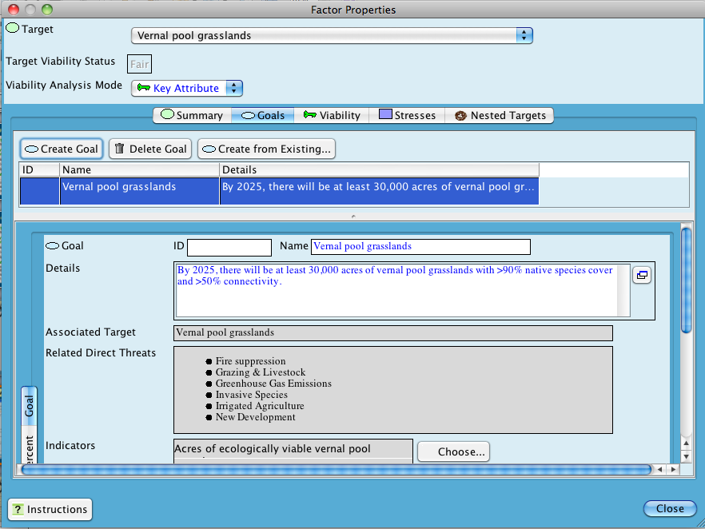
Goals in Miradi
Step 2A

Slide 20
Careful…A Goal is NOT a Threat Reduction Objective
Conservation target: Riparian habitat
Goal: By June 2025, there is a buffer of at least 50 feet of riparian habitat along at least 50 miles of the Sacramento River and its tributaries.
Threat to target: New development
Threat reduction objective: Beginning in 2015, there is no further development in high priority riparian habitat along the Sacramento River.

Slide 21
Example of a Goal
Step 2A
Goal 2: By June 2020, 300 new private properties encompassing 150 ha of high conservation value* wetlands on the Swan Coastal Plain reliably support key ecological processes** and contain viable populations of key native flora and fauna, as listed by the Department of Environment and Conservation.
* High conservation value wetlands = wetlands assigned ‘Conservation’ management category by the Department of Environment and Conservation, Western Australia.
** Ecological processes include groundwater recharge and hydroperiod (see viability assessment)

Slide 22
Example Goal
Target: Coral Reefs
Goal: By 2025, at least 80% of the coral reef habitat in the northern bioregion will have live coral coverage of at least 20% and will contain healthy populations of key species*
* Healthy populations of species at the top of the food chain, such as sharks, and an abundance of other key species, such as parrot fish and spiny lobster. Whether a population is “healthy” will be based on the latest scientific understanding. See viability assessment for population numbers for different species.

Slide 23
Example Goal
Target: Montane forest (in Eastern Arcs)
Goal: By 2017, 100% of remaining montane forest* is effectively conserved** and connectivity among major forest patches*** is created.
* Based on baseline data from 1999 -2003 (total is around 2,000,529 ha)
** Effectively conserved = Intact tree canopy with full set of species including representative endemic species
*** Ulugurus (Bunduki, Kitumbaku Hills), East Usambaras (Derema, Nilo-Kambai/Segoma), Udzungwa (Scarp to Matundu/Iyonde)

Slide 24
Which of the Following Comply with the Criteria for a Good Goal?
In 10 years, eliminate mangrove harvesting in all of Ban Don Bay, Thailand.
By 2022, more than 80 pairs of quetzales will successfully nest and reproduce each year in the Sierra de las Minas Biosphere Reserve.
Within 12 years of the start of the project, Katani Nature Preserve will serve as an effective ecological corridor for tigers traveling between Karimara and Sulaken National Parks.
By 2015, the population of Golden Lion Tamarins has increased.

Slide 25
CMP Strategic Planning Process
Team, Scope, Vision
Conservation Targets
Viability Assessment
Goals
Determining Strategies
Results Chains
Objectives and Activities
Threat Rating
Conceptual Model
Monitoring Plan

Slide 26
Instructions
For your conservation target, develop a goal.
Ensure that the goal meets all of the criteria.
Transfer the results to Miradi.

Slide 27
Questions that Coaches Should Ask: Goals
Does the team have a well-articulated concept of success for their project, expressed in specific, measurable, time-bound goals?
Are the goals ambitious but achievable?
Do these goals really provide direction for the project’s actions?
NOTE: These questions also apply to threat reduction objectives, which are defined after developing results chains.

