Slide 1
Dream and Area
Notes:
*Note: This presentation can be shortened by focussing on the following pages: 6, 7, 8, 11, 14

Slide 2
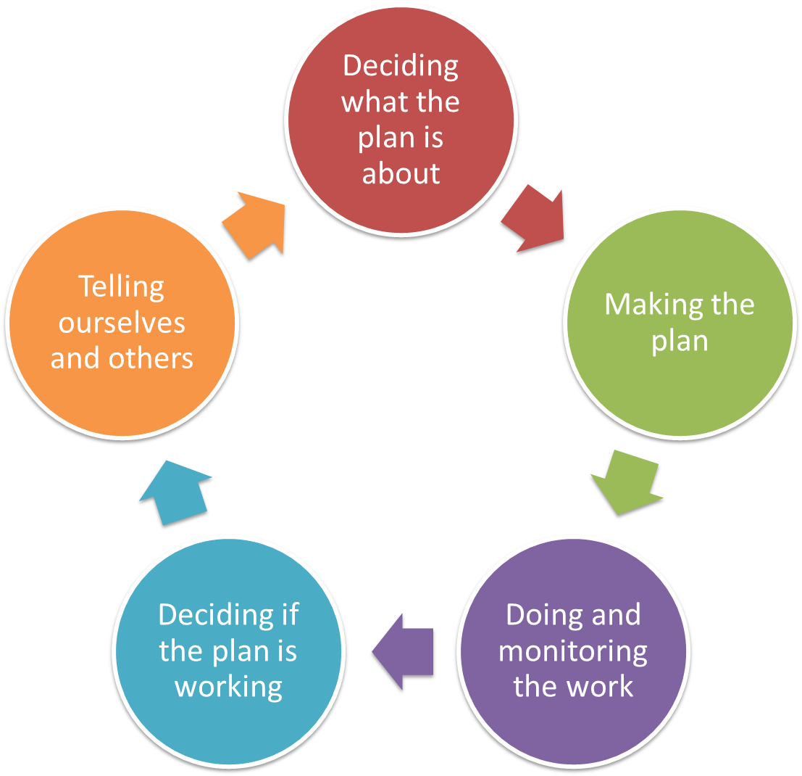
Deciding what the Plan is all about
Dream and Area
Overview
Pre-planning
Dream & Area
Targets & Health
Problems & Causes
Situation Analysis
In the Conservation Standards “Dream & Area” refers to “Vision & Scope”
Notes:
Dream and Area are referred to as Vision and Scope in the Conservation Standards. This is the first actual workshop step in developing the plan.

Slide 3
Deciding what the Plan is all about
Dream
Overview presentation
What makes a good dream (vision statement)
What is the area (scope) of my project
Resources & Exercise
Notes:
This presentation covers three main topics: It explores what makes a good dream (or vision statement). In the next step we discuss the area (or scope) of the project. At the end we look at some additional resources and the workshop exercise.

Slide 4
Deciding what the Plan is all about
Dream
Make a statement about success
Why do this step?
  This is the first step in pointing the plan in the right direction – you need to be clear about what you want the future to look like if you are successful in making the plan work
  It is also helpful to be clear about what you are not going to be working on for other stakeholders
Notes:
The discussion around the Dream and Area of the plan, are the first workshop discussions that point the plan in the right direction.
In order to find a shared vision to which a community subscribes to in the future, it is most appropriate to include as many community members as possible or at least a good representation of all factions of a community.

Slide 5
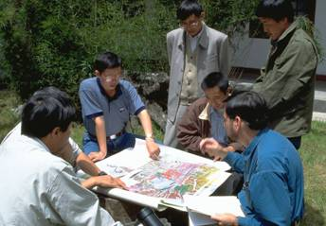
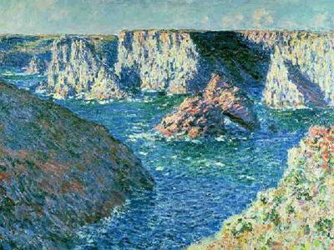
Deciding what the Plan is all about
Dream
Make a statement about success
A vision is like a lighthouse, which illuminates rather than limits, giving direction rather than destination."
-- James J. Mapes
The goal is not to find the majority opinion, but to arrive at a vision that reflects the thinking of the whole group.
Notes:
As described earlier – developing a vision statement is a process of bringing the community together – different groups in a community have sometimes different priorities;
think about the groups in your community that you want to include in this step:
elders & youth;
male & female;
important for this step is that everyone can find themselves embedded in the vision so that the community embarks together on a journey.

Slide 6
Deciding what the Plan is all about
Dream
Make a statement about success
Dream:
A description of the desired state or ultimate condition that a project is working to achieve
A good Dream will balance the following criteria:
  Relatively general:
  Broadly defined to encompass all project activities
  Visionary:
  Inspirational in outlining the desired change in the state of the targets toward which the project is working
  Brief:
  Simple and succinct so that all project participants can remember it
Notes:
When attempting to explain the desired status or ultimate condition of a project, it helped when participants were advised to imagine the state of a project (e.g. country) at the time when one generation hands it over to the next generation, to take control of the future.
At other occasions it helped to approach this step by advising the audience to think about a newspaper frontpage 10 years in the future. What outcomes could the project report on, if all the work was successful?
Consider the 3 criteria: Relatively general, visionary and brief to create a succinct message for a community.

Slide 7
Deciding what the Plan is all about
Dream
Workshop Tools and Tips
Discuss success and change as a group/groups
    Pretend the plan has been operating for 10 years – what has changed?
    It can help to ask people to think back to what things used to be like – even generations ago
Bring groups back together and report back
    Arrange similar ideas together and then make a single statement that covers each idea
      Use voting / colours / or cards and arrange
      Combine similar ideas into one thought
Get one of the team to take these ideas and build a statement
    For rapid approach, can just use small group & review existing material
Notes:
There are different approaches and tools for the development of a dream / vision statement:
Sometimes it helps to split the workshop into groups to have discussions in smaller groups, and later report back and develop a vision that incorporates the discussions in the groups; in other cases communities prefer to undertake this step as one group – what may take longer and with a higher risk that voices may get lost; but the approach has to suit the community not the facilitator;
It is advisable that the final word-smithing of a vision statement is undertaken after the workshop – and then reviewed by workshop participants in a more final format;

Slide 8
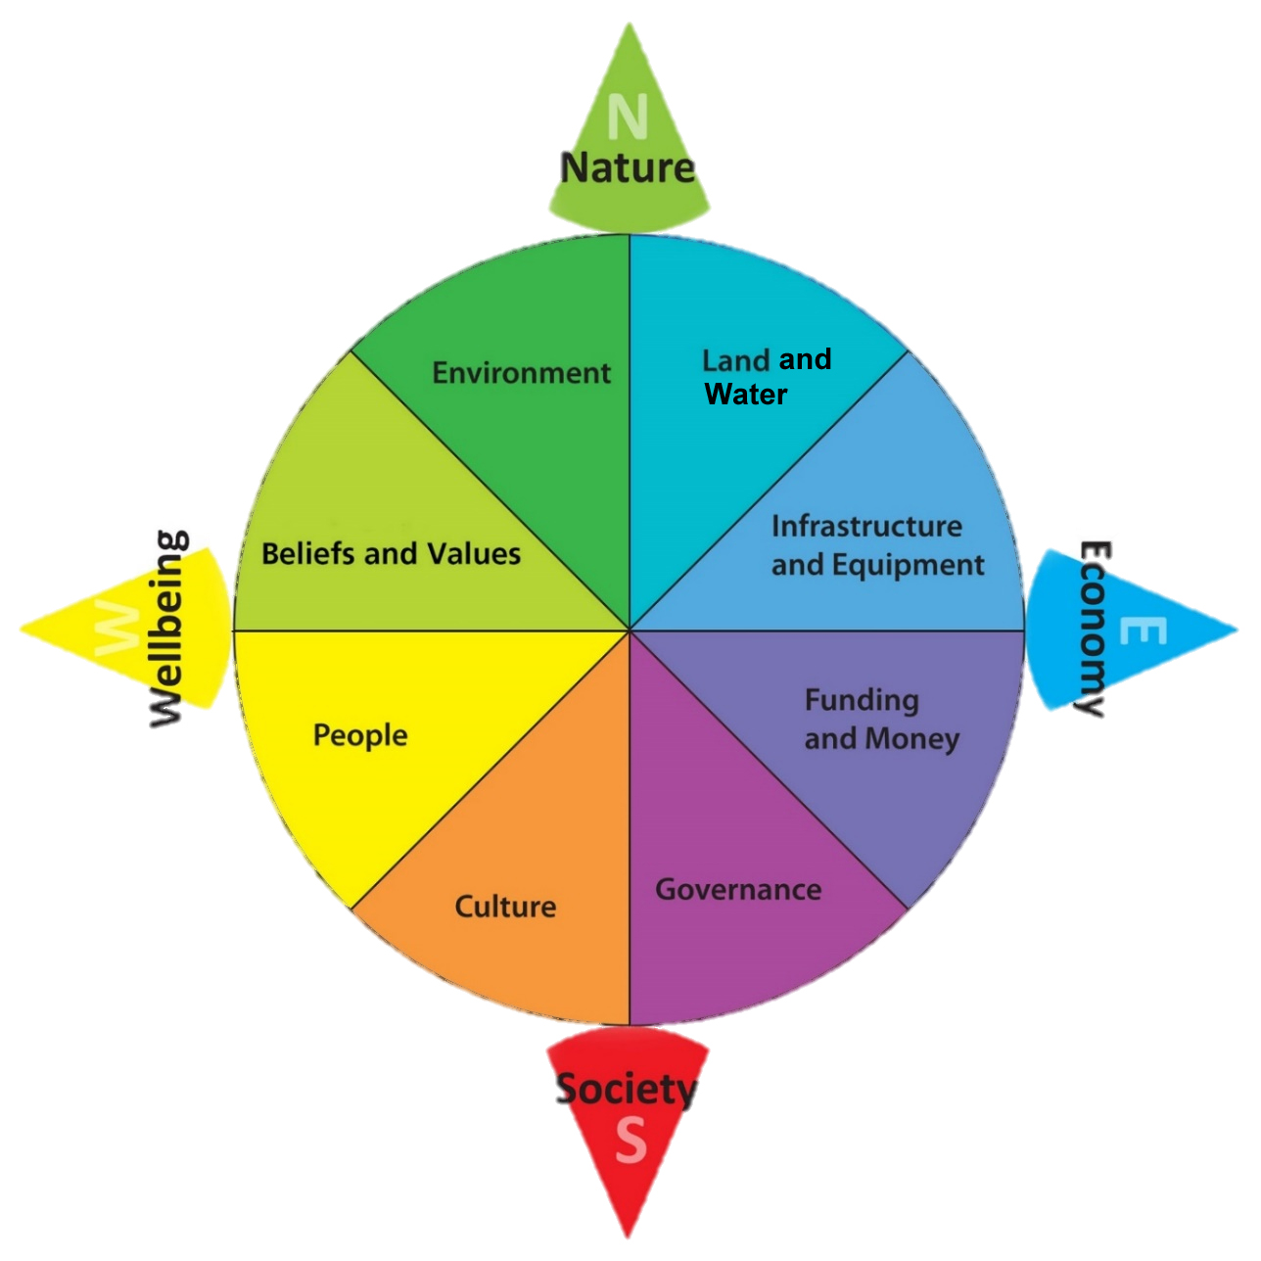
Deciding what the Plan is all about
Dream
Workshop Tools and Tips
Notes:
A well-received workshop tool is the compass – adapted by Andre Grant (Centre of appropriate Technologies).
The four cardinal directions Nature, Economy, Society and Wellbeing cover main topics, with a second level of detail in the second tier.
Interchangeably Sustainable Development Goals can be used to guide the conversation and ensure relevant elements are adopted into the vision statement.

Slide 9
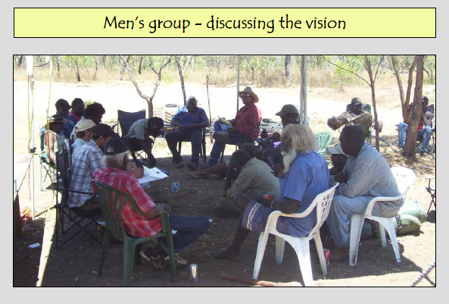
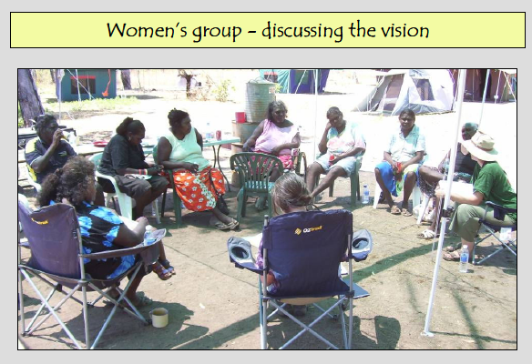
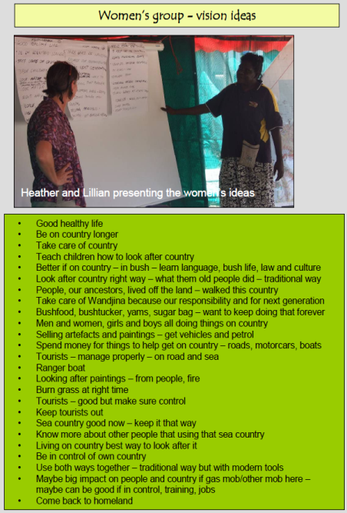
Deciding what the Plan is all about
Dream
Examples – considering cultural sensitivities
Notes:
In the specific case of Wunambal and Gaambera Traditional Owners the group decided to split into a men’s group and a women’s group, with both groups reporting back to each other after discussions.
When working in an Indigenous cross-cultural context it sometimes becomes important to ensure that there is a access to a co-facilitator of the opposite gender, or that training of some workshop participants from the community is incorporated in the design of the consultation project.

Slide 10
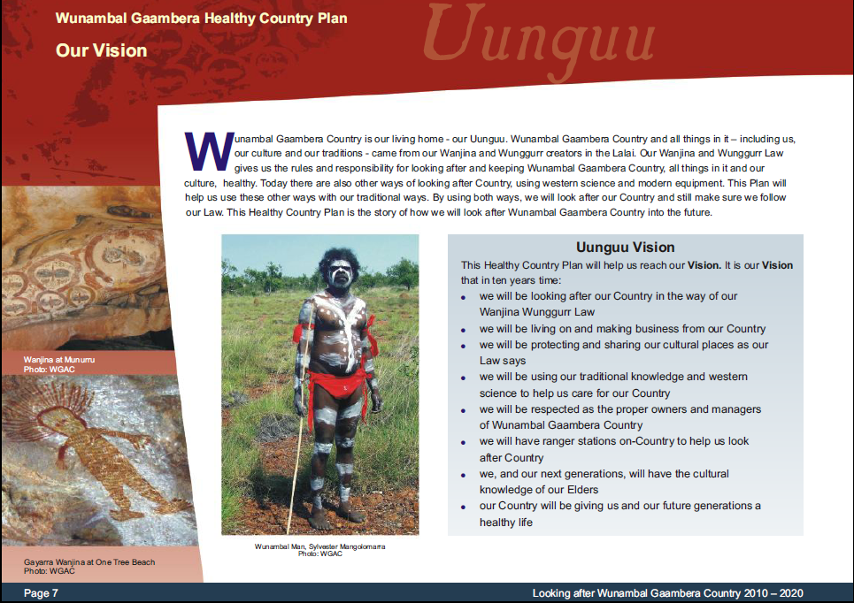
Deciding what the Plan is all about
Vision/Dream
Example – Final vision Wunambal Gaambera
Notes:
After the workshop a draft vision statement was formulated by the writer of the plan and reviewed and amended at subsequent planning meetings when the project was reporting back.
What do you think of the vision for the Wunambal Gaambera Healthy Country Plan? Do you think all important components are covered? Do you think some are missing or surprising from your experience?

Slide 11
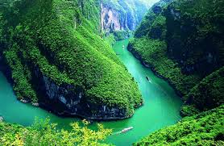
Deciding what the Plan is all about
Vision/Dream
Example – Yantze Basin
"A region where a living river links the Tibetan Plateau and the Pacific; where people thrive in harmony with nature, pandas play in the forests, children swim with dolphins and fish in the clear water, pheasants dance among the rhododendrons, and the cranes sing at sunrise. A region where natural cycles sustain a rich and ancient culture."
Notes:
This is an example from China – the vision for the Yantze Basin Plan. This is an example for a very well-crafted vision statement, that creates a very poetic and visual image of how the future of the Yantze Basin should look like.

Slide 12
Deciding what the Plan is all about
Dream / Area
This Presentation
What makes a good vision statement
What is the scope of my project
Resources to support the step
Notes:
Now that we looked at how to develop a vision statement, we now learn more about the scope of conservation projects.

Slide 13
Deciding what the Plan is all about
Area
Work out the Boundary of your Plan
Why do this step?
  Define the boundaries of your project and what you want to do
  Helpful to be clear about where you are not going to be working – particularly when talking to neighbouring land holders, or other stakeholders.
Notes:
The boundary of a plan can develop over time, and future steps may require revisiting the area for a project.
The project area delineates where we are working, but as importantly where we are not working (and sometimes gives us a hint of whom we may have to engage with as “project neighbours” and other stakeholders).

Slide 14
Deciding what the Plan is all about
Area
Work out the Boundary of your Plan
Projects occur at many scales and with many themes
  Property (e.g. a land parcel / indigenous land)
  Region (e.g. drainage area of a )
  Species (e.g. Cassowary)
  Target (e.g. cultural landscape)
Map spatial area of Project
  Map values to manage
  Where, what, how important
Notes:
The project area comes at many scales and in many shapes: some are property specific – e.g. land that is managed by an Indigenous Group; other scopes can be more regional and include the entire watershed of an area.
But scope can be as well target-specific – the habitats a certain animal requires in a life-cycle or a cultural landscape;

Slide 15
Deciding what the Plan is all about
Area
Work out the Boundary of your Plan
SINGLE AREA
Priority Areas
MULTIPLE AREA
Things that are in a lot of places over a large area
Wide-Ranging Species
Partnerships
Notes:
Sometimes the important things a project is trying to manage are located in a confined area – a single area scope recommends itself. If the important things are spread over a larger region, a multi area scope may be more useful where a project may work e.g. with other partners.
This for example often applies for plans written for a species that migrates in the course of its life.

Slide 16
Deciding what the Plan is all about
Area
Workshop Tools and Tips
Define the boundaries of your project and what you want to do
Community mapping
  Spending time on country makes mapping easier; knowledge about location of values;
  Various methods: topographic maps, mud maps, remote sensing, GIS;
Background reports
  Can also be useful to have a review of other knowledge about country i.e. non-Indigenous science perspective
Notes:
To work out the boundary of a project, maps are a helpful tool – from the most rudimentary maps sketched in the workshop, where certain targets occur, all the way to using sophisticated maps developed specifically for the project.
Even out in the field, a map roughly sketched in the sand, while using what implements there are available, can help developing a good understanding of the scope for a project and inform discussion around targets in the next step.

Slide 17
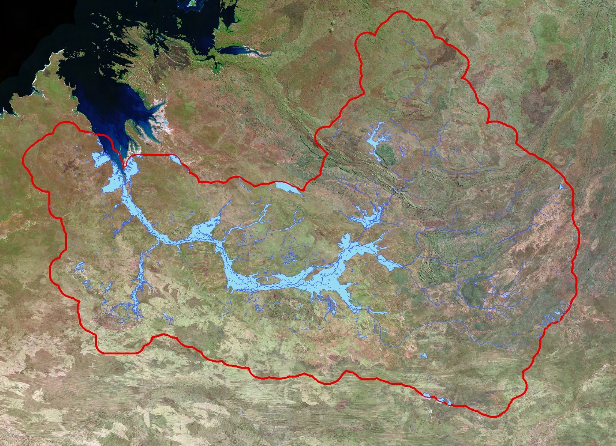
Deciding what the Plan is about
Area
Example Case Study
Area: A river and its watershed
Notes:
In this example the project team decided that the main area is the watershed of a river. The river itself has high conservation values in a otherwise arid landscape - because of its natural and cultural importance.
Many rare and endangered terrestrial and aquatic species use the river and its river banks for their habitat and generations of indigenous people used the water course to sustain themselves in the landscape, creating a detailed mosaic of cultural sites along the course of the river.

Slide 18
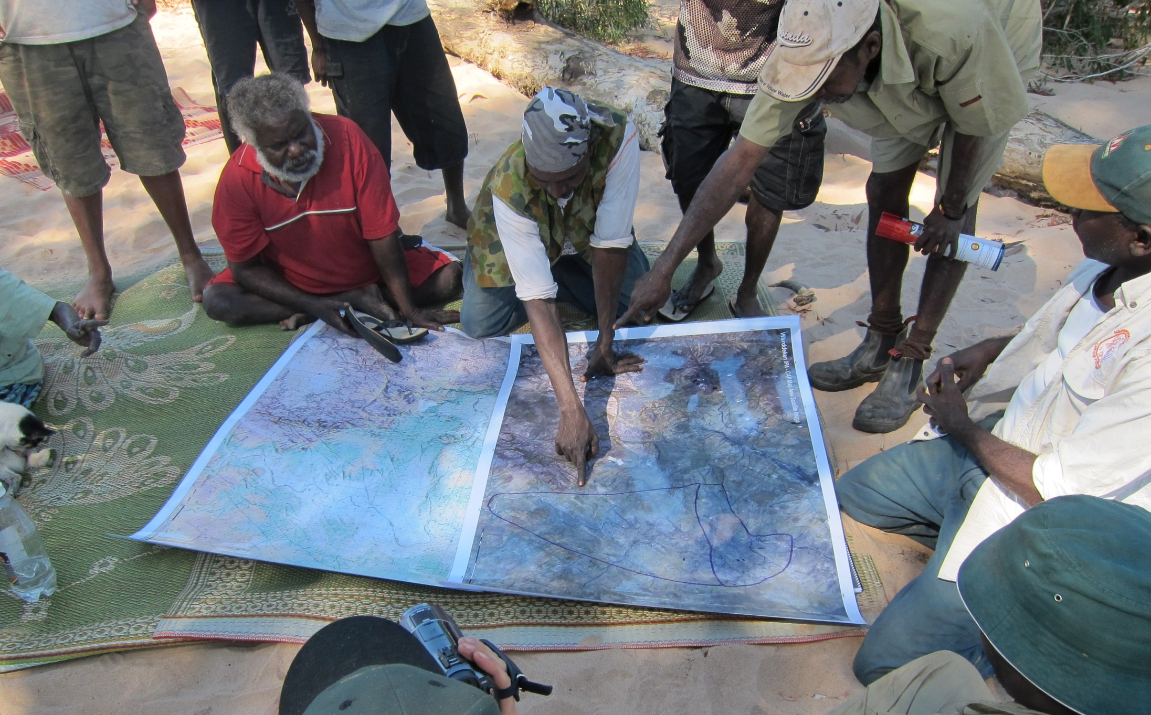
Deciding what the Plan is all about
Area
Example – community mapping
Notes:
Every community has experts for specific areas – during community mapping those people can share their knowledge to help identify the project scope.
When using printed paper maps it helps to have laminated copies on which community members can draw with white-board markers and amend the scope adequately once we look at the occurrence of all targets. As a facilitator it is important to take photos at all relevant stages to keep a record of draft-scope-stages.

Slide 19
Deciding what the Plan is all about
Area
Example – Boundaries of Indigenous Groups
Notes:
Once back from on-country meetings, the scope developed in the workshops is translated into a Geographic Information System to develop the relevant maps for the Plan of Management.
Here Wunambal Gaambera Traditional Owners show first in general where their Traditional Land is located and in a second map how they refer to their land in a traditional context – using traditional language names and areas of different groups within their tribe (Wunambal and Gaambera people).

Slide 20
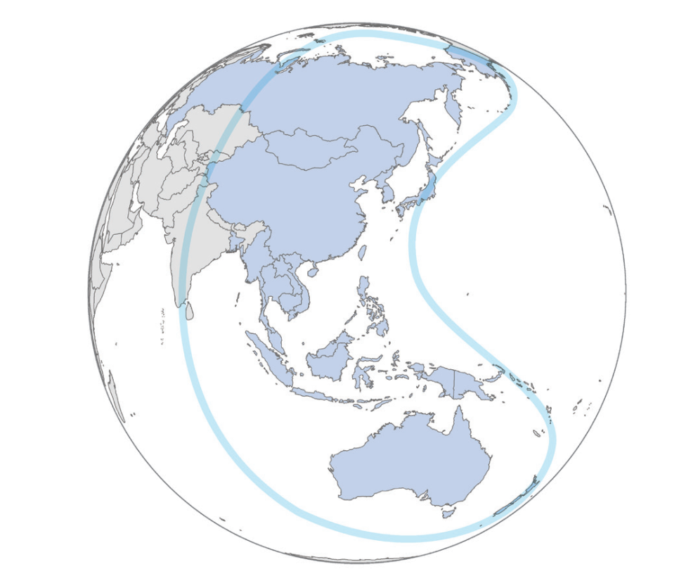
Deciding what the Plan is all about
Area
Example – Thematic / geographic area
East Asian—
Australasian Flyway
Notes:
Sometimes scope is thematic and as in this example e.g. focusses on the fly-path of Asian and Australian migratory birds – or it could focus on the habitat that is suitable for a certain species.

Slide 21
Deciding what the Plan is all about
Dream / Area
This Presentation
What makes a good vision statement
What is the scope of my project
Resources to support the step

Slide 22
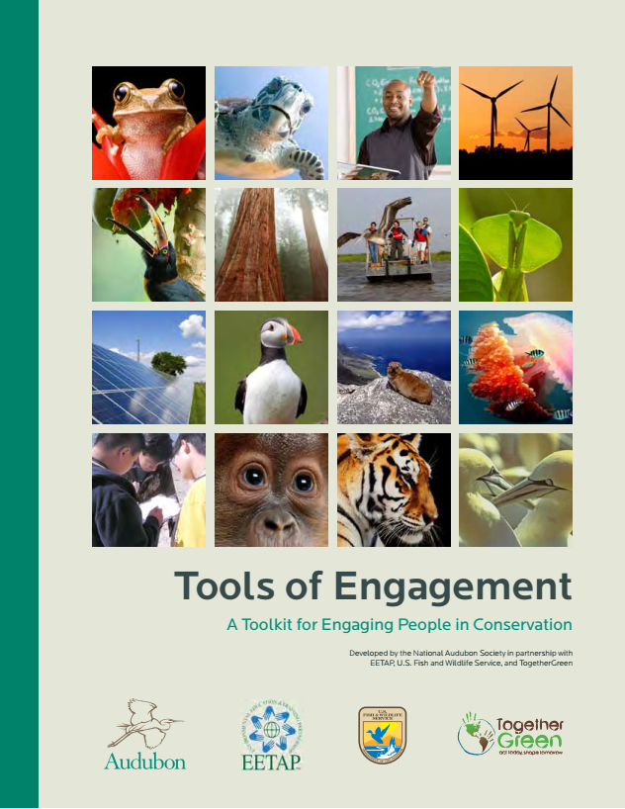
Deciding what the Plan is all about
Resources
For Area and Dream
Notes:
This planning guide was developed by Audubon, the U.S. Fish and Wildlife Service, the Environmental Education and Training Partnership, and TogetherGreen. The toolkit is based on the Open Standards and has many helpful facilitation techniques and planning tools to facilitate this step.

Slide 23
Deciding what the Plan is all about
Dream / Area
Workshop Exercise
Step 1: Area
Determine the area for your project
Discuss possible areas to consider – pick one or define your own
  Property / Region
  Thematic / threatened species
  Other? - you decide
Step 2: Pre-planning
Decide roles in your team using the Project Team ‘target’
Brainstorm the responses to the following questions. Write the answers on flip charts.
  Why do we need a plan?
  Who is the plan for?
  Who else should be involved in the planning?
  What will we produce at the end of the process – books, posters, videos etc?
  What will we do and when to produce the plan? How much is this likely to cost?
  Who should lead/be involved in each step?
Use the HCP Summary Card and planning table to guide some of your thinking.
Step 3: Dream
Draft an initial dream for the area you determined in step 1
Imagine you are coming in to the region after an absence of 20 years. You pick up a copy of a newspaper and there is an article about your region. What does the headline say, what are the main points
and photos the article would use? Write these down and then use them to decide a vision
Notes:
For Step 1 of the exercise we normally anticipate 20 minutes, for step 2 30 minutes and for step 3 again 20 minutes to give time for review and feedback.

Slide 24

Attribution
Product of the Conservation Coaches Network, 2019
These presentations were adopted of materials from members of the Conservation Coaches Network.
CCNet strongly recommends that this presentation is given by experts familiar with the adaptive management process presented by the Conservation Measures Partnership’s Open Standards for the Practice of Conservation / Community of Practice – Indigenous CS projects and CS projects on Indigenous Land and Waters.
You are free to share this presentation and adapt it for your use. Please attribute the work to CCNet. If you significantly alter, transform, or build upon this work, it may be appropriate to remove the HCP logo.

