Slide 1
Strategies
Achieving our Goals
Notes:
*Note: This presentation can be shortened to focus on the following pages: 4, 6, 7,18, 20, 21, 22, 24, 25;
Developing our strategies will help us to achieve the goals to protect the targets and reduce the threats that we have identified in the first phase of the Healthy Country Planning process (Deciding what the plan is about).

Slide 2
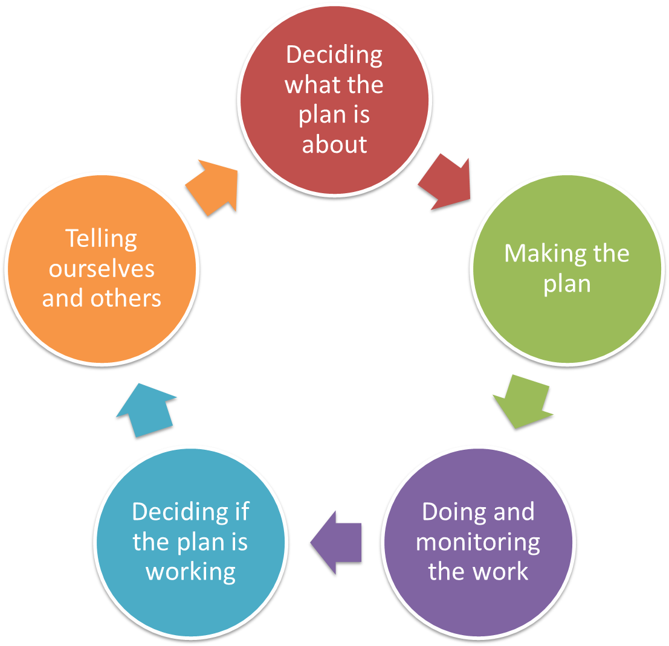
Making the plan
Strategies
Overview
Goals
Strategies
Road Maps
Measures
Notes:
In this step we use the information that we collated in the Situation Analysis and develop and evaluate our strategies – which are the strategic actions to achieve our goals that we determined in the previous step.

Slide 3
Making the plan
Strategies
Overview Presentation
Why do this step?
Example Strategies
How to develop and rate Strategies

Slide 4
Making the Plan
Strategies
Achieving our Goals
Why we do this step?
To identify key Strategies that will move us directly to achieving our Goals
To evaluate strategies to see if they are feasible and will have an effect
Notes:
This is a critical step in order to make land management decisions strategic. Identify a range of strategies that will move a project towards achieving the goals and picking the most feasible strategies out of a larger range.

Slide 5
Making the Plan
Strategies
Why and who
Start of actual plan, based on previous work
Goals and Strategies are absolutely key to shifting to solution-focused thinking
Core planning team (or even 1 person)
At least one person who is good at thinking about strategic solutions
Probably not scientists
Reality test with implementers

Slide 6
Making the Plan
Strategies
What are strategies?
What you do to achieve the Goal or Objective?
Strategies are a broad course of action designed to restore targets, reduce threats, and/or develop capacity.
A strategy is typically used as an umbrella term to describe a set of specific actions.
The situation analysis is the starting point to brainstorm and identify strategies.

Slide 7
Making the Plan
Strategies
General types of Strategies
Strategy Selection
Restoration
(to build health)
Mitigation
(to reduce a threat)
Capacity
(to create capacity)
Notes:
Previously we only talked in general about two types of strategy – mitigation and restoration. Capacity building as a third bundle of strategy belongs to those general types.

Slide 8
Making the plan
Strategies
Overview Presentation
Why do this step?
Example Strategies
How to develop and rate Strategies

Slide 9
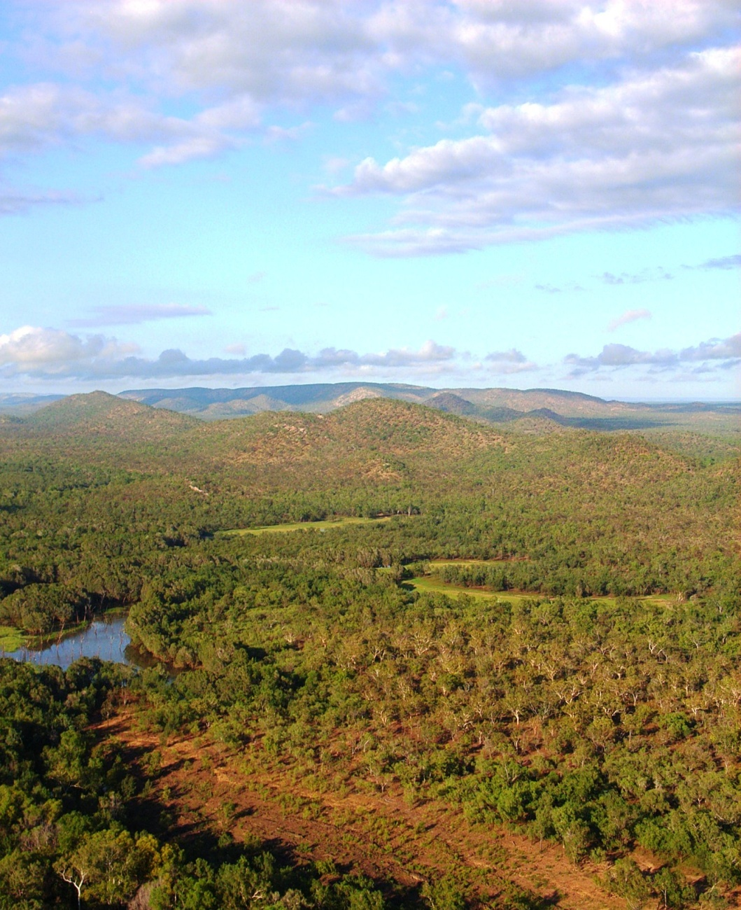
Making the Plan
Strategies
Land/water protection
Indigenous Protected Area
Joint Management
Purchase land
Purchase of Water Rights
Covenants and easements

Slide 10
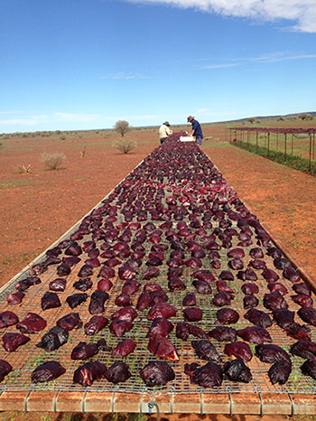
Making the Plan
Strategies
Land/water management
Fire Management
Introduced Species Control
Tourism strategy
Restoration
Influencing neighboring Management

Slide 11
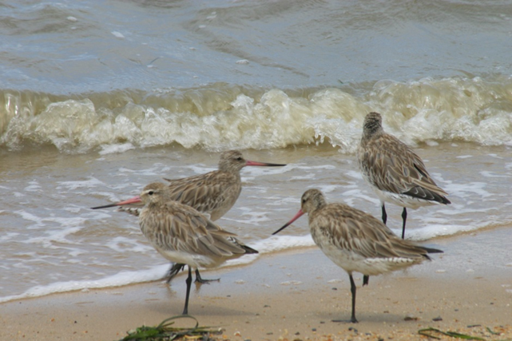
Making the Plan
Strategies
Species management
Enhancing or restoring specific plant and animal populations
Reintroducing species
Ex-situ (off-site)

Slide 12
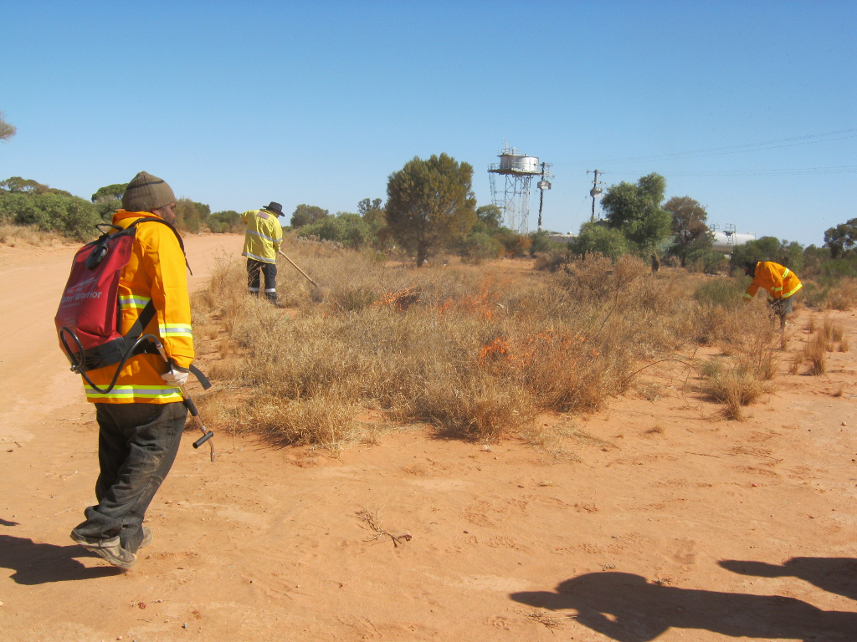
Making the Plan
Strategies
Livelihood, economic and other incentives
Enterprises that directly depend on the maintenance of natural resources
Alternative products and services that substitute for environmentally damaging ones
May also build support for a policy or other strategy

Slide 13
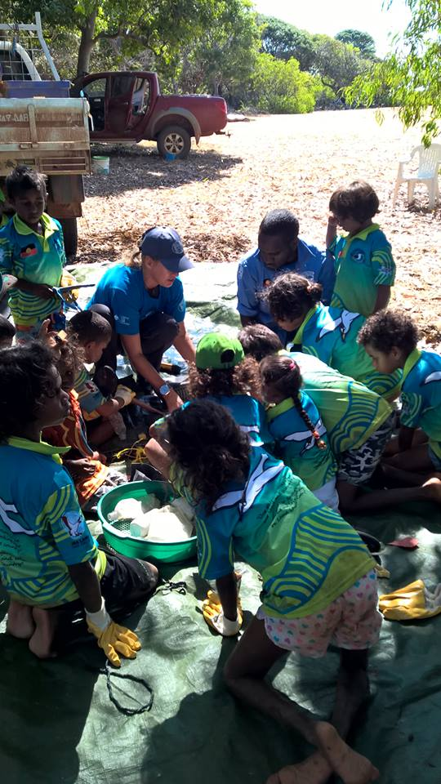
Making the Plan
Strategies
Education and awareness
knowledge, skills and information exchange
raising environmental awareness
providing information through various media

Slide 14
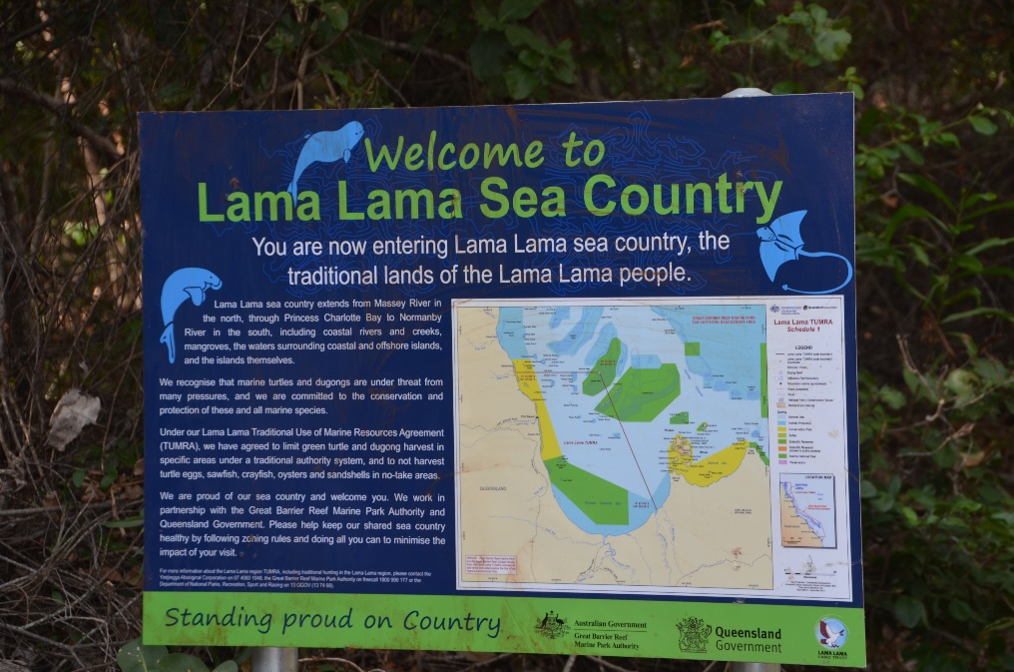
Making the Plan
Strategies
Law and policy
Legislation
Policies and regulations
Private sector standards and codes
Compliance and enforcement

Slide 15
Making the Plan
Strategies
External capacity building
Creating new local land trusts
Forming and facilitating partnerships
Raising and providing funds

Slide 16
Making the plan
Strategies
Overview Presentation
Why do this step?
Example Strategies
How to develop and rate Strategies

Slide 17
Making the Plan
Strategies
Selecting Strategies
Complex projects & problems typically require more than one strategy
e.g., halt overfishing & dredging (threats) to save reef (target)
Strategies might need to:
demonstrate alternative practices
change policy
Communicate / educate to provide pressure from consumers
engage influential partners in a strategic alliance
Notes:
Often you have to apply a set of strategies to solve a problem.

Slide 18
Making the Plan
Strategies
Five Steps: mine your earlier work
Check Vision/Dream and Scope/Area
Use Situation Analysis to explore the social, political, and economic context and identify opportunities
Review Goals
Brainstorm potential strategies that might accomplish each Goal, or multiple Goals;
Finally, select Strategies based on benefits, feasibility and costs.
Notes:
To brainstorm strategies, look back at the information that was developed in the previous steps. The Situation Analysis shows, where the opportunities and intervention points are to deploy best strategies. The goals identify the outcomes that our project wants to achieve with the help of the strategies.

Slide 19
Making the Plan
Strategies
Brainstorm, probing questions to identify strategies
Ask...
Is there an underlying cause - social, individual, cultural, economic?
Who is involved?
What are their needs?
Who else is likely to be effected +/- ?
Who will determine the outcome?
What motivates the key players?
What’s the ballpark cost? How many zeros?

Slide 20
Making the Plan
Strategies
Constructing Strategies
Certification
VS.
Change forest
code to permit
certification
Start with a verb
If useful, specify who
Clearly describing the strategy may require a longer name - or (better) a description in “details” (in Miradi)
WCS
will change forest code to permit certification
Complete legal analysis
and work with Forest
Department to change
forest code to
permit certification

Slide 21
Making the Plan
Strategies
Hints
Good strategies are:
addressing threats at the most effective point: Good strategies affect one or more key intervention points that you identified in your situation analysis
focused: Strategy outlines a specific courses of action that needs to be carried out
feasible: Can be done with the project's resources and skills.
appropriate: acceptable within your cultural, social, and biological norms.

Slide 22
Making the Plan
Strategies
Deciding which one(s)
Not all ideas are gold
Need to decide between different ideas in a way that is clear
Depends on a number of factors:
Cost
Time
Capacity
Capability
Influence

Slide 23
Making the Plan
Strategies
Deciding which one
Lots of Methods for comparing alternatives
Simple voting
Constructed scales
Rating on 1-10 scale
Poor, Fair, Good, Very Good
Natural scales
Costs
Area
Pick one that works for your situation
Might use more than one
Notes:
The old CAP Excel Tool used multiple 4-scale ratings and ranks as one of the most comprehensive rating tools:
Level of contribution a strategy made to one or more target or threat goals
Estimated viability rating improvement
Estimated threat rating reduction
Duration of benefit
Leverage
Feasibility based on lead individual / institution
Feasibility based on ease of implementation
Feasibility based on ability to motivate key constituencies
Cost estimates

Slide 24
Making the Plan
Strategies
Using a simple scale
Potential Impact – Degree to which the strategy (if implemented) will lead to desired changes in the situation within the scope of your project
Very High – completely mitigate a threat or restore a target.
High – help mitigate a threat or restore a target.
Medium – possibly help mitigate a threat or restore a target.
Low –probably not contribute to meaningful threat mitigation or target restoration.
Feasibility – Degree to which your project team could implement the strategy within likely ethical, financial/staffing, and technical/time constraints
Very High – ethically, technically, AND financially feasible.
High – ethically and technically feasible, but may require some additional financial resources.
Medium – ethically feasible, but either technically OR financially difficult
Low – not ethically, technically, OR financially feasible.
Notes:
If you use Miradi as a container for the information of your Healthy Country Planning Process, Miradi rates strategies by assessing the potential impact and the feasibility of a project (which considers financial, technical, ethical constraints).
And uses the Matrix on the next slide to give an overall rating for Strategies.

Slide 25
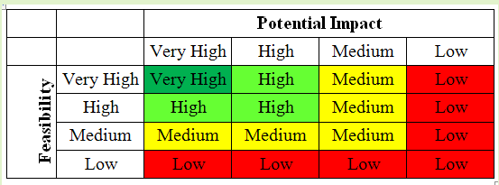
Making the Plan
Strategies
Using a simple scale
Potential Impact – how much will the strategy (if we do it) actually lead to changes we want in our project
Feasibility – how much our project team can do the strategy within likely ethical, financial/staffing, and technical / time constraints
Notes:
While the specific context in the end decides, a project normally would want to ensure that Very High and High rated strategies are implemented and then address medium ranked strategies.

Slide 26
Making the Plan
Strategies
Workshop Exercise
Summary: Each group will evaluate at least two strategies; and look at strengths and weaknesses of these strategies. This approach can be used to compare strategies and help decide which ones to select for the plan.
STEP 1
Choose one of your Goals
Look at your Situation diagram and talk about (brainstorm) all the different strategies (actions to improve targets or reduce threats) to achieve the Goal.
Write the strategies on yellow sticky notes and place them on the diagram
When you have done this for one Goal, pick another and do it again.
STEP 2
Select just one of the strategies. Use the displayed table and look at the list of criteria for Feasibility and Impact, which will help you think about and give a score to each strategy.
The overall score will then be used to compare, and rank, each strategy.
Repeat this process for as many strategies as you can.
STEP 3
Consider the results:
Were they what you expected?
Did you identify any weaknesses in your strategy? If so, consider whether the strategy can be improved.
Are there any strategies that appear to be really strong against these criteria.
Select strategies for your plan based on this assessment i.e. which strategies ranked highest

Slide 27
Making the Plan
Strategies
Using a simple scale
Potential Impact – Degree to which the strategy (if implemented) will lead to desired changes in the situation within the scope of your project
Very High – completely mitigate a threat or restore a target.
High – help mitigate a threat or restore a target.
Medium – possibly help mitigate a threat or restore a target.
Low –probably not contribute to meaningful threat mitigation or target restoration.
Feasibility – Degree to which your project team could implement the strategy within likely ethical, financial/staffing, and technical/time constraints
Very High – ethically, technically, AND financially feasible.
High – ethically and technically feasible, but may require some additional financial resources.
Medium – ethically feasible, but either technically OR financially difficult
Low – not ethically, technically, OR financially feasible.

Slide 28
Making the Plan
Strategies
Using a simple scale
Potential Impact – how much will the strategy (if we do it) actually lead to changes we want in our project
Feasibility – how much our project team can do the strategy within likely ethical, financial/staffing, and technical / time constraints

Slide 29
Attribution
Product of the Conservation Coaches Network, 2019
These presentations were adopted of materials from members of the Conservation Coaches Network.
CCNet strongly recommends that this presentation is given by experts familiar with the adaptive management process presented by the Conservation Measures Partnership’s Open Standards for the Practice of Conservation / Community of Practice – Indigenous CS projects and CS projects on Indigenous Land and Waters.
You are free to share this presentation and adapt it for your use. Please attribute the work to CCNet. If you significantly alter, transform, or build upon this work, it may be appropriate to remove the HCP logo.

