Slide 1
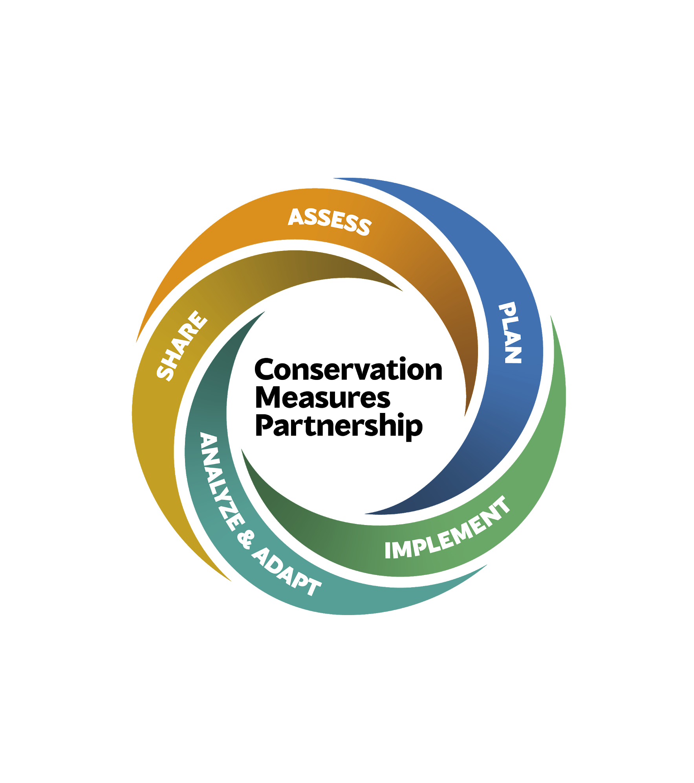
Global Environment & Development Agendas:
An Integrated Strategy for Conservation
A Conservation Measures Partnership Learning Initiative
Supported by the Gordon and Betty Moore Foundation
Definition, Theory of Change, and
Recommendations for Application
December 15, 2020

Slide 2
About this Report
This report provides an overview of Global Environment and Development Agendas: Strategies for Conservation. It includes the defining characteristics of this strategy, a generic situation analysis of the context to be navigated in applying this strategy, a generic theory of change of how to influence and leverage agendas for conservation, and recommendations for design and implementation of the strategy.
Content
The work is not a general analysis of big agendas, but rather an exploration of how they can be used as strategies at sub-national scales to deliver conservation outcomes, as well as how they can be influenced and adapted by the actions and results delivered at local, national or regional scales.
Intended audiences
Conservation and other Social Change Organizations interested in using this strategy.
Policy Makers, Companies, and Funders who might want to promote and/or support this strategy.
Researchers who might want to assess the effectiveness of this strategy.
Funders who might help establish and fund evidence libraries.
Format
This is an annotated deck, design primarily for reading and collaboration versus presentation. It is organized in sections that are akin to chapters, with slides containing detailed content. References can be found in the ‘Speaker Notes’ window below each slide. Additional data and information can be found in the Annexes.

Slide 3
Contributors and Participants in the Global/National Environment & Development Agendas Learning Group *
Core Framework Developed By: | Case Studies: | Participants in Learning:
Charles Latremouille Independent | Lisa Ernoul Tour du Valat | Doreen Robinson UNEP | Pia Paaby Forever Costa Rica Association
Sabina Khan Helmholtz Centre for Environmental Research - UFZ | Tamia Souto Independent Consultant | Will Beale WWF UK | Eleanor Carswell Bush Heritage
Nakedi Maputla African Wildlife Foundation | Julien Sémelin MAVA Foundation | Marion Osieyo WWF International
Jamie Deppen Cary Institute of Ecosystem Studies | Marko Pecarevic WWF Adria | Paulina Arroyo Moore Foundation
Laura d’Arcy Zoological Society of London |  | Nick Salafsky Foundations of Success
Sheila O’Connor Independent Consultant |  | Estuardo Secaira Independent
 |  | Reinaldo Lourival Nature and Cultureta International
 |  | John Waugh Independent
 |  | Vance Russell Independent
 |  | Oscar Moldinado Independent
* Contributing to this report does not necessarily imply individual or institutional agreement with all details herein
-Bold = Main Collaborators and Facilitators of the learning initiative

Slide 4
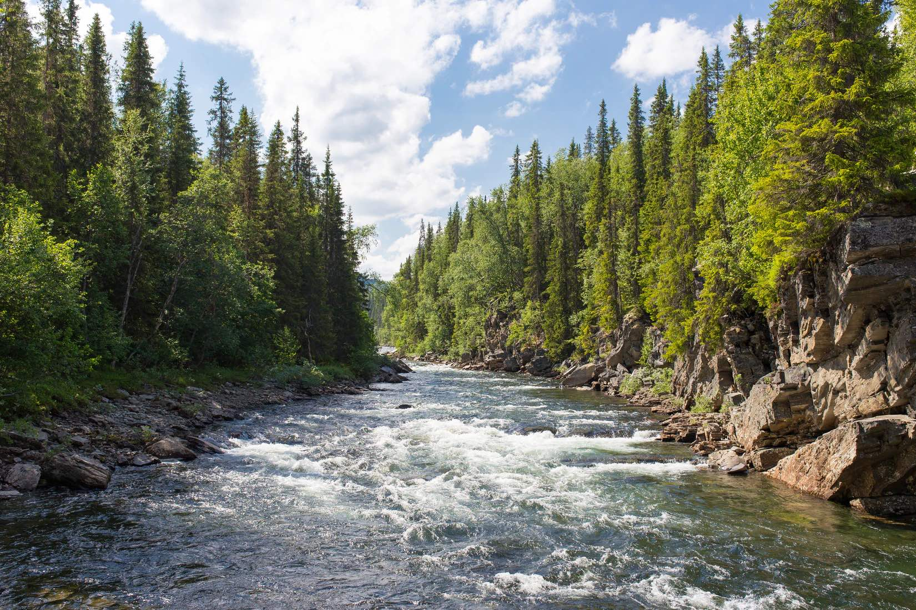
Table of Contents
Executive Summary
Introduction
Background and overview
Key Questions
Strategy Definition
Defined Need
Methods
Situation Analysis
Theory of Change
Discussion
Barriers to Effective Use of the Strategy
Overcoming Barriers
Knowledge Gaps & Priority Research Questions
Conclusions and Recommendations
Annex A: Key Resources
Annex B: Case Studies
Notes:
Photo Source: Jon Flobrant - https://unsplash.com/photos/rB7-LCa_diU

Slide 5
Global Environment & Development Agendas (ED Agendas): Strategies for Conservation (ED4C)
High-level environment and development agendas are designed to create the changes in decision-making necessary for sustainable development. There is, however, often a disconnect between local contexts and national-level understanding and decision-making. Here is a need for learning to show how these agendas are useful to deliver conservation and human well-being outcomes and for these, in turn, to influence the setting of agendas.
1. Executive Summary
Background and Overview
Global Environment and Development Agendas are high-level political processes involving government-to-government interactions and commitments, that have implications at the local, national, regional and global scales, and that typically focus on sustainable development outcomes. As conservation strategies, practitioners would try to both influence the content and adoption of high-level government [and corporate] commitments, and leverage such commitments, to facilitate better conservation (and human well-being) outcomes.
Key Questions Addressed
What might be a generic situation analysis and theory of change for influencing and leveraging global ED agendas, which can act as a scaffold that can be adapted for use and vetted within a particular local context?
What are key issues and learning lessons derived from featured case-studies, practitioners’ experience in working with ED4C strategies and the academic and grey literature?
What are some future research priorities which could advance our effective application of ED4C strategies?

Slide 6
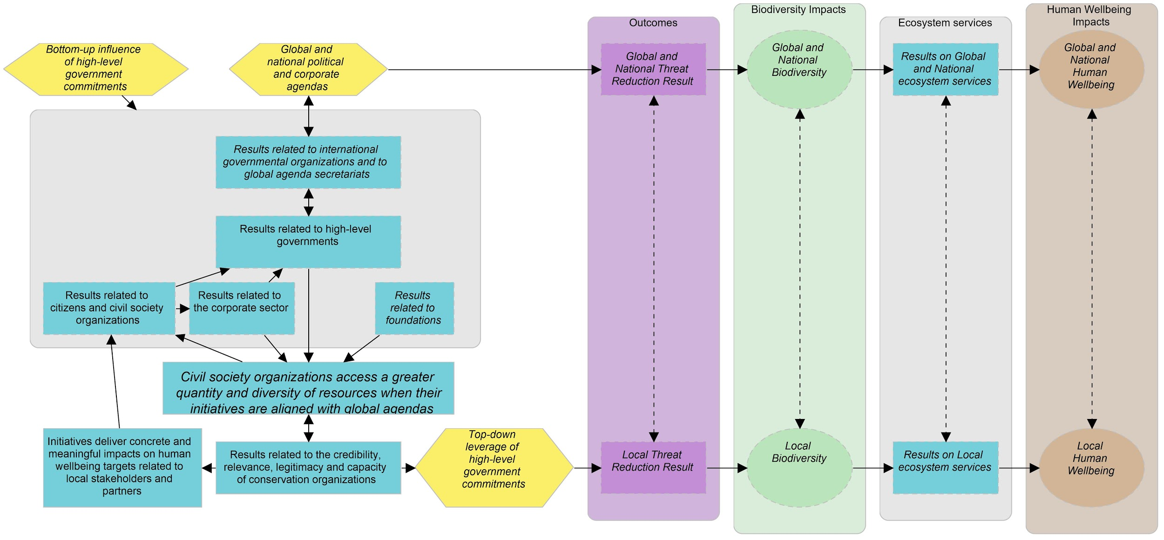
Generic Theory of Change for Global Environment & Development Agendas
The working group developed a ‘generic’ theory of change (TOC) to show how sub-national organizations can influence or leverage Global Environment & Development Agendas. This is the high level version of the TOC.
1. Executive Summary

Slide 7
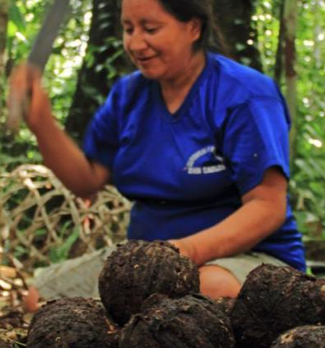
Synthesis of Findings from Case-Studies
We reviewed three case studies which leveraged ED agendas as conservation strategies. They were used to validate the TOC, understanding which elements are indeed likely to play out. They also illuminated key learning lessons (below) for on-going and future initiatives.
1. Executive Summary
Amarakaeri Communal Reserve & REDD+ in Peru Tamia Souto Independent Consultant |  | Leveraging UNFCCC Paris Agreement Stakeholder engagement: engage main actors from inception, partnerships crucial to overcome technical difficulties, strategic partnerships gives access to other influential actors, ensure time and skills for coordination activities Build admin capacities to manage requirements of major donors (e.g., USAID) Difficult to progress from idea >> project >> “proof of concept”
Important Marine Mammal Areas in the Mediterranean Sea Julien Semelin MAVA Foundation |  | Leveraging CBD, IUCN, CMS and Agreement for the Conservation of Cetaceans Participation of member state experts and recognition by regional and national institutions and governments Project needs sufficient scale to demonstrate meaningful contribution to targets Leverage other legal agreements to bolster relevance
Mediterranean Wetlands Alliance Lisa Ernoul Tour du Valat |  | Leveraging CBD Aichi Targets Aligning with Aichi targets secured funding from national agencies, but required taking on non-conventional work Different visions and approaches of partners require careful institutional design: common (concept and project management) language, different membership statuses, and lead actor managing changes and conflicts Rich range of perspectives resulted in interesting peer-to-peer learning

Slide 8
Synthesis of Findings from Case-Studies
We reviewed three case studies which leveraged ED agendas as conservation strategies. They were used to validate the TOC, understanding which elements are indeed likely to play out. They also illuminated key learning lessons (below) for on-going and future initiatives.
1. Executive Summary
Projects may need to achieve scale to justify alignment and meaningful contribution towards targets of ED agendas
Partnerships will generally be necessary elements of projects in order to reach scale, overcome technical difficulties and build credibility and legitimacy. Therefore, there needs to strategic institutional design in order to:
balance power dynamics which may dissuade key stakeholders from participating
Help partners maintain their credibility and legitimacy with their constituencies, stakeholders and institutions
Organisations may have to adopt an interest in issues, roles and assignments (tasks) which are outside of their traditional focus and operations in order to establish and maintain effective partnerships
Alignment with ED agendas allows access to key stakeholders and resources which could not have been possible with other conservation strategies; however, organisations need ot

Slide 9
1. Executive Summary
Conclusions
Global/National ED Agendas can provide a powerful legitimate mandate and unlock substantial resources for conservation work. They require interdisciplinary teams for skillful integration of human well-being considerations, scaling to generate meaningful contributions to achievement of targets, and strategic partnerships for effective implementation and collective impact.
Under what conditions could an ED Agenda strategy be necessary and appropriate?
When the national government has made a (binding) commitment to an ED agenda and this high-level commitment can be used to persuade both national agencies and sub-national governments to adopt measures which they have been strongly reluctant in pursuing (e.g., gazettement of protected areas)
When leadership is required to align multiple agencies at multiple scales to adopt a common theory of change and a coordinated and coherent approach to biodiversity conservation and natural resource management, in order to have a longer-lasting and greater (collective) impact.
When strong conservation or human well being achievements have been secured in a particular national or sub-national context, then ED agendas can help sustain them. This would avoid the use of resources to remediate (re)emerging problems and instead allocate them towards maintaining already effective solutions.

Slide 10
1. Executive Summary
Conclusions
Global/National ED Agendas can provide a powerful legitimate mandate and unlock substantial resources for conservation work. They require interdisciplinary teams for skillful integration of human well-being considerations, scaling to generate meaningful contributions to achievement of targets, and strategic partnerships for effective implementation and collective impact.
Under what conditions could an ED Agenda strategy be necessary and appropriate?
When there is a desperate need for good governance mechanisms (particularly transparent and participatory development planning processes), ED agendas can justify and support efforts to establish a framework for data collection, stakeholder consultations, investigations (monitoring) and reporting of activities.
When a conservation organisation (and its partners) has the credibility (competency) and legitimacy (social license) to navigate complex negotiations and sensitive conflicts amongst diverse stakeholder interests.

Slide 11
1. Executive Summary
Conclusions
Global/National ED Agendas can provide a powerful legitimate mandate and unlock substantial resources for conservation work. They require interdisciplinary teams for skillful integration of human well-being considerations, scaling to generate meaningful contributions to achievement of targets, and strategic partnerships for effective implementation and collective impact.
What are critical barriers to the successful uptake/application of an ED Agenda strategy?
Discontinuity in the political will, supportive policies and implementation programs associated with ED agendas, due to changes in governments .
Deep and chronic conflicts to sensitive issues (e.g., land tenure, political ideology, socio-cultural tensions) which give rise to ‘irreconcilable differences’ amongst key stakeholders, or which require sophisticated and lengthy conflict resolution processes that exceed the capacity of organisations and deadlines to demonstrate proof-of-concept or return-on-investment.
Individual and institutional behaviour change is lengthy and non-linear, which introduces uncertainty into theories of change and affect the timely delivery of project outcomes to demonstrate proof-of-concept or return-on-investment.
Both governments and other stakeholders (particularly CSOs) are unaware of the existence or benefit of ED agendas and confused about how to navigate the complex institutional arrangements associated with participating in ED agendas (e.g., accessing resources for implementing and reporting progress on national commitments).

Slide 12
1. Executive Summary
Conclusions
Global/National ED Agendas can provide a powerful legitimate mandate and unlock substantial resources for conservation work. They require interdisciplinary teams for skillful integration of human well-being considerations, scaling to generate meaningful contributions to achievement of targets, and strategic partnerships for effective implementation and collective impact.
What critical actions could support successful uptake/application of an ED Agenda strategy?
Build relationships with:
high-level organisations (e.g., UNDP) and government bureaucrats that have exclusive advisory roles to government; they can promote the continuity of your work throughout changes in government and policy cycles.
stable sub-national CSOs which have a long history of engagement and solid relationships with local stakeholders and can make a project sustainable and stronger to weather changes in government support
Engage universities and NGOs in voluntary reporting of national status and trends, re: contribution towards ED agendas (e.g., protected area coverage, etc.), which may incentivise national government to maintain political will.
Develop ED agendas toolkits which helps national government to understand agendas and benefits of commitment (e.g., access to funding) and helps CSOs to navigate complex institutional arrangements to access resources.

Slide 13
1. Executive Summary
Conclusions
Global/National ED Agendas can provide a powerful legitimate mandate and unlock substantial resources for conservation work. They require interdisciplinary teams for skillful integration of human well-being considerations, scaling to generate meaningful contributions to achievement of targets, and strategic partnerships for effective implementation and collective impact.
What actions could support successful uptake/application of an ED4C strategy?
Develop a solid situation analysis and theory of change (e.g., using a political ecology perspective and by vetting with target stakeholders) to understand the time, skills and resources needed to tackle foundational socio-political conflicts which bottleneck conservation work and provide honest communication on difficulties and uncertainties to funders and partners, to manage their expectations
Build (balanced) interdisciplinary project teams and partnerships with the credibility (e.g., social science, humanities and communications expertise) and legitimacy (e.g., social license and trust) to design and manage conflict resolution processes and behavioural change initiatives
Offer training opportunities for CSOs and government agencies in program and project management, biodiversity science, facilitation and conflict resolution, etc., so that they can take the lead in designing and implementing effective processes, programs and projects.

Slide 14
1. Executive Summary
Conclusions
Global/National ED Agendas can provide a powerful legitimate mandate and unlock substantial resources for conservation work. They require interdisciplinary teams for skillful integration of human well-being considerations, scaling to generate meaningful contributions to achievement of targets, and strategic partnerships for effective implementation and collective impact.
What key research is needed on using ED Agendas’ strategies?
How do you convince governments to embrace decentralised decision-making processes and inter-ministerial collaboration mechanisms?
What are the challenges faced within the corporate sector to understand and adopt programming in support of ED agendas?
How do civil society organisations in other sectors influence and leverage ED agendas, how do they see their connection to conservation, how do they respond to our theory of change?
What are pitfalls in using ED Agendas? (e.g., maladapative conservation impacts)?
What are the effects of introducing ED agenda discourses and programs into local communities and what social safeguards are necessary to mitigate adverse socio-economic and cultural impacts?

Slide 15
2. Introduction and Background
High-level environment and development agendas are designed to create the changes in decision-making necessary for sustainable development. There is, however, often a disconnect between local contexts and national-level understanding and decision-making. Here is a need for learning to show how these agendas are useful to deliver conservation and human well-being outcomes and for these, in turn, to influence the setting of agendas.
Background and Overview
Global Environment and Development Agendas are high-level political processes involving government-to-government interactions and commitments, that have implications at the local, national, regional and global scales, and that typically focus on sustainable development outcomes. As conservation strategies, practitioners would try to both influence the content and adoption of high-level government [and corporate] commitments, and leverage such commitments, to facilitate better conservation (and human well-being) outcomes.
Key Questions Addressed
What might be a generic situation analysis and theory of change for influencing and leveraging global ED agendas, which can act as a scaffold that can be adapted for use and vetted within a particular local context?
What are key issues and learning lessons derived from featured case-studies, practitioners’ experience in working with ED4C strategies and the academic and grey literature?
What are some future research priorities which could advance our effective application of ED Agenda strategies?
Notes:
Photo source: Inside RGE.> Sustainable Operations>Asian Agri Signs the Indonesia Palm Oil Pledge, from https://www.inside-rge.com/sustainable-operations/asian-agri-signs-indonesia-palm-oil-pledge/

Slide 16
2. Introduction and Background
Definition and Description
Global Environment and Development Agendas are high level political processes involving government to government interactions and commitments that have implications at local, national, regional and global scales and typically focus on sustainable development outcomes.
Synthetic Definition and Overview:
As conservation strategies, Global Environment and Development Agendas serve to influence and leverage high-level government [and corporate] commitments to facilitate, and create enabling conditions for, more effective conservation outcomes and impacts.
This influence and leverage could result in favorable policy or legislation changes, creating powerful and purposeful common agendas, highlighting ecosystem services and human well-being benefits of nature and nature-based solutions, increased resource availability for conservation work, increased recognition of civil society movements, strengthening sustainability of localized efforts, with a focus on transparency and accountability.
The main purpose of these strategies is to bring about global, national and local changes amongst different actors and stakeholders whose decisions and actions affect biodiversity and human well-being.
Global Environment & Development Agendas fall under the Conservation Measures Partnership’s Conservation Actions Classification (v2.0): 7.2 Policies and Guidelines.
Notes:
Conservation Measures Partnership’s Conservation Actions Classification (v2.0) - https://docs.google.com/spreadsheets/d/1i25GTaEA80HwMvsTiYkdOoXRPWiVPZ5l6KioWx9g2zM/edit#gid=1144804238

Slide 17
2. Introduction and Background
Defined Need
Big agendas’ often do not translate at local scales, voices are often not heard, links to bottom-up approaches unmade and opportunities to influence and/or benefit from more top-down approaches not established often enough. While typically the interactions and advances of big agendas are government-to-government, NGOs and civil society play a role in integrating their goals and actions into conservation strategies. Fundamentally, for strategies using big agendas to deliver conservation success, they must connect to and be reflective of many levels of society, in particular those that are most closely linked to nature, natural resources and ecosystem services.
Why consider Global Development & Environment Agendas at sub-national scales?
Global agendas are here to stay and are increasing in numbers; they will need to be reconciled with eventually.
They influence overarching (sustainable) development approaches and trajectories for national and sub-national jurisdictions and therefore, produce wide-ranging cross-scalar impacts on biodiversity.
They can channel substantial amounts of resources (funding, expertise) towards and political opportunities for executing environmental conservation programs over both the short- and long-term.
They add validity to the cause of environmental conservation by making the link with human well-being. They are opportunities where the conservation community can align with other sustainable development goals (for relevance) and leverage on (for support).
They are revised on cycles of varying length, so nested goals will invariably change. Therefore, the conservation community has an opportunity to bring their expertise and experiences (with the evidence base) to influence these revisions.

Slide 18
2. Introduction and Background
Defined Need
Big agendas’ often do not translate at local scales, and voices are often not heard, links to bottom-up approaches unmade and opportunities to influence and/or benefit from more top-down approaches not established often enough. While typically the interactions and advances of big agendas are government-to-government, NGOs and civil society play a role in integrating their goals and actions into conservation strategies. Fundamentally, for strategies using big agendas to deliver conservation success, they must connect to and be reflective of many levels of society, in particular those that are most closely linked to nature, natural resources and ecosystem services.
Desired results from ED Agendas’ strategies:
To bring about global changes among a wide range of sectors and stakeholders whose decisions and actions have an impact on biodiversity (SCBD 2020).
To leverage resources and create synergies between public and private sectors in terms of resources and mechanisms (e.g., policy, legislation, regulatory, investments).
To influence high-level government or corporate commitments so that they benefit conservation projects, programs or strategies at lower levels.
To align conservation projects, programs or strategies at lowers with global agendas to help governments meet their international commitments, hence increasing support and recognition from global audiences, as well as creating efficiencies through sharing of resources, collaborations, capacity building, empowerment, etc.
Defining characteristics: ED Agenda strategy is different from other types of conservation actions as it leverages high-level government and corporate commitments to facilitate more localized conservation outcomes. It also identifies or creates ‘rewards’ towards the high-level governments and corporations for their presence in global arenas, and delivery of global commitments.
Notes:
SCBD (2020)

Slide 19
2. Introduction and Background
Why Develop a Theory of Change (TOC) for Global Environment & Development Agendas?
A TOC provides a common framework to illustrate the components of ED Agendas, analyze the evidence to understand the conditions under which EDAgendas are effective, and identify knowledge gaps to improve their use.
A Theory of Change provides a common analytical framework for a conservation strategy:
A model of how a suite of conservation actions are expected to lead to desired outcomes and impact.
The basic mechanism by which a given action leads to desired results.
The enabling conditions under which a strategy might achieve results, as well as complementary strategies that could be employed to increase impact or likelihood of success.
Knowledge gaps and respective additional research needs which will improve effectiveness of strategy execution.
If tested with evidence from real-world examples, it can be adaptively refined to incorporate lessons learned.

Slide 20
2. Introduction and Background
Methods: Who Did This Work?
A working group of conservation practitioners from across the world who have worked with Global Environment & Development Agendas was established. We developed a situation analysis and theory of change for influencing and leveraging global agendas, exchanged lessons learnt in design and implementation challenges, and discussed solutions.
Who was involved in this work?
Core working group: Representatives of key organisations involved with ED4C who developed the initial products: Charles Latrémouille (independent consultant), Sabina J. Khan (Helmholtz Centre for Environmental Research - UFZ), Sheila O'Connor (independent consultant), Nakedi Maputla (African Wildlife Foundation - AWF), Jamie Deppen (Cary Institute of Ecosystem Studies) and Laura Darcy (Zoological Society of London)
Participants in Learning - Representatives of organizations and agencies involved with ED Agendas’ strategies who provided feedback
Convenors / facilitators - Charles Latrémouille, Sabina J. Khan and Sheila O'Connor
Through a survey, we found that participants in this work have active engagement in many areas of global/national environment and development agendas including: UNCCC + REDD, SDG 12: Responsible Consumption & Production, Mitigating Public Health risks, the Services of Wetlands, CITES and Wildlife Trafficking, AICHI Target 11: Important Marine mammal Areas and aligning multiple agreements, e.g. NBSAPS, SDGS, Climate.

Slide 21
2. Introduction and Background
Methods: What Did We Do?
A working group of conservation practitioners from across the world who have worked with Global Environment & Development Agendas was established. We developed a situation analysis and theory of change for influencing and leveraging global agendas, exchanged lessons learnt in design and implementation challenges, and discussed solutions.
What did we do?
Step 1: Initial situation analysis & theory of change - The core working group drafted a ‘generic’ situation analysis and theory of change to help participants understand the scope of our work. We then documented barriers and opportunities in a draft situation analysis using literature review, group interviews and expert workshops. Two workshops were conducted in which the situation analysis was transformed into a detailed theory of change. These products use the approach and conventions of the Open Standards for the Practice of Conservation.
Step 2: Refine products using the literature, case-studies and expert consultations - We vetted the initial products of the 3 workshops with the wider circle of experts and used their feedback to refine the work. We particularly vetted the theory of change with analysis of three case-studies which leveraged ED agendas for conservation.
Step 3: Identify implications - We synthesized the findings and recommendations and identified outstanding information needs.
Step 4: Collated supplementary information to further elaborate on and support the key messages generated from this work. (Annex A - Key Reading Resources and Annex B - Evidence from Case studies.

Slide 22
2. Introduction and Background
Methods: What Are the Uses of this Work?
How can these insights be currently used and also form the basis for future elaboration and use of this approach.
Uses of this study
Capture current knowledge: captures the current state of knowledge about different approaches to using ED4C strategies
Improve future studies: By identifying current information gaps, it can form the basis for future elaboration of the TOC and use of this approach and build the evidence-base on what works
Vet assumptions, situation analysis and theory of change with non-conservation oriented actors (e.g., development agencies, CSOs) which are also working with ED agendas, refine a common approach and language
Clarify practical application of using ED agendas to integrated conservation and development issues (bridging the often-mentioned gap between global and local and vice versa) (e.g. how do we go about delivering outcomes)
To build the CAML library on a common framework that can be adapted for use in different contexts

Slide 23
2. Introduction and Background
Methods: What Are the Limitations of this Work?
As with any research, it is important to know the limitations of this work.
Non-systematic review of evidence - We did not attempt to conduct a systematic review of all available evidence. Instead, we made a call for participants who self selected and we selected the literature we reviewed and our case studies.
Interpretation of literature - It was challenging to determine whether the absence of literature (or commentary within the literature) on a factor in our TOC was because authors explicitly felt it was not relevant, or merely did not think to consider it. There was, in fact, very little literature that we found in our brief review that directly spoke to ED Agendas as strategies for conservation.
Small sample size - Our conclusions are based on a very small number case-studies, and therefore, are thus not statistically valid.
Involvement of practitioners in case studies - The case-studies were based on the perspective of conservation practitioners working to implement a ED Agendas strategy in a particular location. This potentially biases reporting of challenges and successes. Reported results should ideally be triangulated against testimonies of other stakeholders involved in or impacted by these projects.
Overlap between experts developing TOC and case studies - Our initial TOC theory of change was developed by experts who were already familiar with the case studies, so the case studies are not a fully independent validation of the TOC our theory of change.
Works in progress - some case studies are still works-in-progress; while reporting preliminary results, it is too early to know ultimate outcomes.

Slide 24
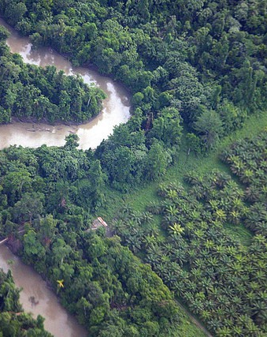
3. Situation Analysis
We developed a situation analysis to examine barriers and opportunities for local organizations to influence and leverage Global Environment & Development Agendas.
A situation analysis examines how socio-environmental factors within a particular context drives [biodiversity loss]. It consists of the following elements:
Direct threats: on-the-ground human activities which lead to biodiversity loss
Intermediate and ultimate factors (social, economic, political, cultural) which drive direct threats
This situation analysis for ED Agenda shows external and internal barriers and opportunities related to five important actors:
Conservation organisations
Civil society organizations (and civil society in general)
Private/corporate sector
High-level governments (national and sub-national)
Intergovernmental organisations
Notes:
Photos source: https://www.eco-business.com/news/indonesias-palm-oil-permit-moratorium-to-last-five-years/ photo by: Michael Thirnbeck, CC BY-NC-SA 2.0

Slide 25
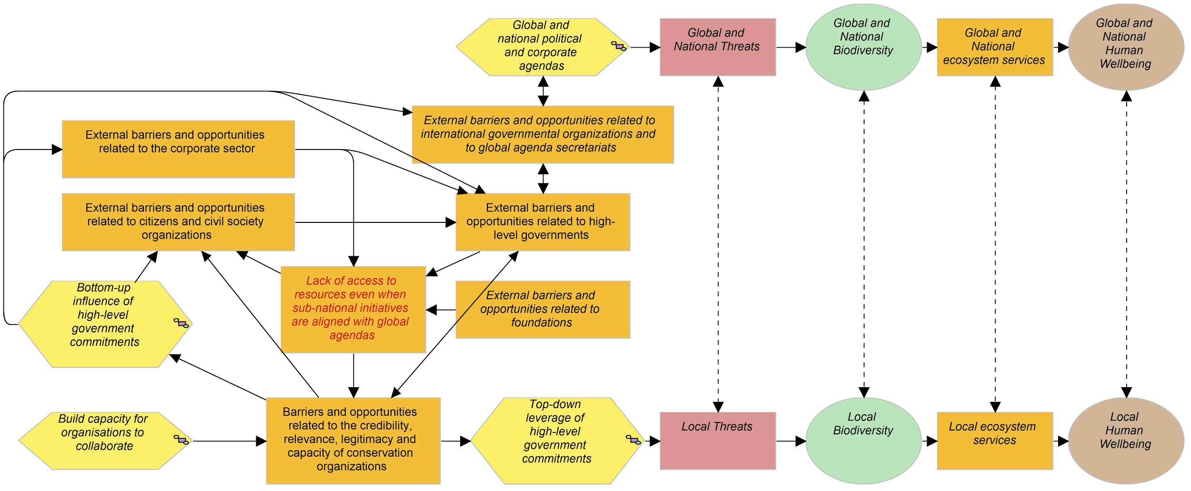
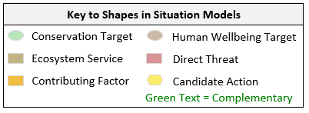
3. Situation Analysis
Situation Analysis for the use of Global Environment & Development Agendas as conservation strategies
The diagram on this page shows a high-level summary of a situation analysis. Each factor in an orange box is further elaborated upon in the following slide. Barriers to and opportunities for the use of ED4C strategies are described per stakeholder: conservation organisations, corporate sector, civil society organisations, foundations, national governments and intergovernmental organisations.

Slide 26
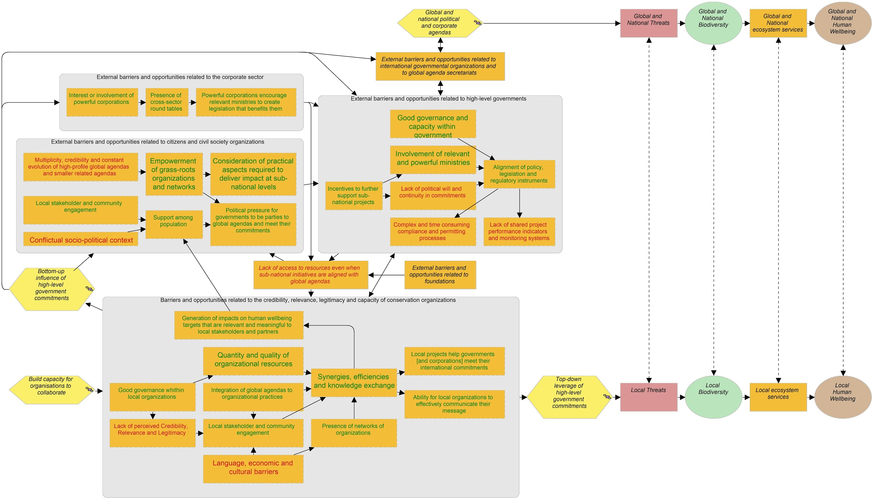
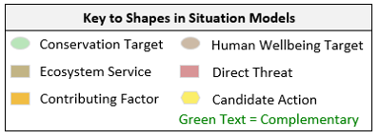
3. Situation Analysis
Situation Analysis for ED Agendas’ Strategies (detailed version)

Slide 27
3. Situation Analysis
Summary of Situation Analysis
National and sub-national governments: discontinuities in political will to commit to ED agendas, due to changes in government, prohibits the necessary long-term investments in implementation mechanisms (policies, plans and programs) to realise conservation and human well-being benefits. However, if good governance practices are already in place, there is capacity and there is involvement of powerful ministries (e.g., Ministry of Finance), implementation mechanisms can proceed even without sustained political will.
Corporate Sector: a lack of awareness, understanding and meaningful interest of corporations in ED agendas may inhibit the establishment of cross-sectoral stakeholder roundtables that can problem-solve barriers (technical, resource, coordination) to implementing initiatives which support ED agendas. Without such investments, there are no generation of benefits from engaging with ED agendas, and therefore, no incentive to lobby governments to commit to ED agendas and create the enabling conditions (e.g., policies, incentives) for private sector initiatives to more easily established and continued beyond piloting stages.

Slide 28
3. Situation Analysis
Summary of Situation Analysis
Conservation Organisations face challenges with their credibility, legitimacy, relevance and capacity to apply ED4C strategies. First, they may not see the value in aligning their work with ED agendas and therefore, do not invest in strategic planning in that direction. Secondly, even with an intention to leverage ED agendas, they may lack good governance mechanisms which enable effective strategic planning, project management and stakeholder engagement that are needed for successful implementation. This leads to unrealised organisational benefits (continued access to expertise, funding, information and decision-making forums) and conservation and human well-being impacts, the latter being crucial to convincing civil society to join the cause. Losing access to benefits reduces the quality and quantity of resources to improve implementation ED4C strategies.
Civil Society and Civil Society Organisations: struggle to understand the growing suite of ED agendas and navigate the associated complex institutional arrangements concerning legal commitments, roles and responsibilities of different actors, program design, funding, monitoring and reporting, etc. As a result, they do not engage with ED agendas to realise their potential benefits to advancing their stakes and interests. If there is engagement with ED agendas, there may be a lack of understanding of the full-suite practicalities of successful implementation. With persistent implementation challenges and unrealised benefits, there is no incentive to lobby government to release critical resources to improve the capacity of sub-national projects to deliver national progress towards ED agenda targets.

Slide 29
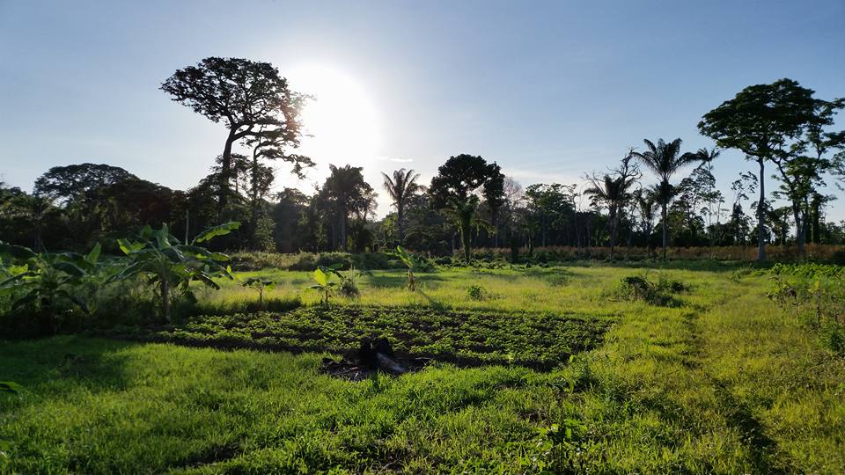
4. Theory of Change
A theory of change addresses the changes in the factors in the situation analysis which are necessary to stop or reduce biodiversity loss. It focuses on the:
Drivers that create the value proposition for different stakeholders to engage in execution of the strategy
Enabling conditions that ensure that the strategy will be effective in a given context
It consists of the following elements:
Ultimate desired state of biodiversity (impact) as a result of execution a strategy
Intermediate results (chain of changes in factors of the situation analysis) that lead to these outcomes
Steps (actions) for implementing the strategy to achieve these intermediate results
Notes:
Photo source: Sabina J. Khan (Agroforestry System in the Rupununi, Guyana, 2017) (please credit if used for other purposes)

Slide 30
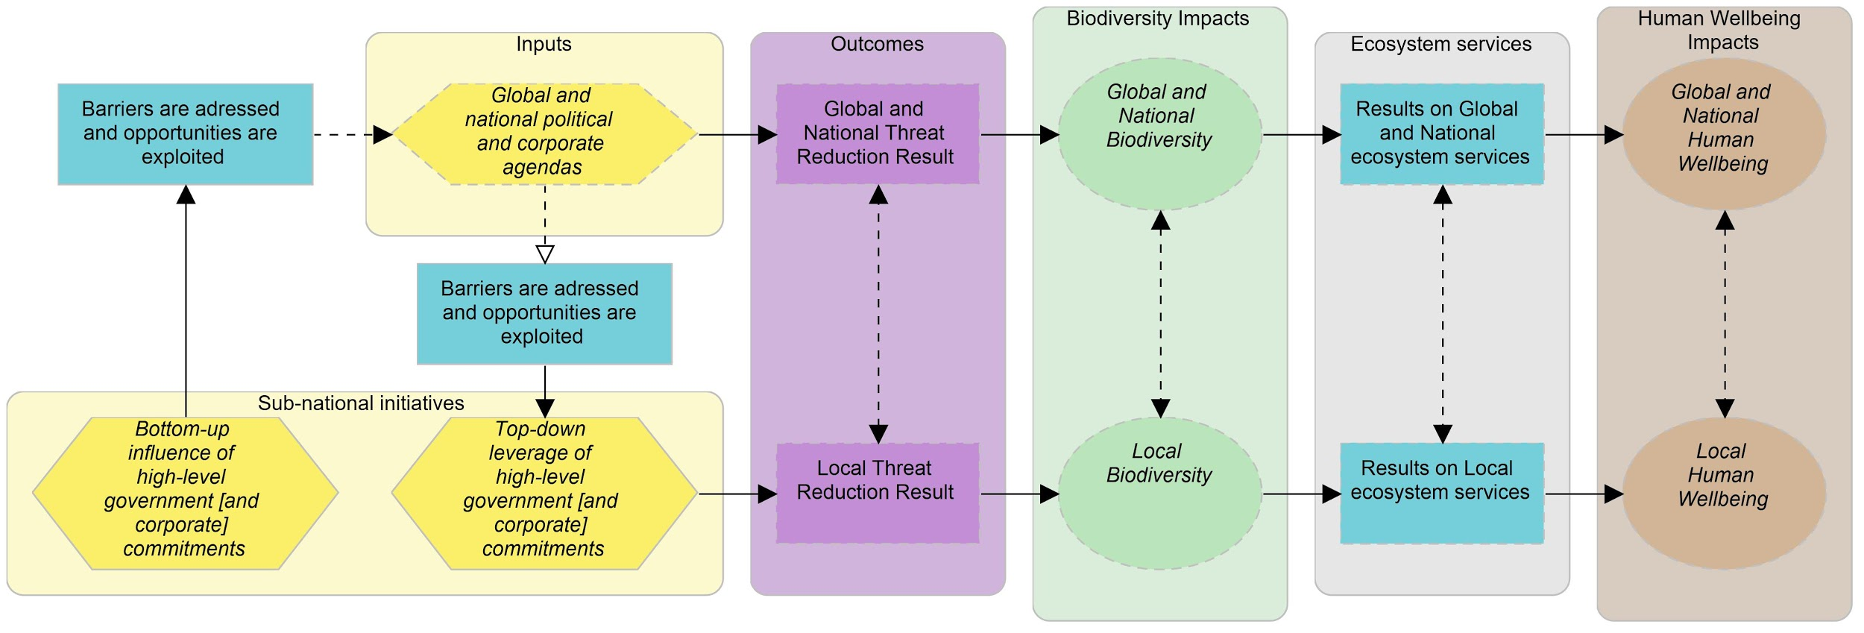
4. Theory of Change
High-Level TOC for Global Environment & Development Agendas
The diagram on this page shows a high-level summary of a theory of change. In the following slide, there is a detailed elaboration of which and how barriers are addressed and opportunities are exploited, by each major stakeholder: conservation organisations, corporate sector, civil society organisations, foundations, national governments and intergovernmental organisations.

Slide 31
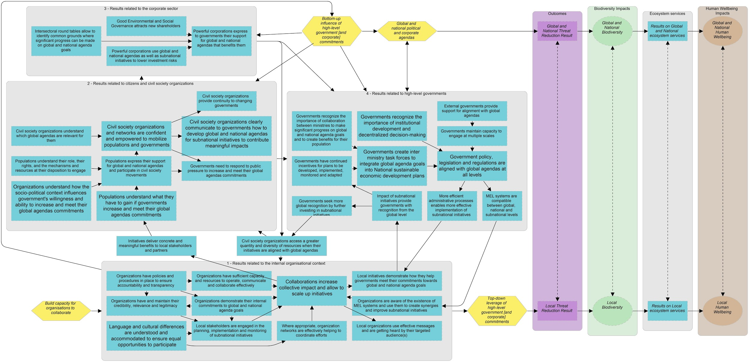
4. Theory of Change
Detailed TOC for Global Environment & Development Agendas
This is a detailed version of a Theory of Change (TOC) vetted by working group inputs, case studies, and literature review.

Slide 32
4. Theory of Change
Results Chain: Corporate Sector

Slide 33
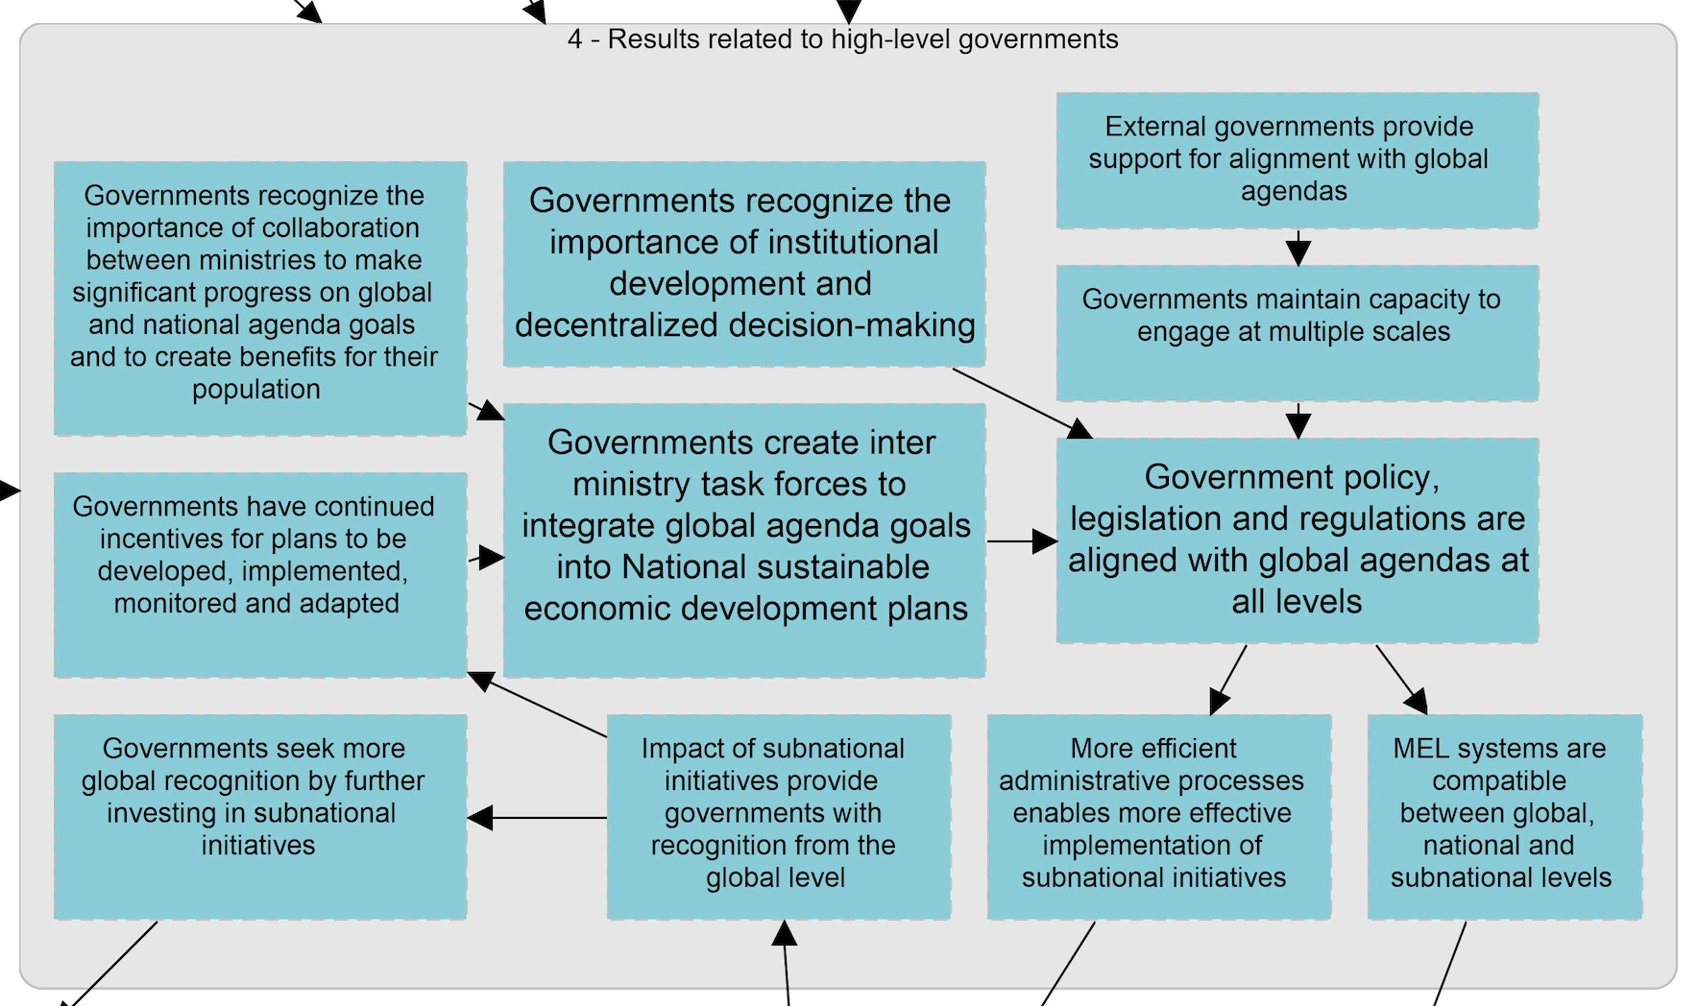
4. Theory of Change
Results Chain: High-Level Government

Slide 34
4. Theory of Change
Results Chain: Conservation Organisations

Slide 35
4. Theory of Change
Summary of Theory of Change
Overview of the key results to be achieved within a Theory of Change for Global Environment & Development Agendas
Language, economic and cultural differences are understood and accommodated to ensure equal and meaningful opportunities for key and interested stakeholders to participate in ED4C initiatives.
An improved philosophy of ‘working better together’ leads to collaborations between conservation organisations and civil society organisations in other sectors which allow for a larger range of implementation tactics to scale up initiatives and increase collective impact.
Local initiatives demonstrate how they help governments meet commitments towards global and national goals. This incentivises them to create enabling conditions (e.g., programs, funding) to further implementation of such initiatives.
National and sub-national governments create inter-ministerial task forces to integrate global agenda goals into national sustainable development plans and align policies and programs to meet respective targets

Slide 36
4. Theory of Change
Summary of Theory of Change
Overview of the key results to be achieved within a Theory of Change for Global Environment & Development Agendas
Civil society organizations access a greater quantity and diversity of resources to improve implementation when their initiatives are aligned with global agendas.
Stakeholders at the local scale understand and benefit from the conservation and human well-being outcomes that are gained if their governments meet commitments of a global agenda. They are incentivised to lobby their government and corporations to increase commitments, programs and resources for further implementation.
Powerful corporations express to governments their support for global and national agendas which benefit them.

Slide 37
5. Discussion
Discussion
In this section we consider the necessity versus the desirability of using Environment & Development Agendas as strategies for conservation. When selecting strategies, we not only need to develop a strong theory of change, identify our assumptions, and determine how we will know it is working. We must also ask some fundamental strategic questions:
When is it necessary (versus desirable, but not necessary) to use E&D agendas to deliver conservation outcomes?
When is it desirable (but not necessary) to use E&D agendas to deliver conservation outcomes?
We have begun to tease out these questions so that it is clearer for the key actors to decide under what conditions the strategy is most likely to succeed and if those conditions exist. Thinking along these lines may help us understand whether an ED strategy is a distraction or whether it is likely to deliver a return-on-investment.
Notes:
Photo source: https://www.worldcocoafoundation.org/

Slide 38
5. Discussion
When is it necessary (versus desirable, but not necessary) to use E&D agendas to deliver subnational conservation outcomes?
When donors request that projects are designed to contribute to a specific ED agenda target, then it is necessary to reference the agenda in project planning and communications to external stakeholders.
When the national government has made a (binding) commitment to an ED agenda and this high-level commitment can be used to persuade (inspire political will in) both national agencies and sub-national governments to adopt measures which they have been strongly reluctant in pursuing (e.g., gazettement of protected areas)
When national-level institutions and actors are needed to provide a clear directive, and common and engaging language for unconverted actors or to overcome socio-political differences of actors within regional initiatives
When leadership is required to align multiple agencies at multiple scales to adopt a common theory of change and a coordinated and coherent approach to biodiversity conservation and natural resource management, in order to have a longer-lasting and greater (collective) impact.
When strong conservation or human well being achievements have already been secured in a particular national or sub-national context, then ED agendas can help sustain them. This would avoid the use of resources to remediate (re)emerging problems and instead allocate them towards maintaining already effective solutions.

Slide 39
5. Discussion
When is it necessary (versus desirable, but not necessary) to use E&D agendas to deliver subnational conservation outcomes?
When an ED agenda provides an opportunity (i.e., a mandate and a dedicated stream of resources) to make a precedent-setting ‘proof-of-concept’ for an issue that has been systematically hard to tackle; a (successful) demonstration project will challenge business-as-usual assumptions and buffer perception of risks associated with large-scale investments, which may deter political will and buy-in from/engagement with stakeholders
When an ED agenda provides an opportunity to introduce critical ‘good governance’ standards and mechanisms (e.g., rights-based approach, free, prior and informed consent) and institutional developments (e.g., mandatory inter-ministerial or stakeholder roundtables) which are essential foundations for conservation work in general. ED agendas programs can justify and support efforts to establish a framework for data collection, stakeholder consultations, investigations (monitoring) and reporting of activities. Examples of such situations include:
when international supply chains involve extraction of wildlife, natural resources and land within a local context
when there is generally little information on the targeted exploitation of resources
when payments for ecosystems services (e.g., forest carbon mitigation) involve international transactions

Slide 40
5. Discussion
When is it desirable (but not necessary) to use E&D agendas to deliver subnational conservation outcomes?
To position a project/organization to access a substantial amount of funds, expertise, information and other incentives which are made available to engage in the delivery of global agendas
Alternatively, when the organisation already has sufficient resources to (1) manage projects of a sufficient scale that would demonstrate meaningful progress towards ED agenda targets and/or (2) navigate complex institutional systems which accompany ED agenda localisation (e.g., grant management, monitoring and reporting mechanisms)
To position stakeholders to be part of a global/national community and conversation agenda. For example, when there are stakeholders within the local civil society whose voices are strong enough to reach national and international forums and persuade national commitments to ED agendas, which align with the organisation/project goals.
To link what are perceived as ‘only local issues’ (e.g., forest fires) to global issues (e.g., climate change or health ecology)’ alternatively, to also link what are perceived as ‘only global issues’ to local socio-environmental issues
When a conservation organisation (and its partners) has:
a sound understanding of local socio-economic issues and is sufficiently committed to and skilled in incorporating and delivering meaningful human well-being outcomes (which are often targets within ED agendas)
the credibility and legitimacy to manage complex negotiations and sensitive conflicts amongst diverse stakeholders

Slide 41
5. Discussion
When is it desirable (but not necessary) to use E&D agendas to deliver subnational conservation outcomes?
When there is already integration of an ED agenda into sub-national government decision-making processes in which there are (1) bilateral commitments; (2) clear theories of change and mandates for systematic planning; (3) clearly established roles and responsibilities (accountability) of institutions and actors -- all of which allows an organisation/project to better understand where in the system to intervene and who to influence.
When there is high uncertainty or non-linear relationships between biodiversity conservation and the provision of ecosystem services and human well-being benefits. Projects under an ED agenda umbrella can improve understanding of performance (impact) of strategies, relationships between factors (trade-offs in outcomes), irreconcilable incompatibilities in goals (horizontally across sectors and vertically across scales), etc.

Slide 42
6. Barriers to Successful Use of Strategy
Potential Barriers to Uptake and Execution of ED Agendas as Strategies for Conservation
Political Cycles: Discontinuity in political will and implementation due to changes in governments and the extensive time lag between adoption of international commitments and eventual adoption of aligned national policies, plans and programs. These cyclical changes in politics and policy introduces high risks to conservation investments.
Lack of Official National Commitments: No (even vague) commitment to ED agendas at the national level, therefore there are no national and sub-national targets which articulates the need for on-ground projects. This makes it difficult to argue the relevance of conservation programs as a tool for meeting international commitments and therefore, gain legitimacy and access to resources for their execution.
Bottlenecks in Government Mandates
Ministries have differential access to and influence on decision-making processes. For example, the Ministry of Foreign Affairs may be a key player in international negotiations (e.g., within the CBD processes) but does not share information with the ministries that have implementation responsibilities (e.g., Ministry of Environment, Ministry of Agriculture). Further, goals within the same agenda may be managed by different ministries, which have differential power (e.g., Ministry of Finance holds high influence on funding but may not be involved in planning processes). Therefore, government actors can sometimes be barriers to understand and access ED agenda commitments, mechanisms and resources.

Slide 43
6. Barriers to Successful Use of Strategy
Potential Barriers to Uptake and Execution of ED Agendas for Conservation
Lack of Capacity and Institutional Development: There is political will to implement ED agendas but there is no expertise on:
Developing and implementing coordinated and coherent intra- and inter- sectoral policies, plans, programs
Data collection and analysis for monitoring and evaluation (e.g., downscaling of global indicators to the local level)
Facilitation, negotiation and conflict resolution processes
Transparency, accountability and anti-corruption processes
Further, there may be the erosion of local and institutional capacity in which those who eventually become fully versed in ED agendas leave their institution or community, taking their expertise and network of connections with them.
Strategic Planning Capacity: Difficulty of governments and organisations to know, in advance, how much and which resources will be needed for successful implementation. An underestimate may lead to failure of conceptually-sound projects because of resource constraints, thereby reducing lack of confidence to commit to subsequent projects and funding.

Slide 44
6. Barriers to Successful Use of Strategy
Potential Barriers to Uptake and Execution of ED Agendas for Conservation
Lack of comprehensive catalogue of projects: There is no system tracking the existence of projects (within a community, region, etc.) and how they contribute towards specific ED agenda targets. If you do not know which projects exist and which projects have the same goals as yours, it is difficult to collaborate to generate synergies, reduce incoherence, and articulate a case-for-support to national governments on the collective impact (which affects ability to access resources for scaling up).
Complex Institutional Setting: There are a multitude of ED agendas which create confusion, amongst government, CSOs and corporations, about their interrelated implementation at the national and sub-national levels. There may be a lack of local capacity to understand and navigate complex mechanisms such as funding (especially for performance-based funds such as REDD+), Free, Prior and Informed Consent (FPIC), etc.
Lengthy and Uncertain Behaviour Change Process: Time needed for behaviour change (at the individual and institutional levels) is lengthy because different stakeholders understand and respond to information in different time spans. Furthermore, the process of behaviour change requires skillful application of sociology – not simply ‘awareness-raising’ campaigns. For example, at the individual psychological level, some decision-makers fight, freeze or flight when confronted with ‘bad news’ while others take immediate, decisive, constructive action. These differences introduce uncertainty into theories of change and affect the timely delivery of project outcomes and therefore, perceptions of effectiveness and eligibility for funding renewal.

Slide 45
6. Barriers to Successful Use of Strategy
Potential Barriers to Uptake and Execution of ED Agendas for Conservation
Social Conflict: Deep and chronic conflicts to sensitive issues such as land tenure, land-use, political ideology, socio-cultural tensions, and long-standing rivalry amongst key stakeholders inhibits collaboration (joint programs, information and resource sharing, etc.). Some of these issues may be unsolvable. Otherwise, they require sophisticated and lengthy conflict resolution processes which exceeds the capacity (skills, resources) of organisations and the time span to provide a return-on-investment (demonstration of outcomes and impact) within the lifespan of a project, potentially leading to perception of failure and non-renewal of project funding to continue work. Furthermore, there may be a quantitative bias (e.g., ‘targets’) in measuring the impact of projects, which does not adequately assess progress on tackling these foundational socio-political issues.
Non-alignment with the evidence base:
The evidence-based work at sub-national levels indicate that ‘win-win’ solutions promoted at the international and national levels are not feasible (i.e., unacceptable trade-offs between actors which are irreconcilable) at the local level. Further, bottom-down approaches used by national level actors may be incompatible with the evidence-base of effective approaches to conservation at the sub-national level (e.g., community-based conservation concessions may be more effective than the establishment of command-and-control protected areas, though the latter is the preferred modus-operandi of national level actors).

Slide 46
6. Barriers to Successful Use of Strategy
Potential Barriers to Uptake and Execution of ED Agendas for Conservation
Problem definition approach: Conservation projects may work with a negative ‘threat reduction’ approach that is not receptive to certain actors. For example, agricultural production has been broadly labelled as largest threat to biodiversity, but agricultural sector actors also understand themselves as a source of solutions to the biodiversity crisis and food security.
Invalid assumptions about directions of influence: It is often assumed that ED agendas are only capable of influencing sub-national contexts. It is not adequately recognised that the sub-national context can work bottom-up to influence national approaches. However, it is recognised that with bottom-up approaches, it is challenging to scale-up projects to demonstrate results in meaningful ways to decision-makers and the private sector. This difficulty arises because of capacity of organizations (ability to work collaboratively in large groups), issues of compliance and permitting process.
Scaling Issues: What represents as a barrier or enabling factor may differ across stakeholders interests, cultures and across geographical and jurisdictional scales. This leads to difficulties in finding win-win solutions with acceptable trade-offs to all stakeholders.

Slide 47
7. Overcoming Barriers
Overcoming Barriers
Partner with stable CSOs that have a long history of engagement and solid relationships with local stakeholders, in order to continue projects with/without government support;
Build relationships with high-level organisations (e.g., UNDP) which often have exclusive advisory roles to government; they can can promote your work throughout changes in government.
Build relationships with government bureaucrats who manage standardised programs throughout changes in government and can keep you abreast of where your project can fit within new policy and program changes.
Work at different governmental scales: partnering and advancing goals at both the national and sub-national levels can make a project sustainable and stronger.
Engage universities and NGOs in international reporting of national status and trends, re: contribution towards ED agendas (e.g., protected area coverage, etc.), which may incentivise national government to act.
Develop ED agendas toolkits which helps government understand agendas and benefits of commitment (e.g., access to funding) which help CSOs understand the purpose, implementation mechanisms, roles and responsibilities of actors, etc. within various ED agendas.

Slide 48
7. Overcoming Barriers
Overcoming Barriers
Offer training opportunities in strategic planning, program and project management, biodiversity science, facilitation and conflict resolution approaches, etc., so that all actors can lead the design of effective processes, programs and projects.
Build (balanced) interdisciplinary teams and partnerships with the adequate social science, humanities and communications expertise to inform and execute behavioural change initiatives. They should also have credibility and legitimacy with stakeholders to design and manage effective conflict resolution processes.
Develop a very thorough situation analysis and theory of change -- vetted by different target actors and using a political ecology lens --- to understand the reality of time, skills and resources needed to tackle socio-political issues which bottleneck conservation work.
Provide honest communication of the situation analysis and theory of change (i.e., difficulties and uncertainties) to funders and partners, so that they understand that some time in the project may solely be dedicated towards building the foundation for further work (e.g., building relationships to overcome social conflicts, building baseline capacities of key actors, etc.)

Slide 49
8. Knowledge Gaps and Priority Research Questions
Knowledge Gaps and Research Questions
These gaps and research questions were identified and prioritized by the ED Agendas’ participants and working group.
Global & General
Historically, how well have global agendas done in achieving their goals and what factors led to final results?
How do we create Monitoring, Evaluation and Learning systems compatible across global to local scales?
How does global agenda policy implementation, from local->subnational->national, affect conservation success?
From a global agenda perspective, what are the bottlenecks/hindrances to effective conservation strategy implementation and how can they be overcome?
What individual behaviour change strategies can be used to facilitate larger institutional change?

Slide 50
8. Knowledge Gaps and Priority Research Questions
Knowledge Gaps and Research Questions
Governments
What are governments’ level of understanding of global agendas?
How have governments gone about aligning policies, programs, etc. across all jurisdictional levels? What makes governments recognize the importance of inter-ministry collaboration to the point they will do it?
How do you convince governments to embrace decentralized decision-making?
Corporate Sector
What is the corporate sector’s level of understanding of ED agendas?
What are the barriers for the corporate sector’s commitment to / or engagement in ED agendas?

Slide 51
8. Knowledge Gaps and Priority Research Questions
Knowledge Gaps and Research Questions
Environmental and Civil Society Organisations
How do CSOs in other sectors see their connection to conservation? How have they leveraged ED agendas?
How well is the theory of change in our model received by stakeholders?
What are pitfalls in using ED4C? (e.g., maladpative socio-political/cultural and conservation impacts)?
What models exist for CSOs engaging corporations in ED4C agendas? Which ones are most effective and why?
What are CSOs current understanding of ED agendas and the socio-political context that influences a government's willingness and ability to increase and meet their global agenda commitments?

Slide 52
8. Knowledge Gaps and Priority Research Questions
Knowledge Gaps and Research Questions
Local Communities / Civil Society
What are the unintended effects of mainstreaming global agenda discourses and initiatives into local communities? (e.g., integration of Indigenous Communities into new institutional arrangements)
What are the minimum social safeguards that should be in place for engaging communities in global agendas? (e.g., Free, Prior and Informed Consent, Rights-Based Approach)?
How can gender/equity/diversity/inclusion/empowerment issues best be included at the local to national scales?
How can community-led conservation more effectively influence and drive global agendas/policy?

Slide 53
9. Conclusion and Recommendations
Conclusion
Global ED Agendas can provide a powerful legitimate mandate for conservation work and unlock substantial resources for conservation. They require skillful integration of human well-being considerations.
To be successful and durable, ED Agendas’ strategies need strong organizations to overcome barriers and help voices be heard, need capacity (technical, technological, human and financial), need supporting policy, institutions and governance mechanisms, and need transparency and accountability that informs and links all scales of action.
Our work has begun to show when and how to use ED Agendas as a strategy for conservation at sub-national scale, and how to influence the design, implementation and monitoring of global and national agendas. However, we have gaps in our knowledge to fill to strengthen our evidence that using this strategy is worthwhile, and under what conditions it is most likely to lead to success.
Notes:
Photo source: Sabina J. Khan (Balata Crafts made by Indigenous Communities in the Rupununi, Guyana, 2017) (please credit if used for other purposes)

Slide 54
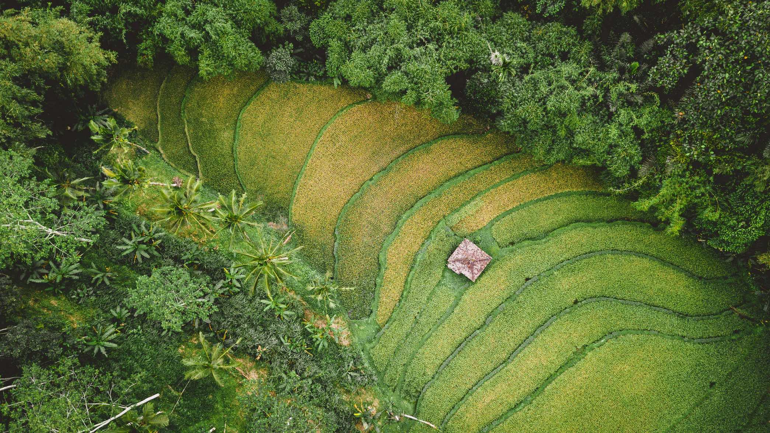
9. Conclusion and Recommendations
Recommendations on Next Steps
Focal group discussions on final product
Undertake key research and strengthen evidence
Document additional case studies as evidence
Publication of a journal article
Notes:
Photo source: Ivan Bandura - https://unsplash.com/photos/QfefrzHQAdM

Slide 55
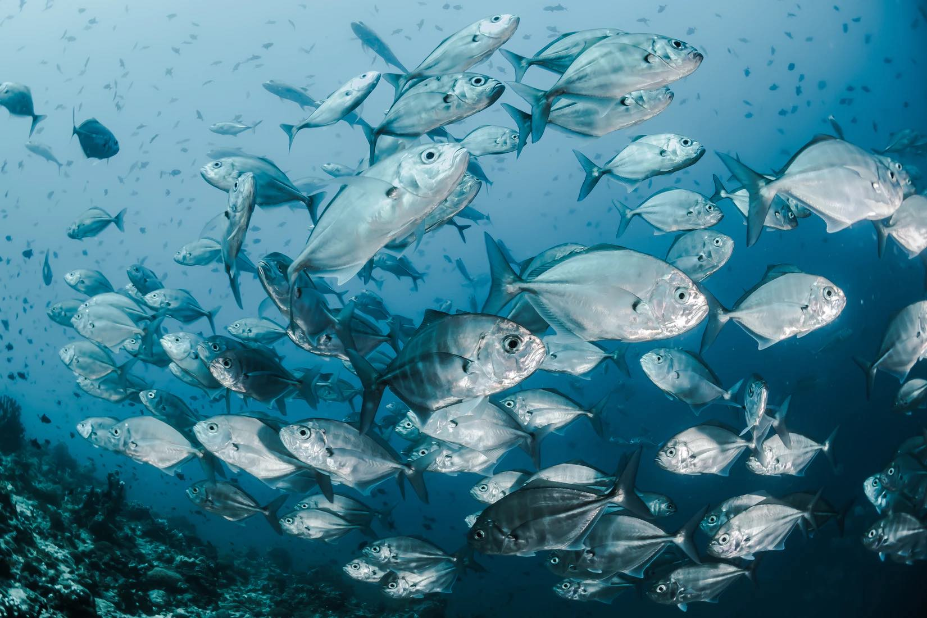
10. Annex A: Key Resources
Annex A. Key Resources
Teaser Presentation Summarising Work here and here
Situation Analysis and Theory of Change within Miradi Share here.
Environment & Development Agendas - Learning Group Documents (reports, case-studies, surveys) here.
Supplementary Resources for Further Reading here.
Notes:
Photo Source: Sebastian Pena Lambarri - https://unsplash.com/photos/YV593oyMKmo

Slide 56
10. Annex A: Key Resources
Annex A. Key Resources
Cash, D., Clark, W.C., Alcock, F., Dickson, N.M., Eckley, N., Jäger, J. (2003). Salience, credibility, legitimacy and boundaries: linking research, assessment and decision making. John F. Kennedy School of Government, Harvard University, Faculty Research Working Papers Series 10.2139/ssrn.372280. Retrieved from: http://nrs.harvard.edu/urn-3:HUL.InstRepos:32067415
Conservation Measures Partnership. 2016. Incorporating Social Aspects and Human Wellbeing in Biodiversity Conservation Projects, Version 2.0/
https://cmp-openstandards.org/wp-content/uploads/2016/07/Incorporating-Social-Aspects-and-Human-Wellbeing-in-Biodiversity-Conservation-Projects-v.-2.0-July-2016.pdf
Conservation Research Initiative. (2020). Biodiversity, Nature and the UN Sustainable Development Goals. https://www.conservation.cam.ac.uk/Key_Programmes/biodiversity-nature-and-the-un-sustainable-development-goals
Fisher, J. R. B., S. A. Wood, M. A. Bradford and T. R. Kelsey. 2020. Improving your impact: how to practice science that influunces environmental policy and management. Conservation Science and Practice 7(2): 1-14.
Foundations of Success. 2007. Using Results Chains to Improve Strategy Effectiveness: An FOS How-To Guide. Foundations of Success, Bethesda, Maryland, USA. https://fosonline.org/wp-content/uploads/2019/11/FOS_Results_Chain_Guide_2007-05.pdf
Foundations of Success. 2009. Using Conceptual Models to Document a Situation Analysis: An FOS How-To Guide. Foundations of Success, Bethesda, Maryland, USA.
Notes:
Photo source: https://www.thejakartapost.com/news/2019/08/26/indofood-goes-ahead-with-palm-oil-expansion-despite-citigroups-withdrawal.html Shutterstock/File

Slide 57
10. Annex A: Key Resources
Annex A. Key Resources
Gustafsson, Karin & Lidskog, Rolf. (2018). Boundary organizations and environmental governance: Performance, institutional design, and conceptual development. Climate Risk Management. 19. 10.1016/j.crm.2017.11.001.
Moilanen, A, J. Laitila, T. Vaahtoranta, L. V. Dicks, and W. J. Sutherland. 2014. Structured Analysis of conservation strategies applied to temporary conservation. Biological Conservation 170: 188-197.
Ringler, C. (2015). SDGs fail to address interlinkages between goals and targets. Retrieved from: http://peoplefoodandnature.org/blog/sdgs-fail-to-address-interlinkages-between-goals-and-targets/
Secretariat of the Convention on Biological Diversity (SCBD) (2020) Global Biodiversity Outlook 5 – Summary for Policy Makers. Montréal.
Tulder, R. van (2018), Business & The Sustainable Development Goals: A Framework for Effective Corporate Involvement, Rotterdam School of Management, Erasmus University, Rotterdam.
UN. Dept of Economic and Social Affairs. 2015. Transforming our World: the 2030 Agenda for Sustainable Development and the 17 Goals.
Weichselgartner, J. and Kasperson, R.E. (2010) Barriers in the Science-Policy-Practice Interface: Toward a Knowledge Action-System in Global Environmental Change Research. Global Environmental Change, 20, 266-277.
Yiwen, Zeng & Maxwell, Sean & Runting, Rebecca & Venter, Oscar & Watson, James & Carrasco, L Roman. (2020). Environmental destruction not avoided with the Sustainable Development Goals. Nature Sustainability. 3. 1-4. 10.1038/s41893-020-0555-0.
Notes:
Photo source: https://www.thejakartapost.com/news/2019/08/26/indofood-goes-ahead-with-palm-oil-expansion-despite-citigroups-withdrawal.html Shutterstock/File

Slide 58
11. Annex B: Case-Studies
Annex B. Evidence from Specific Cases
Case studies are meant to ground the conceptual work by providing preliminary evidence illustrating whether:
our situation assessment is representative of barriers and opportunities for action
our theory of change may play out as we propose.
Three cases were reviewed, demonstrating the use of two global environment agendas:
Convention on Biological Diversity, Aichi Targets
United Nations Framework Convention on Climate Change, Paris Agreement
Notes:
Photo source: http://ecotrust.or.ug/programme-areas/management-and-control-of-pollution/trees-for-global-benefit/gestapelte-holzstamme/

Slide 59
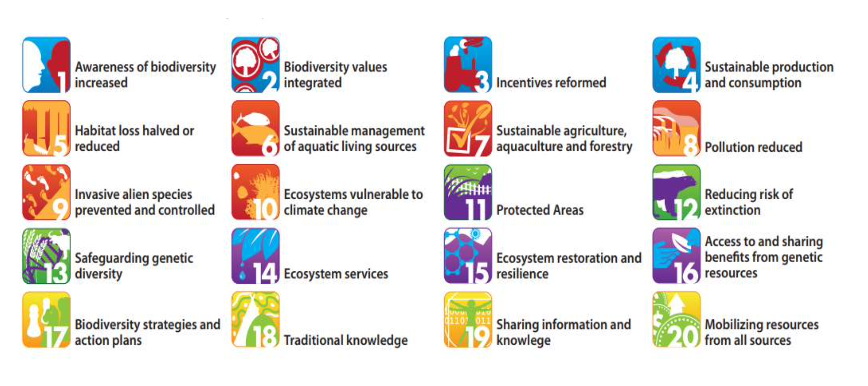
11. Annex B: Case-Studies
Annex B. Evidence from Specific Cases
Convention on Biological Diversity, Aichi Targets
Case Study 1: Conservation of wetlands and contributing to achievement of Aichi biodiversity targets (5, 9, 14, 19) through the Mediterranean Wetlands Alliance
Case Study 2: Progressing towards CBD Aichi target 11 in the Mediterranean Sea through the designation of Important Marine Mammal Areas (IMMAs)
Notes:
Photo source: http://ecotrust.or.ug/programme-areas/management-and-control-of-pollution/trees-for-global-benefit/gestapelte-holzstamme/

Slide 60
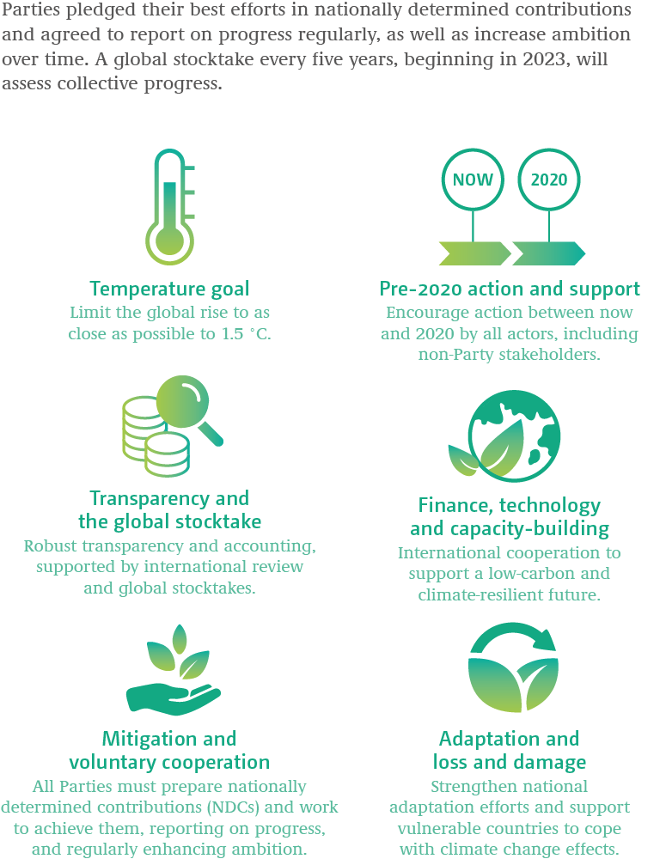
11. Annex B: Case-Studies
Annex B. Evidence from Specific Cases
United Nations Framework Convention on Climate Change, Paris Agreement
Case Study 3: Contributing to Peru’s national commitments to reducing greenhouse gas emissions through implementation of REDD+ Indigena Amazonica
Notes:
Photo source: http://ecotrust.or.ug/programme-areas/management-and-control-of-pollution/trees-for-global-benefit/gestapelte-holzstamme/

Slide 61
11. Annex B: Case-Studies
Case Study 1: Mediterranean Wetlands Alliance
Facilitated the the improvement of wetlands conservation across the entire Mediterranean Basin, by working through the Convention on Biological Diversity Aichi Targets.
Aim: conserve wetlands and contribute to achievement of Aichi biodiversity targets (5, 9, 14, 19) through training, experience sharing and advocacy
Expected Results
Enable multi-directional dialogue between Member states, re: available knowledge on model sites, experiences, best practices, etc.
Link local, national and regional stakeholders and initiatives through innovative, concrete joint actions on prioritised policy and strategic topics
Build capacity of civil society to participate in wetland management and conservation activities
Increase the public awareness of wetlands
What is the status of design and implementation?
Project is in its 4th year of implementation with participation of ca. 20 organizations from different Mediterranean countries
Main focus to date has been the establishment of a red alert system and implementation of peer-to-peer training sessions.
Several “red alerts” have already been identified with a group advocacy response
2-3 training sessions have been implemented per year ranging from communication to restoration and participative practices.

Slide 62
11. Annex B: Case-Studies
Case Study 1: Mediterranean Wetlands Alliance
Facilitated the the improvement of wetlands conservation across the entire Mediterranean Basin, by working through the Convention on Biological Diversity Aichi Targets.
What lessons and recommendations for designing and implementing the strategy have emerged from this case?
A common (concept and project management) language is needed between environmental and development organizations. Other language issues are difficult, therefore translation services are needed or training workshops divided by groups.
A rotating governance structure had its limits, therefore the Tour du Valat took the lead role in coordinating and securing funding. They needed to manage members fluctuation through time and fund the first phase of the project.
It was difficult to align perspectives of advocacy-oriented organizations with governmental bodies, therefore the institutional set-up designated civil society as direct partners and governments as invited participants. Both actors were relieved with the arrangement as it helped balance power relations and manage credibility and legitimacy of their participation.
Aichi targets provided common ground between the Alliance and the French Development Agency and led to funding support, but also let to the Alliance taking on some activities which which are outside of their ‘normal’ range.
Different visions and approaches of partners is rich, allowing for interesting peer-to-peer training, but also creates conflicts, feeling of isolation and different implementation implications, and there is need for adaptive management.

Slide 63
11. Annex B: Case-Studies
Case Study 2: Designation of Important Marine Mammal Areas (IMMAs) in the Mediterranean Sea
Facilitated the designation of IMMAs by working through the Agreement for the Conservation of Cetaceans of the Black Sea, Mediterranean sea and Contiguous Atlantic Area (ACCOBAMS), Convention on Biological Diversity's Ecologically or Biologically Significant Areas (CBD EBSAs), the IUCN Key Biodiversity Areas (KBAs), and the Convention on Migratory Species (CMS).
Aim: to design and implement a process to designate Important Marine Mammal Areas (IMMAs) in the Mediterranean Sea by the IUCN Marine Mammal Protected Areas Task Force.
IMMAs are discrete portions of habitat, important to marine mammal species, that should be considered within place-based conservation efforts, e.g., marine spatial planning and marine protected areas. Identification of IMMAs can accelerate a planning process for habitat protection.
Expected Results
IMMAs are identified in the Mediterranean Sea
Implementation of effective spatial protection measures is facilitated
A global IMMA network is launched
What is the status of design and implementation?
IMMAs have been identified in the Mediterranean sea as planned and the pilot project is now closed.
The initiative is continuing globally, triggering identification of IMMAs in 5 other regional seas - 159 IMMAs, covering 15+ M km² (4% of global waters).
Examples of where IMMAs translated in effective conservation actions:
New MPAs declared in Bangladesh.
Oil & gas projects relinquished in South Africa
Coastal plans put forward in Indonesia
Maritime traffic restrictions are under consideration globally.

Slide 64
11. Annex B: Case-Studies
Case Study 2: Designation of Important Marine Mammal Areas (IMMAs) in the Mediterranean Sea
Facilitated the designation of IMMAs by working through the Agreement for the Conservation of Cetaceans of the Black Sea, Mediterranean sea and Contiguous Atlantic Area (ACCOBAMS), Convention on Biological Diversity's Ecologically or Biologically Significant Areas (CBD EBSAs), the IUCN Key Biodiversity Areas (KBAs), and the Convention on Migratory Species (CMS).
What lessons and recommendations for designing and implementing the strategy have emerged from this case?
Ensure adequate consultation and participation of experts from member states (legitimacy, credibility)
Ensure recognition by regional and national institutions and government authorities (legitimacy, relevance)
Scale matters! Your project needs to be at a sufficiently large scale to make a meaningful progress towards meeting Aichi target 11 for marine protection and migratory species like Cetaceans
In the Mediterranean Sea, the ACCOBAMS (Agreement for the Conservation of Cetaceans of the Black Sea, Mediterranean sea and Contiguous Atlantic Area) already designated “Critical Cetacean Areas”, a status recognised by member states. Developing an IMMA process in the Mediterranean without the recognition of ACCOBAMS would be a dead end for the process. Mediterranean IMMAs were also recognised by ACCOBAMS and its members.

Slide 65
11. Annex B: Case-Studies
Case Study 3: Amarakaeri Communal Reserve and REDD+ in Peru
Facilitated the implementation of REDD+ Indigena Amazonica (RIA), an indigenous project for mitigation, adaptation and resilience to climate change, by working through the UNFCCC Paris Agreement. It supported national commitments to reducing greenhouse gas emissions and adapted the REDD+ mechanism to the Indigenous cosmovision and development priorities.
Aim: To align the goals of a national protected area, Amarakaeri Communal Reserve, (articulated in the Protected Area Master Plan) with those of Indigenous communities (articulated in community ‘Life Plans’) and Peru’s commitments under the Paris agreement using tripartite agreements between the state, Indigenous representatives, and Indigenous communities.
Expected Results
Secure land rights of the 10 Indigenous communities
Implementation of the Protected Area Master Plan and community Life Plans
Establishment of governance, financial sustainability and inter-institutional agreements
Reduction in greenhouse gas emissions by avoiding deforestation of 563,000 hectares of tropical forests
What is the status of design and implementation?
Master Plan is being implemented and reviewed every 5-years
Led by a group of Indigenous representatives in partnership with the National Park Service
Partnerships with NGOs who provide technical and financial support
Partnerships with each Indigenous community (via their Life Plans, which have their own conservation and development goals)
Results documented as a contribution towards Peru’s 2010-2030 commitments under the Paris agreement
Now a model for the other 9 Communal Reserves in Peru

Slide 66
11. Annex B: Case-Studies
Case Study 3: Amarakaeri Communal Reserve and REDD+ in Peru
Facilitated the implementation of REDD+ Indigena Amazonica (RIA), an indigenous project for mitigation, adaptation and resilience to climate change, by working through the UNFCCC Paris Agreement. It supported national commitments to reducing greenhouse gas emissions and adapted the REDD+ mechanism to the Indigenous cosmovision and development priorities.
What lessons and recommendations for designing and implementing the strategy have emerged from this case?
It benefits to be able to showcase the initiative at the global scale (e.g., the UNFCCC COPs) to gain momentum
Supported should be secured from indigenous indigenous representatives, organizations and communities from inception
It is difficult to progress from idea, to project to “proof of concept” (e.g., REDD+ with an Amazon Indigenous was a new concept)
Build adequate capacity to fundraise and manage grants according to major donors requirements (e.g., USAID)
Time and expertise is needed for coordination between the multiple stakeholders involved in forest management, protection and climate change mitigation and adaptation (national and regional government, Indigenous institutions, tec.)
Partnerships are crucial to overcome technical difficulties: indigenous representatives needed support to implement project
The National Park Service as an implementation partner gave leverage to discuss and coordinate with other government entities

Slide 67
11. Annex B: Case-Studies
Annex B. Synthesis of Findings from Featured Case Studies
Synthesis of findings:
Projects may need to achieve scale to justify alignment and meaningful contribution towards targets of ED agendas
Partnerships will generally be necessary elements of projects in order to reach scale, overcome technical difficulties and build credibility and legitimacy. Therefore, there needs to strategic institutional design in order to:
balance power dynamics which may dissuade key stakeholders from participating
Help partners maintain their credibility and legitimacy with their constituencies, stakeholders and institutions
Organisations may have to adopt an interest in issues, roles and assignments (tasks) which are outside of their traditional focus and operations in order to establish and maintain effective partnerships
Alignment with ED agendas allows access to key stakeholders and resources which could not have been possible with other conservation strategies; however, organisations need capacity to effectively manage these elements

