Slide 1
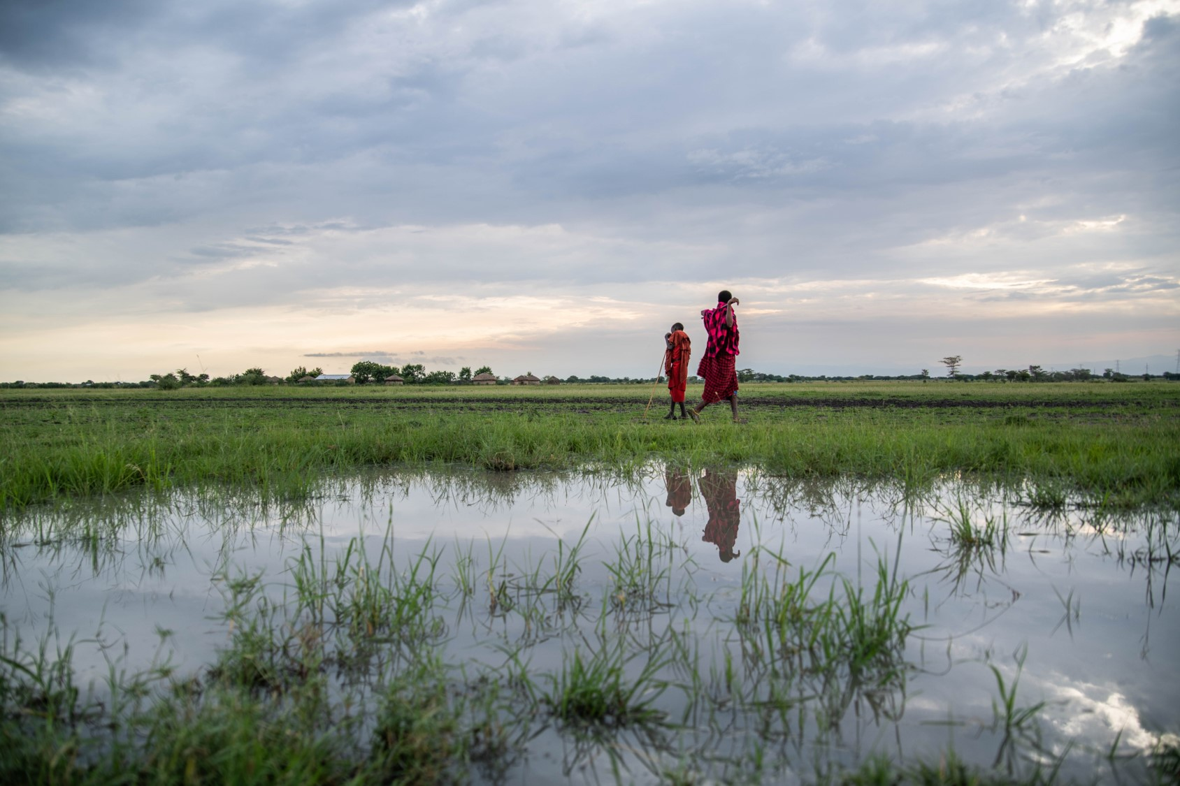
Population, Health and Environment:
An integrated approach to conservation
Definition, Theory of Change, Barriers to Adoption, and Recommendations
15 December 2020
A Conservation Measures Partnership Learning Initiative
Supported by the Gordon and Betty Moore Foundation
Photo source: NTRI/Roshni Lodhia

Slide 2
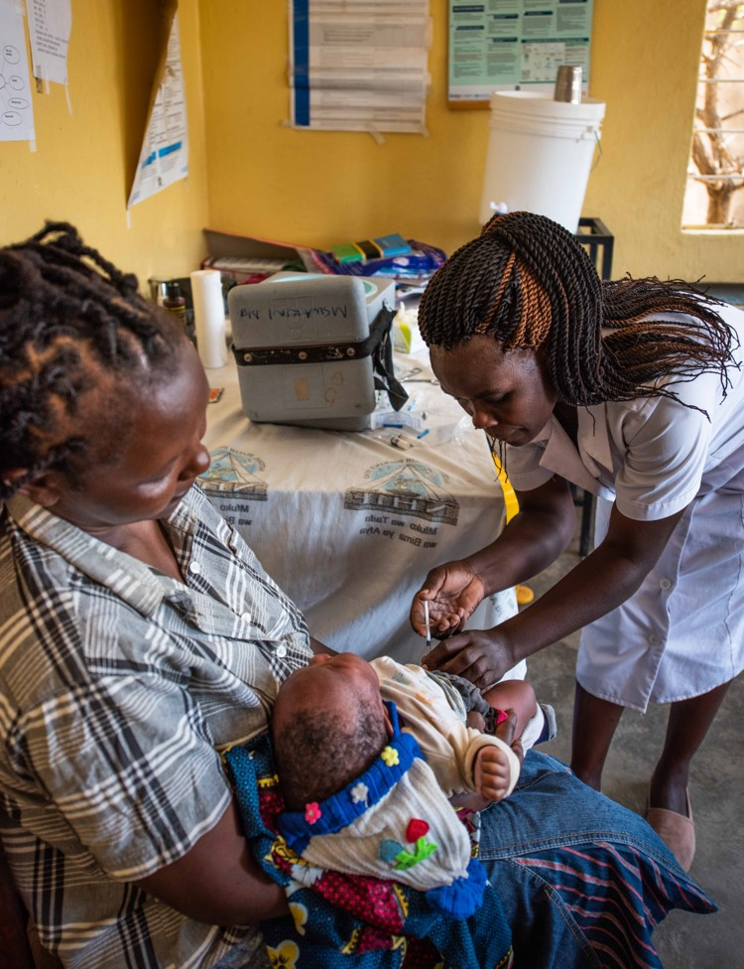
Table of Contents
2020 PHE Collaborative Learning Initiative - Final Report
Abstract
Introduction
CMP-Moore Learning Series
PHE Learning Initiative
This Report
Methods
Overall Learning Process
Identifying Learning Needs
Clarifying PHE
Identifying Barriers to Adoption
Results
PHE Learning Needs
PHE Definition
Theories of Change
Barriers to Adoption
Discussion
Key Findings
Conclusions
Recommendations
Next Steps
Learning About Learning
Annexes
Additional Information Supporting Learning
Photo source: NTRI/Roshni Lodhia
Notes:
Photo source: NTRI/Roshni Lodhia

Slide 3
List of Acronyms and Abbreviations
2020 PHE Collaborative Learning Initiative - Final Report
Acronyms
CMP | Conservation Measures Partnership
CS | Conservation Standards
FP | Family Planning
IUCN | International Union for Conservation of Nature
KII(s) | Key Informant Interview(s)
PHE | Population, Health & Environment
RH | Reproductive Health
SDG(s) | Sustainable Development Goal(s)
TOC | Theory of Change
Notes:
Photo source: NTRI/Roshni Lodhia

Slide 4
2020 PHE Collaborative Learning Initiative - Final Report
0. Abstract
Learning Process
A group made up of four facilitators, and 29 experts in integrated health and conservation approaches, explored the learning that would benefit to the conservation sector related to an integrated health and conservation approach called Population, Health and Environment (or PHE). To address the need for greater clarity over what PHE is and its value to conservation, drawing from existing definitions and logic pathways, the group developed the PHE Definition and set of PHE-related Theories of Change (TOCs) herein. The group also reached out to the conservation sector to understand the barriers to adoption of this type of approach and made recommendations for addressing those barriers and for future learning.
PHE Definition for the Conservation Sector
PHE is a multisectoral partnership approach to biodiversity conservation, human health, and sustainable livelihoods. PHE approaches are developed inclusively and equitably in response to local situations and the expressed needs of the people most closely linked to biodiversity conservation. PHE is intended to improve human health, particularly reproductive health, while empowering communities to achieve sustainable livelihoods, manage natural resources, conserve biodiversity, and maintain ecosystem services.
By integrating actions across multiple sectors, PHE can reach more people linked to biodiversity outcomes, engage more men in reproductive health, and more women in livelihood and natural resource management. PHE can, ultimately, achieve more significant and longer-lasting conservation outcomes than would likely occur without integration. When barriers to family planning are removed and contraceptive needs are met, women and girls can exercise their reproductive rights, leading to healthier timing and spacing of pregnancies, improved health of women and their children, and more time and energy to engage in education, conservation, and livelihood activities.
[Continued on next slide]

Slide 5
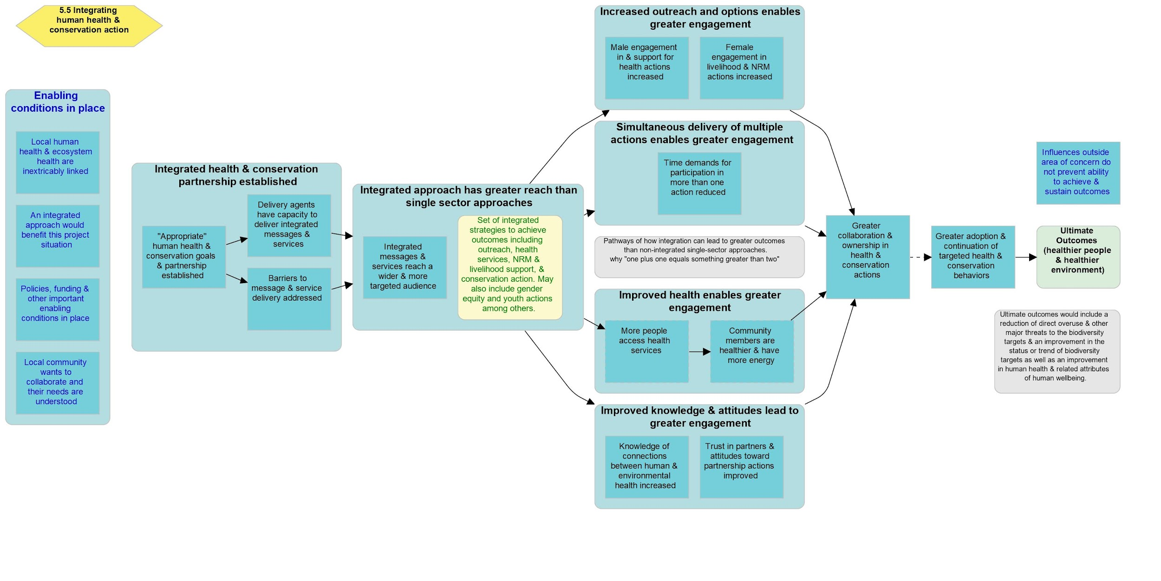
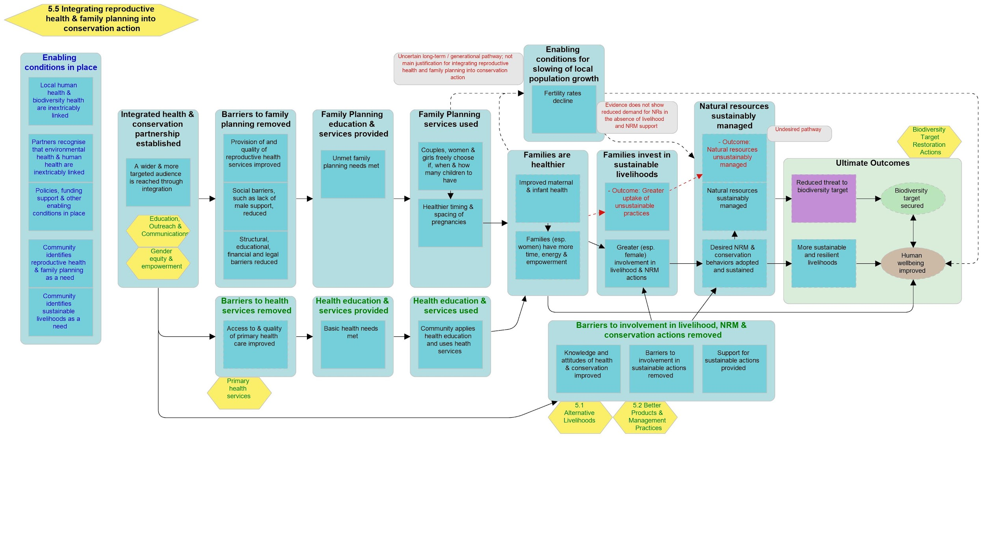
Two PHE-Related Theories of Change
Two TOC diagrams illustrate the anticipated values and conservation impacts of integrating health with conservation action and, specifically, integrating reproductive health and family planning with conservation action as part of a PHE approach.
An “Integrating Human Health & Conservation Action” TOC illustrates the value of a general integrated health and conservation approach. It highlights the different pathways that may lead to greater and longer-term impacts than might be possible through non-integrated approaches.
An “Integrating Reproductive Health & Family Planning into Conservation Action” TOC was developed to illustrate the value of including a reproductive health and family planning component in an integrated health and conservation approach. It highlights how removing barriers to family planning can lead to improved health, livelihood, and conservation outcomes. When addressing unmet reproductive health and family planning needs are part of an integrated health and conservation approach, it is considered PHE.
[Continued on next slide]

Slide 6
Barriers to Adoption
The biggest barriers preventing wider organizational adoption of PHE include, lack of necessary funding, lack of awareness of PHE and understanding of its value, lack of organizational experience and expertise, and increased cost and complexity of integrated projects. Other important barriers identified included a belief that PHE is a diversion from mission-based work, lack connection to appropriate partners, lack of policy support, lack of evidence of impact, and political / religious sensitivities around family planning.
Recommendations
Key recommendations from this learning include to:
Reframe PHE within other integrated development approaches and clarify its relationship to women's roles and gender equity and to climate change adaptation;
Provide increased and improved documentation of benefits of PHE approach (case studies, journal publications, presentations at conferences, better dissemination of existing resources);
Develop TOCs for additional key components of PHE, apply case studies, and include example indicators of success.
Create and share a list of potential partners across sectors to facilitate PHE partnerships;
Generate an outreach plan for thoughtful dissemination of resources, survey analysis, and framing of PHE to identified audiences;
Integrate and streamline PHE in existing conservation community resources and practices, such as the Conservation Standards, Conservation Actions & Measures Library, among others; and
Provide increased and targeted advocacy to donor community, including through a targeted report.

Slide 7
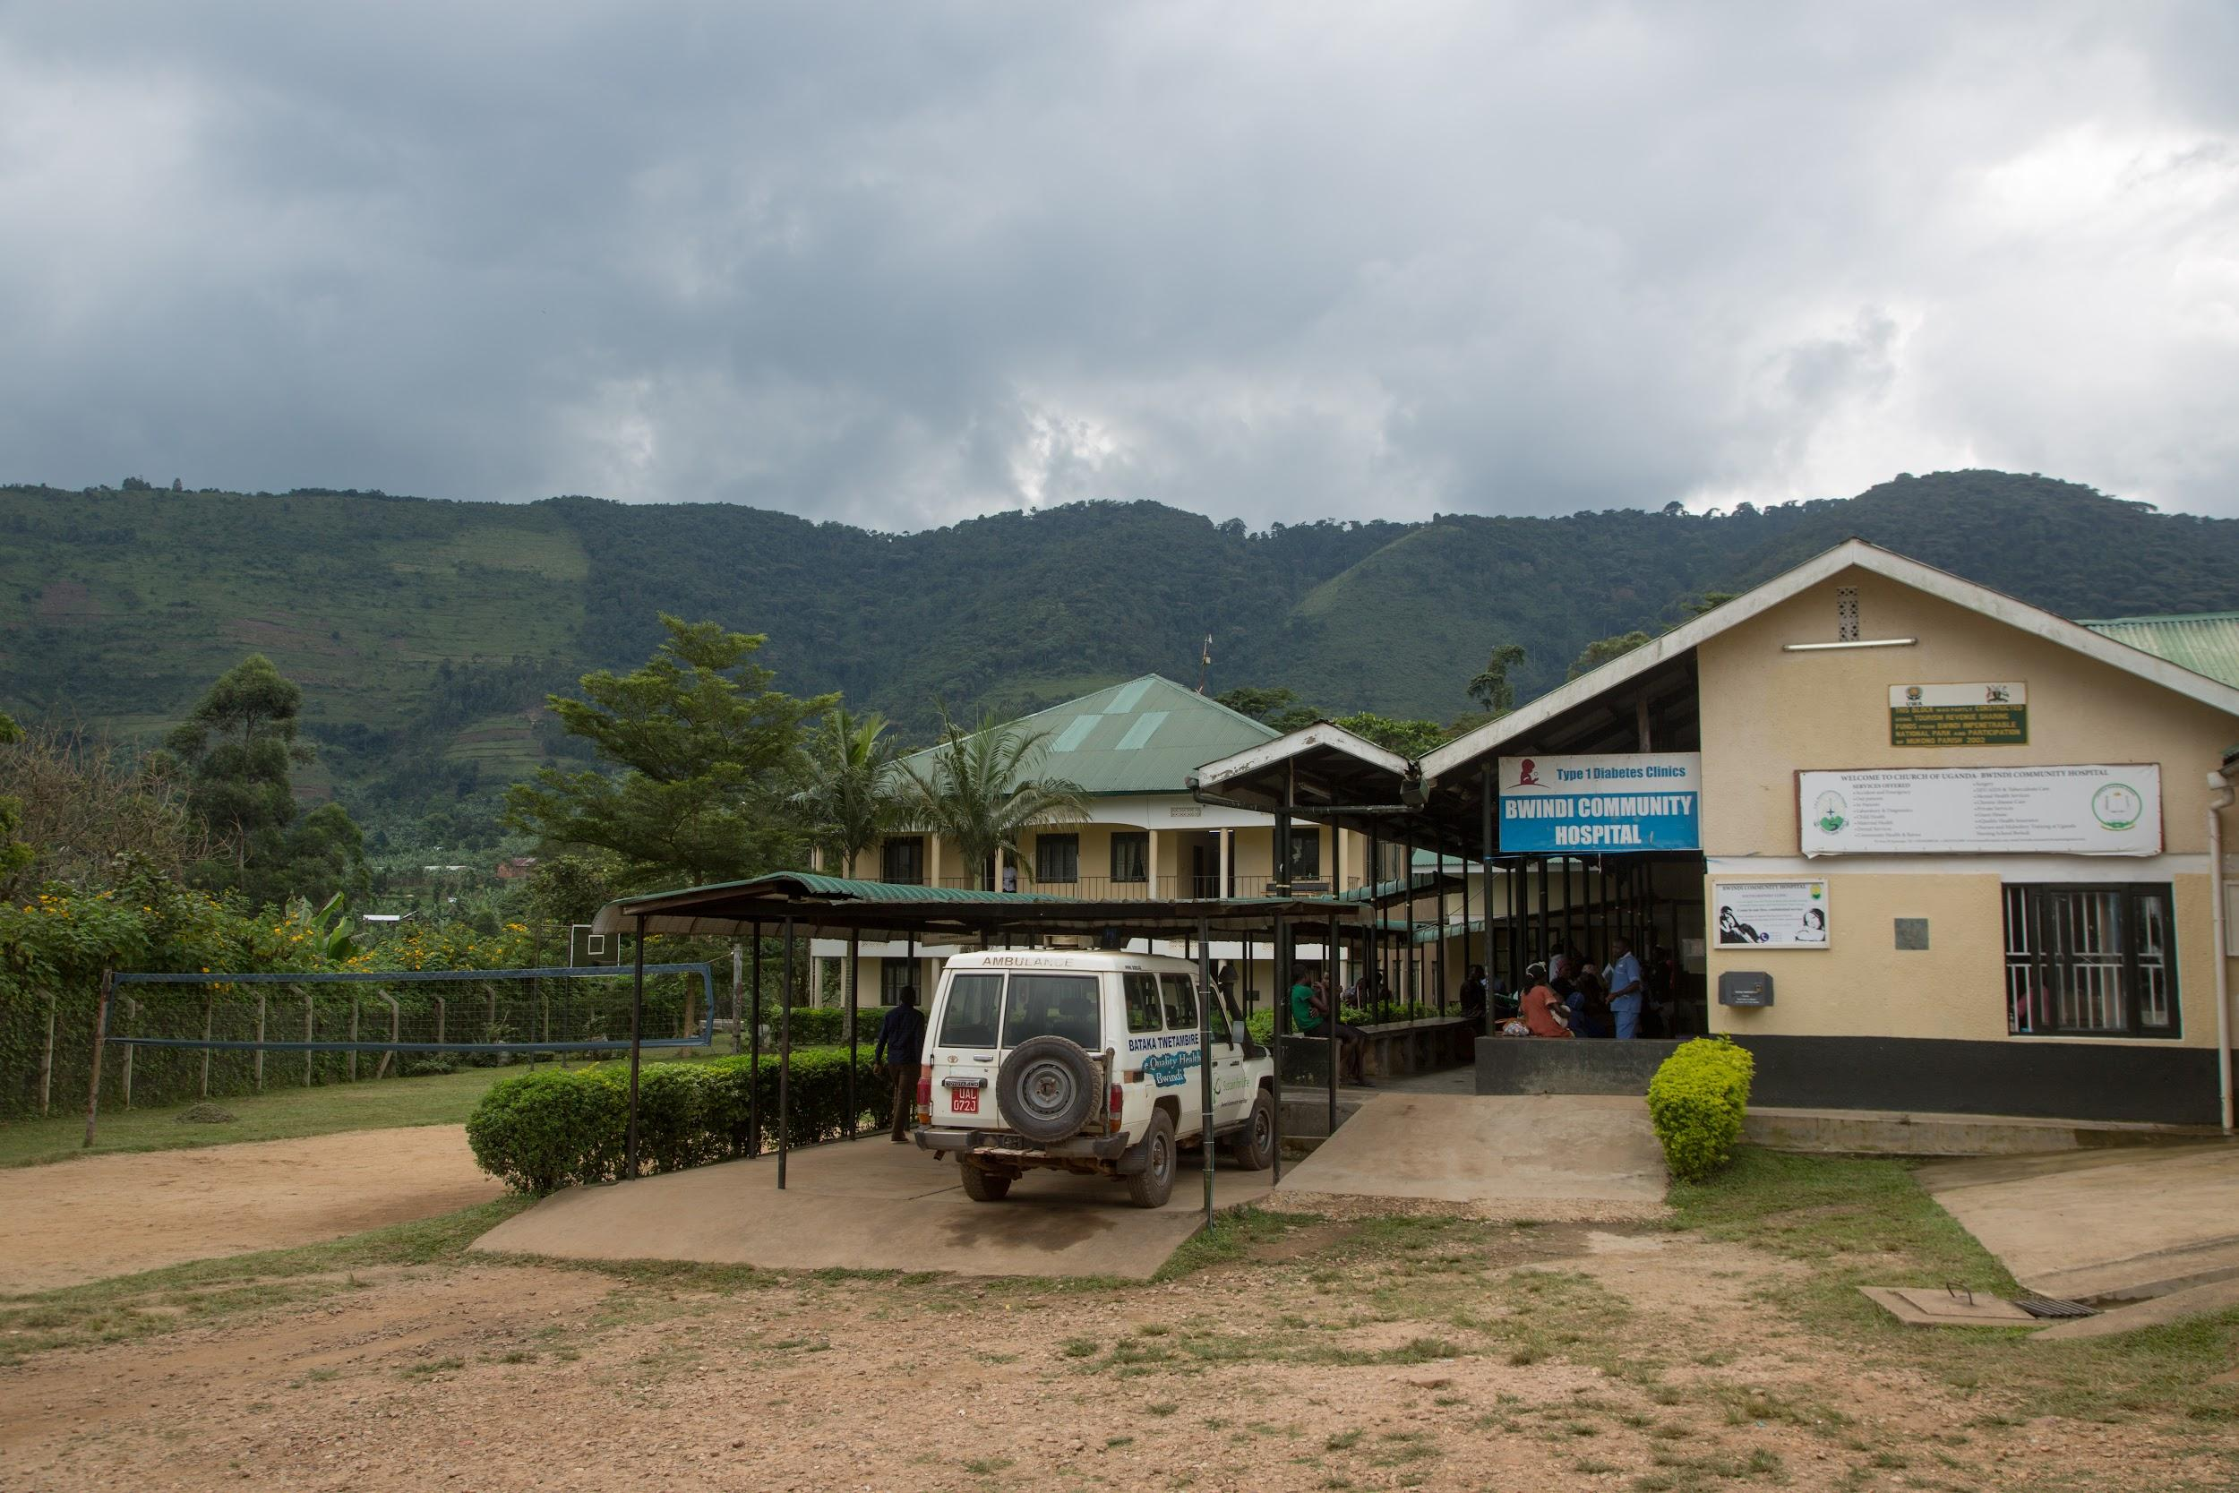
Introduction
Learning about Population, Health and Environment Approaches
Photo source: Margaret Pyke Trust
Notes:
Photo source: Margaret Pyke Trust

Slide 8
2020 PHE Collaborative Learning Initiative - Final Report
1.1 Introduction - CMP-Moore Learning Series
CMP-Moore Learning Initiative Series
In 2019, Conservation Measures Partnership (CMP) and the Gordon and Betty Moore Foundation launched a Learning Series to advance collaborative learning around important conservation questions. In 2020, the Learning Series was directed at strategies in current use or anticipated increased usage that require further elaboration and/or review to improve their effective application.
2020 Selected Learning Topics
The CMP membership prioritized four topics for learning, all that deal with “the people side” of conservation:
Population, Health and Environment - this initiative (Coordinator: Erica Cochrane)
Holistic Approach for Well-being of Biodiversity and People (Coordinator: Elizabeth O’Neill)
Broader Environment-Development Agendas & Links to Conservation (Coordinator: Sheila O’Connor)
Justice, Equity, Diversity, and Inclusion (Coordinators: Judy Boshoven, Ashleigh Baker, Adrienne Marvin)
Learning Initiative Limitations
The timeline for the learning initiatives was very compressed. Topics were selected in July with final reports and products due in mid-December. Selected topics were very generalized, thus an important first step in all of the learning initiatives was to clarify the topic and what learning was needed around that topic.

Slide 9
2020 PHE Collaborative Learning Initiative - Final Report
1.2 Introduction - PHE Learning Initiative
PHE Learning Purpose
The purpose of the PHE Learning Initiative was to improve CMP's and, more broadly, the conservation sector's understanding of PHE and its value to biodiversity conservation, to identify barriers that prevent uptake of this type of approach, and to identify recommended actions the PHE community and others can do to remove those barriers. Specific objectives were to:
Provide clarity for CMP and similar conservation-focused organizations and actors on PHE and its value to conservation;
Identify barriers to PHE adoption by CMP members and other similar organizations.
PHE Learning Limitations
The short timeframe for the Learning Initiative led to a number of limitations of the learning and this summary report. Those who were able to commit the time on such short notice, were those already actively involved in PHE. All learning group members, except for those facilitating the learning process, were long-term PHE experts who believe in the value of PHE and want to see greater PHE uptake. We were not able to recruit broad representation across the CMP and conservation sector. With the time that we had, we solicited that input from the broader sector via an online survey, but did not have much time to use the results of that survey to inform other parts of the learning.
Some specific limitations to each learning product are noted in the report; however, overall, the short timeframe means that we did not have time to complete an exhaustive review of the literature, to illustrate and apply case studies, to fully analyze the data collected, or to test the learning outputs with others who are not PHE experts.

Slide 10
2020 PHE Collaborative Learning Initiative - Final Report
1.3 Introduction - This Report
Report Purpose
The purpose of this report is to present key findings from the CMP-Moore PHE Learning Initiative. In this report, we summarize the learning process, provide a working definition of PHE, present two related Theories of Change, highlight important barriers to organizational adoption of PHE, and make recommendations for future action.
Report Audiences
People who we hope will use this report include:
Conservation Organizations and Practitioners who might be interested in applying PHE;
Population, Health and Environment Experts who want to support greater adoption of PHE;
Health and Family Planning Experts who might be interested in applying/advocating for PHE; and
Funders who might want to promote and/or support PHE.
Report Format
This is an annotated slide deck, design primarily for reading and collaboration versus presentation. It is organized in sections that are akin to chapters - Introduction, Methods, Results, Discussion, Conclusion - with slides containing detailed content. The Annexes following the report provide more detail on the process, discussions, and data that lead to the report findings.

Slide 11
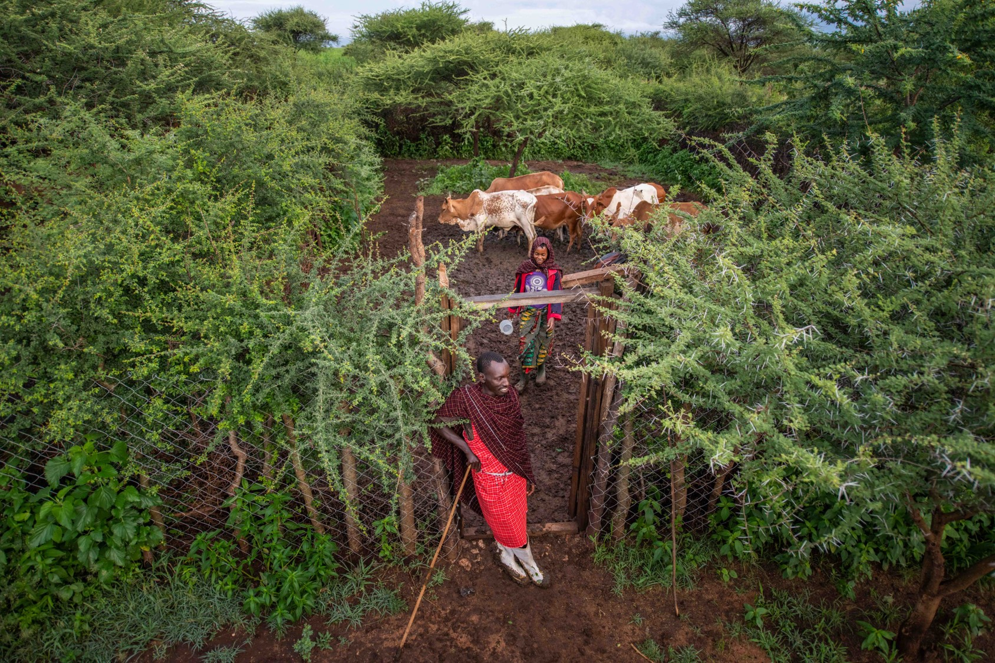
2. Methods
Process Used for Learning as a Community
Photo source: NTRI/Roshni Lodhia
Notes:
Photo source: NTRI/Roshni Lodhia

Slide 12
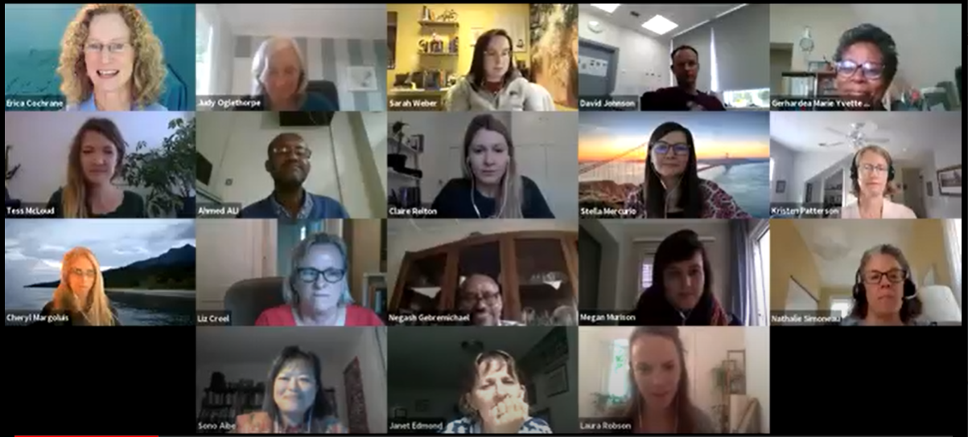
2020 PHE Collaborative Learning Initiative - Final Report
2.1 Methods - Overall Learning Process
The first phase of the learning process was to recruit interested individuals and to organize the collaborative structure that would help us achieve the desired learning objectives and products.
Collaborative Learning Group
From the outset, the plan for this Learning Initiative (as well as for the Holistic Approach and Broader Development-Environment Agenda Learning Initiatives) was to facilitate a collaborative learning process involving numerous individuals across CMP member organizations and beyond. Because PHE is by nature an approach that cuts across conservation, health and development sectors, we looked for learning group members both within and beyond CMP. A call for interest was sent to CMP and CCNet; however, nearly all learning group members were recruited by directly contacting those already actively involved in the PHE sector and having them recruit colleagues active in PHE.
The full list of active learning group members, organizational affiliations, and emails are listed in the table on the following slide.
[Continued on next slide]

Slide 13
Learning Group Members
Name | Organization | Email
Ahmed Mohammed | PHE Ethiopia Consortium | ahmedmoh95@yahoo.com
Ashleigh Baker | Foundations of Success* | Ashleigh@fosonline.org
Carina Hirsch | Margaret Pyke Trust | carina@margaretpyke.org
Caroline Stem | CMP*; Foundations of Success* | caroline@fosonline.org
Cheryl Margoluis | Pathfinder International | CMargoluis@pathfinder.org
Clive Mutunga | USAID* | cmutungamuia@usaid.gov
David Johnson | Margaret Pyke Trust | david@margaretpyke.org
Dr. Yvette Ribaira | John Snow, Inc | yvette_ribaira@mg.jsi.com
Elaine Rossi | John Snow, Inc | elaine_rossi@jsi.com
Gerhardea Marie Yvette Ribaira | John Snow, Inc | yvette_ribaira@mg.jsi.com
Janet Edmond | Conservation International* | jedmond@conservation.org
Janine Barden-O'Fallon | USAID* | bardenof@email.unc.edu
Judy Oglethorpe | WWF US* | judy.oglethorpe@wwfus.org
Kerryn Morrison | International Crane Foundation* Endangered Wildlife Trust | kerrynm@ewt.org.za
Kristen Patterson | Population Reference Bureau | kpatterson@prb.org
Laura Robson | Blue Ventures | laura@blueventures.org
Name | Organization | Email
Liz Creel | John Snow, Inc | ecreel@jsi.com
Lynne Gaffikin | Stanford University | earthlg@gmail.com
Maria Corazon Guevara de la Paz |  | coradlp2002@yahoo.com
Nagesh Teklu | PHE Consortium Ethiopia | pheethiopia@gmail.com
Nathalie Simoneau | WWF US* | Nathalie.Simoneau@wwfus.org
Pamela Onduso | Pathfinder International | ponduso@pathfinder.org
Sam Sellers | USAID* | ssellers@usaid.gov
Sono Aibe |  | sonoaibe8@gmail.com
Spike Millington | International Crane Foundation* | spike@savingcranes.org
Stella Mercurio | The Jane Goodall Institute* | smercurio@janegoodall.org
Tess McLoud | Population Reference Bureau | tmcloud@prb.org
Claire Relton** | International Crane Foundation* Endangered Wildlife Trust | clairer@ewt.org.za
Erica Cochrane** | CMP; International Crane Foundation* | ecochrane@savingcranes.org
Megan Murison** | Endangered Wildlife Trust | meganm@ewt.org.za
Sarah Weber** | CMP* | sarah@conservationmeasures.org
* CMP Member organizations
** Facilitators/Lead Authors

Slide 14
Learning Convenings
A series of three online Convenings were organized where learning group members advanced the learning objectives as a community. Convening 1 in September focused on reviewing findings from the Key Informant Interviews (KIIs) and PHE Expert Survey, setting the learning objectives and desired final products, and establishing smaller work groups around particular products. Convening 2 in October focused on finalizing the larger CMP Learning Survey and reviewing two main TOCs. Convening 3 in November focused on reviewing findings from the CMP Learning Survey, finalizing a PHE definition for the conservation community, and developing a set of recommendations from the learning. A total of 29 people participated in one or more of the Convenings with 19, 24, and 25 participants in each convening. Two learning initiative members were not able to join the Convenings and contributed their input offline as part of the homework leading up to and following from each Convening.
Work Groups
The specific work products were advanced in smaller work groups outside of the Convenings. In particular, the Definition, TOC and CMP Survey Work Groups spent significant time both in additional online meetings as well as offline providing input and advancing each product to bring to the larger learning group in the Convenings.
Tools and Resources
We used a variety of online tools and resources as part of the learning initiative. We used Zoom as our online meeting platform and MURAL as a collaborative workspace both during online meetings as well as offline collaboration. We used Survey Monkey as our main survey tool but also used Google Sheets to get feedback after each Convening. Learning group members provided links to important existing PHE publications and resources. We organized all of the learning content and resources in a Google Drive folder, making use of google documents, google spreadsheets and google slides to keep us organized.

Slide 15
2020 PHE Collaborative Learning Initiative - Final Report
2.2 Methods - Identifying Learning Needs
The second phase included surveying members of the PHE community to better understand what knowledge already exists and what new learning was needed that was not being filled by other efforts.
Key Informant Interviews
Erica conducted eleven hour-long unstructured Key Informant Interviews (KIIs) with 16 individuals active in the PHE sector. The purpose of the interviews was to refine the learning initiative focus, recruit learning group members, identify important resources relevant to the learning, and identify others that should be involved or otherwise consulted. Those interviewed included the following (all but two of whom were members of the learning group): Ashleigh Baker, Cara Honzak (Pathfinder), Carina Hirsch, Caroline Stem, Cheryl Margolius, Clive Mutunga, David Johnson, Judy Oglethorpe, Kerryn Morrison, Kristen Patterson, Laura Robson, Negash Teklu, Nathalie Simoneau, Spike Millington, Stella Mercurio, Vik Mohan (Blue Ventures).
Pre-Convening Homework
As part of the homework leading up to Convening 1, learning group members were asked to answer the question “If you could change one thing about how PHE is understood, supported, or implemented, what would it be”.
PHE Expert Survey
A survey titled CMP PHE Learning Initiative Survey was developed in Survey Monkey to better understand what those working in the PHE field believe would be most valuable to learn as part of this initiative. The survey was distributed to everyone who had been contacted during the KIIs and those who had expressed interest in being part of the learning initiative with a request to share the survey with others actively involved in PHE. Twenty-six people responded representing 19 different organizations and spanning four continents and nine countries. All but the four members of the learning facilitation team had more than five years of experience working in PHE and 60% had more than 10 years of experience.

Slide 16
2020 PHE Collaborative Learning Initiative - Final Report
2.3 Methods - Clarifying PHE
The third phase of the learning process focused on using the expertise of the learning group to provide greater clarity to CMP and the wider conservation sector on what PHE is and its value. We specifically focused on the development of two main products.
PHE Definition
The Definition Work Group used input from the KIIs and the PHE Expert Survey to develop an initial draft that was vetted with the entire learning group during Convening 2. Input was then used to refine and develop a working definition specifically for the conservation sector.
Theory of Change
The TOC Work Group used input from the KIIs and PHE Expert Survey to sketch out initial draft TOCs. The TOCs were vetted in Convening 2. Input was then used to refine the TOCs and develop the associated narratives. They follow the principles laid out in the Open Standards for the Practice of Conservation (or Conservation Standards):
A theory of change (TOC) diagram is a tool that clarifies assumptions about how a given conservation action is expected to lead to desired outcomes. The diagram maps out a series of causal relationships that link factors in an “if…then” fashion.
It can also be used to show the enabling conditions under which the strategy might achieve results as well as complementary strategies that could be employed.
If a generic TOC is then tested with evidence from real-world examples, the theory can be vetted and adaptively changed over time to incorporate lessons learned.

Slide 17
2020 PHE Collaborative Learning Initiative - Final Report
2.4 Methods - Identifying Barriers to Adoption
The fourth phase of the learning process focused on developing a better understanding of the barriers and potential solutions to those barriers to organizational adoption of PHE approaches. Although some of the methods used in Identifying Learning Needs asked about barriers and potential solutions to adoption, we were missing the voices of those who had not yet adopted PHE approaches. Given that the learning group was comprised of PHE experts active in the field, we recognized that we needed additional information from the conservation sector, and as such, designed and administered a CMP Learning Survey.
CMP Learning Survey
A survey titled CMP Learning Survey – October 2020 was developed in Survey Monkey to better understand the conservation sector’s knowledge, value and experience with PHE approaches and the barriers to and factors that support organizational uptake of PHE approaches. The survey was distributed to the CMP contact list, the Conservation Coaches Network (CCNet) listserv, and the members of this learning initiative with a request to all three groups to share the survey within their organizations and communities of practice.
A total of 234 people responded; however, only 175 responses are summarized. 59 were removed because they were incomplete or were irrelevant. Although respondents ranged from CEOs to field staff, more than half categorized their position as senior leader, advisor, director, or manager and are likely able to influence decisions within with their organization. Respondents came from (or support) organizations whose work/missions are at least partly focused on biodiversity conservation, including at least 42 respondents from 14 CMP member organizations. Although there was a good geographic spread in both where respondents and organizations were based and where their work was focused, more than 50% of the organizations were based in North America.

Slide 18
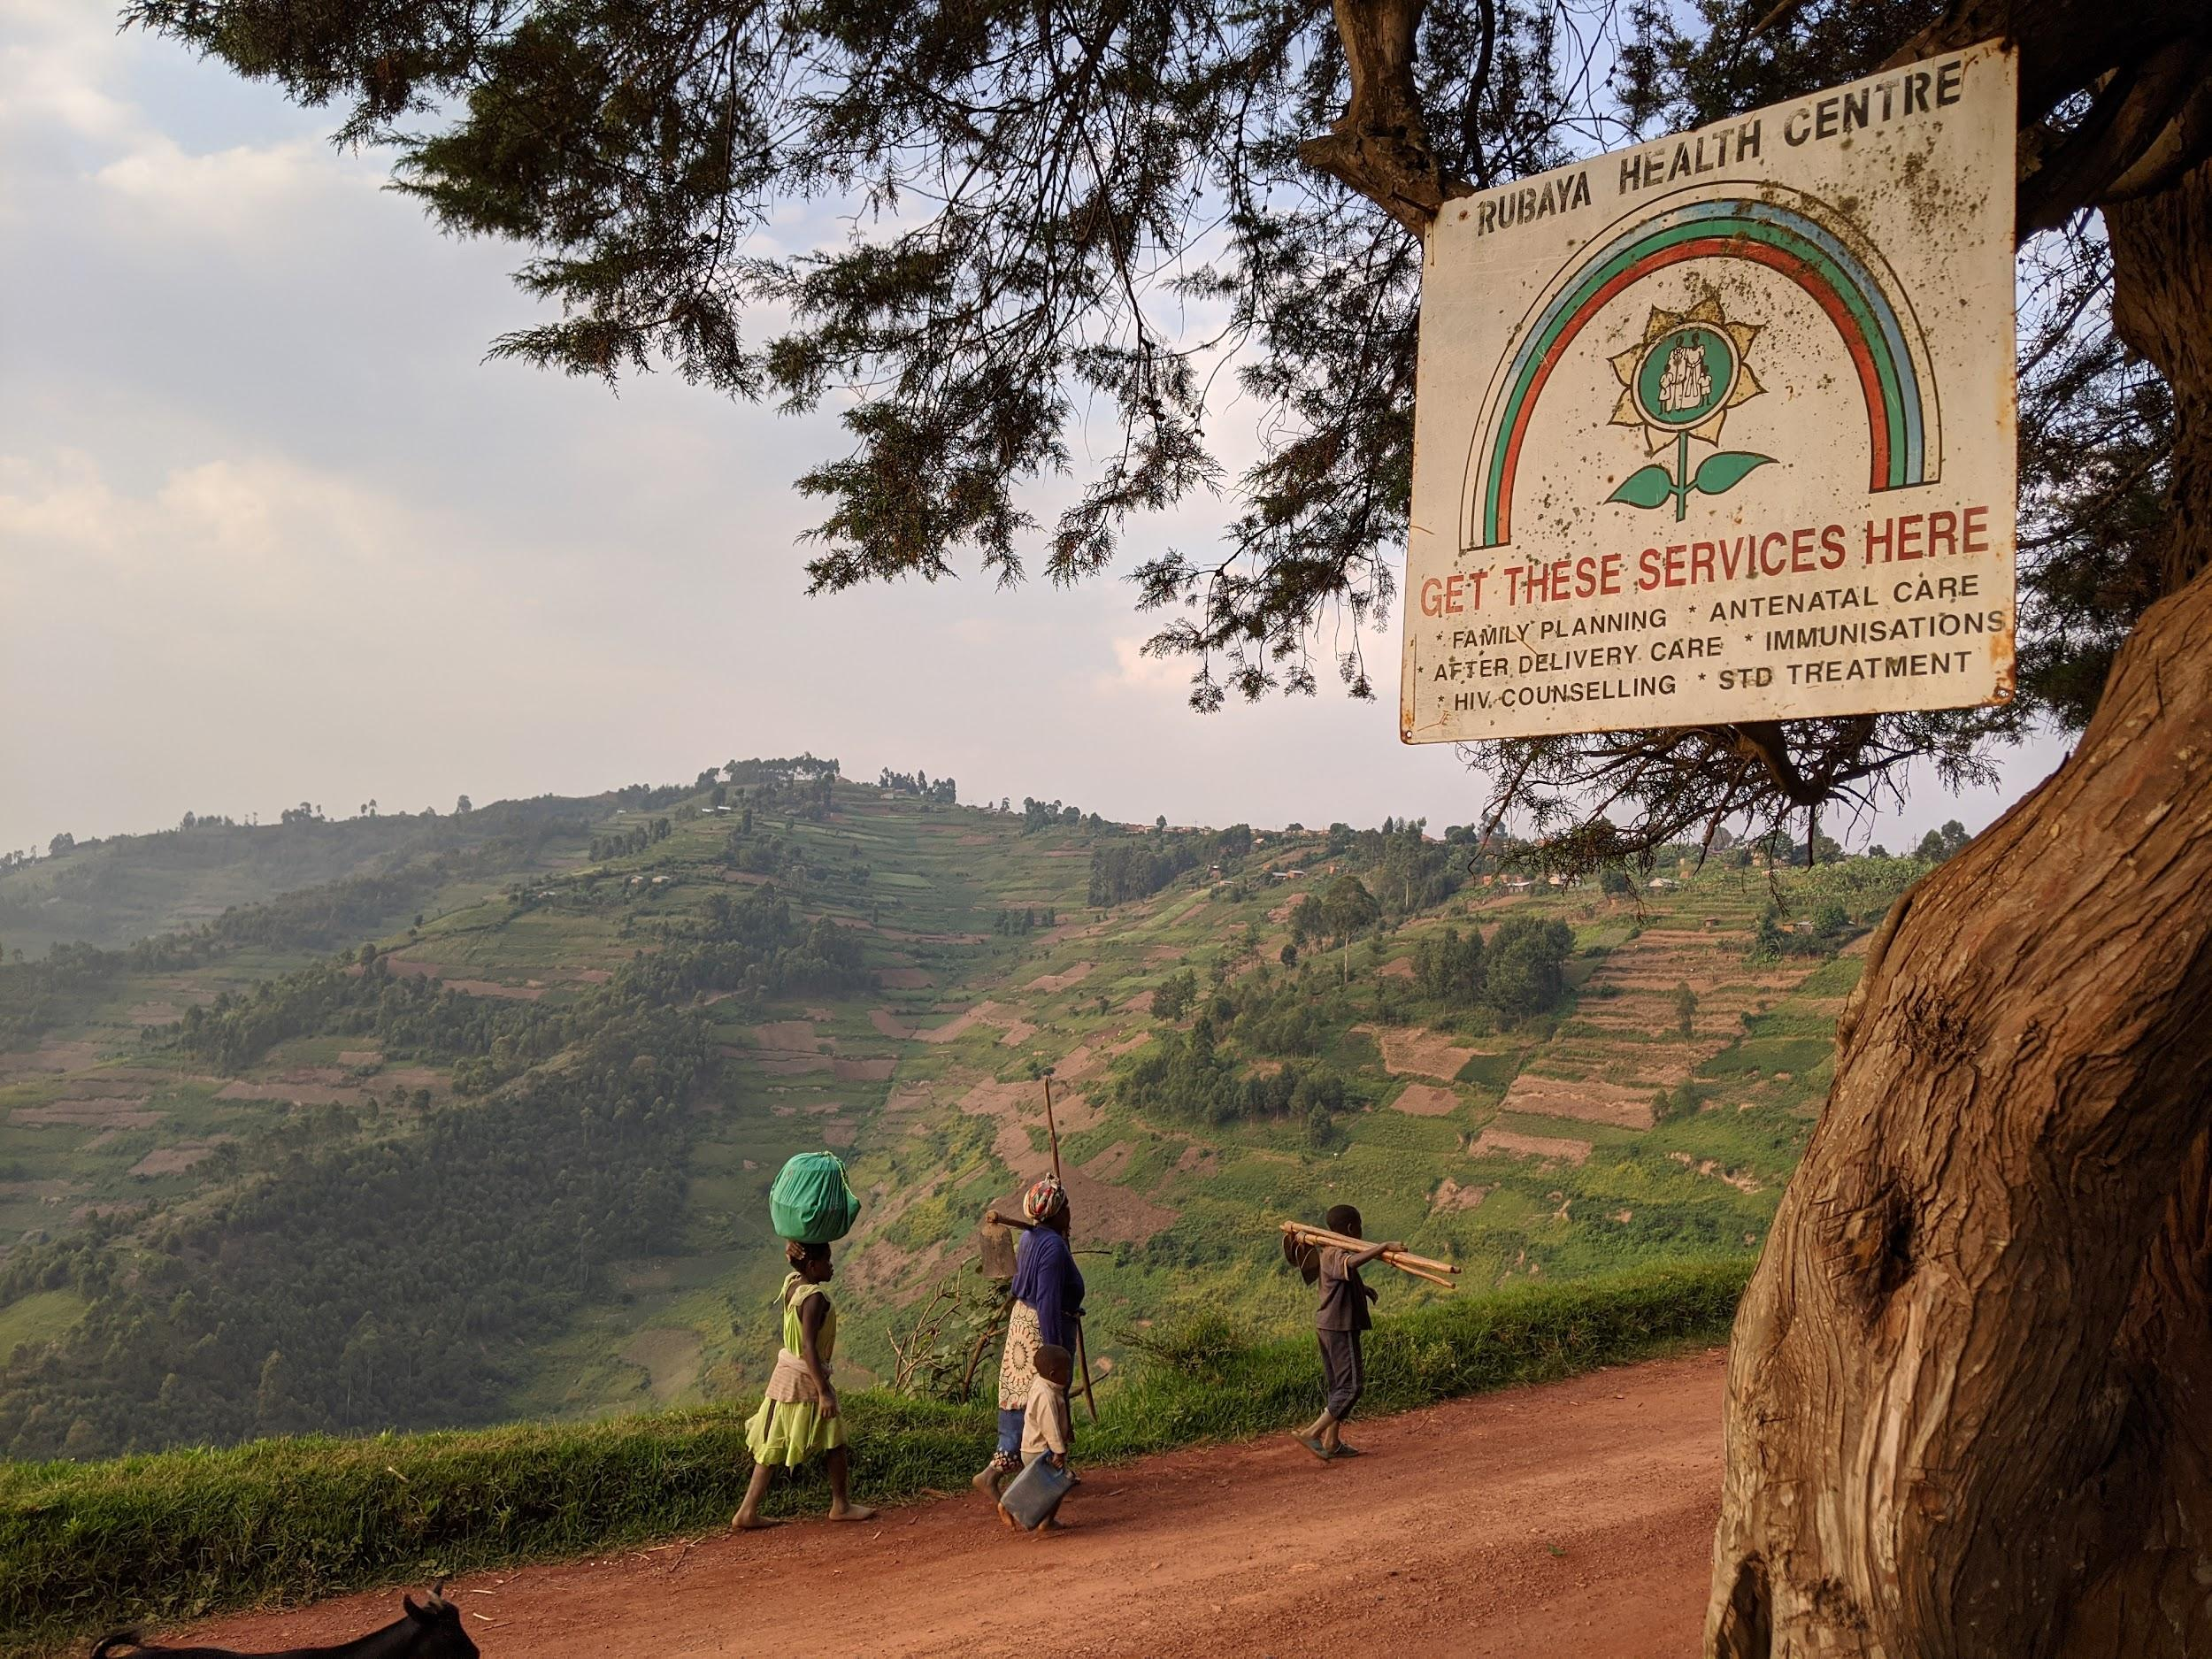
3. Results
Summary of Needs, Definition, Theory of Change, and Barriers to Adoption
Photo source: Margaret Pyke Trust
Notes:
Photo source: Margaret Pyke Trust

Slide 19
2020 PHE Collaborative Learning Initiative - Final Report
3.1 Results - PHE Learning Needs
Results from the KIIs, Pre-Convening Homework, and PHE Expert Survey are briefly summarized in the following slides. In brief, these results brought forward where there is agreement, where clarity is lacking, and where knowledge is lacking.
Agreement
There was broad agreement that PHE is a valuable approach to biodiversity conservation in certain situations and that the learning group would like to see greater uptake of PHE across the conservation sector. There was also agreement on the anticipated benefits of PHE and under what situations PHE is likely to be appropriate.
Lack of Clarity
There was a lack of clarity both within the PHE experts, as well as an assumed lack of clarity among conservation practitioners, as to what PHE is exactly. The sector was lacking an agreed upon definition for PHE, clarity about what components are needed to consider something a PHE approach, and an agreed upon theory of change for how PHE is expected to lead to conservation impacts.
Lack of Knowledge
There were assumptions made about what barriers are preventing PHE adoption and what is needed to encourage greater adoption; however, we lacked direct input from the conservation sector regarding their knowledge, attitudes and experience with PHE, the barriers they face in PHE adoption where it is relevant, and what would help address those barriers.

Slide 20
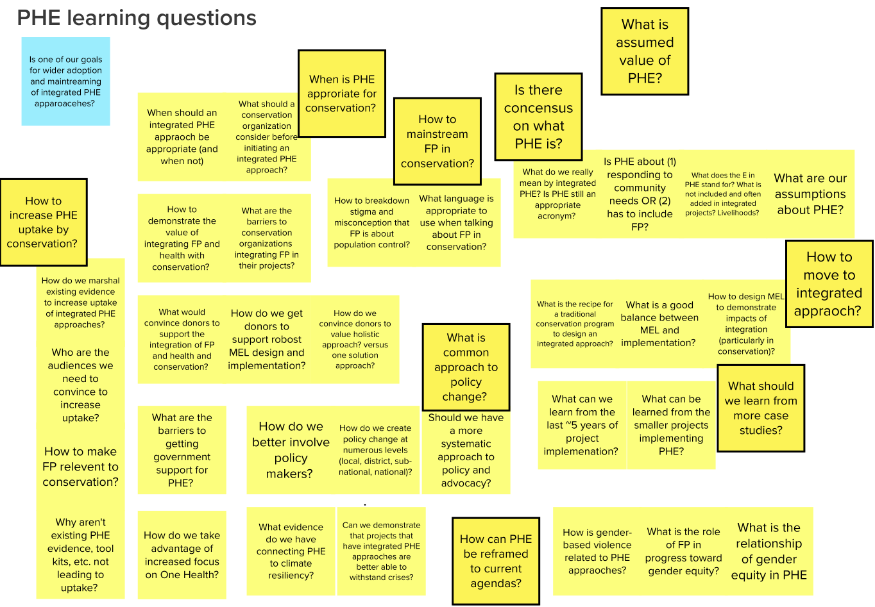
2020 PHE Collaborative Learning Initiative - Final Report
3.1.1 Key Informant Interview Summary
Questions that came up during KIIs were recorded in MURAL, grouped and summarized into key PHE Learning questions:
How to increase PHE uptake by conservation organizations?
How to mainstream Family Planning into conservation?
When is PHE appropriate for conservation?
What is the assumed value of PHE?
Is there consensus of what PHE is?
How can PHE be reframed to current agendas?
What is the common approach to policy change?
How do organizations move to an integrated approach?
What should we learn from more case studies?
[Continued on next slide]

Slide 21
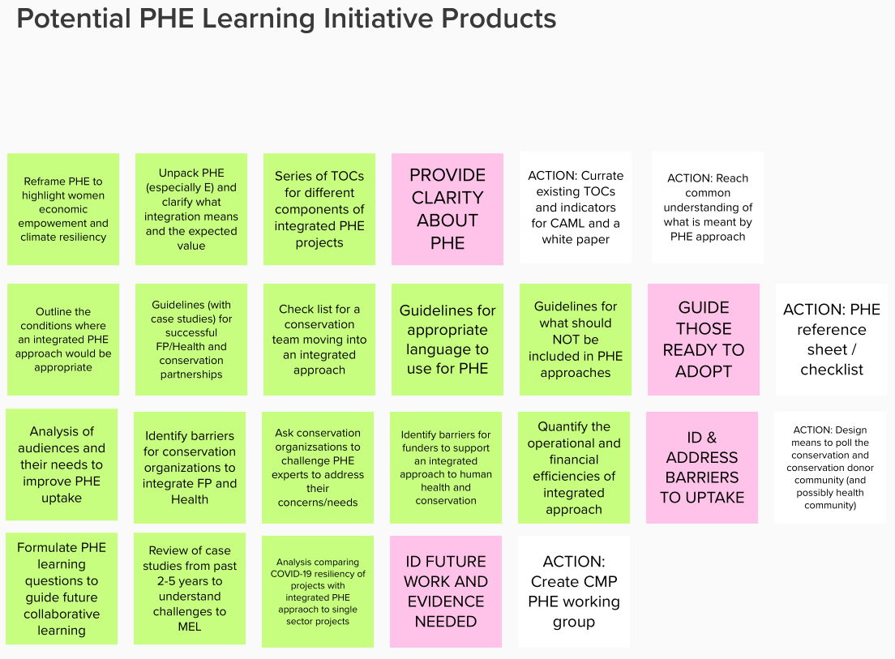
2020 PHE Collaborative Learning Initiative - Final Report
3.1.1 Key Informant Interview Summary
Desired actions mentioned during the KIIs were summarized in MURAL into desired long-term PHE learning actions (green) and potential objectives (pink) and actions (white) for this CMP Learning Initiative. Potential actions proposed for this learning initiative included the following:
Curate existing TOCs and indicators for the CMP Conservation Action and Measures Library and a white paper
Reach common understanding of what is meant by a PHE approach
Develop/disseminate a PHE reference sheet/checklist
Design a means to poll the conservation and conservation donor community (and possibly health community)
Create a CMP PHE working group

Slide 22
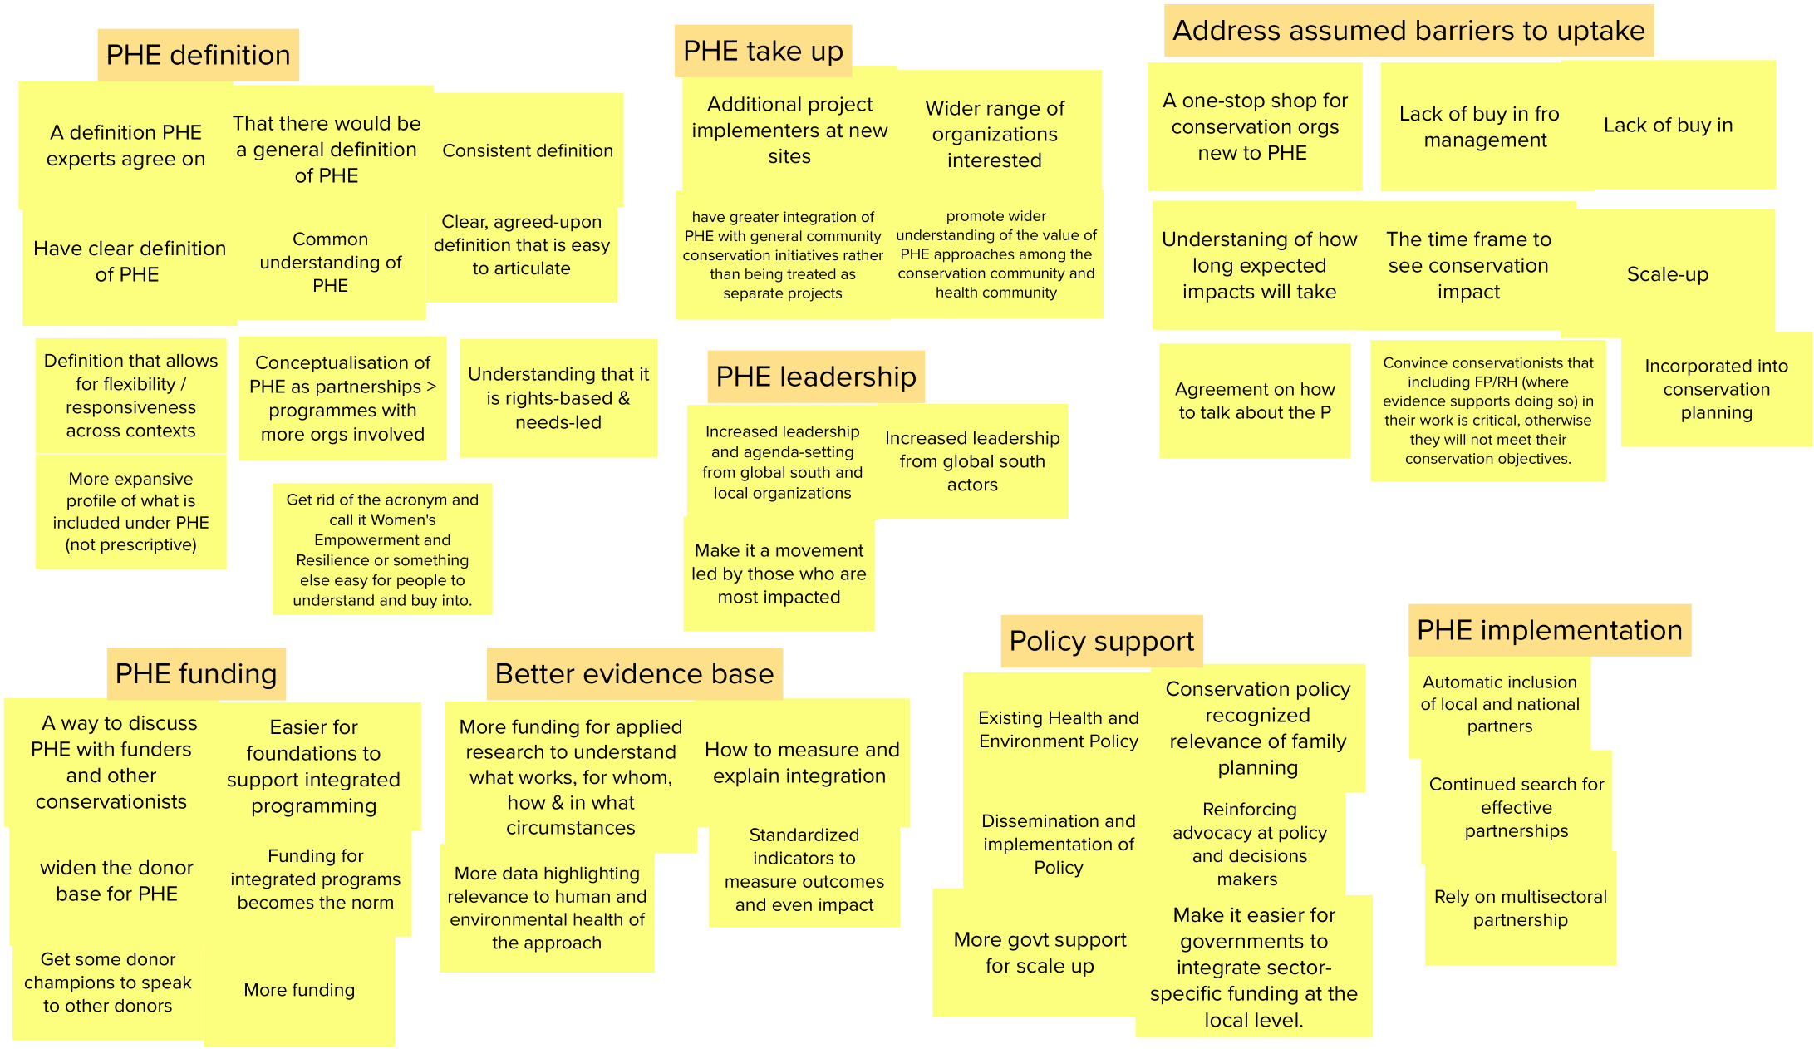
2020 PHE Collaborative Learning Initiative - Final Report
3.1.2 Pre-Convening Homework Summary
The PHE Learning Group responses to the question “If you could change one thing about how PHE is understood, supported, or implemented, what would it be” were recorded and grouped in MURAL. These responses can be summarized as follows:
Need for a PHE Definition
Desire for greater PHE uptake
Need to address barriers to uptake
Need for better PHE funding
Desire for greater PHE leadership from those based where PHE is most relevant
Need for better evidence base to show that PHE is effective
Need for stronger policy support
Recognition of the importance of partnership in PHE implementation

Slide 23
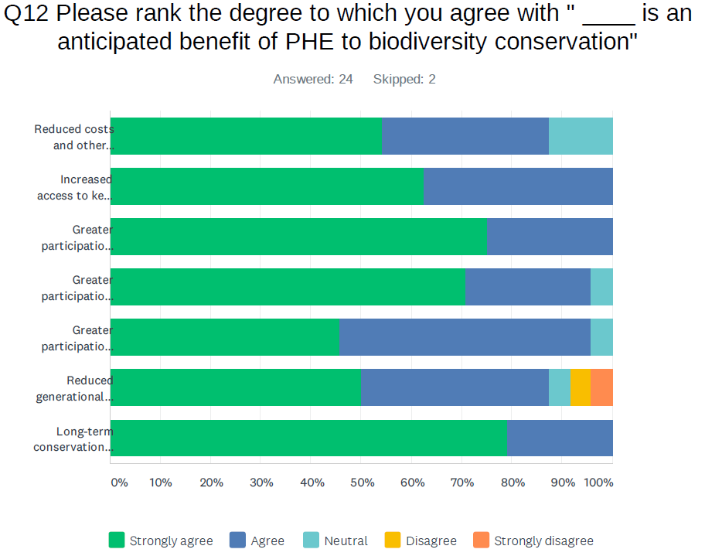
2020 PHE Collaborative Learning Initiative - Final Report
3.1.3 Expert Survey Summary - Anticipated Benefits
There is agreement on the anticipated benefits of PHE to biodiversity conservation:
There was broad agreement on the listed items as anticipated benefits of PHE to biodiversity conservation, particularly increased access to key sectors, greater participation because of improved health, and long-term conservation impacts due to integration.
Inputs were useful in the development of a definition and associated TOCs.
The open-ended comments also noted:
PHE approaches may be more costly and more complex than single sector approaches
Gaining greater female engagement is often more complicated than just improving health; gender equity is an important component of PHE
The impact of PHE on reducing pressure on natural resources may take generations, and thus is not easily measured in most PHE efforts that are designed around shorter time frames
Rank how much you agree with “____ is an anticipated benefit of PHE to biodiversity conservation
Reduced costs and other efficiencies
Increased access to key community sectors
Greater participation by all because healthier
Greater participation by women because healthier
Greater participation because of goodwill
Reduced generational pressures on resources
Long-term conservation impacts and resiliency

Slide 24
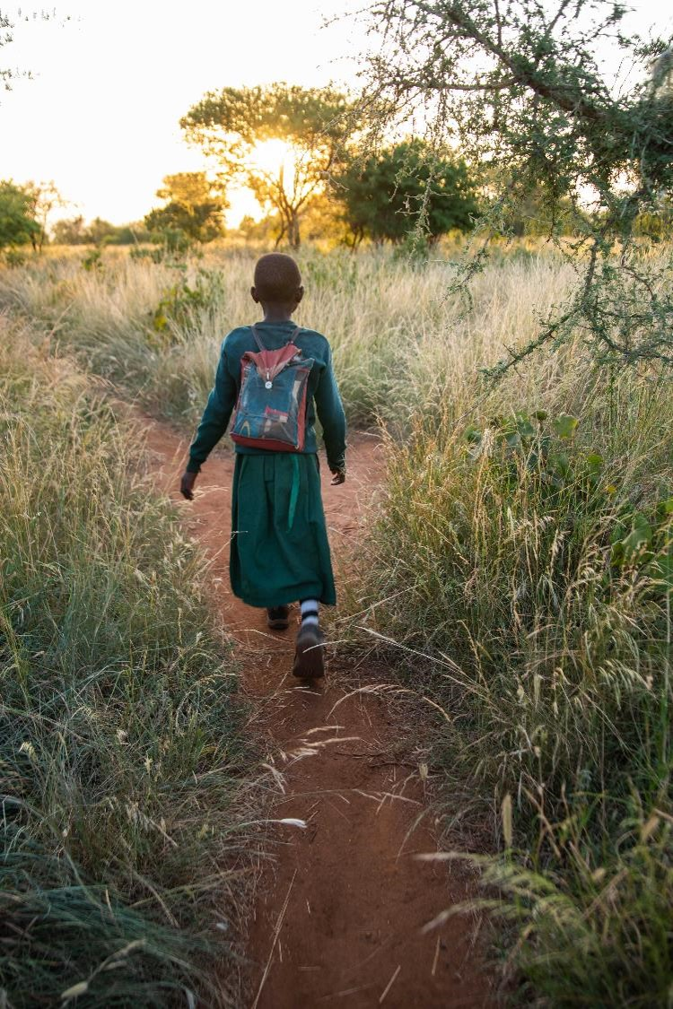
2020 PHE Collaborative Learning Initiative - Final Report
3.1.3 Expert Survey Summary - Situations Where PHE May Be Appropriate
There was broad agreement on the factors that would predict that a PHE approach would be advantageous for a biodiversity project. The factors that respondents rated highest as predictors were the following:
There is an unmet need for family planning.
The community requests health support, and specifically for reproductive and maternal health.
Poor health conditions reduce community engagement in conservation, natural resource management, and livelihood initiatives.
Women are underrepresented in conservation, natural resource management, and livelihood decisions and initiatives.
Encroachment and environmental degradation are threats to healthy natural resources, human health and livelihoods.
Local human population growth is a driver of biodiversity threats and degradation of ecosystem services.
The open-ended comments also noted important predictors that a PHE approach might be advantageous:
Poverty.
Resource-dependence on natural resources that are lacking (i.e. lack of arable land, declining fish stocks,etc.).
Poor education/literacy.
Photo source: NTRI/Roshni Lodhia
Notes:
Photo source: NTRI/Roshni Lodhia

Slide 25
2020 PHE Collaborative Learning Initiative - Final Report
3.1.3 Expert Survey Summary - Lack of Clarity
There is lack of clarity and agreement on what PHE is:
The three questions to the right show that there was not agreement among PHE experts and, presumably, the conservation community about what PHE means.
Other questions not illustrated here, also suggest that there is a lack of clarity as to what components need to be included for an approach to be considered PHE.
We asked if the community should continue to refer to the approach as PHE. 70% were in favour of keeping the PHE acronym while providing better clarity. Those not in favor, were concerned with (1) not being prescriptive but rather taking a holistic approach and having the interventions determined by community need, and (2) the political sensitivities around including “Population” specifically as a separate component when family planning and reproductive health can be grouped under “Health” interventions.
The open-ended comments also noted:
Lack of clarity on the integration aspects between the linkages of population, health and environment.
There are misconceptions around the purpose for inclusion of a family planning and reproductive health component.
There is confusion among terms including Population Environment and Development (PED) and on the relationship of gender equity to PHE.
Do you think the PHE community agrees on what PHE means?
What proportion of the conservation community do you think is aware of PHE?
Of that proportion, do you think the conservation community agrees on what PHE means?

Slide 26
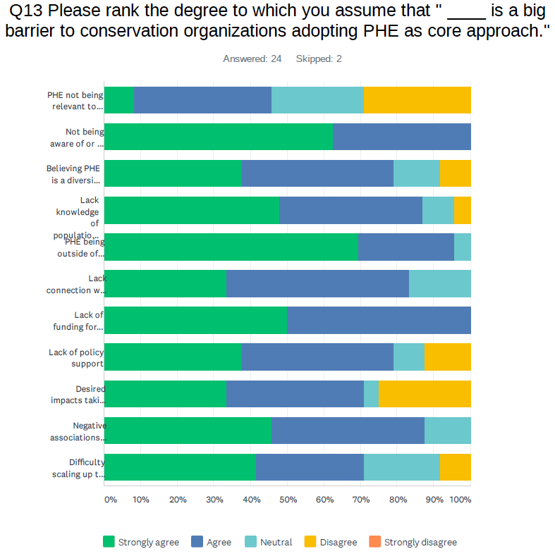
2020 PHE Collaborative Learning Initiative - Final Report
3.1.3 Expert Survey Summary - Assumed Barriers to Adoption
Rank how much you assume “____ is a big barrier to conservation organizations adopting PHE as a core approach”
There is also broad agreement on the assumed barriers to PHE adoption:
The top assumed barriers were expertise, awareness, funding, connection with a health partner, and negative associations with family planning
It was noted that we need to hear directly from conservation organizations.
This list and input was used to design a survey for the conservation sector.
The open-ended comments include additional barriers not in the original list including:
Lack knowledge of the impact of ill health on behavior and resource use.
Difficult to measure success.
Not relevant to their work
Not aware of PHE
Believing is a diversion
Not aware of family planning relevance
PHE outside of expertise
Lack connection with health partner
Lack funding for integration
Lack policy support
Impacts take to long
Negative associations with family planning
Difficulty scaling up

Slide 27
2020 PHE Collaborative Learning Initiative - Final Report
3.1.3 Expert Survey Summary - Learning Objectives and Products
There was agreement on the desired focus and outputs of the learning initiative:
People did not want to duplicate past efforts. A lot of work has already been done or is being done on resource lists, guidance and trainings, case studies and specific TOCs, and indicators. There are also a number of active PHE-related working groups.
Respondents agreed that the Learning Initiative should focus on the following:
“Provide clarity for CMP members and similar organizations on what PHE is, the linkages between P, H and E, and PHE’s potential value for biodiversity conservation”.
“Identify barriers for CMP members and similar organizations to take up PHE approaches in their work”, and “Identify what is needed by CMP members and similar organizations to take up PHE approaches”.
Disseminate existing body of knowledge on PHE programming and lessons learned to CMP members.
Respondents further agreed that the following would be valuable products:
PHE Definition
Generic PHE TOC diagram and narrative
Results of a Survey of CMP member and similar organizations identifying barriers to and needs for PHE adoption
Curated set of PHE Resources for CMP members and other conservation organizations
Presentation/Communication about PHE and this learning to CMP and other conservation actors
Broader/longer-term CMP PHE Working Group
Link to full PHE Expert Survey Results with identifying information redacted.

Slide 28
2020 PHE Collaborative Learning Initiative - Final Report
3.2 Results - PHE Definition
Pulling from the KIIs, PHE Expert Survey, discussions during Convening 2, and significant offline review by the PHE Definition Work Group, on the next slide is a working definition of PHE for the conservation community.
Purpose of Definition
We developed an “elevator pitch” definition of PHE that can be included in the Conservation Standards. It is meant to clarify what a PHE approach is, when it is likely to be relevant to conservation efforts, and how the approach is meant to lead to conservation outcomes. It clarifies how integrating health, particularly reproductive health and family planning, into conservation actions can lead to improved community engagement and empowerment and, ultimately, improved biodiversity outcomes.
Target Audience for Definition
The main audience for the definition is CMP and other conservation-focused organizations and practitioners who:
want to understand how PHE is relevant to their biodiversity conservation mandate,
want to understand how a PHE approach may help them achieve greater and longer lasting biodiversity outcomes,
are considering adopting a PHE approach in their work and need to communicate with others about the approach.
Limitations of Definition
This is seen as a working definition that will be adapted over time. This is only a definition of PHE for the conservation sector; it emphasizes the value for and expected outcomes important to biodiversity conservation. It is not meant to be the sole definition of PHE; other definitions can be developed that specifically target and resonate best with other important sectors for successful PHE partnerships, such as the health and rural development sectors.
[Continued on next slide]

Slide 29
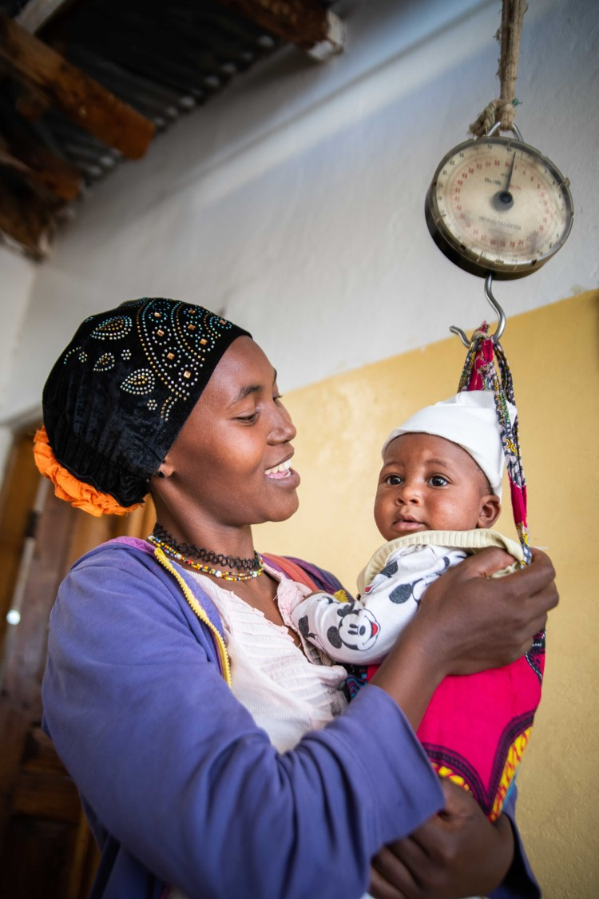
2020 PHE Collaborative Learning Initiative - Final Report
3.2.1 PHE Definition for the Conservation Sector
Population, Health and Environment (PHE) is a multisectoral partnership approach to biodiversity conservation, human health, and sustainable livelihoods. PHE approaches are developed inclusively and equitably in response to local situations and the expressed needs of the people most closely linked to biodiversity conservation. PHE is intended to improve human health, particularly reproductive health, while empowering communities to achieve sustainable livelihoods, manage natural resources, conserve biodiversity, and maintain ecosystem services.
By integrating actions across multiple sectors, PHE can reach more people linked to biodiversity outcomes, engage more men in reproductive health, and more women in livelihood and natural resource management. PHE can, ultimately, achieve greater and longer-lasting conservation outcomes than would likely occur without integration. When barriers to family planning are removed and contraceptive needs are met, women and girls can exercise their reproductive rights, leading to healthier timing and spacing of pregnancies, improved health of women and their children, and more time and energy to engage in education, conservation, and livelihood activities.
Photo source: NTRI/Roshni Lodhia
Notes:
Photo source: NTRI/Roshni Lodhia
This definition was finalised over the period between the first convening and November 2020.

Slide 30
2020 PHE Collaborative Learning Initiative - Final Report
3.3 Results - Theories of Change
With significant offline work by the TOC Work Group and input during Convening 2, the following TOC diagrams and narratives were developed.
Purpose of TOCs
The TOCs are meant to illustrate the anticipated values and conservation impacts of integrating health with conservation action and, specifically, integrating reproductive health and family planning with conservation action as part of a PHE approach.
Target Audience for the TOCs
As with the definition, these are specifically designed for the conservation community. The main audiences are CMP and other conservation-focused organizations and practitioners who:
want to understand how an integrated health and conservation approach can deliver greater conservation impacts than an unintegrated, single-sector approach,
want to understand how including reproductive health and family planning into an integrated health and conservation approach is meant to help achieve greater and longer lasting biodiversity outcomes,
need a generic or high-level TOC to clarify the logic of proposed or on-going work.
[Continued on next slide]

Slide 31
2020 PHE Collaborative Learning Initiative - Final Report
PHE-Related TOCs
In the slides below we present two different, but related TOCs.
The “Integrating Human Health & Conservation Action” TOC is meant to illustrate the value of a general integrated health and conservation approach and the different pathways we expect that may lead to greater and longer-term impacts than might be possible through non-integrated single-sector approaches.
The “Integrating Reproductive Health & Family Planning into Conservation Action” TOC is meant to illustrate the value of specifically including a reproductive health and family planning component into an integrated health and conservation approach. When the actions of addressing unmet reproductive health and family planning needs are included in an integrated human health and conservation approach, then it is considered a PHE approach.
Limitations of TOCs
The two TOC diagrams are high-level, generic, and only address some of the logic behind a PHE approach. The second “Integrating Reproductive Health & Family Planning into Conservation Action” TOC comes closest to a PHE TOC; however reproductive health and family planning are only a subset of what should be a number of integrated components that respond to the specific situation and community needs. The logic behind the integration of these other important components, such as gender equity and women’s empowerment, livelihood support, education, etc. have not been fleshed out. In addition, the TOC diagrams herein have not yet been applied to and tested against real world cases and they lack indicators and suggested measures of success.

Slide 32
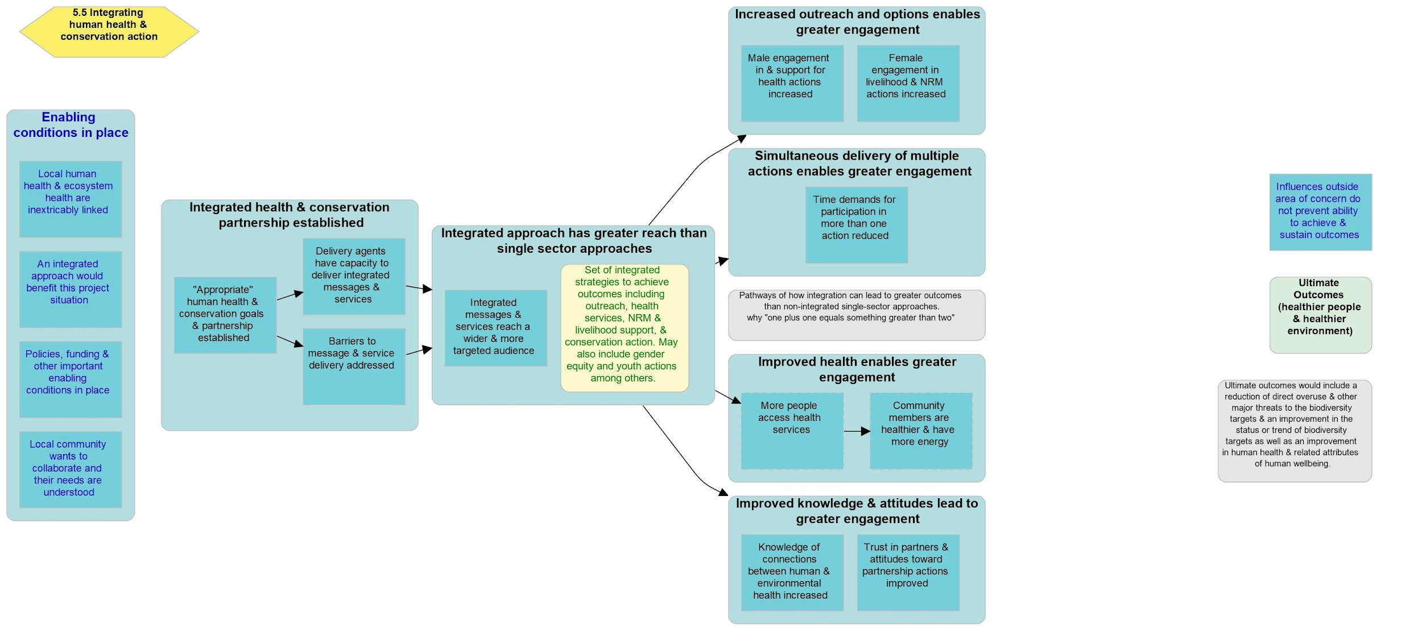
2020 PHE Collaborative Learning Initiative - Final Report
3.3.1 Integrating Human Health & Conservation Action
Notes:
The ultimate desired outcomes (green box) are to achieve a reduction in direct overharvesting of local natural resources and major threats to biodiversity, as well as an improvement in human health & related attributes of human wellbeing.
Moving to the left side of the diagram, a number of enabling conditions (blue boxes with blue text) need to be in place for this integrated approach to be relevant and effective. These include a direct linkage between human and environmental health; government, policy and funding support for the desired outcomes; expressed interest and needs by the community; and, the fact that influences from outside of the area of concern do not prevent the ability to achieve outcomes.
The first two group boxes of intermediate results (blue boxes with black text) required for this approach to be effective include the establishment of an integrated partnership between health, conservation and other relevant partners. This partnership allows for the delivery of integrated messages and services that reach a wider and more targeted audience than would be possible through a single-sector approach.
The intermediate results that follow represent the different pathways that may lead to greater engagement in health, natural resource management, livelihood, and conservation actions than may be possible in non-integrated single-sector approaches. These pathways may include increased outreach, maximized time with community, improved health, and/or improved knowledge and attitudes.
The intermediate result of greater engagement is assumed to lead to greater adoption and continuation of desired behaviors leading to the ultimate outcomes. The dashed line indicates an important assumption that requires more evidence.
As outcomes are realized, improved community value of and ownership over desried behaviors creates a feedback loop that reinforces behavior change and leads to greater and sustained outcomes that benefit both people and the environment.

Slide 33
2020 PHE Collaborative Learning Initiative - Final Report
2020 PHE Collaborative Learning Initiative - Final Report
3.3.1 Integrating Human Health & Conservation Action
Overview of the Theory of Change
The ultimate desired outcomes (green box) are to achieve a reduction in direct overharvesting of local natural resources and major threats to biodiversity, as well as an improvement in human health & related attributes of human wellbeing.
Moving to the left side of the diagram, a number of enabling conditions (blue boxes with blue text) need to be in place for this integrated approach to be relevant and effective. These include a direct linkage between human and environmental health; government, policy and funding support for the desired outcomes; expressed interest and needs by the community; and, the fact that influences from outside of the area of concern do not prevent the ability to achieve outcomes.
The first two group boxes of intermediate results (blue boxes with black text) required for this approach to be effective include the establishment of an integrated partnership between health, conservation and other relevant partners. This partnership allows for the delivery of integrated messages and services that reach a wider and more targeted audience than would be possible through a single-sector approach.
The intermediate results that follow represent the different pathways that may lead to greater engagement in health, natural resource management, livelihood, and conservation actions than may be possible in non-integrated single-sector approaches. These pathways may include increased outreach, maximized time with community, improved health, and/or improved knowledge and attitudes.
The intermediate result of greater engagement is assumed to lead to greater adoption and continuation of desired behaviors leading to the ultimate outcomes. The dashed line indicates an important assumption that requires more evidence.
As outcomes are realized, improved community value of and ownership over desried behaviors creates a feedback loop that reinforces behavior change and leads to greater and sustained outcomes that benefit both people and the environment.

Slide 34
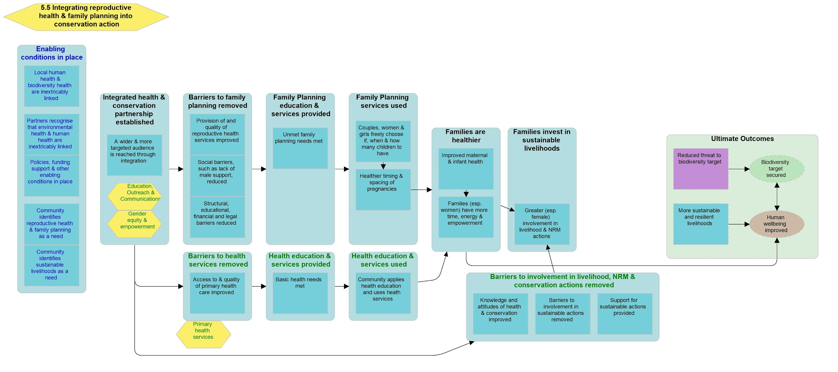
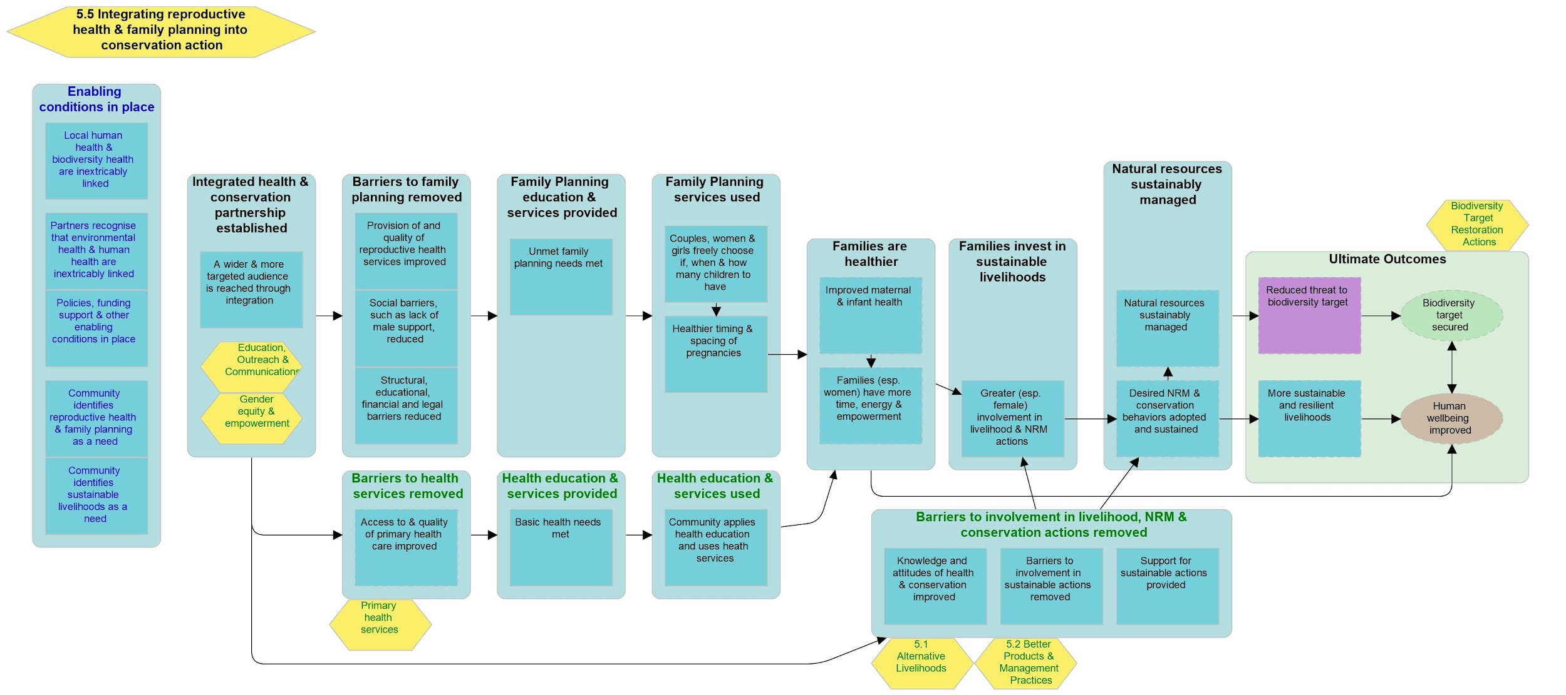
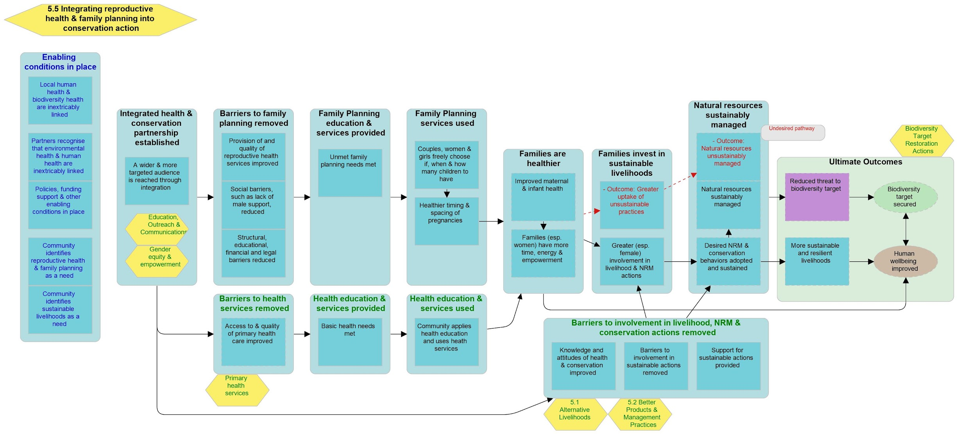
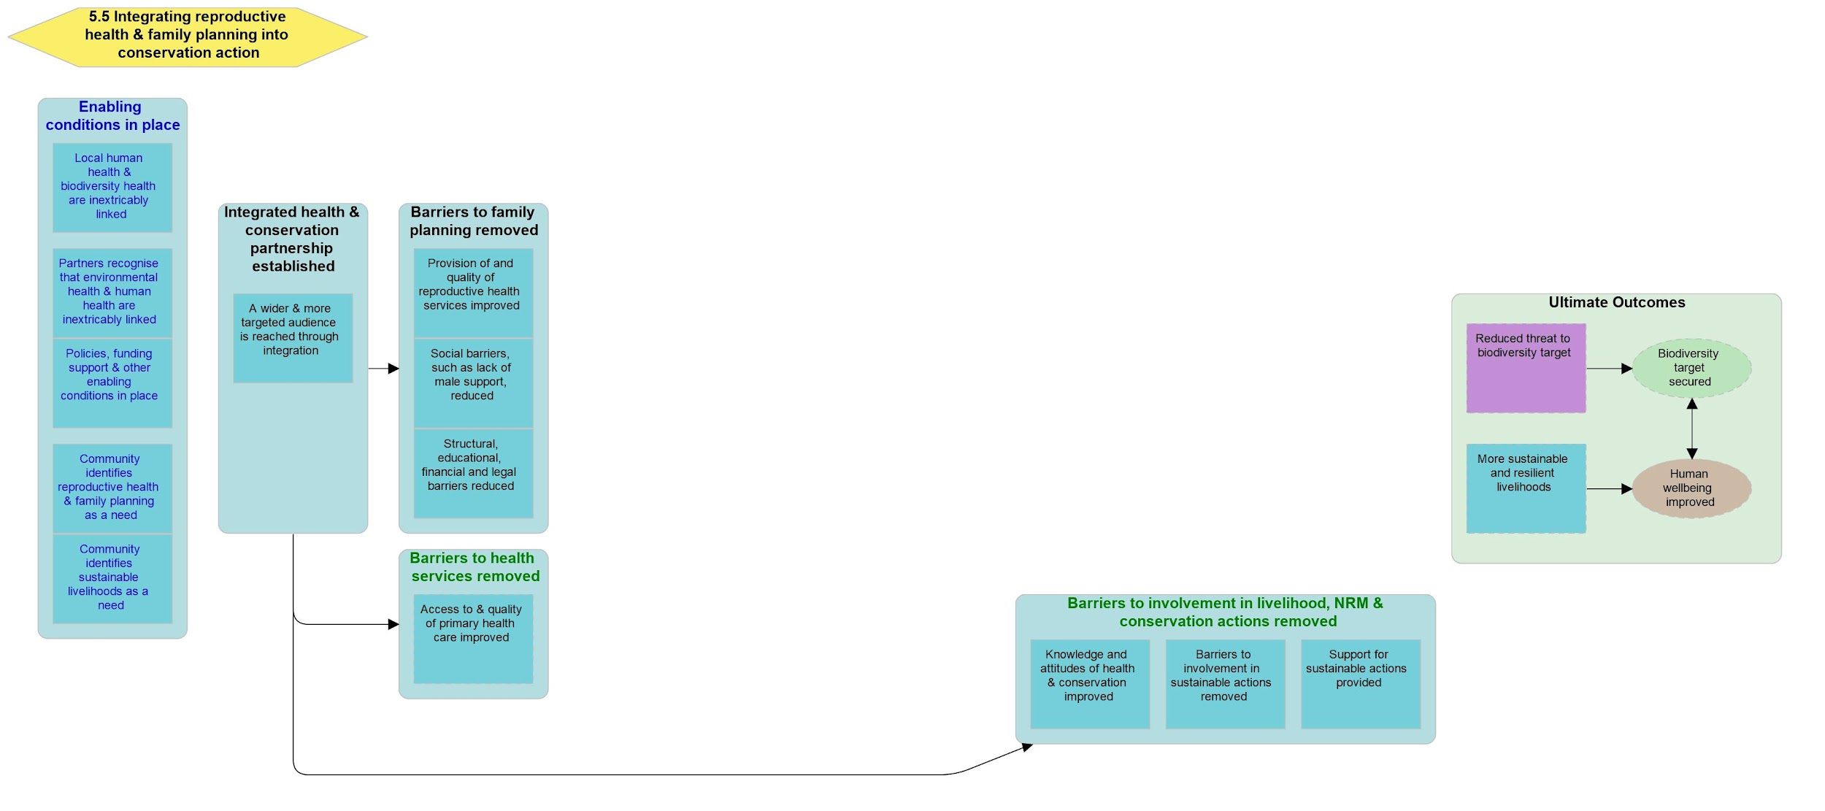
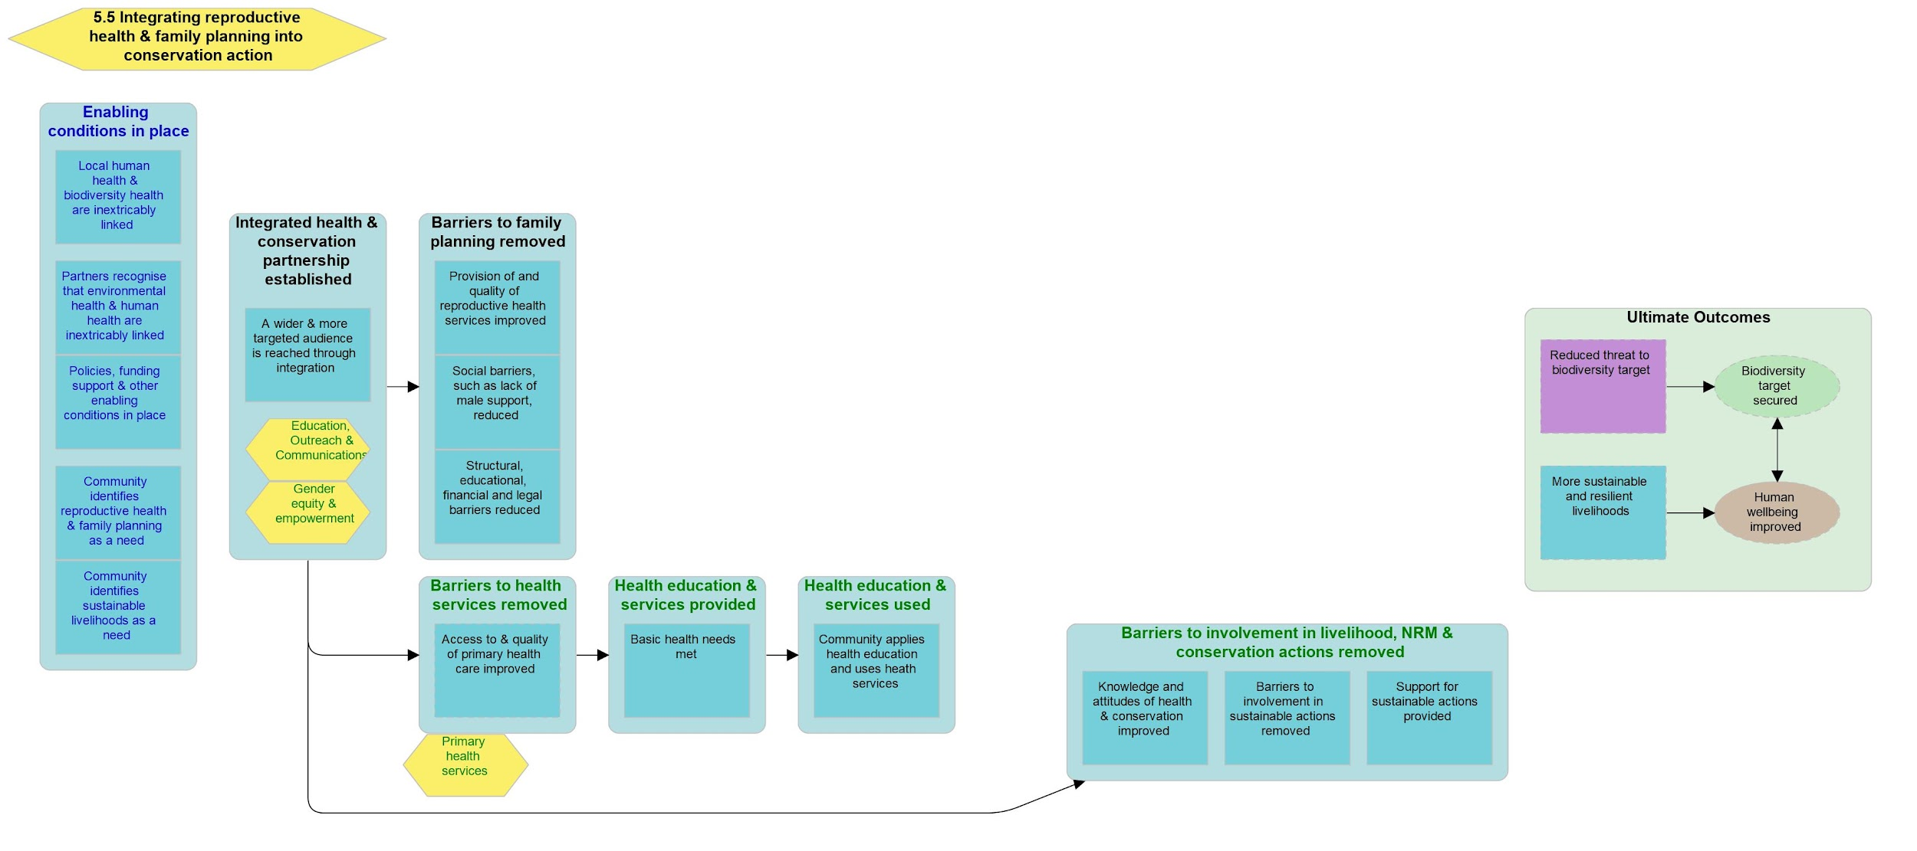
2020 PHE Collaborative Learning Initiative - Final Report
3.3.2 Integrating Reproductive Health & Family Planning into Conservation Action
Notes:
The main theory in this diagram is represented in the group boxes with black text. Group boxes with blue text are enabling conditions and those with green text are contributing results supported by other integrated strategies.
The ultimate desired outcomes (green group box) are to reduce threats to biodiversity, while ensuring that natural resources are sustainably managed, biodiversity is conserved, and ecosystem services are maintained. Simultaneously, this approach aims to improve human health, particularly reproductive health, and achieve more sustainable and resilient livelihoods for local people.
Moving to the left side of the diagram, this integrated approach requires a number of enabling conditions (blue boxes with blue text) to be in place for it to be relevant and successful. There should be a direct linkage between human health and the health of the environment, i.e. communities are directly dependent on natural resources and the ecosystem services they provide. Baseline surveys and community needs assessments should reveal that human population growth threatens biodiversity and harms ecosystem services, negatively influencing human health and resiliency. These linkages need to be recognized by all of the relevant partners. Additionally, there should be an expressed need by the community for the delivery of reproductive and family planning services, as well as access to sustainable livelihood opportunities and extension services. Human population growth should not be driven by in-migration. Finally, government, policy and funding support for the desired outcomes should be secured.
The first intermediate result (blue boxes with black text) group box required for this approach to be effective includes the establishment of an integrated partnership between health, conservation and other relevant partners. This partnership allows for the delivery of integrated messages and services that reach a wider and more targeted audience than would be possible through a single-sector approach.
A critical initial stage in this integrated approach includes the intermediate results (in three blue group boxes, one with black text and two with green text) to remove barriers; barriers restricting access to health and family planning services, and equitable involvement in conservation initiatives, natural resource management, and sustainable livelihoods.
The supporting strategies (yellow hexagons with green text) of “Education, outreach and communication” and “Gender equity and empowerment” help remove barriers and improve knowledge and appreciation of the linkages between population growth, human health, and the environment that sustains both human wellbeing as well as biodiversity.
The intermediate results (blue boxes with black text) describe how meeting the reproductive health and family planning needs of people leads to couples, women and girls choosing whether, when and how many children to have. This is expected to lead to healthier timing and spacing of pregnancies, which improves family health. Families, especially women will have more time and energy to engage in livelihood and natural resource management opportunities.
Integrated supporting strategies (yellow hexagons with green text) engage community members in sustainable livelihoods and natural resource management such that the undesired results (blue boxes with red text) of investing more time and energy in unsustainable practices are not realized.
There is uncertainty (dotted arrow) about whether healthier families and healthier timing and spacing of pregnancies results in a long-term decline in the fertility rate. Additionally, a decline in the fertility rate may not result in reduced demand for natural resources.
The integrated strategies (yellow hexagons with green text) necessary to achieve desired outcomes will be situation dependent and are not limited to the five illustrated.

Slide 35
2020 PHE Collaborative Learning Initiative - Final Report
3.3.2 Integrating Reproductive Health & Family Planning into Conservation Action
Overview of the Theory of Change
The main theory in this diagram is represented in the group boxes with black text. Group boxes with blue text are enabling conditions and those with green text are contributing results supported by other integrated strategies.
The ultimate desired outcomes (green group box) are to reduce threats to biodiversity, while ensuring that natural resources are sustainably managed, biodiversity is conserved, and ecosystem services are maintained. Simultaneously, this approach aims to improve human health, particularly reproductive health, and achieve more sustainable and resilient livelihoods for local people.
Moving to the left side of the diagram, this integrated approach requires a number of enabling conditions (blue boxes with blue text) to be in place for it to be relevant and successful. There should be a direct linkage between human health and the health of the environment, i.e. communities are directly dependent on natural resources and the ecosystem services they provide. Baseline surveys and community needs assessments should reveal that human population growth threatens biodiversity and harms ecosystem services, negatively influencing human health and resiliency. These linkages need to be recognized by all of the relevant partners. Additionally, there should be an expressed need by the community for the delivery of reproductive and family planning services, as well as access to sustainable livelihood opportunities and extension services. Human population growth should not be driven by in-migration. Finally, government, policy and funding support for the desired outcomes should be secured.
The first intermediate result (blue boxes with black text) group box required for this approach to be effective includes the establishment of an integrated partnership between health, conservation and other relevant partners. This partnership allows for the delivery of integrated messages and services that reach a wider and more targeted audience than would be possible through a single-sector approach.
[Continued on next slide]

Slide 36
2020 PHE Collaborative Learning Initiative - Final Report
3.3.2 Integrating Reproductive Health & Family Planning into Conservation Action
Overview of the Theory of Change
A critical initial stage in this integrated approach includes the intermediate results (in three blue group boxes, one with black text and two with green text) to remove barriers; barriers restricting access to health and family planning services, and equitable involvement in conservation initiatives, natural resource management, and sustainable livelihoods.
The supporting strategies (yellow hexagons with green text) of “Education, outreach and communication” and “Gender equity and empowerment” help remove barriers and improve knowledge and appreciation of the linkages between population growth, human health, and the environment that sustains both human wellbeing as well as biodiversity.
The intermediate results (blue boxes with black text) describe how meeting the reproductive health and family planning needs of people leads to couples, women and girls choosing whether, when and how many children to have. This is expected to lead to healthier timing and spacing of pregnancies, which improves family health. Families, especially women will have more time and energy to engage in livelihood and natural resource management opportunities.
Integrated supporting strategies (yellow hexagons with green text) engage community members in sustainable livelihoods and natural resource management such that the undesired results (blue boxes with red text) of investing more time and energy in unsustainable practices are not realized.
There is uncertainty (dotted arrow) about whether healthier families and healthier timing and spacing of pregnancies results in a long-term decline in the fertility rate. Additionally, a decline in the fertility rate may not result in reduced demand for natural resources.
The integrated strategies (yellow hexagons with green text) necessary to achieve desired outcomes will be situation dependent and are not limited to the five illustrated.

Slide 37
2020 PHE Collaborative Learning Initiative - Final Report
3.4 Results - Barriers to Adoption
Link to full CMP Learning Survey with identifying information redacted.
Pulling mostly from the CMP Learning Survey but also from KIIs, PHE Expert Survey, and Convening 1 discussions, barriers to organizational adoption of PHE and potential solutions to support adoption are summarized in the following slides.
Purpose of Barrier Identification
In order to better support PHE adoption, it was important to better understand the conservation sector’s knowledge, value, and experience with PHE approaches and the barriers to and factors that may support organizational uptake of PHE approaches.
Target Audience for Barrier Identification
The main audiences are the PHE Community as well as CMP and conservation-focused organizations and practitioners who:
want to encourage and guide uptake of PHE approaches within their and/or other conservation-focused organizations,
want to understand lessons learned by others and avoid PHE adoption pitfalls,
want to fund PHE and other similar integrated conservation approaches across the sector.
Limitations of Barrier Identification
What is presented are initial summary results. There are many constructive and detailed responses to open-ended questions that still require more review. Additionally, there are analyses we did not have time to complete in 2020. In particular, the survey reached a diverse group of respondents in terms of knowledge, experience, position, and geography. We did not have a chance to filter the data by these different audiences. We also had intended to conduct focus group interviews to complement data collected via the survey. Although we had 20 survey respondents who were willing to be part of these focus group interviews, we did not have time for this work during 2020.

Slide 38
In the context of conservation, have you heard of the acronym PHE?
2020 PHE Collaborative Learning Initiative - Final Report
3.4.1 Knowledge
As anticipated in the PHE Expert Survey, knowledge of PHE was very low. If you remove the respondents who said they had experience with PHE, only 17% of respondents had heard of PHE and only 16% felt confident or somewhat confident that they could provide a working definition.
Numerous open-ended responses also remarked on not having heard about PHE and many of them remarked on how it sounds useful and are interested in learning more.
36%
If filter out those with PHE experience, only 17% had heard of PHE
How confident are you in providing a working definition of PHE?
37%
If filter out those with PHE experience, only 16% are confident or somewhat confident

Slide 39
2020 PHE Collaborative Learning Initiative - Final Report
3.4.2 Attitudes and Practice
When given a working definition for PHE, 83% of respondents believed that PHE would be valuable to their organization’s work; however, in practice, there is a disconnect.
The following slide shows results from two separate questions, illustrating that many local needs, including basic health and family planning, are seen as highly linked to conservation effectiveness; however, most conservation organizations look to others to address health and family planning needs or they don’t work on them at all.
Please consider the following as a working definition of PHE:
"The Population, Health, and Environment (PHE) approach to biodiversity conservation aims to achieve greater and longer-lasting conservation outcomes by improving local human health, through access and equity to primary health care services, particularly family planning and reproductive health, while also assisting communities to conserve biodiversity, manage natural resources, and develop sustainable livelihoods."
Given this definition, how often do you think a PHE approach would be valuable to your or your organization's work...
83%
[Continued on next slide]

Slide 40
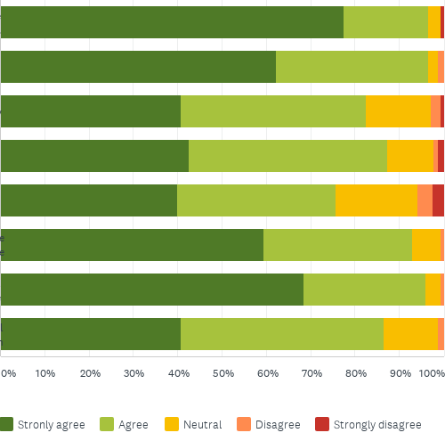
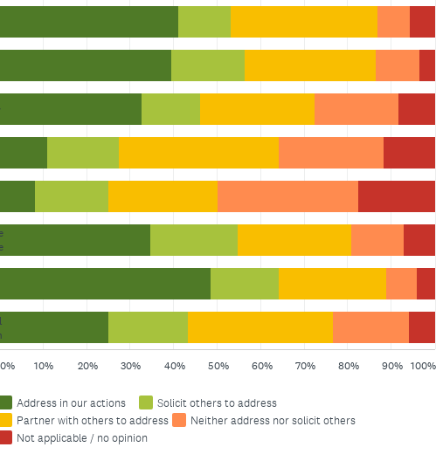
I believe the following local needs, where they exist, are critical to address to ensure biodiversity conservation outcomes.
2020 PHE Collaborative Learning Initiative - Final Report
3.4.2 Attitudes and Practice
When the following needs influence biodiversity conservation, my/our most common response has been...
Sustainable livelihoods
Education
Gender equity
Basic health
Family planning
Land/resource tenure
Local governance
Cultural preservation
Notes:
Value and Practice: Although more than 75% of respondents agreed that basic human health and family planning are critical to address to ensure biodiversity conservation outcomes, in practice the respondents reported that these needs were the least likely to be addressed directly or through partners.

Slide 41
2020 PHE Collaborative Learning Initiative - Final Report
3.4.3 Barriers to Adoption
The next slide shows that show that both those with and without PHE experience, identified a similar set of priority barriers to uptake (we noted those without PHE experience as assumed barriers and those with as realized). These are also consistent with the priority barriers identified in the PHE Expert Survey. The highest-ranked barriers were lack of funding, increased cost and complexity, lack of organizational experience, and lack of awareness of PHE. The next most important barriers included a belief that PHE is a diversion from their mission, lack of connection to appropriate partners, and lack of policy support. The PHE Expert Survey had identified negative associations with family planning as a critical assumed barrier; however, that was not ranked as high in the larger CMP Learning Survey.
Additional assumed barriers noted in the open-ended comments included:
Lack of evidence and uncertainty about the causal relationships
Lack of understanding that the approach is needs-driven and rights-based
Additional realized barriers noted in the open-ended comments by those with PHE experience included:
Lack of dedicated funding
Lack of organizational champions including lack of leadership support
Concerns about mission drift
Political / religious sensitivities around family planning
Lack of knowledge of sensitivities and how to talk about PHE
Lack of understanding of how to do PHE and where to go to learn
Lack of capacity and resources available / competing needs within org
Lack of funding for partners to deliver reproductive health services
[Continued on next slide]

Slide 42
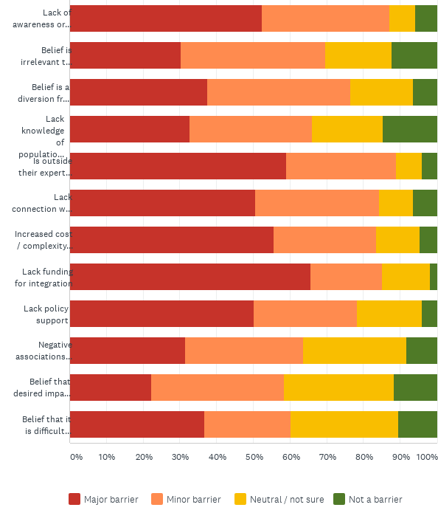
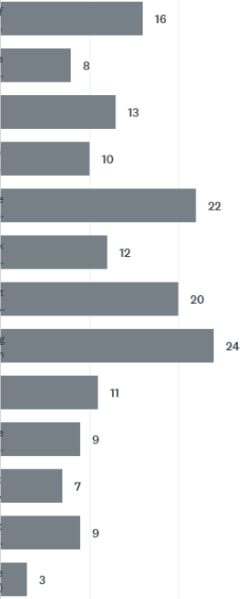
Assumed barriers
2020 PHE Collaborative Learning Initiative - Final Report
3.4.3 Barriers to Adoption
General assumed barriers to PHE uptake compared to actual barriers encountered in PHE application
Realized barriers
Lack of awareness of approach
Belief is irrelevant
Belief is a diversion
Lack knowledge of population projections
Is outside expertise
Lack connection with health partner
Increased cost / complexity
Lack of funding
Lack policy support
Negative associations with family planning
Belief that impacts take too long
Belief that is difficult to scale up

Slide 43
2020 PHE Collaborative Learning Initiative - Final Report
3.4.4 Potential Solutions
Responses to three open-ended questions of those with PHE experience, helped identify potential solutions summarized below.
Of those with experience, the main factors that led to their PHE adoption included:
A staff champion / staff committed to the approach
A willing and able partner
Dedicated funding
Existing local trust / a participatory approach
Suggestions for actions that would encourage greater PHE adoption included:
Greater awareness building and advocacy for the PHE approach with conservation organizations, funders, and government
More case studies and evidence of impact including examples that use the Conservation Standards
Greater funding support for PHE specifically and for integrated cross sectoral and long-term approaches more generally
Help connecting conservation organizations to appropriate health and development partners
Development of guidance and information to support adoption
Specific requests of the PHE community included:
Greater awareness creation around what PHE means and its benefits
Case studies demonstrating success
Assistance connecting to the right partners
Support/mentoring from the PHE community to drive initial integration of PHE into conservation organizations

Slide 44
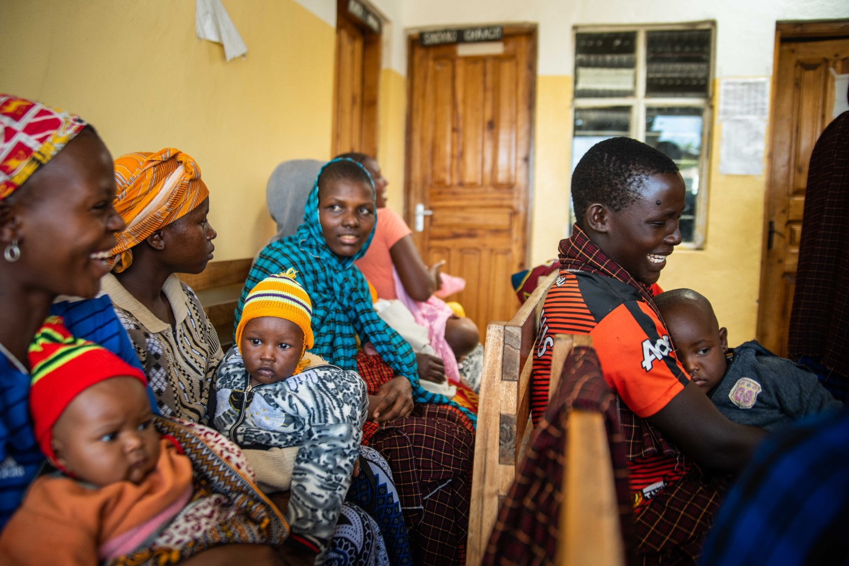
4. Discussion
Key Findings from the Learning
Photo source: NTRI/Roshni Lodhia
Notes:
Photo source: NTRI/Roshni Lodhia

Slide 45
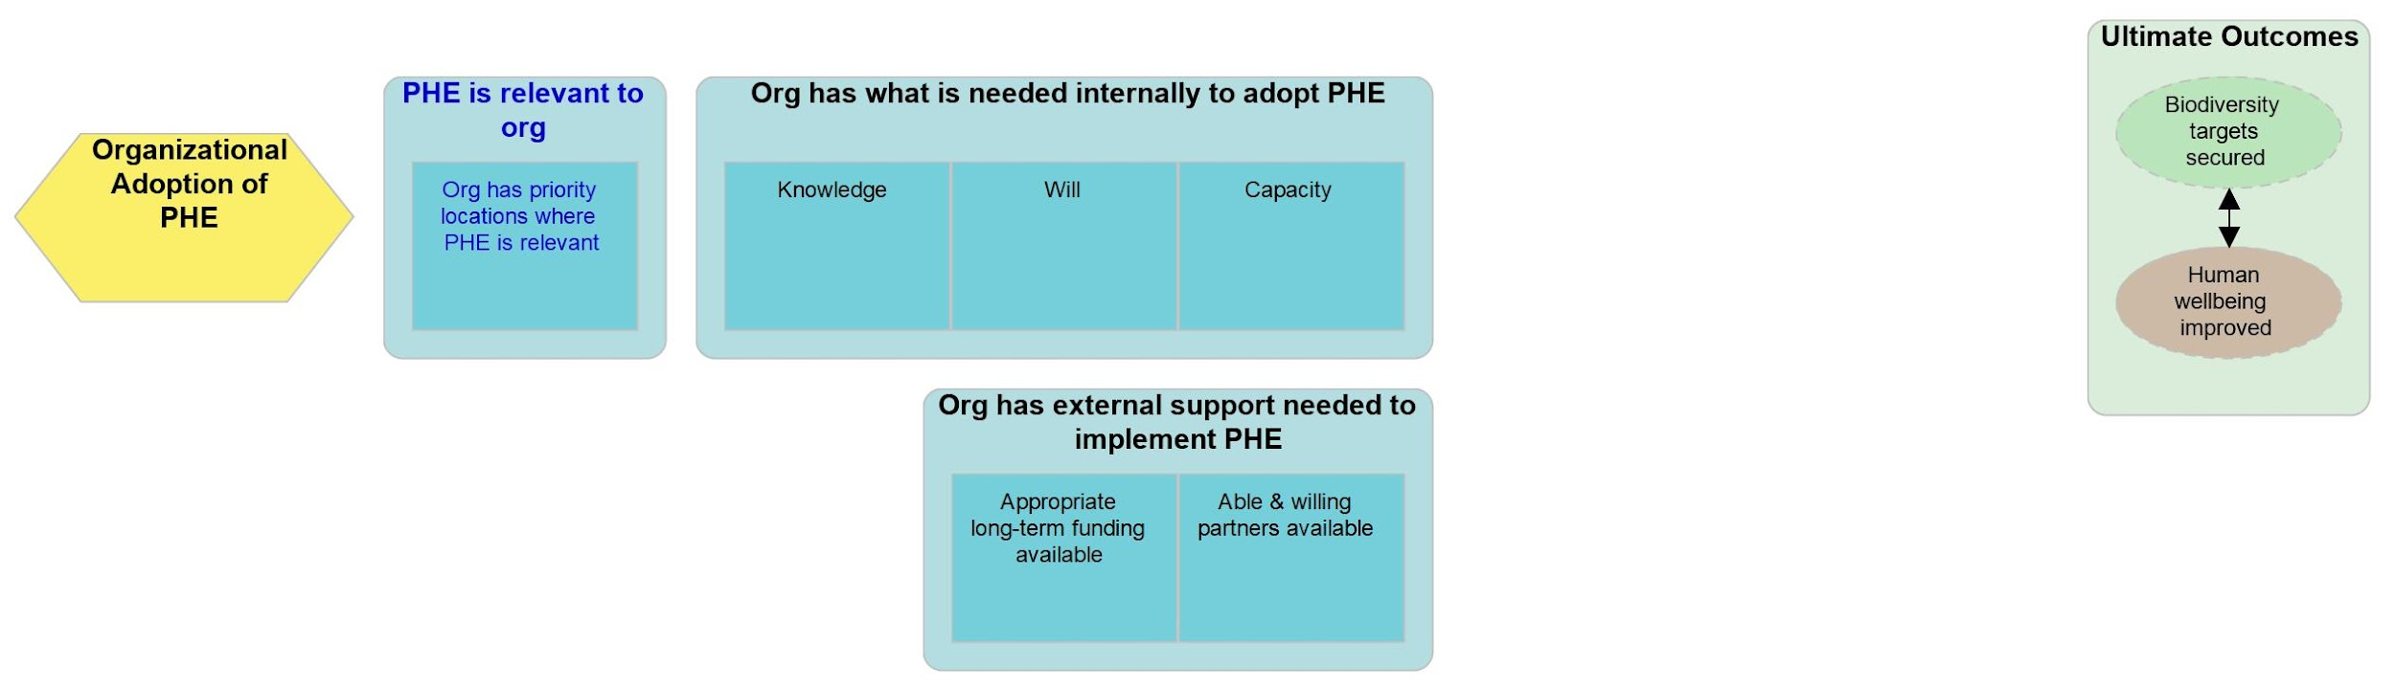
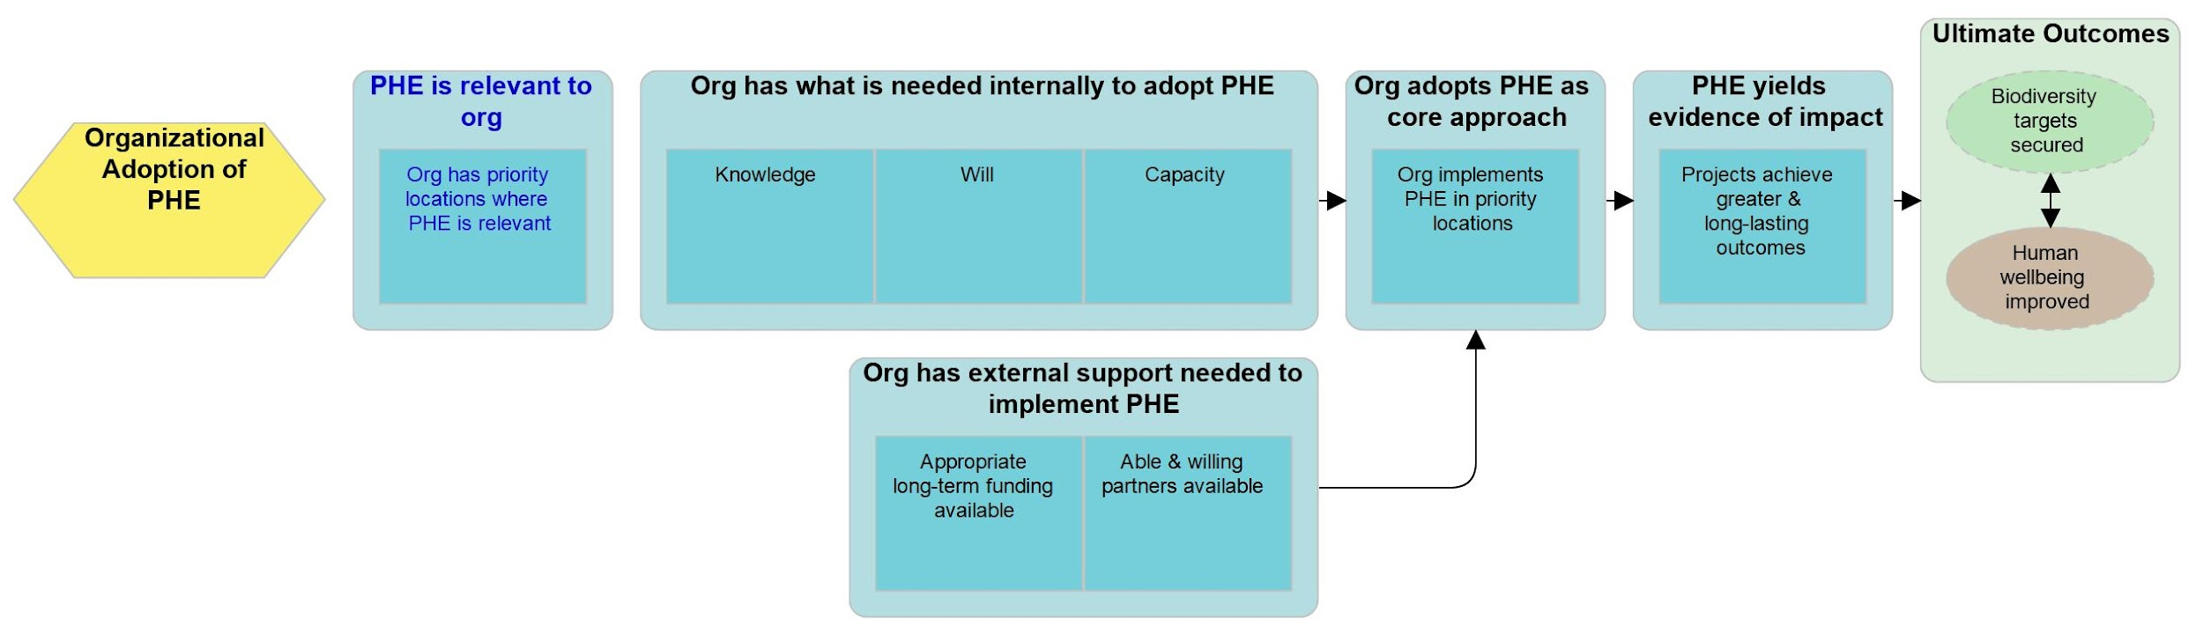
2020 PHE Collaborative Learning Initiative - Final Report
4.1 Discussion - Key Findings
Results from this learning initiative helped to better understand the barriers to greater adoption of PHE approaches by conservation organizations. Two products of this learning, the working PHE Definition for the conservation sector and the two TOC diagrams, provide a start to address one of the key barriers to PHE adoption: the lack of knowledge and understanding of what PHE is, and how it can lead to greater and longer lasting conservation outcomes than other approaches. The preliminary “Organizational Adoption of PHE Approaches” TOC below is meant to illustrate the major factors that influence, and may lead to, organizational uptake of PHE. These factors are further discussed in the following slides and summarized in the subsequent table.
4.1.1 Organizational Adoption of PHE Approaches
[Continued on next slide]
Notes:
The ultimate desired outcomes (green box) of organizational adoption of PHE approaches are to have greater and more sustaining improvements to the status of biodiversity targets and human wellbeing where PHE is applied.
The enabling condition (blue box with blue text) is that PHE needs to be relevant to the organization. The organization needs to have priority work in places where the health of local people and biodiversity health are inextricably linked, such that biodiversity outcomes cannot be achieved or sustained without improved local community health and wellbeing.
Two group boxes of intermediate results (blue boxes with black text) are required for this approach to be effective. The organization needs to have the internal knowledge, will and capacity to adopt PHE and the external funding and partners to support that adoption.
Internally, an organization needs to know about PHE and understand how it can lead to greater and longer-term impacts. To effectively adopt PHE and connected it to the organization’s mission, an organization needs to have support at all levels from leadership through to field staff. Long-term integrated community-based approaches and staff dedicated to the approach with the skills, training, and guidance to work in partnership are required to design and implement an integrated multi-sectoral PHE project.
Externally, an organization needs access to able and willing partners. It needs a strong multi-sectoral partnership that works collaboratively to design, execute, and evaluate its integrated PHE approach. An organization and its partners need adequate funding to initiate the approach inclusively and equitably, to crosstrain implementing staff, and to sustain the approach over the long term.
If these requirements are in place, then the final intermediate results of the organization implementing PHE in its relevant projects and those projects yielding evidence of achieving greater and longer-lasting outcomes than was possible in the absence of a PHE approach can happen. As projects demonstrated impact, greater internal and external support for PHE adoption will be generated allowing the organization to expand adoption to other relevant projects.

Slide 46
2020 PHE Collaborative Learning Initiative - Final Report
2020 PHE Collaborative Learning Initiative - Final Report
4.1.1 Organizational Adoption of PHE Approaches
Overview of the Theory of Change
The ultimate desired outcomes (green box) of organizational adoption of PHE approaches are to have greater and more sustaining improvements to the status of biodiversity targets and human wellbeing where PHE is applied.
The enabling condition (blue box with blue text) is that PHE needs to be relevant to the organization. The organization needs to have priority work in places where the health of local people and biodiversity health are inextricably linked, such that biodiversity outcomes cannot be achieved or sustained without improved local community health and wellbeing.
Two group boxes of intermediate results (blue boxes with black text) are required for this approach to be effective. The organization needs to have the internal knowledge, will and capacity to adopt PHE and the external funding and partners to support that adoption.
Internally, an organization needs to know about PHE and understand how it can lead to greater and longer-term impacts. To effectively adopt PHE and connected it to the organization’s mission, an organization needs to have support at all levels from leadership through to field staff. Long-term integrated community-based approaches and staff dedicated to the approach with the skills, training, and guidance to work in partnership are required to design and implement an integrated multi-sectoral PHE project.
Externally, an organization needs access to able and willing partners. It needs a strong multi-sectoral partnership that works collaboratively to design, execute, and evaluate its integrated PHE approach. An organization and its partners need adequate funding to initiate the approach inclusively and equitably, to crosstrain implementing staff, and to sustain the approach over the long term.
If these requirements are in place, then the final intermediate results of the organization implementing PHE in its relevant projects and those projects yielding evidence of achieving greater and longer-lasting outcomes than was possible in the absence of a PHE approach can happen. As projects demonstrated impact, greater internal and external support for PHE adoption will be generated allowing the organization to expand adoption to other relevant projects.

Slide 47
2020 PHE Collaborative Learning Initiative - Final Report
4.1.1 Key Findings on barriers to PHE Adoption (pg. 1)
This table summarizes the factors that influence organizational uptake of PHE approaches, possible actions that might enable uptake, as well as future learning questions.
Factors | Uptake is more likely if... | Uptake is less likely if... | Actions to support uptake | Future learning questions
Funding | Funding is available for the initial phase, including baseline surveys, community needs assessment, and partnership development BEFORE setting the action plan. There is funding for the integration and the increased complexity. Long-term funding with appropriate expectations of outcomes and timelines is available. Required indicators are integrated across sectors (e.g. health, economic development, good governance, and environmental conservation), similar to those used by USAID. | The PHE project is being funded by multiple single-sector donors and/or short-term funding with different timelines and expectations. Donor is not supportive of a PHE approach. Monitoring and reporting onerous and timeline expectations too short. | Lobby donors to establish funding for integrated projects, for initial phase of integrated projects, and for long-term support. Help set appropriate expectations of time to establish and realize impacts from a PHE project. Advocate for PHE as cost effective (value for money) Advocate for PHE as a community-driven approach that meets people’s needs holistically and mirrors how they live their lives. | What are the opportunities to advocate for more and better integrated funding streams? What are the best ways to set appropriate expectations of outcomes and timelines? What do donors need to be able to fund integrated programming? Should we target donors whose funding isn’t tied to government mandates (e.g. foundations to integrate funding streams)?
[Continued on next slide]

Slide 48
2020 PHE Collaborative Learning Initiative - Final Report
4.1.1 Key Findings on barriers to PHE Adoption (pg. 2)
Factors | Uptake is more likely if staff / orgs ... | Uptake is less likely if staff / orgs ... | Actions to support uptake | Future learning questions
Organizational knowledge | Are aware of PHE and the value of integrated health and conservation approaches. Are aware of successful PHE projects and where to find guidance. Draw on existing PHE materials to raise internal awareness. | Have not heard of PHE or other integrated approaches. Do not understand or are skeptical of how PHE can lead to greater and longer-term impacts. | Provide clarity on and value of PHE and integrated approaches. Share available knowledge, guidance and training more widely. Conduct outreach to key groups. Incorporate PHE examples into conservation training. | How to incorporate the best practices for integration into the Conservation Standards ?
Organizational will | Have some component of human wellbeing in their mission, and have gender and livelihood action plans. Report on some SDGs. Are committed to PHE and to fundraise for it. | Have key supporters against anything involving family planning or reproductive health. | Reframe PHE to address misconceptions around “population”, clarify that it is “rights-based” and not about control. Illustrate relationship with climate resiliency, gender equity, and other SDGs. Provide talking points on likely concerns. | How to energize leadership for commitment? How to dispel negative associations?
Organizational capacity | Have an in-house champion for integrated approaches, and a social scientist on staff who supports PHE. Have experience with integrated approaches. Have basic understanding of all the components of the approach. | Have not embedded as a core strategy. Have not institutionalized the skill and the champion leaves. | Mentor orgs that are getting started with PHE. Provide guidance on resources and training to support PHE. Build and share knowledge on what has and has not worked for organizational uptake. | How orgs take initial experience with PHE and scale up to other projects?
[Continued on next slide]

Slide 49
2020 PHE Collaborative Learning Initiative - Final Report
4.1.1 Key Findings on barriers to PHE Adoption (pg. 3)
Factors | Uptake is more likely if... | Uptake is less likely if... | Actions to support uptake | Future learning questions
Partners and partnerships | Integrated multi-sectoral partnerships have been established between conservation and health orgs (and possibly government agencies); all being strong orgs that are not in competition with each other. | Conservation orgs take on health and livelihood work that is not within their expertise. Potential health and development partners do not see value of integrating. | Provide examples of effective PHE partnerships. Help match appropriate conservation, health and rural development partners. Outreach to health and development sector. | What is the role of the established PHE community in making those partner matches? How to sustain and encourage more partnerships to flourish?
Organizational relevancy | Org has priority locations where PHE may be more successful than other approaches. Long-term success has not been achieved using single-sector approaches. | Org is working in areas where PHE is inappropriate (e.g. no unmet family planning need). Appropriate partners are absent. | Simple guidance on how to assess if PHE is appropriate. Demonstrate how to tailor approach to address community needs and partner abilities.
Evidence | There is a strong evidence base that PHE is effective. Case studies and examples exist from situations relatable to the org. First experiences with PHE deliver clear conservation outcomes. | First experiences with PHE do not lead to desired outcomes. Relatable examples are not accessible. Impacts are too difficult to measure. | Write up and disseminate more case studies. Improve and distribute existing guidance on evaluating impact and related indicators. | How to evaluate impact of integration (to show that 1+1 is greater than 2)? How to measure desired generational impact and resiliency?

Slide 50
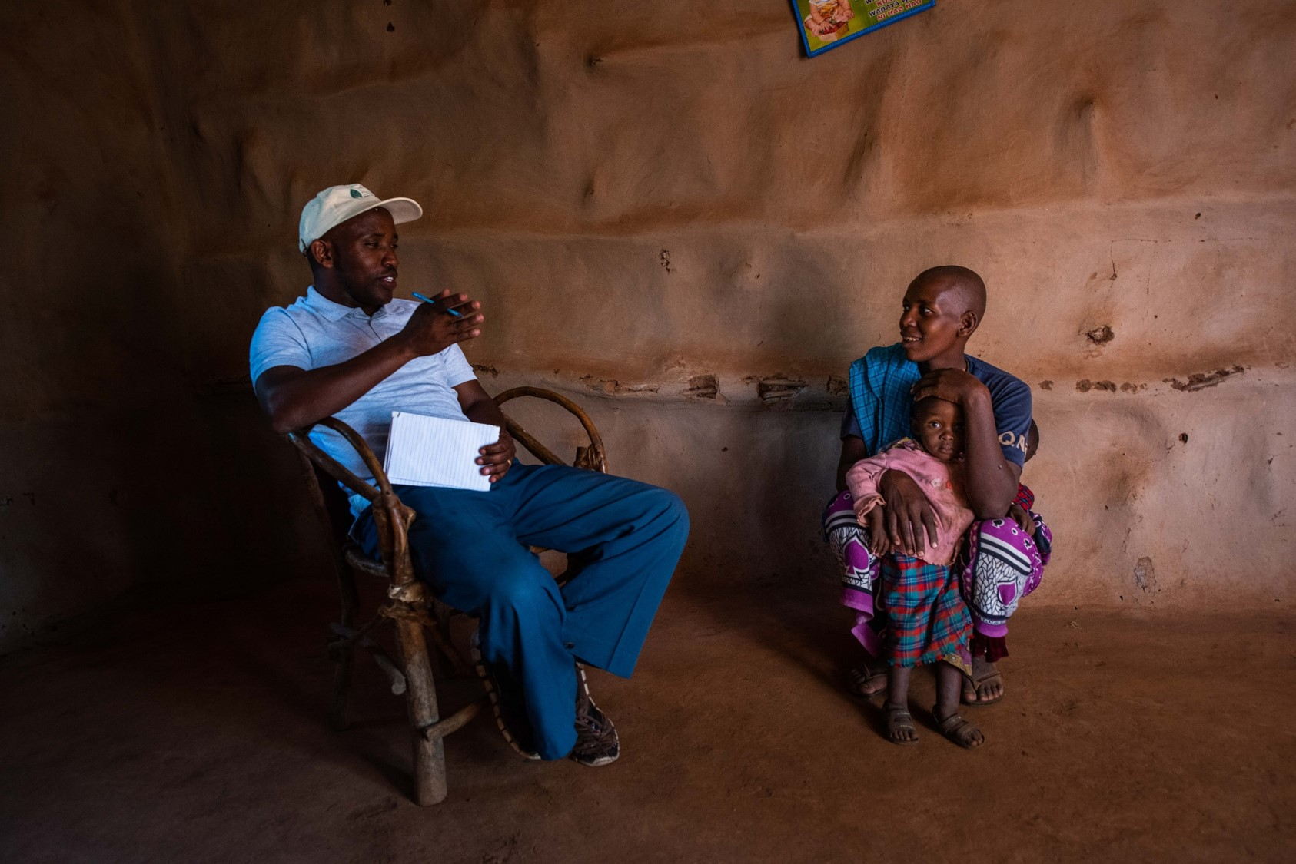
5. Conclusions
Recommendations and Next Steps
Photo source: NTRI/Roshni Lodhia
Notes:
Photo source: NTRI/Roshni Lodhia

Slide 51
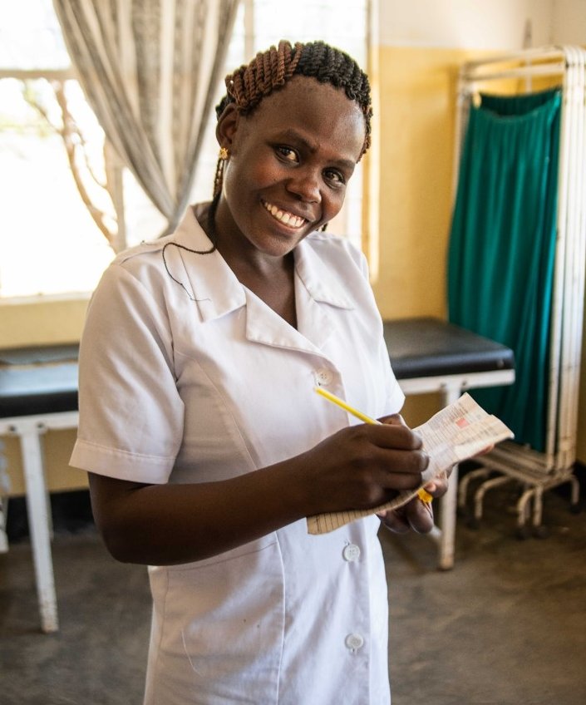
2020 PHE Collaborative Learning Initiative - Final Report
5.1 Conclusions - Recommendations
The findings from this learning initiative highlight the belief, not just by those already active in the PHE field, but also by the general conservation community, that PHE can be a valuable approach to achieve meaningful biodiversity conservation outcomes. Further, it is likely applicable in many more situations than it has been or is being applied. However, there are many barriers to wider adoption of PHE and other integrated health and conservation approaches.
This learning helped prioritize those barriers to adoption and identify a suite of potential actions to address them.
This learning went far in addressing the lack of clarity around what PHE is and its value by bringing the experts together and working toward agreement around a definition and theory of change. By disseminating this report and its products, the learning will also increase awareness of PHE, what is included in a PHE approach, how PHE is anticipated to work, and where to look for more support.
There is still work and learning needed to improve clarity and knowledge and address other important barriers to adoption. Key recommendations toward this effect can be found in the table on the next slide.
Photo source: NTRI/Roshni Lodhia

Slide 52
2020 PHE Collaborative Learning Initiative - Final Report
5.1.1 Recommendations
Recommended actions to continue learning around PHE and begin to address identified barriers to adoption.
Theme | Recommendation | Actor | Target Audience
Clarification of PHE Definition & Framing | Reframe PHE within other integrated development approaches and with regards to climate change vs. local environmental degradation and relationship of PHE to women's roles and gender equity | PHE Community | PHE Community
Creation / Curation of Additional PHE Resources | Provide increased and improved documentation of benefits of PHE approach (case studies, journal publications, presentations at conferences, better dissemination of existing resources) | PHE Community | PHE Community, CMP/CCNet
 | Develop TOCs for additional key components of PHE approach, apply case studies, and include example indicators of success | PHE Community | PHE Community, CMP/CCNet
 | Create a list of partners across sectors to facilitate PHE partnerships | PHE Community | All potential PHE partners
Outreach and Engagement | Create an outreach plan and summary document for dissemination of resources, survey analysis, and framing of PHE to identified audiences | PHE Community | PHE Community
 | Integrate and streamline PHE in existing conservation community resources and practices, such as the Conservation Standards, Conservation Actions & Measures Library, among others | PHE & CMP/CCNet | PHE Community
 | Provide increased and targeted advocacy to donor community, including through targeted report | PHE & CMP/CCNet | PHE Community

Slide 53
2020 PHE Collaborative Learning Initiative - Final Report
5.2 Conclusions - Next Steps
Continue Learning into 2021
A CMP PHE Working Group (many of those involved in the 2020 PHE Learning Initiative) would like to advance the following:
Additional analyses of the CMP Learning Survey;
Improved framing of PHE to clarify the relationship with other integrated / holistic approaches, climate change, and gender equity, and dispel misconceptions about the inclusion of “Population” in the approach;
Vetting of the PHE Definition, Theories of Change, and Recommendations through focus group interviews with representatives from CMP and CCNet;
Application of case studies against and improvements to the Theories of Change including the addition of indicators;
Improved access to and sharing of available PHE resources with the CMP and CCNet community;
Development and execution of a PHE outreach plan for thoughtful dissemination of findings and products from the learning to identified audiences; and,
Development of a paper to submit to Conservation Science & Practice summarizing the TOC and this learning.

Slide 54
2020 PHE Collaborative Learning Initiative - Final Report
5.3 Conclusions - Learning about Learning
Benefits of the Learning Process
The process we took generated a lot of engagement. Perhaps different from other consultant-driven processes, this truly was a collaborative learning experience, such that everyone was engaged, contributed, and had buy in to the final products. Because of the multisectoral nature of PHE, we had significant representation from outside of CMP, all who were very keen to have the opportunity to collaborate with CMP. Group members were both surprised and encouraged that PHE bubbled up as one of the priority CMP learning topics. Having seen minimal PHE uptake within the broader conservation community in the past 20 or so years, despite attempts to provide guidance, training, resources, and case studies, those involved appreciated the opportunity to learn more about how to serve the conservation community and support greater adoption of PHE and other similar approaches.
Constraints of Learning Process
The major constraint was time. Although the learning group was very invested in the process, a number of them remarked on the need for future initiatives to be more clear about the commitment needed and more respectful of participants’ time and other work obligations. There were important cross initiative learning that was missed because of time constraints. In particular, this initiative was strongly related to and could have benefited from greater coordination with the Holistic Approaches and the Justice, Equity, Diversity, and Inclusion learning initiatives. We did have three of the PHE learning group members join the Holistic Strategies convenings and one of the leads from the Justice, Equity, Diversity and Inclusion group join one of our convenings. However, there simply was not enough time to coordinate and share findings and synergies as we went along.
Recommendations for Future Learning Processes
The learning initiatives have been a successful way to advance our collective knowledge and to encourage collaboration and innovation. Additional reflections are included in the Final Coordination Report - CMP-Moore Collaborative Learning Initiative.

Slide 55
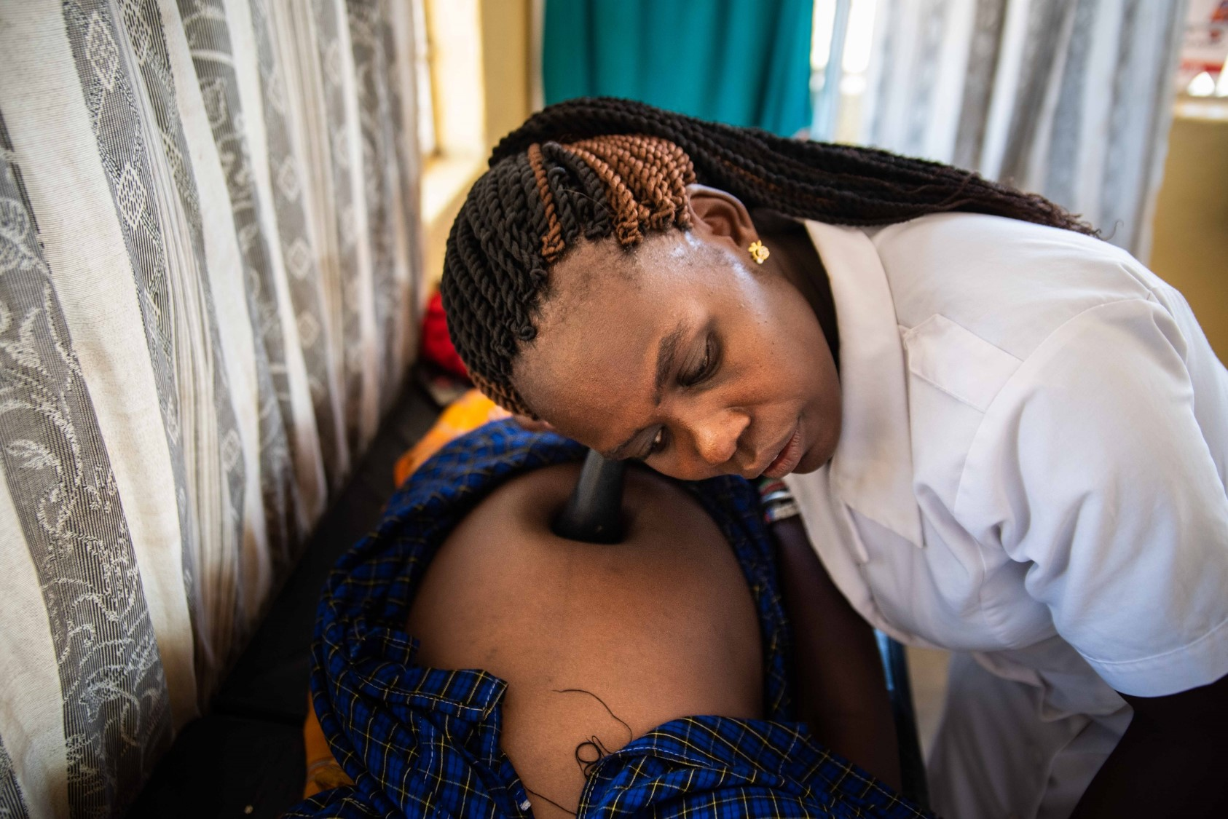
6. Annex
Additional Information Supporting the Learning Initiative Findings
Photo source: NTRI/Roshni Lodhia
Notes:
Photo source: NTRI/Roshni Lodhia

Slide 56
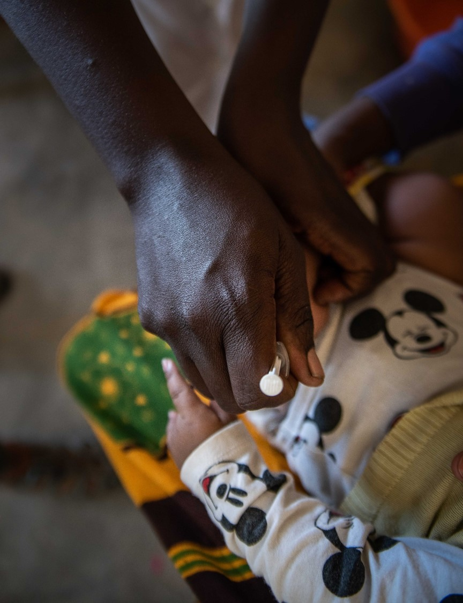
Links
Below are a number of links that provide additional information supporting the learning initiative findings:
A curated list of resources for the conservation community. These will be posted in the CMP Workspace for PHE.
A full list of resources referenced for this learning initiative. These were the publications and resources drawn from internet searches, provided during Key Informant Interviews, and referenced during Convenings.
PHE Expert Survey results.
CMP Learning Survey - October 2020 results.
The MURAL workspaces and meeting notes:
Convening 1 MURAL workspace and meeting notes.
Convening 2 MURAL workspace and meeting notes.
Convening 3 MURAL workspace and meeting notes.
The PHE Learning Initiative Work Plan and Spreadsheet used initially to organize the learning and the various work groups.
2020 PHE Collaborative Learning Initiative - Final Report
6.1 Annex - Additional
Information Supporting Learning
Photo source: NTRI/Roshni Lodhia
Notes:
Photo source: NTRI/Roshni Lodhia
Resource list: https://docs.google.com/spreadsheets/d/1BsIeYG541LVVemXyWm1C2GwiKVKrrySoqKzg1K1oRcA/edit#gid=0

